Slide 1

Jake Vestal
Design and Testing of Algorithmic Trading Systems with Python
Video 5:
GitHub + PyCharm

Slide 2
GitHub: The Very Basics
Think of it as “Google Drive, Box, Dropbox, etc… but with strict rules”.
“GitHub” is a for-profit website owned by Microsoft that is built on git.
“git” itself is free and open source software
…which just so happens to be hosted on GitHub: https://github.com/git/git
You can create a REPOSITORY (“repo” for short) containing all files for your project
A repo = a GitHub project
Here’s a great example repo with good documentation: https://github.com/tidyverse/dplyr
Many important projects – such as the Linux kernel itself – live on GitHub: https://github.com/torvalds/linux
GitHub has three main purposes:
Collaboration: Work on the same repo with many other people without your changes and additions conflicting
Deployment: Instruct other apps & services – such as a webpage – to use the code in your repo
Sanity: git’s strict set of rules are your FRIEND, not your ENEMY, even if they seem annoying at first. They allow you to keep track of your local vs. your deployed version of an app without overwriting something important, and give you the ability to roll back your app to a point in time when it worked if you added some new code that breaks it.

Slide 3
Create a GitHub Account
www.github.com

Slide 4
Sign up for Student Developer Pack
https://education.github.com/pack
Lots of good, free resources from many different vendors!

Slide 5
Fork the testapp Repository in GitHub
testapp is a simple Dash app written to help you complete and understand the setup process we’re going through to build your trading app.
testapp lives in its repo owned by Jake at https://github.com/JakeVestal/testapp.
You are allowed to clone testapp onto your own computer…
This means you’ll download a local copy of testapp
You can change the source code however you like.
If any changes are made to the testapp repository, you can pull those changes into your clone
…but you will not be able to push your own changes to the testapp repo
only Jake (the owner) can do that.
So, you’ll need to fork the testapp repo.
Forking fully copies another user’s GitHub repo into a new, identical repo that you own.
Then, you can make as many changes as you want
You will use your own forked repo, on which you have full push and pull permission.

Slide 6
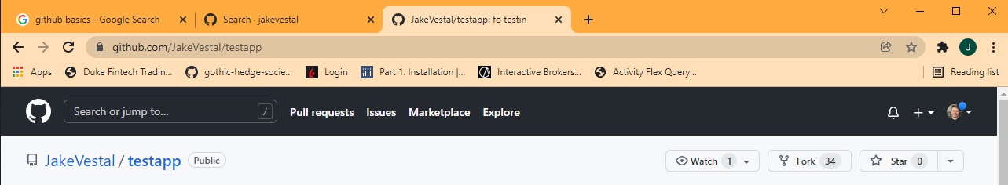
Fork the testapp Repository in GitHub
To create a fork, just go to the repo you want to fork. Click here and follow the instructions.

Slide 7
Workflow for a Trading App
You’ll need to set up your PyCharm project on both your server and your local computer.
On your Server: PyCharm will be used for setup and debugging only. → No development!
→ Unless you’re logged in and actively working on something, PyCharm should never be running on your server.
On your local computer: Development work is to be done on your local machine. You’ll push your updated app to GitHub, and the Webhooks service + nginx will update the code on your server itself.

Slide 8
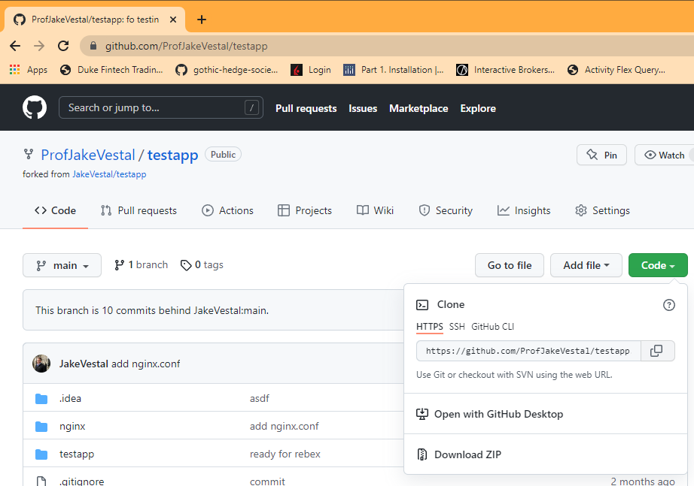
Clone your repo with PyCharm
Navigate to your new fork in GitHub.
Click here to copy your repo’s URL to the clipboard.
Now, open PyCharm

Slide 9
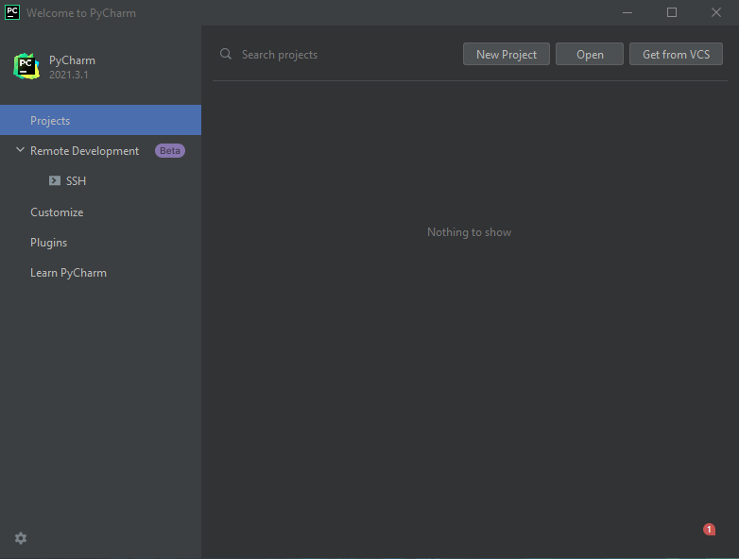
Clone your repo with PyCharm
Click “Get From VCS”
“VCS” = “version control system”; i.e., platforms like Git, SubVersion, etc

Slide 10
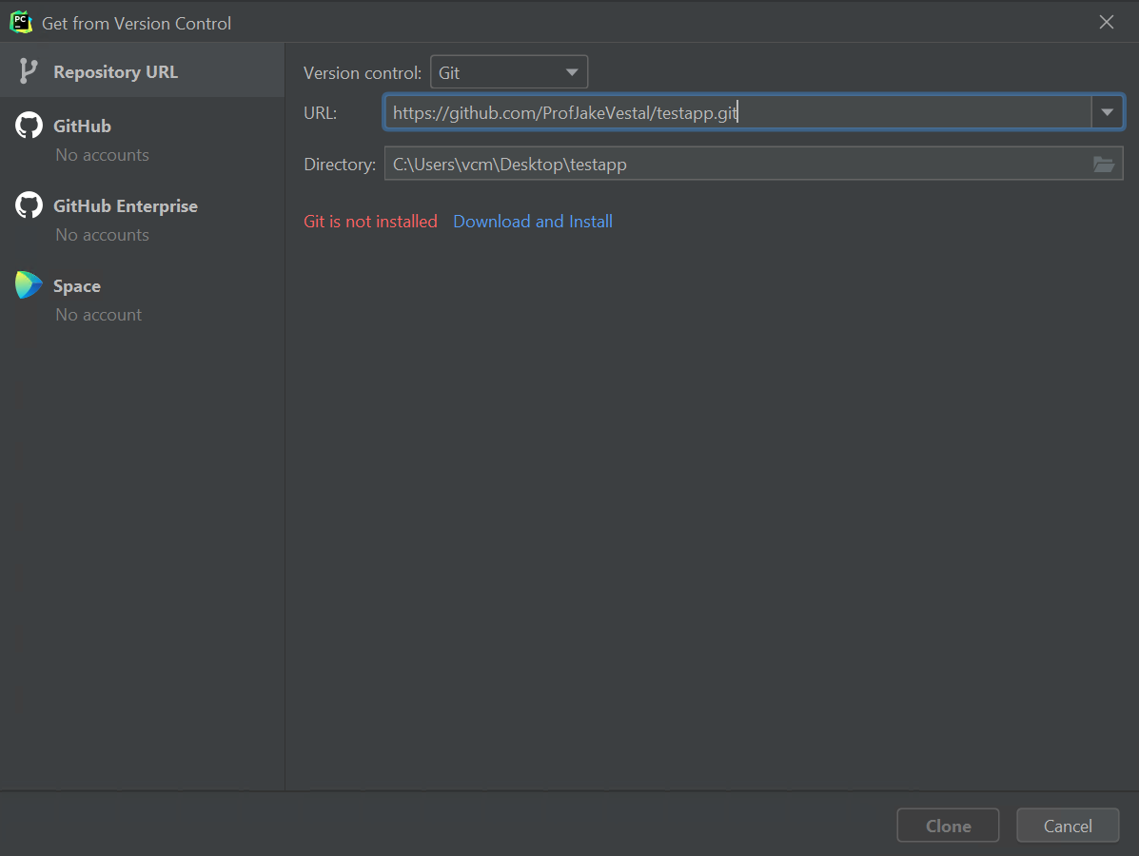
Clone your repo with PyCharm
URL of the repo you want to clone
→ In this case it’s your fork of testapp
Choose where you want the project to go
→ Put it on your desktop if you’re in my course
If you see this message, click Download and Install.
→ PyCharm will install Git for you
→ Wait for it to finish before proceeding
Click “Clone” when ready

Slide 11
Clone your Repo with PyCharm
Your repo is now cloned. This means:
You’ve downloaded all the files in the repo to your local computer.
Because you used PyCharm to clone the repo, PyCharm will automatically recognize that your project is connected to GitHub
You should make use of PyCharm’s GitHub features when working with day-to-day GitHub tasks (pulls, pushes, etc)
You might need to shut down & restart PyCharm if your project doesn’t appear immediately…
…but make sure the progress bar at the bottom of the window isn’t busy before exiting PyCharm

Slide 12
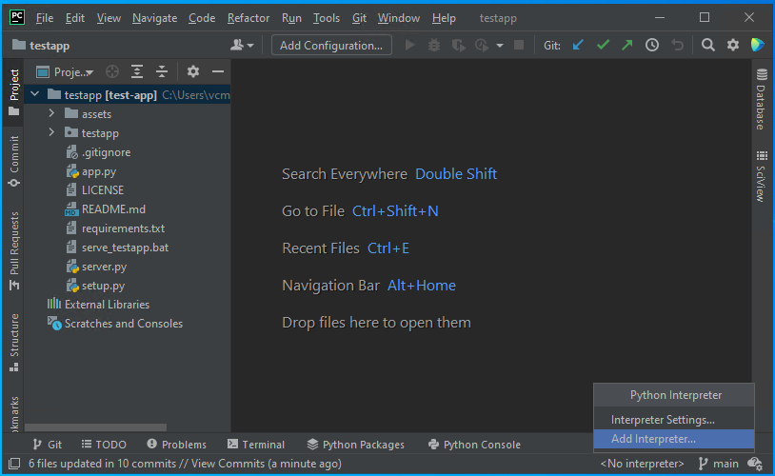
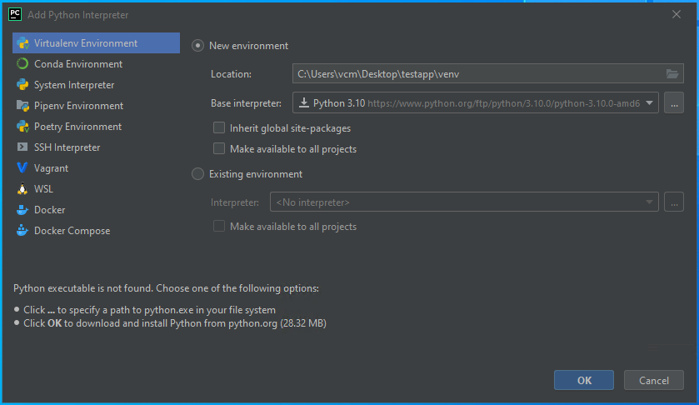
Set Up Your PyCharm Project
Add an Interpreter
Select “New environment”
Choose latest version of Python
Choose
“Add Interpreter”
Leave unchecked
Click here
Click “OK” when ready
We’re going to create a special installation of Python just for this project.
That installation of Python – called the interpreter – is the installation of Python that our app will use.
It lives in a folder named “venv” in our project’s directory
venv will contain the installation of Python we’ll use as well as all the extra Python packages needed
Create venv by choosing “Add Interpreter” from the menu that appears when you click the interpreter box at the lower right-hand corner of the PyCharm window (says “<No interpreter>” at first)

Slide 13
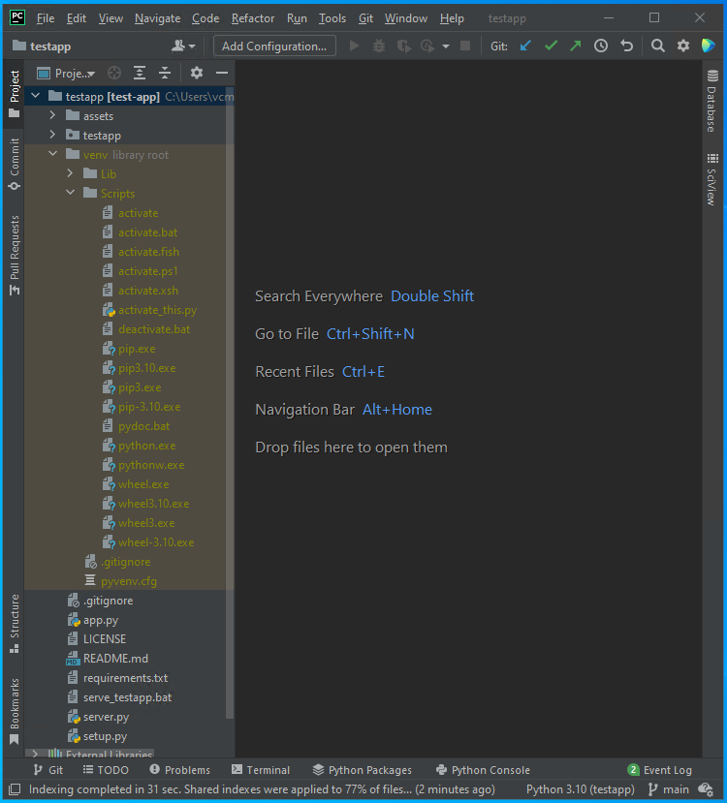
Your Project’s Interpreter
“Interpreter” = The installation of Python that lives in venv
You now have a version of Python installed in venv.
The .exe file that runs this version of Python is in /Scripts
venv, and changes made to it, will not be stored in GitHub.
You can see why by opening the .gitignore file which instructs Git to ignore everything in the venv directory
Keep it this way.
Your project (and app) will use this installation of Python.
Next we’ll add packages to our interpreter.

Slide 14
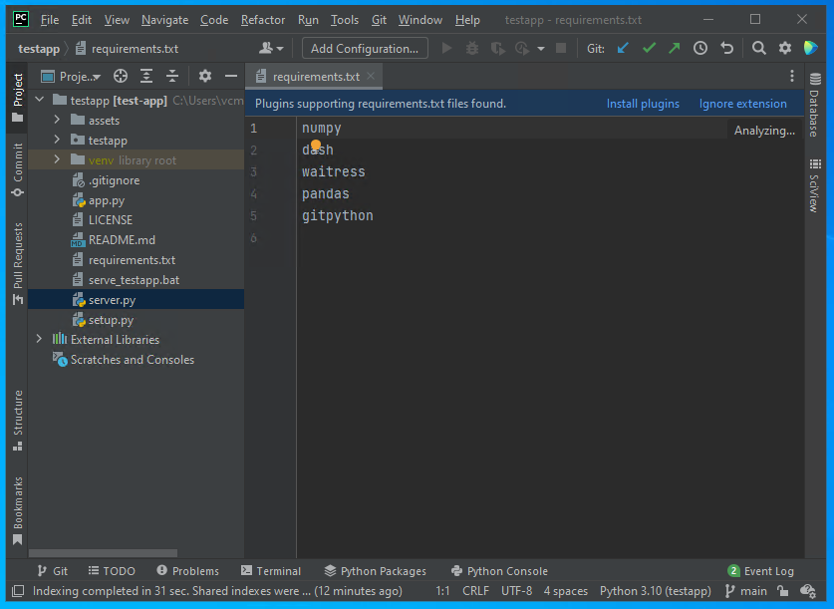
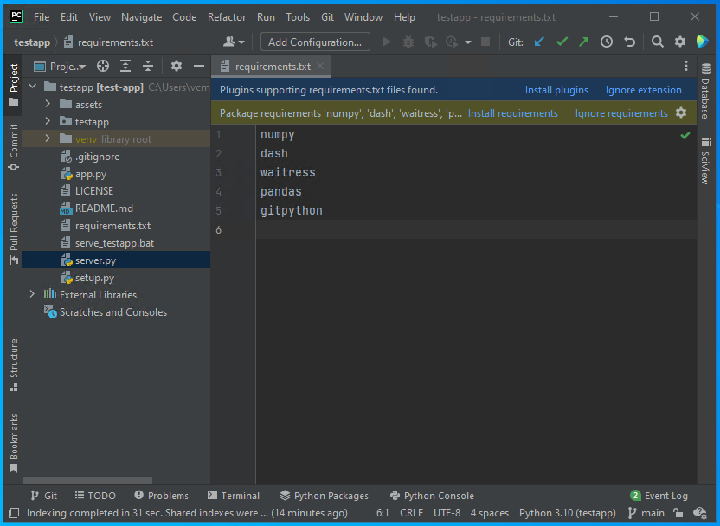
Open a File in PyCharm
Open the file requirements.txt in PyCharm.
Give it a little time…
Always wait for PyCharm to finish if you see it analyzing
Many little windows and notifications like this!
Complete!

Slide 15
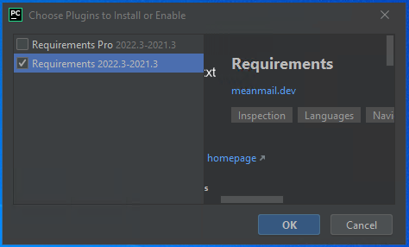
About Plugins
PLUGINS are often worthwhile to install.
When a plugin exists that might for a file type or language that PyCharm detects in your project, it will let you know with a message.
JetBrains (the company that makes PyCharm) has an active app store for PyCharm plugins & add-ons.
This message is telling you that someone has written a plugin that supports requirements.txt files.
Click “install plugins” to see the plugins on the app store that PyCharm has flagged as relevant.
The “Pro” ones usually require a fee or a license
A description of what the plugin does is provided
I personally don’t prefer the requirements.txt plugin, so I usually click “ignore extension” when that banner pops up.
Read about the plugins, select the ones you want, click “OK” or “Cancel”
Browse & manage plugins at File > Settings > Plugins

Slide 16

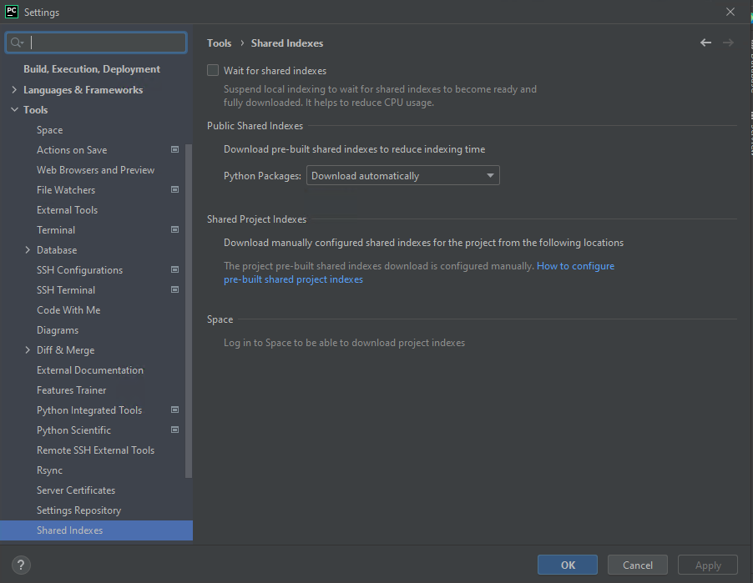
Always Download Pre-Built Shared Indexes
You might encounter a little popup message like this:
PyCharm spends a lot of time indexing
When it’s indexing, PyCharm is analyzing your code
Looking for installed packages, code-completion text, possible errors, etc.
Downloading a pre-built shared index means that PyCharm doesn’t have to index everything from scratch every time
Can speed things up
I usually click “Always download” when the window pops up in a new PyCharm project.
If you missed the window, or want to adjust this setting manually:
Go to File > Settings > Tools > Shared Indexes
In Public Shared Indexes, set Python Packages to Download automatically

Slide 17
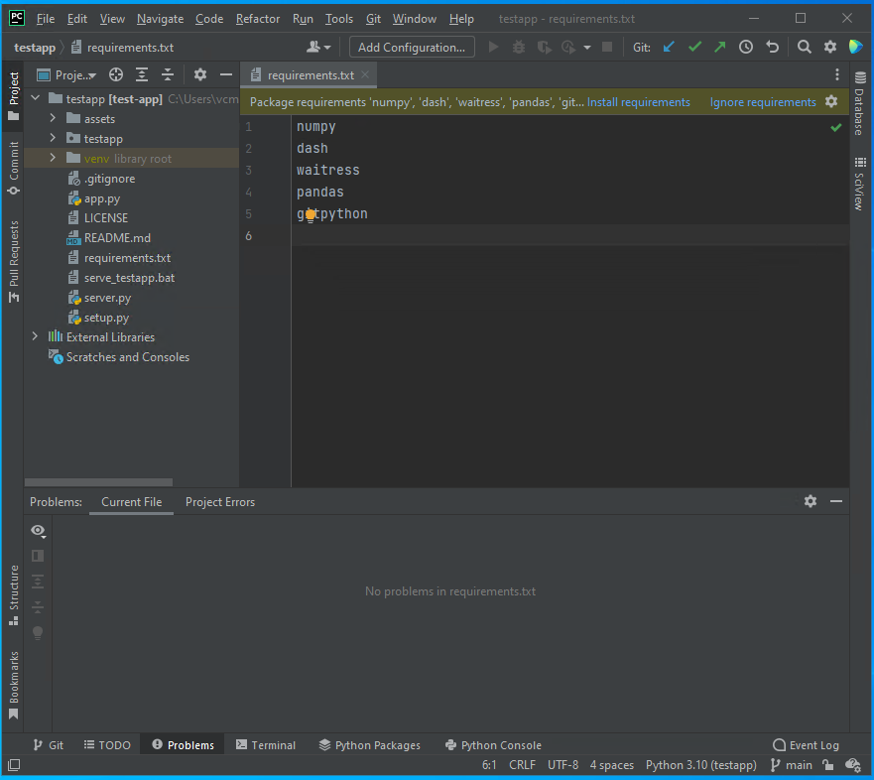
Installing Requirements
Back to the requirements.txt file.
When you open this file in PyCharm, it should start analyzing your code
While it’s doing this, PyCharm is checking that every package whose name appears in listed in the requirements.txt is installed and available in the project’s Python interpreter we set up in venv
If it catches any packages in requirements.txt that aren’t installed, it will give you a message.
If it doesn’t give you a message, you can try:
Uninstalling the “requirements” plugin you may have installed, which blocks this feature
Use the Python Packages tab to install your packages
Use the terminal to install your packages manually with “pip install [package name]”
Fastest way is usually to just click the link provided in the banner.

Slide 18
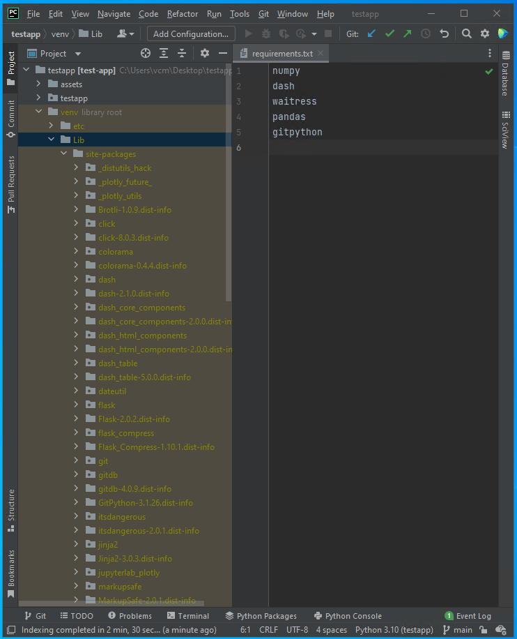
Packages and venv
When the installer finishes:
You should see a lot of newly installed packages show up in your venv folder at venv\Lib\site-packages
Now you see why we don’t track this directory with GitHub – way too many files to be pushing & pulling
You can delete and re-create venv at any time by following the steps that got us to this point.
Might want to upgrade your Python version
Maybe test backward compatibility with an older version of Python
Etc.

Slide 19
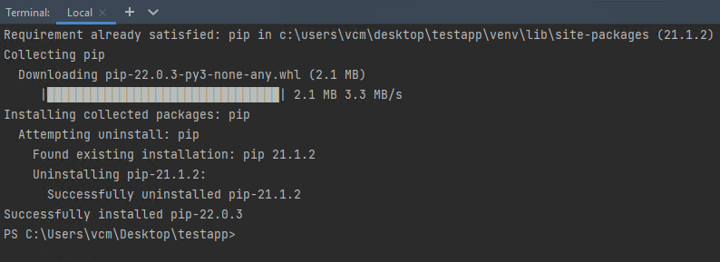
Upgrading pip
pip is Python’s Package Manager.
If you see a message anywhere asking you to upgrade pip…
Just follow instructions and enter the command in your TERMINAL (not your CONSOLE) to upgrade pip:
…such as this one…
Successful output looks like this.
Probably want to restart PyCharm afterwards because it’s a good habit after installing something.

Slide 20
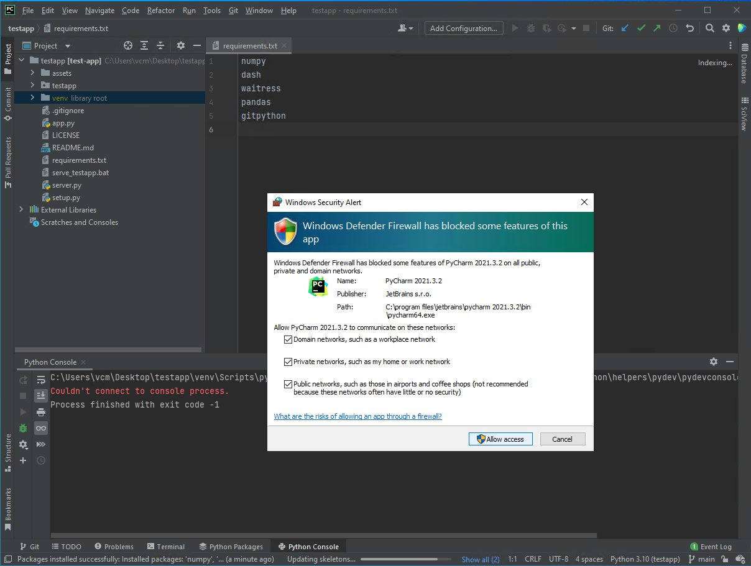
PyCharm & Windows Defender
If you encounter this message:
Check all boxes
Click “Allow Access”
Usually shows up when you open a Pycharm console for the first time

Slide 21
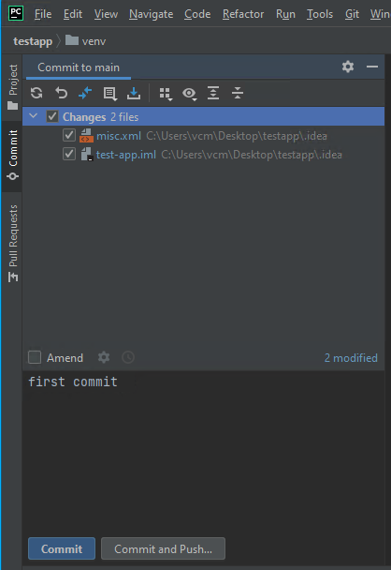
Final Tests: Push and Pull
At this point, your PyCharm project is set up!
Test that you can PULL from GitHub:
Make some changes in your GitHub repo directly on the website
Commit your changes
Click the blue down arrow in PyCharm to update your local repo
You usually want the “merge” strategy, not the “rebase”
Test that you can PUSH to GitHub:
Make some changes in your local repo in PyCharm
Click on the commit tab in PyCharm, select the files you want to push, write commit message, and click “commit and push”
Check your GitHub repo from a web browser – you should see your commit message and changes appear.

Slide 22
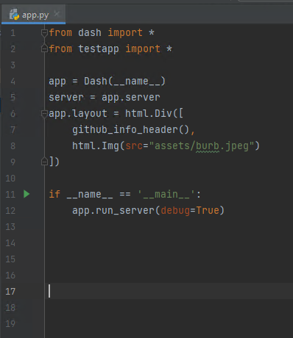
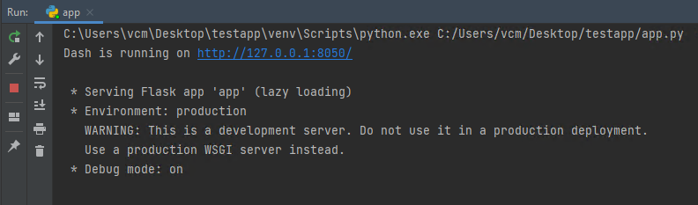
Final Tests: app.py
Open app.py in PyCharm and click the green button
App should run in PyCharm
Console output provides a url at which your Dash app is being served on your local machine.
Click the link:
App should open in a browser.

