Slide 1

Jake Vestal
Design and Testing of Algorithmic Trading Systems with Python
Class 2:
Fundamentals

Slide 2
Golden Rules
Whenever possible, use modeling to predict a discrete random variable as opposed to continuous. A binary rv is even better.
It’s usually better to add information to a model (additional features, variables) vs. tweaking the model.
Do it with limit orders… not market orders.
Asset allocation is at least as important as strategies.

Slide 3
Today
Working with the Refinitiv API
Return Measures & series of returns
Portfolios
Sharpe, Alpha & Beta
Blotter -> Ledger -> Evaluate.
Next week we start on Python: Dash and “split-apply-combine”
HW Published!

Slide 4
Golden Rules
We’ll return to this theme throughout the semester as the Golden Rules – and their applications – show up in the course.
There might be a few more Golden Rules I’ll add in later years, and maybe I’ll re-word these until they’re just right.
Possible other Golden Rules:
Start developing a strategy with OHLCD daily trade data, and go to finer granularity from that if you need it.
If you can run a strategy successfully with equities (or some other underlying) then you can probably do it with options at 100x the profit.
…still thinking about those last two.

Slide 5
Refinitiv API
Set up your API Key
Store as an Environmental Variable
Use CODEBK
Also use QuickStart
https://developers.refinitiv.com/en/api-catalog/eikon/eikon-data-api/quick-start

Slide 6
Today In Class:
The Refinitiv API
https://www.youtube.com/watch?v=vgddzovktKU&ab_channel=JakeVestal

Slide 7

The finance world, unless stated otherwise, thinks of percents and returns in terms of this equation:
Rate of value change between
Time 1 and Time 2
Price at Time 2
Price at Time 1
$$P_{2}=P_{1}e^{rt}$$
The timespan between
Time 1 and Time 2
The number e, 2.718…

Slide 8


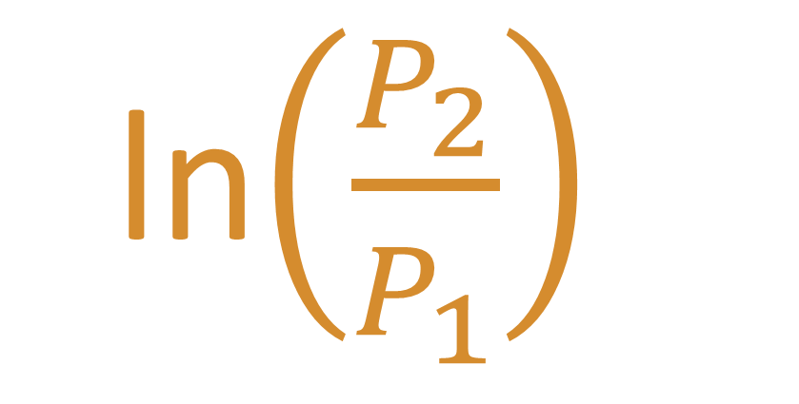
Continuously Compounded Rate of Return
“CCR”
ln$\left(\frac{P_{2}}{P_{1}}\right)$
Is the “rt” in P₂ = P₁e^{rt}
If you don’t believe me:
$$P_{2}=P_{1}e^{rt}=P_{1}e^{\text{ln}\left(\frac{P_{2}}{P_{1}}\right)}=P_{1}\left(\frac{P_{2}}{P_{1}}\right)$$
$$P_{2}=P_{2}$$
Also called the “Log Return”
Has “units” of percent (%)
We mostly use this metric in Computational Finance
Understanding other forms are important (next class)

Slide 9
OHLC Data
Open: First price a stock traded at on that day
High: Highest price that someone paid for a stock that day
Low: Lowest price that someone sold a stock for that day
Close: Last price a stock traded at on that day
Volume: The total number of shares of a stock that traded hands that day

Slide 10
Adjusted Close (1 of 2)
DIVIDENDS
A company may choose to return excess profits to its shareholders in the form of additional stock, or cash. When/if this happens, some sources (e.g., Yahoo) deduct the value of the dividend from the closing share price.

Slide 11
Adjusted Close (2 of 2)
SPLITS
A company may want to change the number of shares issued (usually increase). For example, if a company issued a two-for-one split, the number of shares issued on the market would double… therefore, they’d be worth half as much as before the split.
Some sources incorporate this information into the Adj Close of the trading day before the split, by multiplying by the split ratio (2 in this example).

Slide 12

If you are trying to re-create what trades would have executed in the past…
…i.e., you’re NOT looking for an overall metric of your return including splits and dividends…
NEVER use Adjusted Close, ALWAYS use actual price.

Slide 13
And don’t ever use Yahoo Finance data to make decisions with real money
For demonstration and debugging purposes though, it’s great.

Slide 14

Excel Breakout: simple metrics
Pick a stock, download data from Yahoo
Example for each metric:
Simple
strict
Multiple
log

Slide 15
Each of the previous metrics compares two prices and outputs a single return.

Slide 16
Analyzing a SERIES of returns
We’ve now got a spreadsheet open, displaying a series of returns in time.
It’d be nice to be able to summarize them so as to compare to other investments.
We will look at two (2) ways to do so

Slide 17
The Arithmetic Mean Rate of Return (1 of 2)
A series of returns might look like this:
r = [ 1.3%/week, 3.0%/week, 2.3 %/week, 2.8 %/week, 1.9 %/week]
(bold means it’s a time series of returns)
In this example, the Arithmetic Mean Rate of Return would be
the simple average of the returns:
r = (1.3 + 3.0 + 2.3 + 2.8 + 1.9)/5 = 2.3% per week

Slide 18
But Arithmetic Mean Rate of Return doesn’t always tell the most accurate story…
r = [+25%/qtr, -20%/qtr, +25%/qtr, -20%/qtr]
The Arithmetic Mean Rate of Return is 2.5% per quarter!
Does this make sense??
qtr = “quarter”

Slide 19
Another way to look at it…
Start Here
No return yet
Earned zero dollars, $0

Slide 20
Another way to look at it…
r_{n=1} = 25%/qtr
0
End of Q1
Earned +25
Up by factor of 1 + 0.25 = 1.25

Slide 21
Another way to look at it…
End of Q2
Lost 20%
Down by factor of 1 – 0.20 = 0.80
0
1.25

Slide 22
Another way to look at it…
0.80
AREA is
0.80 x 1.25
= 1
0
1.25

Slide 23
Another way to look at it…
Square of same area
‘evens out’ contributions
from each quarter
AREA is
0.80 x 1.25
= 1
1
0.80
1.25
1
Length of a side of square = 1 (factor)
Subtract 1 to get %: 1 – 1 = 0

Slide 24
Add another dimension…
Volume is
0.80 x 1.25 x 1.25
= 1.25
Even out sides,
Equivalent volume cube…
0.80
1.25
1.25
Length of a side of cube = 1.07 (factor)
Subtract 1 to get %: 1 – 1 = 1.07
1.07

Slide 25
…And so on.
By “averaging geometrically” in this way, we arrive at…
$$GMRR=\sqrt[n]{\left({1+r}_{1}\right)\left({1+r}_{2}\right)\left({1+r}_{3}\right)…\left({1+r}_{n}\right)}−1$$
The Geometric Mean Rate of Return!

Slide 26
Portfolio Space The Foundation of Financial Risk Analysis
Over a defined holding period, for any asset:
Expected Return: the % return that you believe is the most likely to be observed at the end of the holding period
Expected Risk: a calculated number that quantifies how uncertain you are of actually realizing the expected return
An Asset
(a stock)
Return
Risk

Slide 27
What return can I get if I am willing to accept 0% volatility of return risk?
Answer: the RISK-FREE rate of return.
The interest paid by US Govt. on short-term borrowing

Slide 28
Assumption: Investors are Risk Averse and Profit Maximizing
Between two assets with the same forecast volatility, investors will choose the one with higher expected return (Profit Maximizing).
Between two assets with the same expected return, they will choose the one with lower forecast volatility (Risk Averse).
Map volatility on the x-axis (E-W), expected return on the y-axis (N-S). Investors want to be in the “upper left”
“Risk-Averse” = “Northwest” Corner

Slide 29
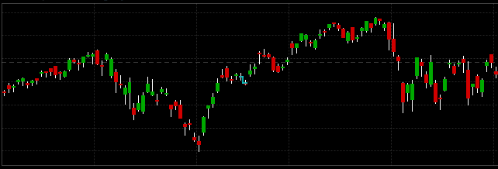
Assumption: Market Prices are Martingales (all else being equal)
Definition:
The best estimate for the next value is the current value.

Slide 30
Return
SE
Standard Deviation of Returns

Slide 31
To Maximize Risk-Adjusted Return
First - Set projected volatility on x-axis, expected return on y-axis
Second - Locate the “risk-free return point” on graph: x = 0, y = risk-free rate
(currently about 2% in US)
Goal:
Find portfolio point (x,y) with maximum slope from risk-free return point
The difference between the expected return and the risk-free return, divided by the expected volatility of return, is the Sharpe Ratio (more on this later)!

Slide 32
Return
Slope: Sharpe Ratio
SE
Standard Deviation of Returns

Slide 33
What about Return of a portfolio?
Notes:
$${\sigma_{pf}}^2 = {w_a}^2 {\sigma_a}^2 {w_b}^2 {\sigma_b}^2 + 2w_aw_bCov_{a,b}$$
$${σ_{pf}}^{2}={w_{a}}^{2}{σ_{a}}^{2}+{w_{b}}^{2}{σ_{b}}^{2}+2w_{a}w_{b}Cov_{a,b}$$

Slide 34

Weighted average of the individual expected returns
Portfolio Return
$$\left\langle r\right\rangle =w_{1}r_{1}+w_{2}r_{2}+w_{3}r_{3}…$$
Notes:
$${\sigma_{pf}}^2 = {w_a}^2 {\sigma_a}^2 {w_b}^2 {\sigma_b}^2 + 2w_aw_bCov_{a,b}$$
$${σ_{pf}}^{2}={w_{a}}^{2}{σ_{a}}^{2}+{w_{b}}^{2}{σ_{b}}^{2}+2w_{a}w_{b}Cov_{a,b}$$

Slide 35
What about Variance of a portfolio?
Notes:
$${\sigma_{pf}}^2 = {w_a}^2 {\sigma_a}^2 {w_b}^2 {\sigma_b}^2 + 2w_aw_bCov_{a,b}$$
$${σ_{pf}}^{2}={w_{a}}^{2}{σ_{a}}^{2}+{w_{b}}^{2}{σ_{b}}^{2}+2w_{a}w_{b}Cov_{a,b}$$

Slide 36
3 Factors in Stock Price Volatility
Market Risk: Stock price moves linked to stock’s overall universe
Sector Risk: Stock price moves linked to companies in same industry sector
Idiosyncratic: Stock price moves unrelated to either; specific to stock

Slide 37
Correlation Coefficient
Definition: The slope of the line-of-best-fit that minimizes the sum-of-squares differences between two random variables.
The long way: Graph in Excel, plot line, get R^2, take square root
The easy way: CORREL()

Slide 38
Some Pairs of Stock Price Changes are More Correlated Than Others
Perfectly Correlated: R = 1
Negatively Correlated R < 0
No Correlation: R = 0
Stock prices changes of companies of same size in same market sectors tend to have high correlations
All stocks generally have > 0 correlation with their market

Slide 39

Covariance
Measures the extent to which two random variables change together.
$$\text{Cov}\left(A, B\right)= \frac{1}{n}\sum_{i=1}^{n}{\left(A_{i}−\overline{A}\right)}\left(B_{i}−\overline{B}\right)$$
→ Use the COVARIANCE.P() function in Excel

Slide 40


Covariance and R
$$−1≤R≤1$$
A “Standardized covariance”
$$\text{Cov}\left(A, B\right)= \frac{1}{n}\sum_{i=1}^{n}{\left(A_{i}−\overline{A}\right)}\left(B_{i}−\overline{B}\right)=σ_{A,B}=Rσ_{A}σ_{B}$$

Slide 41

In other words…
$$\text{Cov}\left(A, B\right)= Rσ_{A}σ_{B}$$

Slide 42
Portfolio Variance of Returns: 2 Assets
Variance of combination of two assets is dependent upon Volatility (SD) of each, weight of each, and Covariance.
Note that weights w(a) + w(b) sum to 1
Variance of the combined assets:
$$σ_{\text{Portfolio}}^{2}=w_{A}^{2}σ_{A}^{2}+w_{B}^{2}σ_{B}^{2}+{2w}_{A}w_{B}\text{Cov}\left(A,B\right)$$
Notes:
$${\sigma_{pf}}^2 = {w_a}^2 {\sigma_a}^2 {w_b}^2 {\sigma_b}^2 + 2w_aw_bCov_{a,b}$$
$${σ_{pf}}^{2}={w_{a}}^{2}{σ_{a}}^{2}+{w_{b}}^{2}{σ_{b}}^{2}+2w_{a}w_{b}Cov_{a,b}$$

Slide 43
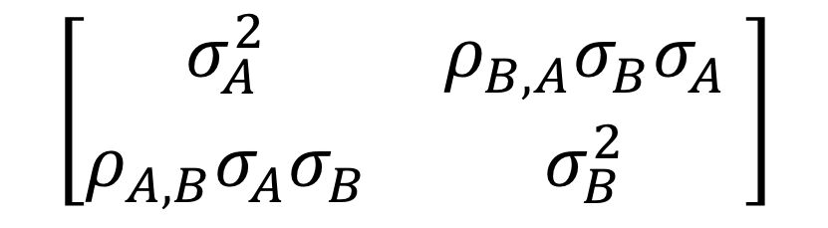
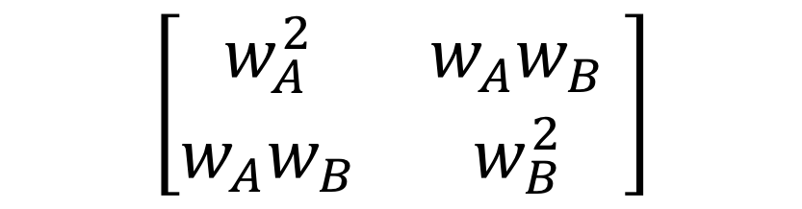
Covariance of B & A
Weight Matrix, Squared
Covariance Matrix
A
B
A
B
$$\left[\begin{matrix}w_{A}^{2} & w_{A}w_{B} \\ w_{A}w_{B} & w_{B}^{2}\end{matrix} \right]$$
$$\left[\begin{matrix}σ_{A}^{2} & ρ_{B,A}σ_{B}σ_{A} \\ ρ_{A,B}σ_{A}σ_{B} & σ_{B}^{2}\end{matrix} \right]$$
A
A
B
B
Covariance of A & B
Covariance of A &A,
Covariance of B & B
…which is just the variance
Notes:
$${\sigma_{pf}}^2 = {w_a}^2 {\sigma_a}^2 {w_b}^2 {\sigma_b}^2 + 2w_aw_bCov_{a,b}$$
$${σ_{pf}}^{2}={w_{a}}^{2}{σ_{a}}^{2}+{w_{b}}^{2}{σ_{b}}^{2}+2w_{a}w_{b}Cov_{a,b}$$

Slide 44
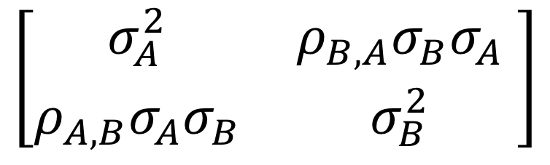
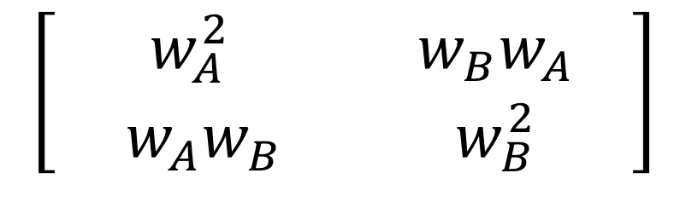
1) Multiply element-wise
$$\left[\begin{matrix}σ_{A}^{2} & ρ_{B,A}σ_{B}σ_{A} \\ ρ_{A,B}σ_{A}σ_{B} & σ_{B}^{2}\end{matrix} \right]$$
$$\left[\begin{matrix}{ w}_{A}^{2} & { w}_{B}w_{A} \\ { w}_{A}w_{B} & w_{B}^{2}\end{matrix} \right]$$
Equal
2) Sum them up
Element-wise multiplication, then sum, has a name:
”Frobenius Product”
$$w_{A}^{2}σ_{A}^{2}+w_{A}w_{B}ρ_{A,B}σ_{A}σ_{B}+w_{B}w_{A}ρ_{B,A}σ_{B}σ_{A}+w_{B}^{2}σ_{B}^{2}$$
3) Portfolio Variance:
$$w_{A}^{2}σ_{A}^{2}+w_{B}^{2}σ_{B}^{2}+{2w}_{A}w_{B}\text{Cov}\left(A,B\right)$$
Notes:
$${\sigma_{pf}}^2 = {w_a}^2 {\sigma_a}^2 {w_b}^2 {\sigma_b}^2 + 2w_aw_bCov_{a,b}$$
$${σ_{pf}}^{2}={w_{a}}^{2}{σ_{a}}^{2}+{w_{b}}^{2}{σ_{b}}^{2}+2w_{a}w_{b}Cov_{a,b}$$

Slide 45

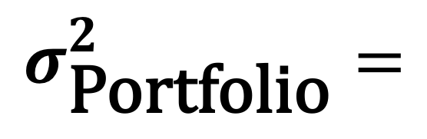
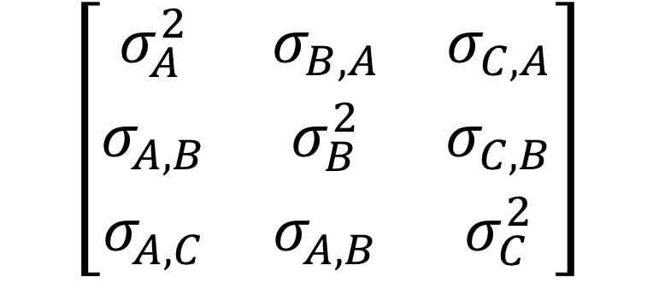
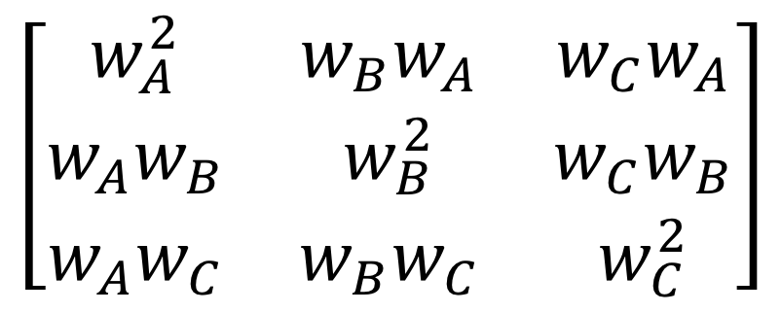
A
B
C
$$\left[\begin{matrix}σ_{A}^{2} & σ_{B,A} & σ_{C,A} \\ σ_{A,B} & σ_{B}^{2} & σ_{C,B} \\ σ_{A,C} & σ_{A,B} & σ_{C}^{2}\end{matrix}\right]$$
A
Three Stocks
A B & C
Element-wise Multiply…
B
C
A
B
C
A
$$\left[\begin{matrix}w_{A}^{2} & w_{B}w_{A} & w_{C}w_{A} \\ w_{A}w_{B} & w_{B}^{2} & w_{C}w_{B} \\ w_{A}w_{C} & w_{B}w_{C} & w_{C}^{2}\end{matrix}\right]$$
$$σ_{\text{Portfolio}}^{2}=$$
B
$$w_{A}^{2}σ_{A}^{2}+w_{B}^{2}σ_{B}^{2}+w_{C}^{2}σ_{C}^{2}$$
$$+{2w}_{A}w_{B}\text{Cov}\left(A,B\right)$$
$$+{2w}_{A}w_{C}\text{Cov}\left(A,C\right)$$
$$+{2w}_{B}w_{C}\text{Cov}\left(B,C\right)$$
C
Then sum…
Notes:
$${\sigma_{pf}}^2 = {w_a}^2 {\sigma_a}^2 {w_b}^2 {\sigma_b}^2 + 2w_aw_bCov_{a,b}$$
$${σ_{pf}}^{2}={w_{a}}^{2}{σ_{a}}^{2}+{w_{b}}^{2}{σ_{b}}^{2}+2w_{a}w_{b}Cov_{a,b}$$

Slide 46
…and so on for n stocks.
Notes:
$${\sigma_{pf}}^2 = {w_a}^2 {\sigma_a}^2 {w_b}^2 {\sigma_b}^2 + 2w_aw_bCov_{a,b}$$
$${σ_{pf}}^{2}={w_{a}}^{2}{σ_{a}}^{2}+{w_{b}}^{2}{σ_{b}}^{2}+2w_{a}w_{b}Cov_{a,b}$$

Slide 47
Return vs. Risk as a Function of Asset Weights

Slide 48
Interpreting the Graph
One end point is 100% GM stock, 0% Microsoft stock
Other end point is 0% GM stock, 100% MS stock
The 9 other marked points on the curve are:
w(GM) = .9, w(MS) = .1,
w(GM) = .8, w(MS) = .2,
w(GM) = .7, w(MS) = .3,
And so on
The graph contains some bad choices
The upward sloping portion of the graph is called the Efficient Frontier
“Northwest is Best!”

Slide 49
The “Efficient Frontier”
We assume:
Investors are “profit-maximizing” and “risk-averse”
Given 2 portfolios with same SD of returns, investors pick the one with higher expected return
Given 2 portfolios with same expected return, investors pick the one with lower SD of returns

Slide 50
Correlation’s Impact on the Efficient Frontier

Slide 51
Correlation’s Impact on the Efficient Frontier

Slide 52
Adding a 3rd Asset Moves Efficient Frontier
WMT + CSCO + SBUX
WMT + CSCO

Slide 53
Portfolio Weightings
By definition, sum of all weightings = 1
No single component’s weight > 1
Weighting <0
Short Selling
Assume no short selling (longs only), unless explicitly stated otherwise in a problem statement, for this course
(absolute value )

Slide 54
QUESTION
Let’s say we designed a trading competition in which everyone spun up a trading account and traded stocks all semester. At the end of the semester, who wins?
Student 1
Student 2
Puts all cash into a risky startup, the return on which fluctuates wildly during the period – sometimes up, sometimes down by large amounts
Diversifies risk by allocating cash across a variety of assets in different industries.
On any given day, student might be up by as much as 60%, or down by as much as -60%.
Value of the portfolio goes steadily up – a healthy, reliable return with low variance.
On the official end of the competition, student is up by a whopping 75%.
At the end of the competition, Student 2 is up by a very respectable 12%.
Got Lucky. The competition just happened to end on a good day for Student 1. By the end of next week, Student 1 was down to -15% return.
Should win. Student 2 was consistently earning a return with low volatility. By the end of next week, Student 2 was up by a little more than 12%.
How can we quantify this?

Slide 55
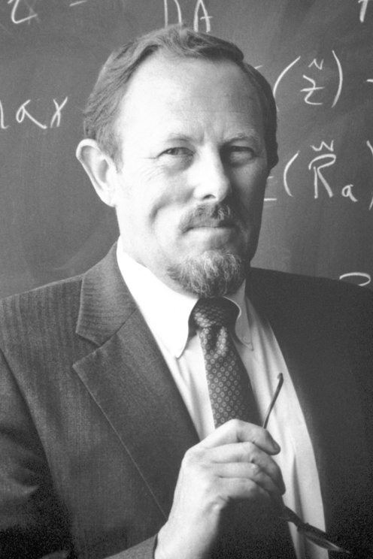
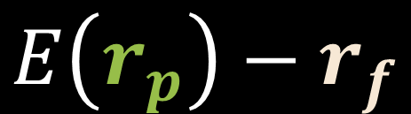

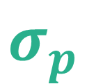
The Sharpe Ratio: Definition
We’d like to develop a metric that has units of RETURN / RISK so that we can quantify how well an investment is doing for the risk being taken.
1) The Return
Difference between the portfolio’s return and the risk-free rate (i.e.; how much better are we doing than risk-free?)
$$E\left(r_{p}\right)−r_{f}$$
$$\text{Sharpe} \text{Ratio} =$$
$$σ_{p}$$
2) The Risk
Portfolio’s volatility (expected standard deviation of returns)
3) Give it a name
William F. Sharpe
Original Paper (1966):
http://web.stanford.edu/~wfsharpe/art/sr/sr.htm
Expected OR Historical
Can measure Sharpe ratio in the past to compare performance, or use expected values to balance a portfolio today

Slide 56
Tradeoffs Between Return and Volatility
Notes:
Return goes up as vol increases
There are some bad portfolios in there.

Slide 57
Sharpe Ratio
The term “market” as used here is taken to mean “all of the assets you’re taking into consideration for your portfolio.”
Also called your “universe”.
By weighting portfolios containing stocks & risk-free bonds, can achieve best available risk/return on the CML (Capital Market Line).
Portfolios that fall on that line have the highest ratio of Return vs. Risk available in a given market.
Slope of the CML is defined by the best-return portfolios*
Slope of the CML = best Sharpe Ratio available in your universe*
Most common metric used to express risk-adjusted returns
* Except for the case in which you’re leveraged at a rate higher than the risk-free rate $r_{f}$.
Let’s explore these concepts in an Excel breakout.
Notes:
Sharpe \ Ratio \ $$ =\frac{E(r_p)-r_f}{\sigma_p}$$
$$Sharpe Ratio=\frac{E\left(r_{p}\right)− r_{f}}{σ_{p}}$$

Slide 58



Excel Breakout
Let’s tie it all together.
Stock A: _____
Exp rtn:
Exp vol:
Stock B: ____
Exp rtn:
Exp vol:
Correlation: ($R_{CB, TXN}$) =
Risk-free rate: $r_{f}=$
Notes:
Sharpe \ Ratio \ $$ =\frac{E(r_p)-r_f}{\sigma_p}$$
$$Sharpe Ratio=\frac{E\left(r_{p}\right)− r_{f}}{σ_{p}}$$

Slide 59
Alpha & Beta

Slide 60
After Markowitz published in 1952
People realized: more stocks, more betas, better risk adjustment
Adding stocks into the universe allows for more selection opportunity to find the best efficient frontier
Theoretically, the “best portfolio” whose universe included all available stocks would have weightings assigned to all stocks
Such a “best portfolio” would not necessarily assign non-zero weights to every stock- some are left out (weight = 0).

Slide 61
Conclusion: No subset of any given universe can produce a more optimal portfolio than the one calculated on the universe as a whole.

Slide 62
Alpha & Beta: Motivation
Sometimes we want to compare an investment’s returns against those of a different asset (i.e., a benchmark).
We can do this by graphing the returns of the benchmark on the x-axis, and those of the asset on the y-axis.

Slide 63
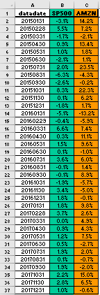
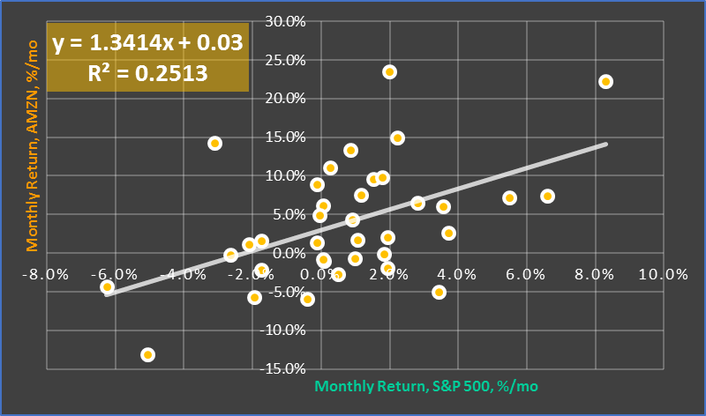
Alpha & Beta: Definition
x-axis: Historical returns of a Benchmark (S&P 500)
Alpha (α): The y-intercept
Beta (β): The slope
…of the line-of-best-fit between an asset and an appropriate benchmark.
y-axis: Historical returns of an Asset (AMZN)
Returns
β
α
Benchmark can be:
An index
Another stock
A strategy
…any financial instrument for which we have historical returns

Slide 64
Alpha & Beta: Interpretation
β
α
What are we saying by drawing a regression line through these returns?
There is mutual information between AMZN and SP500 prices – knowing whether one increases or decreases improves our ability to predict the other
What happens if SP500 Return set to 0?
If the S&P returns nothing, AMZN still returns 0.036% (α). (and that’s good!)
α is therefore sometimes called the “excess return” over the benchmark
If these returns are all log returns, what is Amazon’s excess return, annualized?
= 0.03% * 12 = 0.36%
β measures the sensitivity of AMZN’s returns to those of the S&P 500; i.e., Market Risk
β of 1.34 shows that AMZN was quite sensitive to the market during this time period
β > 1 termed aggressive
β < 1 termed defensive

Slide 65
Alpha and Beta can refer either to Historical Measures or Forecasts
In Capital Market (CAPM) theory, over the long run:
Every asset will have a return equal to the product of its Beta and the difference between the market and the risk-free rate of return
Every asset will therefore have forecast Alpha of 0
Alpha is defined as an asset’s return minus the product of its beta and the difference between the market and risk-free return
historical data show Alphas > 0 and Alphas <0

Slide 66
Because Alpha gives a fund’s return when the overall market’s return is zero, it provides a decent measure of a money manager’s performance over the market.
In other words: why put your money in a mutual fund vs. simply buying shares of an S&P500 index yourself?
Because you believe that the mutual fund will earn you a better alpha.
But mutual funds charge fees, and when you take that into account…

Slide 67
Blotters & Ledgers (demo)

