Slide 1
Upgrade your .NET code! From C# 7.0 to C# 8.0 walkthrough
Wrocław, 10.03.2019, Tomasz Strzałka

Slide 2
Agenda
We are going to talk about…
Introduction
The recent C# versions timeline,
C# 8.0 pre-requirements,
dive into an example.
What’s new in C# 7.1
Async Main method,
default literal expressions,
inferred tuple element names.
What’s new in C# 7.2
Safe efficient code enhancements,
non-trailing named arguments,
leading underscores in numeric literals,
private protected access modifier,
conditional ref expressions.
Introduction
The recent C# versions timeline,
C# 8.0 pre-requirements,
dive into an example.
What’s new in C# 7.1
Async Main method,
default literal expressions,
inferred tuple element names.
What’s new in C# 7.2
Safe efficient code enhancements,
non-trailing named arguments,
leading underscores in numeric literals,
private protected access modifier,
conditional ref expressions.

Slide 3
Agenda
We are going to talk about…
What’s new in C# 7.3
Enabling more efficient safe code,
fixed fields without pinning access,
local ref variables reassignment,
array initializers with stackalloc,
extended fixed support for types,
enhanced generic constraints.
Make existing features better
equality comparator tuple support,
field attributes for auto-implemented properties,
in method overload,
extend expression variables in initializers.
What’s new in C# 7.3
Enabling more efficient safe code,
fixed fields without pinning access,
local ref variables reassignment,
array initializers with stackalloc,
extended fixed support for types,
enhanced generic constraints.
Make existing features better
equality comparator tuple support,
field attributes for auto-implemented properties,
in method overload,
extend expression variables in initializers.

Slide 4
Agenda
We are going to talk about…
What’s new in C# 8.0
Nullable reference types,
async streams,
ranges and indices,
default interface members,
recursive patterns,
switch expressions,
target-typed new-expressions,
extension everything.
What’s new in C# 8.0
Nullable reference types,
async streams,
ranges and indices,
default interface members,
recursive patterns,
switch expressions,
target-typed new-expressions,
extension everything.

Slide 5
Introduction
The recent C# versions timeline

Slide 6
Agenda
We are going to talk about…
Introduction
The recent C# versions timeline,
C# 8.0 pre-requirements,
Introduction
The recent C# versions timeline,
C# 8.0 pre-requirements,
dive into an example.

Slide 7




The recent C# versions timeline C# 8.0 pre-requirements
1
Overlook to the few past releases
 | C# 7.0 | C# 7.1 | C# 7.2 | C# 7.3 | C# 8.0
 | March, 2017 | August, 2017 | November, 2017 | May, 2018
 | .NET Framework 4.6.2 | .NET Framework 4.7 | .NET Framework 4.7.1 | .NET Framework 4.7.2 | .NET Framework 4.8
 | .NET Core 2.0 | .NET Core 2.0 | .NET Core 2.0 | .NET Core 2.1 | .NET Core 3.0
 | .NET Standard 2.0 | .NET Standard 2.0 | .NET Standard 2.0 | .NET Standard 2.0 | .NET Standard 2.0/ .NET Standard 2.1
 | Visual Studio 2017 | Visual Studio 2017 v15.3 | Visual Studio 2017 v15.5 | Visual Studio 2017 v15.7 | Visual Studio 2019
Notes:
https://docs.microsoft.com/pl-pl/dotnet/csharp/whats-new/csharp-version-history https://en.wikipedia.org/wiki/C_Sharp_(programming_language)

Slide 8
Agenda
We are going to talk about…
Introduction
The recent C# versions timeline,
C# 8.0 pre-requirements,
dive into an example.
Introduction
The recent C# versions timeline,
C# 8.0 pre-requirements,
dive into an example.

Slide 9
Dive into an example
2
How things will goanna to work here
Pre-requirement software
Microsoft Visual Studio Enterprise 2019 Preview Version 16.0.0 Preview 2.2,
Microsoft .NET Core SDK 3.0.100.010184.
Visual Studio solution structure
00.Example,
#region C#7.0 Example,
#region C#7.1 Example,
#define _02_CSharp71_EXAMPLE_Question
…
…
01.AsyncMain,
…
Pre-requirement software
Microsoft Visual Studio Enterprise 2019 Preview Version 16.0.0 Preview 2.2,
Microsoft .NET Core SDK 3.0.100.010184.
Visual Studio solution structure
00.Example,
#region C#7.0 Example,
#region C#7.1 Example,
#define _02_CSharp71_EXAMPLE_Question
…
…
01.AsyncMain,
…

Slide 10
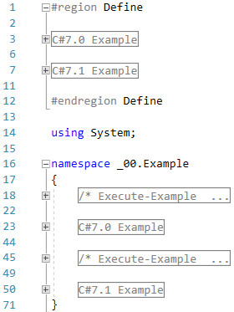
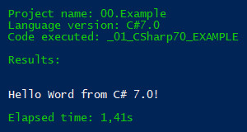
Example
3
C# 7.0 Hello Word

Slide 11
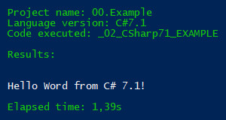
Example
4
C# 7.1 Hello Word

Slide 12
What’s new in C# 7.1

Slide 13
Agenda
We are going to talk about…
Introduction
The recent C# versions timeline,
C# 8.0 pre-requirements,
dive into an example.
What’s new in C# 7.1
Async Main method,
Introduction
The recent C# versions timeline,
C# 8.0 pre-requirements,
dive into an example.
What’s new in C# 7.1
Async Main method,
default literal expressions,
inferred tuple element names.
What’s new in C# 7.2
Safe efficient code enhancements,
non-trailing named arguments,
leading underscores in numeric literals,
private protected access modifier,
conditional ref expressions.

Slide 14
What’s new in C# 7.1
Async Main method

Slide 15
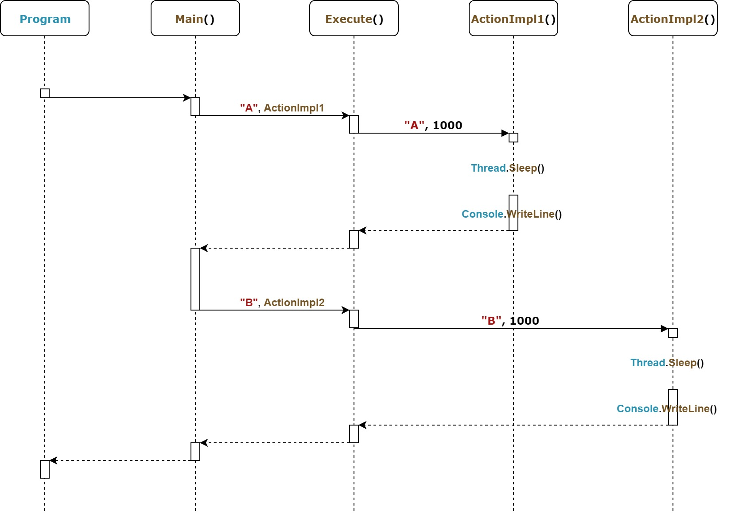
Async Main method
1
C# 7.0, totally synchronous, old fashioned way

Slide 16
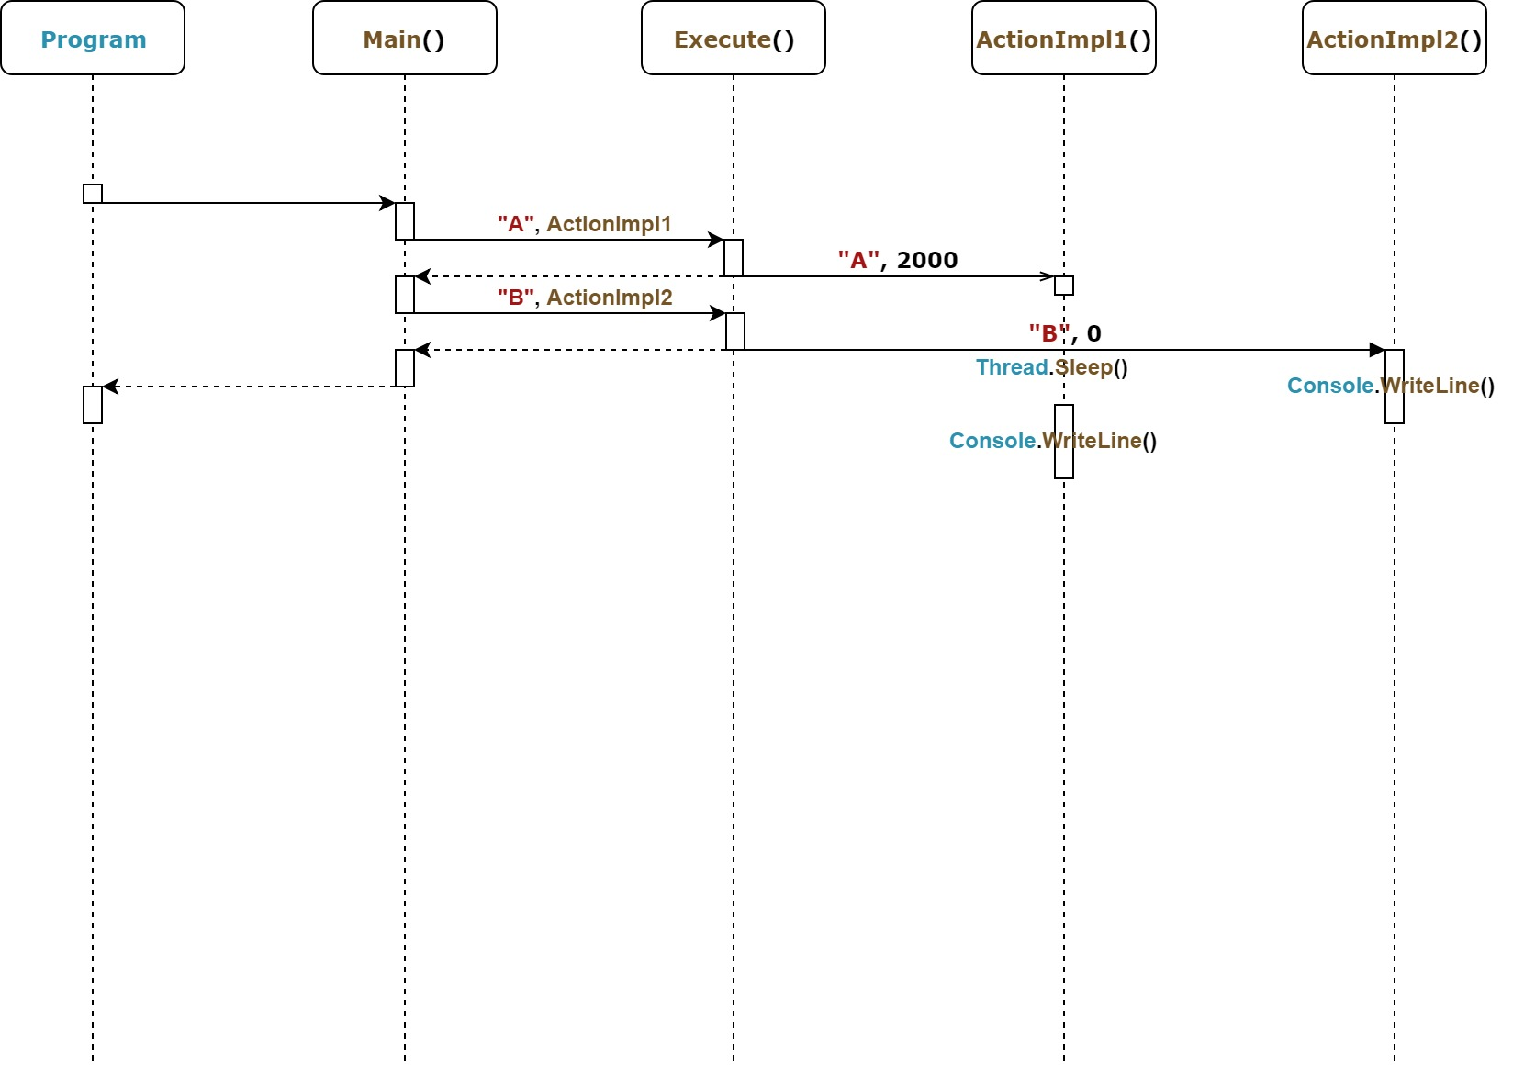
Async Main method
2
C# 7.0, asynchronous, Tasks

Slide 17
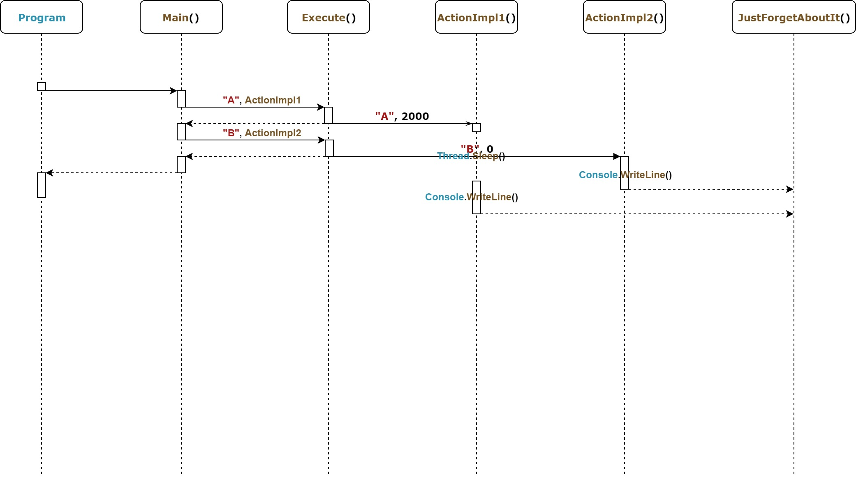
Async Main method
3
C# 7.0, async

Slide 18
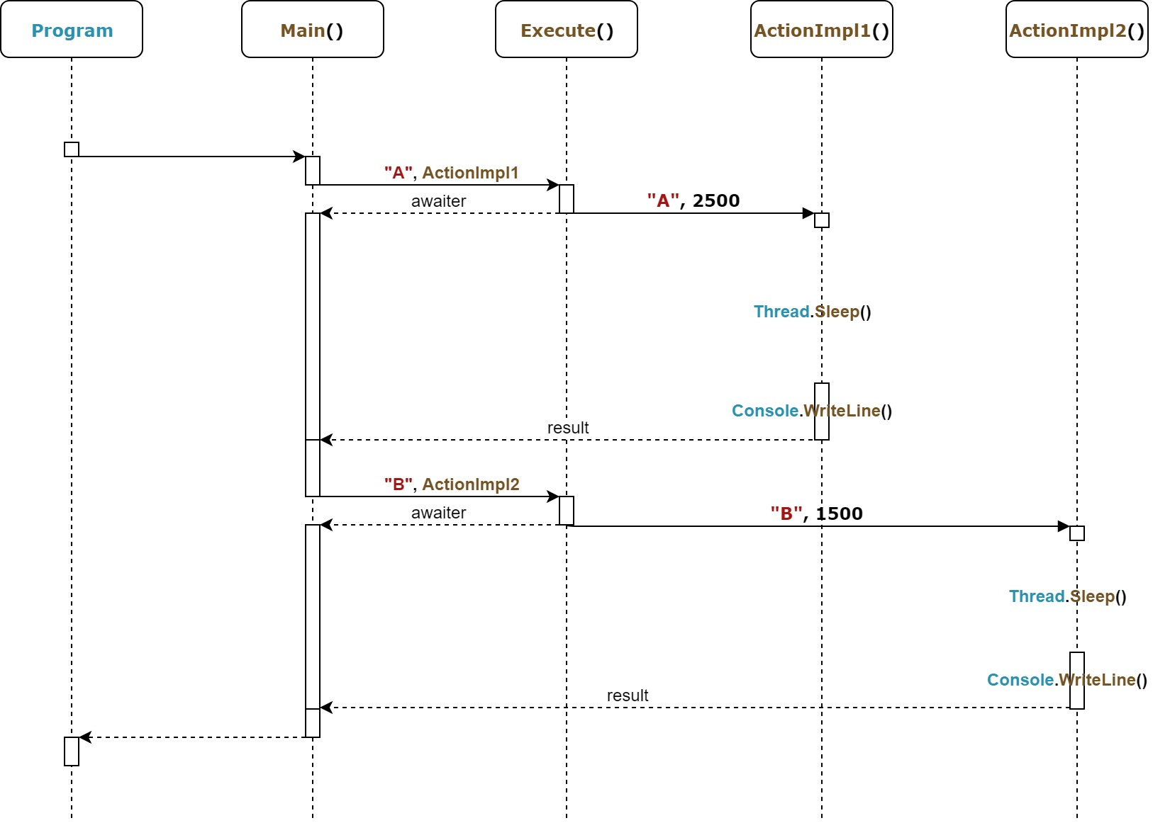
Async Main method
4
C# 7.0, async, awaiter

Slide 19
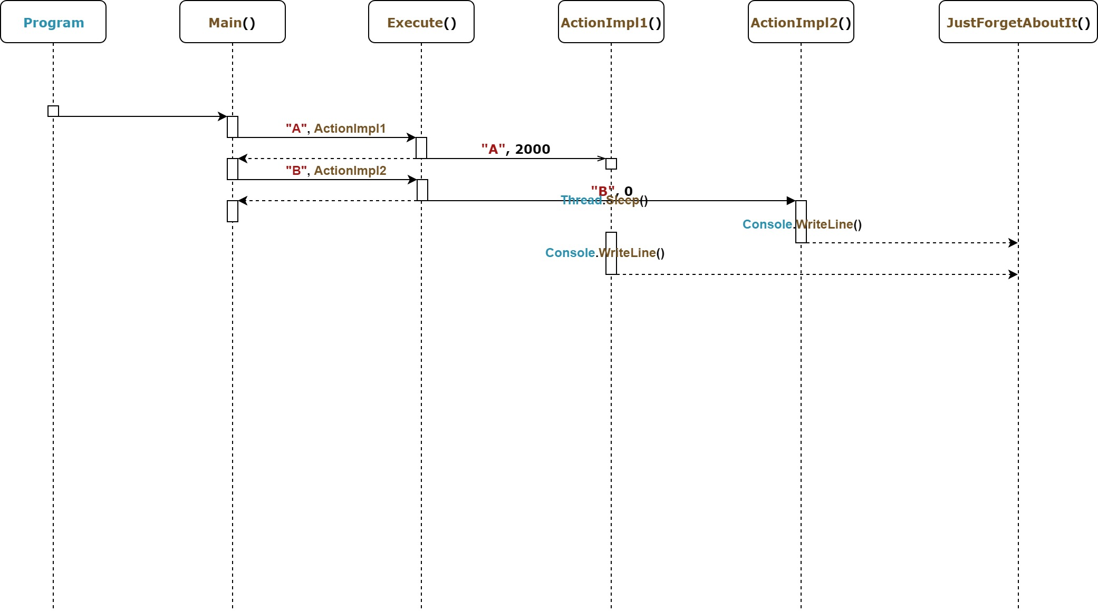
Async Main method
5
C# 7.1, async

Slide 20
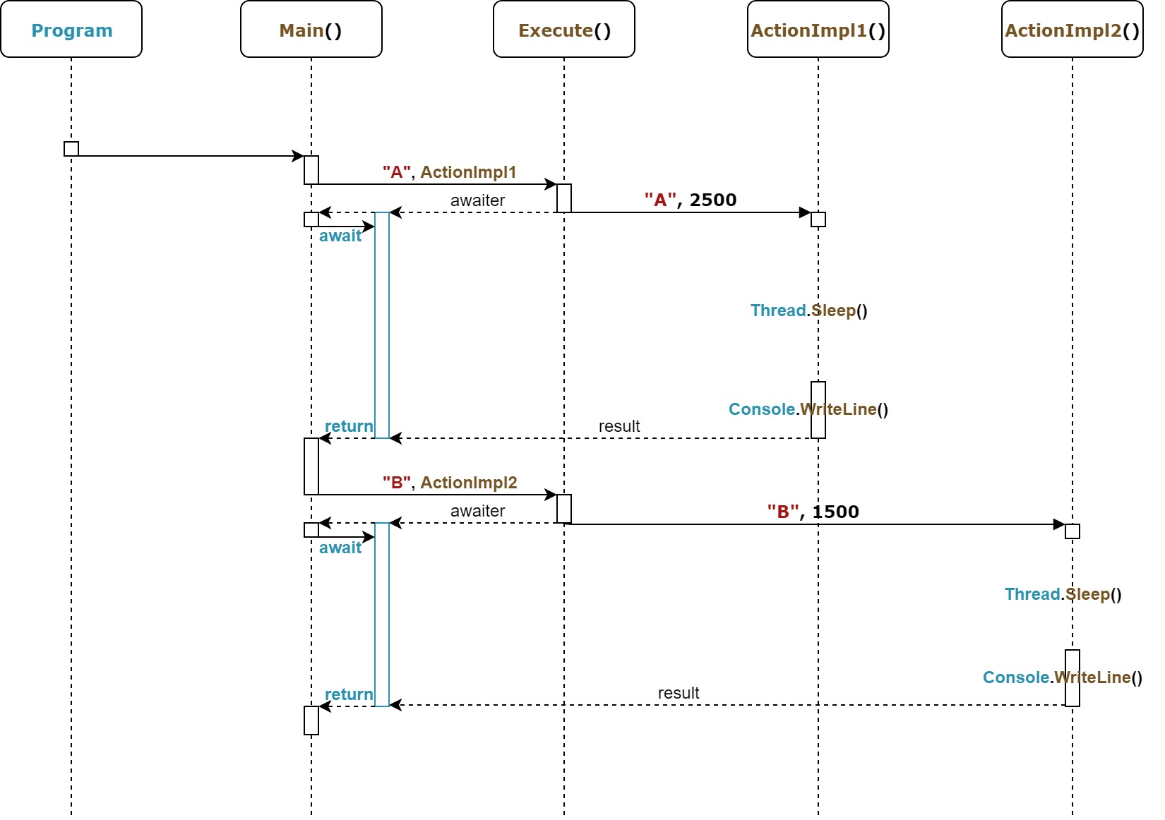
Async Main method
6
C# 7.1, async-await

Slide 21
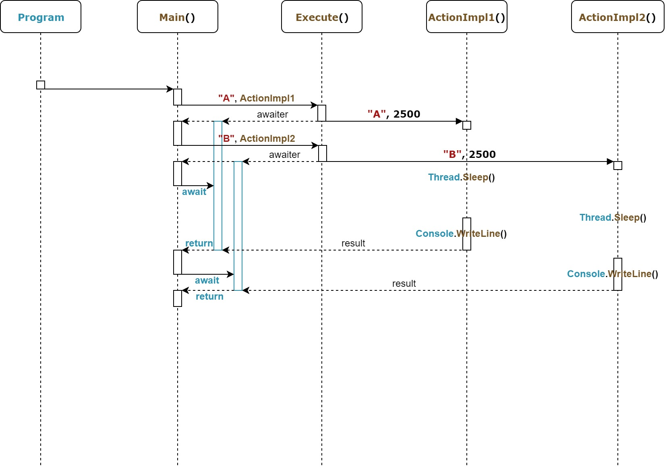
Async Main method
7
C# 7.1, async, await

Slide 22
Agenda
We are going to talk about…
Introduction
The recent C# versions timeline,
C# 8.0 pre-requirements,
dive into an example.
What’s new in C# 7.1
Async Main method,
default literal expressions,
Introduction
The recent C# versions timeline,
C# 8.0 pre-requirements,
dive into an example.
What’s new in C# 7.1
Async Main method,
default literal expressions,
inferred tuple element names.
What’s new in C# 7.2
Safe efficient code enhancements,
non-trailing named arguments,
leading underscores in numeric literals,
private protected access modifier,
conditional ref expressions.

Slide 23
What’s new in C# 7.1
Default literal expressions

Slide 24
Default literal expressions
1
C# 7.0

Slide 25
Default literal expressions
2
C# 7.1

Slide 26
Agenda
We are going to talk about…
Introduction
The recent C# versions timeline,
C# 8.0 pre-requirements,
dive into an example.
What’s new in C# 7.1
Async Main method,
default literal expressions,
inferred tuple element names.
Introduction
The recent C# versions timeline,
C# 8.0 pre-requirements,
dive into an example.
What’s new in C# 7.1
Async Main method,
default literal expressions,
inferred tuple element names.
What’s new in C# 7.2
Safe efficient code enhancements,
non-trailing named arguments,
leading underscores in numeric literals,
private protected access modifier,
conditional ref expressions.

Slide 27
What’s new in C# 7.1
Inferred tuple element names

Slide 28
Inferred tuple element names
1
C# 7.0

Slide 29
Inferred tuple element names
2
C# 7.1

Slide 30
What’s new in C# 7.2

Slide 31
Agenda
We are going to talk about…
Introduction
The recent C# versions timeline,
C# 8.0 pre-requirements,
dive into an example.
What’s new in C# 7.1
Async Main method,
default literal expressions,
inferred tuple element names.
What’s new in C# 7.2
Safe efficient code enhancements,
Introduction
The recent C# versions timeline,
C# 8.0 pre-requirements,
dive into an example.
What’s new in C# 7.1
Async Main method,
default literal expressions,
inferred tuple element names.
What’s new in C# 7.2
Safe efficient code enhancements,
non-trailing named arguments,
leading underscores in numeric literals,
private protected access modifier,
conditional ref expressions.

Slide 32
What’s new in C# 7.2
Safe efficient code enhancements

Slide 33
Safe efficient code enhancements
1
C# 7.1

Slide 34
Safe efficient code enhancements
2
C# 7.2

Slide 35
Agenda
We are going to talk about…
Introduction
The recent C# versions timeline,
C# 8.0 pre-requirements,
dive into an example.
What’s new in C# 7.1
Async Main method,
default literal expressions,
inferred tuple element names.
What’s new in C# 7.2
Safe efficient code enhancements,
non-trailing named arguments,
Introduction
The recent C# versions timeline,
C# 8.0 pre-requirements,
dive into an example.
What’s new in C# 7.1
Async Main method,
default literal expressions,
inferred tuple element names.
What’s new in C# 7.2
Safe efficient code enhancements,
non-trailing named arguments,
leading underscores in numeric literals,
private protected access modifier,
conditional ref expressions.

Slide 36
What’s new in C# 7.2
Non-trailing named arguments

Slide 37
Non-trailing named arguments
1
C# 7.1

Slide 38
Non-trailing named arguments
2
C# 7.2

Slide 39
Agenda
We are going to talk about…
Introduction
The recent C# versions timeline,
C# 8.0 pre-requirements,
dive into an example.
What’s new in C# 7.1
Async Main method,
default literal expressions,
inferred tuple element names.
What’s new in C# 7.2
Safe efficient code enhancements,
non-trailing named arguments,
leading underscores in numeric literals,
Introduction
The recent C# versions timeline,
C# 8.0 pre-requirements,
dive into an example.
What’s new in C# 7.1
Async Main method,
default literal expressions,
inferred tuple element names.
What’s new in C# 7.2
Safe efficient code enhancements,
non-trailing named arguments,
leading underscores in numeric literals,
private protected access modifier,
conditional ref expressions.

Slide 40
What’s new in C# 7.2
Leading underscores in numeric literals

Slide 41
Leading underscores in numeric literals
1
C# 7.1

Slide 42
Leading underscores in numeric literals
2
C# 7.2

Slide 43
Agenda
We are going to talk about…
Introduction
The recent C# versions timeline,
C# 8.0 pre-requirements,
dive into an example.
What’s new in C# 7.1
Async Main method,
default literal expressions,
inferred tuple element names.
What’s new in C# 7.2
Safe efficient code enhancements,
non-trailing named arguments,
leading underscores in numeric literals,
private protected access modifier,
Introduction
The recent C# versions timeline,
C# 8.0 pre-requirements,
dive into an example.
What’s new in C# 7.1
Async Main method,
default literal expressions,
inferred tuple element names.
What’s new in C# 7.2
Safe efficient code enhancements,
non-trailing named arguments,
leading underscores in numeric literals,
private protected access modifier,
conditional ref expressions.

Slide 44
What’s new in C# 7.2
Private protected access modifier

Slide 45
Private protected access modifier
1
C# 7.1

Slide 46
Private protected access modifier
2
C# 7.2

Slide 47
Agenda
We are going to talk about…
Introduction
The recent C# versions timeline,
C# 8.0 pre-requirements,
dive into an example.
What’s new in C# 7.1
Async Main method,
default literal expressions,
inferred tuple element names.
What’s new in C# 7.2
Safe efficient code enhancements,
non-trailing named arguments,
leading underscores in numeric literals,
private protected access modifier,
conditional ref expressions.
Introduction
The recent C# versions timeline,
C# 8.0 pre-requirements,
dive into an example.
What’s new in C# 7.1
Async Main method,
default literal expressions,
inferred tuple element names.
What’s new in C# 7.2
Safe efficient code enhancements,
non-trailing named arguments,
leading underscores in numeric literals,
private protected access modifier,
conditional ref expressions.

Slide 48
What’s new in C# 7.2
Conditional ref expressions

Slide 49
Conditional ref expressions
1
C# 7.1

Slide 50
Conditional ref expressions
2
C# 7.2

Slide 51
What’s new in C# 7.3

Slide 52
Agenda
We are going to talk about…
What’s new in C# 7.3
Enabling more efficient safe code,
fixed fields without pinning access,
local ref variables reassignment,
array initializers with stackalloc,
extended fixed support for types,
enhanced generic constraints.
Make existing features better
equality comparator tuple support,
field attributes for auto-implemented properties,
in method overload,
extend expression variables in initializers.
What’s new in C# 7.3
Enabling more efficient safe code,
fixed fields without pinning access,

Slide 53
What’s new in C# 7.3 Fixed fields without pinning access

Slide 54
Fixed fields without pinning access
1
C# 7.2

Slide 55
Fixed fields without pinning access
2
C# 7.3

Slide 56
Agenda
We are going to talk about…
What’s new in C# 7.3
Enabling more efficient safe code,
fixed fields without pinning access,
local ref variables reassignment,
array initializers with stackalloc,
extended fixed support for types,
enhanced generic constraints.
Make existing features better
equality comparator tuple support,
field attributes for auto-implemented properties,
in method overload,
extend expression variables in initializers.
What’s new in C# 7.3
Enabling more efficient safe code,
fixed fields without pinning access,
local ref variables reassignment,

Slide 57
What’s new in C# 7.3 Local ref variables reassignment

Slide 58
Local ref variables reassignment
1
C# 7.2

Slide 59
Local ref variables reassignment
2
C# 7.3

Slide 60
Agenda
We are going to talk about…
What’s new in C# 7.3
Enabling more efficient safe code,
fixed fields without pinning access,
local ref variables reassignment,
array initializers with stackalloc,
extended fixed support for types,
enhanced generic constraints.
Make existing features better
equality comparator tuple support,
field attributes for auto-implemented properties,
in method overload,
extend expression variables in initializers.
What’s new in C# 7.3
Enabling more efficient safe code,
fixed fields without pinning access,
local ref variables reassignment,
array initializers with stackalloc,

Slide 61
What’s new in C# 7.3 Array initializers with stackalloc

Slide 62
Array initializers with stackalloc
1
C# 7.2

Slide 63
Array initializers with stackalloc
2
C# 7.3

Slide 64
Agenda
We are going to talk about…
What’s new in C# 7.3
Enabling more efficient safe code,
fixed fields without pinning access,
local ref variables reassignment,
array initializers with stackalloc,
extended fixed support for types,
enhanced generic constraints.
Make existing features better
equality comparator tuple support,
field attributes for auto-implemented properties,
in method overload,
extend expression variables in initializers.
What’s new in C# 7.3
Enabling more efficient safe code,
fixed fields without pinning access,
local ref variables reassignment,
array initializers with stackalloc,
extended fixed support for types,

Slide 65
What’s new in C# 7.3 Extended fixed support for types

Slide 66
Extended fixed support for types
1
C# 7.2

Slide 67
Extended fixed support for types
2
C# 7.3

Slide 68
Agenda
We are going to talk about…
What’s new in C# 7.3
Enabling more efficient safe code,
fixed fields without pinning access,
local ref variables reassignment,
array initializers with stackalloc,
extended fixed support for types,
enhanced generic constraints.
Make existing features better
equality comparator tuple support,
field attributes for auto-implemented properties,
in method overload,
extend expression variables in initializers.
What’s new in C# 7.3
Enabling more efficient safe code,
fixed fields without pinning access,
local ref variables reassignment,
array initializers with stackalloc,
extended fixed support for types,
enhanced generic constraints.

Slide 69
What’s new in C# 7.3 Enhanced generic constraints

Slide 70
Enhanced generic constraints
1
C# 7.2

Slide 71
Enhanced generic constraints
2
C# 7.3

Slide 72
Agenda
We are going to talk about…
What’s new in C# 7.3
Enabling more efficient safe code,
fixed fields without pinning access,
local ref variables reassignment,
array initializers with stackalloc,
extended fixed support for types,
enhanced generic constraints.
Make existing features better
equality comparator tuple support,
field attributes for auto-implemented properties,
in method overload,
extend expression variables in initializers.
What’s new in C# 7.3
Enabling more efficient safe code,
fixed fields without pinning access,
local ref variables reassignment,
array initializers with stackalloc,
extended fixed support for types,
enhanced generic constraints.
Make existing features better
equality comparator tuple support,

Slide 73
What’s new in C# 7.3 Equality comparator tuple support

Slide 74
Equality comparator tuple support
1
C# 7.2

Slide 75
Equality comparator tuple support
2
C# 7.3

Slide 76
Agenda
We are going to talk about…
What’s new in C# 7.3
Enabling more efficient safe code,
fixed fields without pinning access,
local ref variables reassignment,
array initializers with stackalloc,
extended fixed support for types,
enhanced generic constraints.
Make existing features better
equality comparator tuple support,
field attributes for auto-implemented properties,
in method overload,
extend expression variables in initializers.
What’s new in C# 7.3
Enabling more efficient safe code,
fixed fields without pinning access,
local ref variables reassignment,
array initializers with stackalloc,
extended fixed support for types,
enhanced generic constraints.
Make existing features better
equality comparator tuple support,
field attributes for auto-implemented properties,

Slide 77
What’s new in C# 7.3 Field attributes for auto-implemented properties

Slide 78
Field attributes for auto-implemented properties
1
C# 7.2

Slide 79
Field attributes for auto-implemented properties
2
C# 7.3

Slide 80
Agenda
We are going to talk about…
What’s new in C# 7.3
Enabling more efficient safe code,
fixed fields without pinning access,
local ref variables reassignment,
array initializers with stackalloc,
extended fixed support for types,
enhanced generic constraints.
Make existing features better
equality comparator tuple support,
field attributes for auto-implemented properties,
in method overload,
extend expression variables in initializers.
What’s new in C# 7.3
Enabling more efficient safe code,
fixed fields without pinning access,
local ref variables reassignment,
array initializers with stackalloc,
extended fixed support for types,
enhanced generic constraints.
Make existing features better
equality comparator tuple support,
field attributes for auto-implemented properties,
in method overload,

Slide 81
What’s new in C# 7.3 In method overload

Slide 82
In method overload
1
C# 7.2

Slide 83
In method overload
2
C# 7.3

Slide 84
Agenda
We are going to talk about…
What’s new in C# 7.3
Enabling more efficient safe code,
fixed fields without pinning access,
local ref variables reassignment,
array initializers with stackalloc,
extended fixed support for types,
enhanced generic constraints.
Make existing features better
equality comparator tuple support,
field attributes for auto-implemented properties,
in method overload,
extend expression variables in initializers.
What’s new in C# 7.3
Enabling more efficient safe code,
fixed fields without pinning access,
local ref variables reassignment,
array initializers with stackalloc,
extended fixed support for types,
enhanced generic constraints.
Make existing features better
equality comparator tuple support,
field attributes for auto-implemented properties,
in method overload,
extend expression variables in initializers.

Slide 85
What’s new in C# 7.3 Extend expression variables in initializers

Slide 86
Extend expression variables in initializers
1
C# 7.2

Slide 87
Extend expression variables in initializers
2
C# 7.3

Slide 88
What’s new in C# 8.0

Slide 89
Agenda
We are going to talk about…
What’s new in C# 8.0
Nullable reference types,
async streams,
ranges and indices,
default interface members,
recursive patterns,
switch expressions,
target-typed new-expressions,
extension everything.
What’s new in C# 8.0
Nullable reference types,

Slide 90
What’s new in C# 8.0
Nullable reference types
Notes:
1) https://docs.microsoft.com/en-us/dotnet/csharp/nullable-references

Slide 91



Nullable reference types
1
C# 7.3
Non-nullable value types
Nullable value types
Referente types
Nullable reference types

Slide 92




Nullable reference types
2
C# 8.0
Non-nullable reference types
Nullable reference types

Slide 93






Nullable reference types
3
C# 8.0 - #nullable processor predicate
disable
enable
safeonly
restore

Slide 94
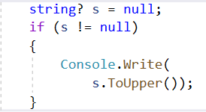
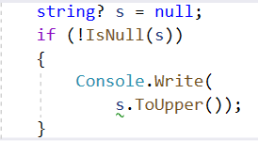
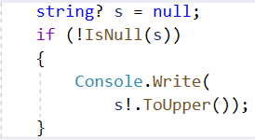
Nullable reference types
4
C# 8.0 – “damn it”/null-forgiving operator
!= operator
IsNull method
Damm-it!

Slide 95
Agenda
We are going to talk about…
What’s new in C# 8.0
Nullable reference types,
async streams,
ranges and indices,
default interface members,
recursive patterns,
switch expressions,
target-typed new-expressions,
extension everything.
What’s new in C# 8.0
Nullable reference types,
async streams,

Slide 96
What’s new in C# 8.0
Async streams

Slide 97
Async streams
1
C# 7.3

Slide 98
Async streams
2
C# 8.0

Slide 99
Agenda
We are going to talk about…
What’s new in C# 8.0
Nullable reference types,
async streams,
ranges and indices,
default interface members,
recursive patterns,
switch expressions,
target-typed new-expressions,
extension everything.
What’s new in C# 8.0
Nullable reference types,
async streams,
ranges and indices,

Slide 100
What’s new in C# 8.0
Ranges and indices

Slide 101
Ranges and indices
1
C# 7.3

Slide 102
Ranges and indices
2
C# 8.0

Slide 103
Agenda
We are going to talk about…
What’s new in C# 8.0
Nullable reference types,
async streams,
ranges and indices,
default interface members,
recursive patterns,
switch expressions,
target-typed new-expressions,
extension everything.
What’s new in C# 8.0
Nullable reference types,
async streams,
ranges and indices,
default interface members,

Slide 104
What’s new in C# 8.0
Default interface members

Slide 105
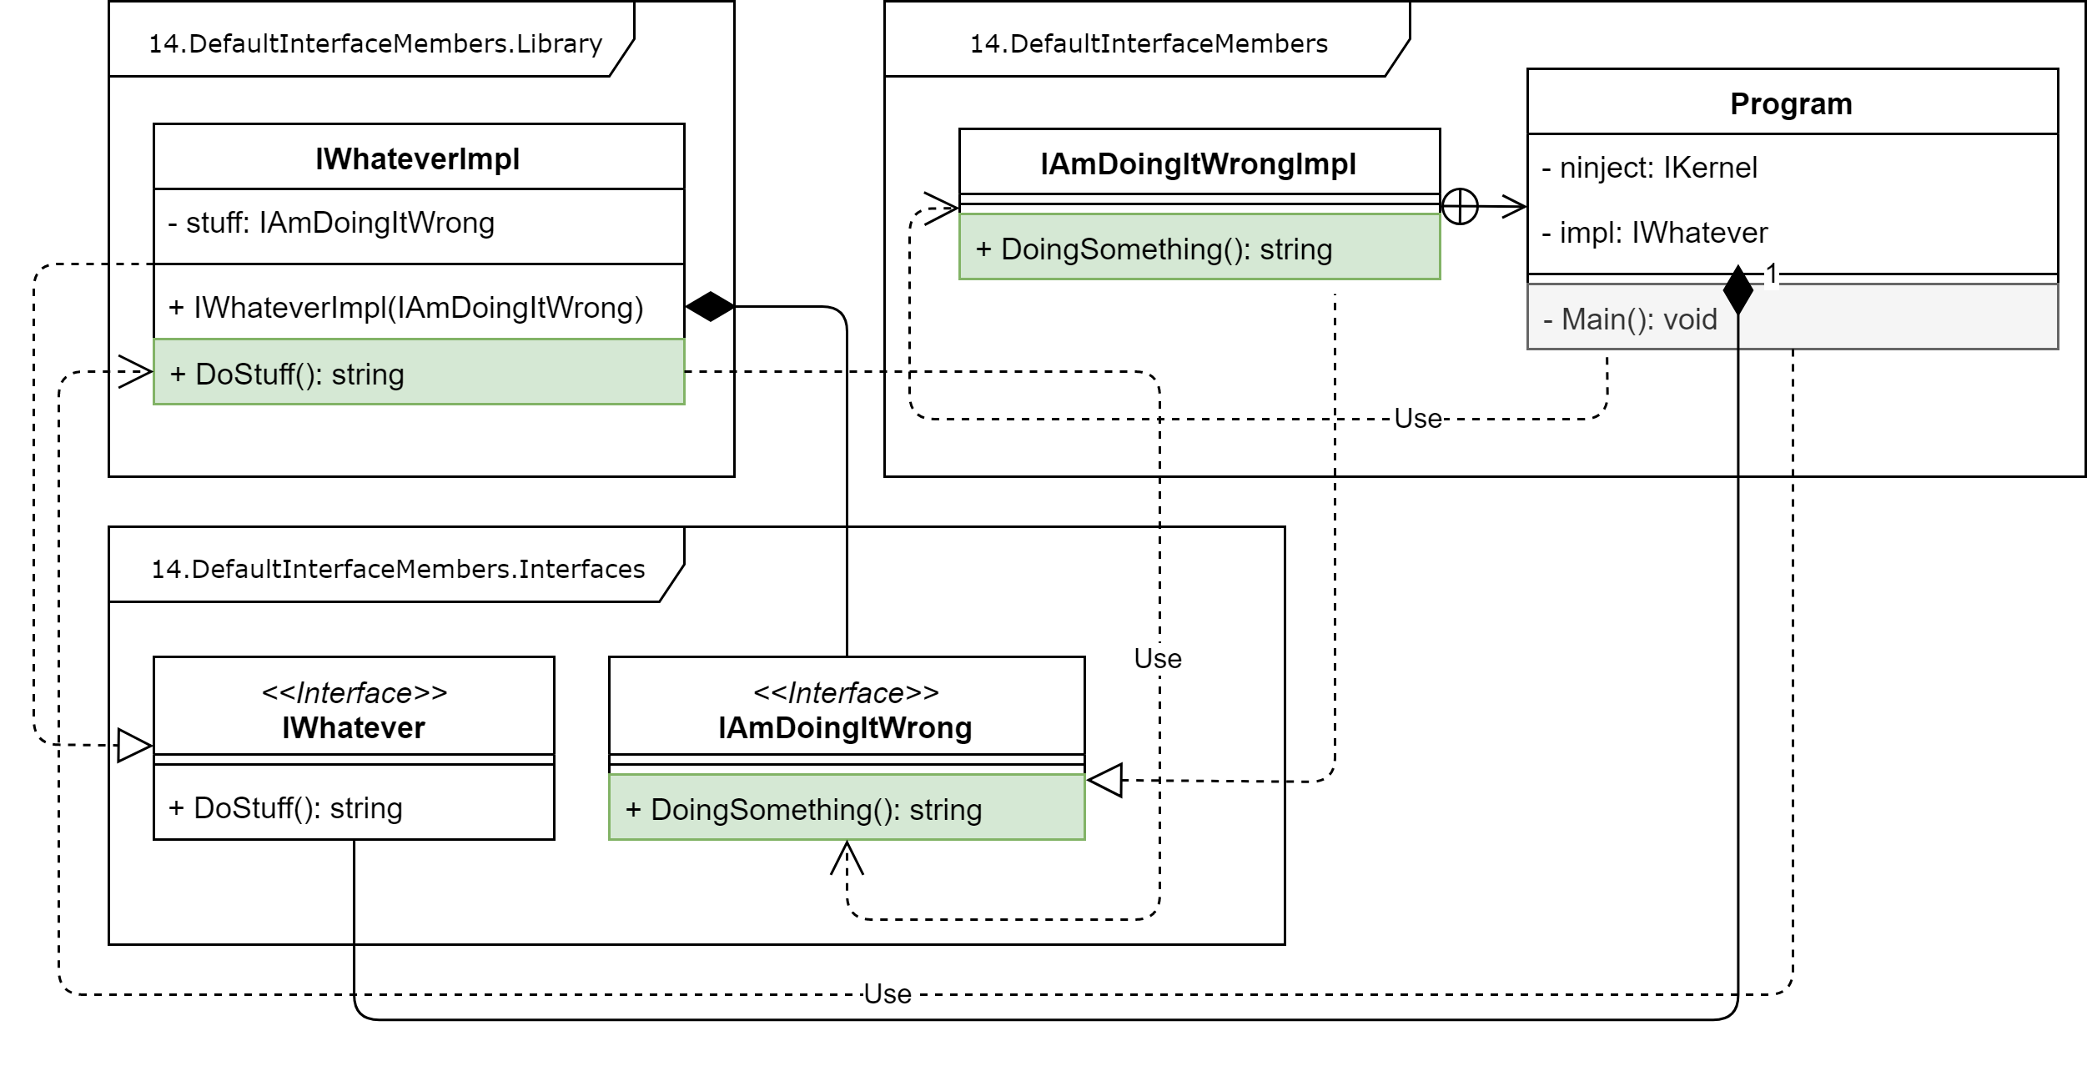
Default interface members
1
C# 7.3 Common interface

Slide 106
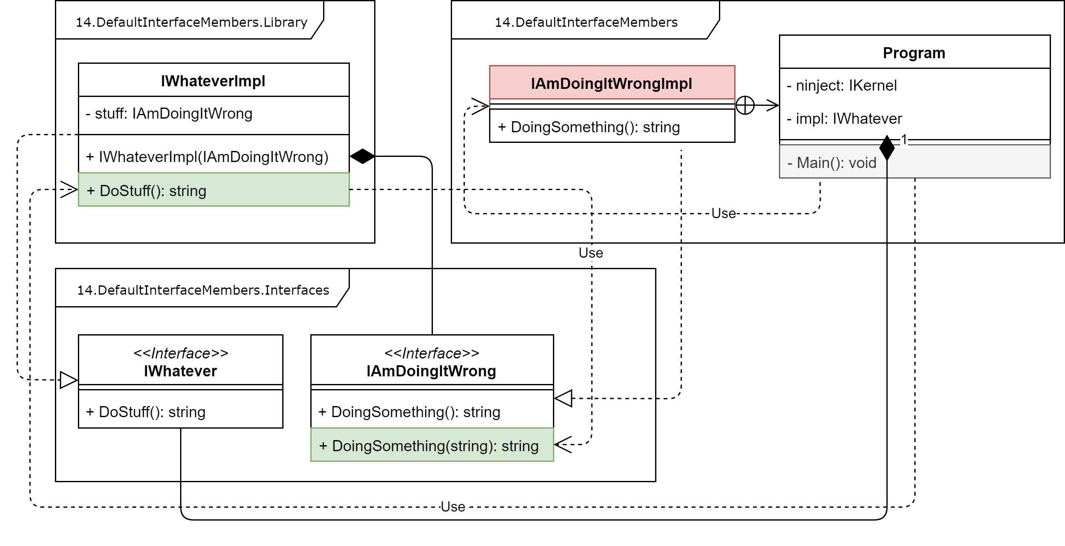
Default interface members
2
C# 7.3 Common interface

Slide 107
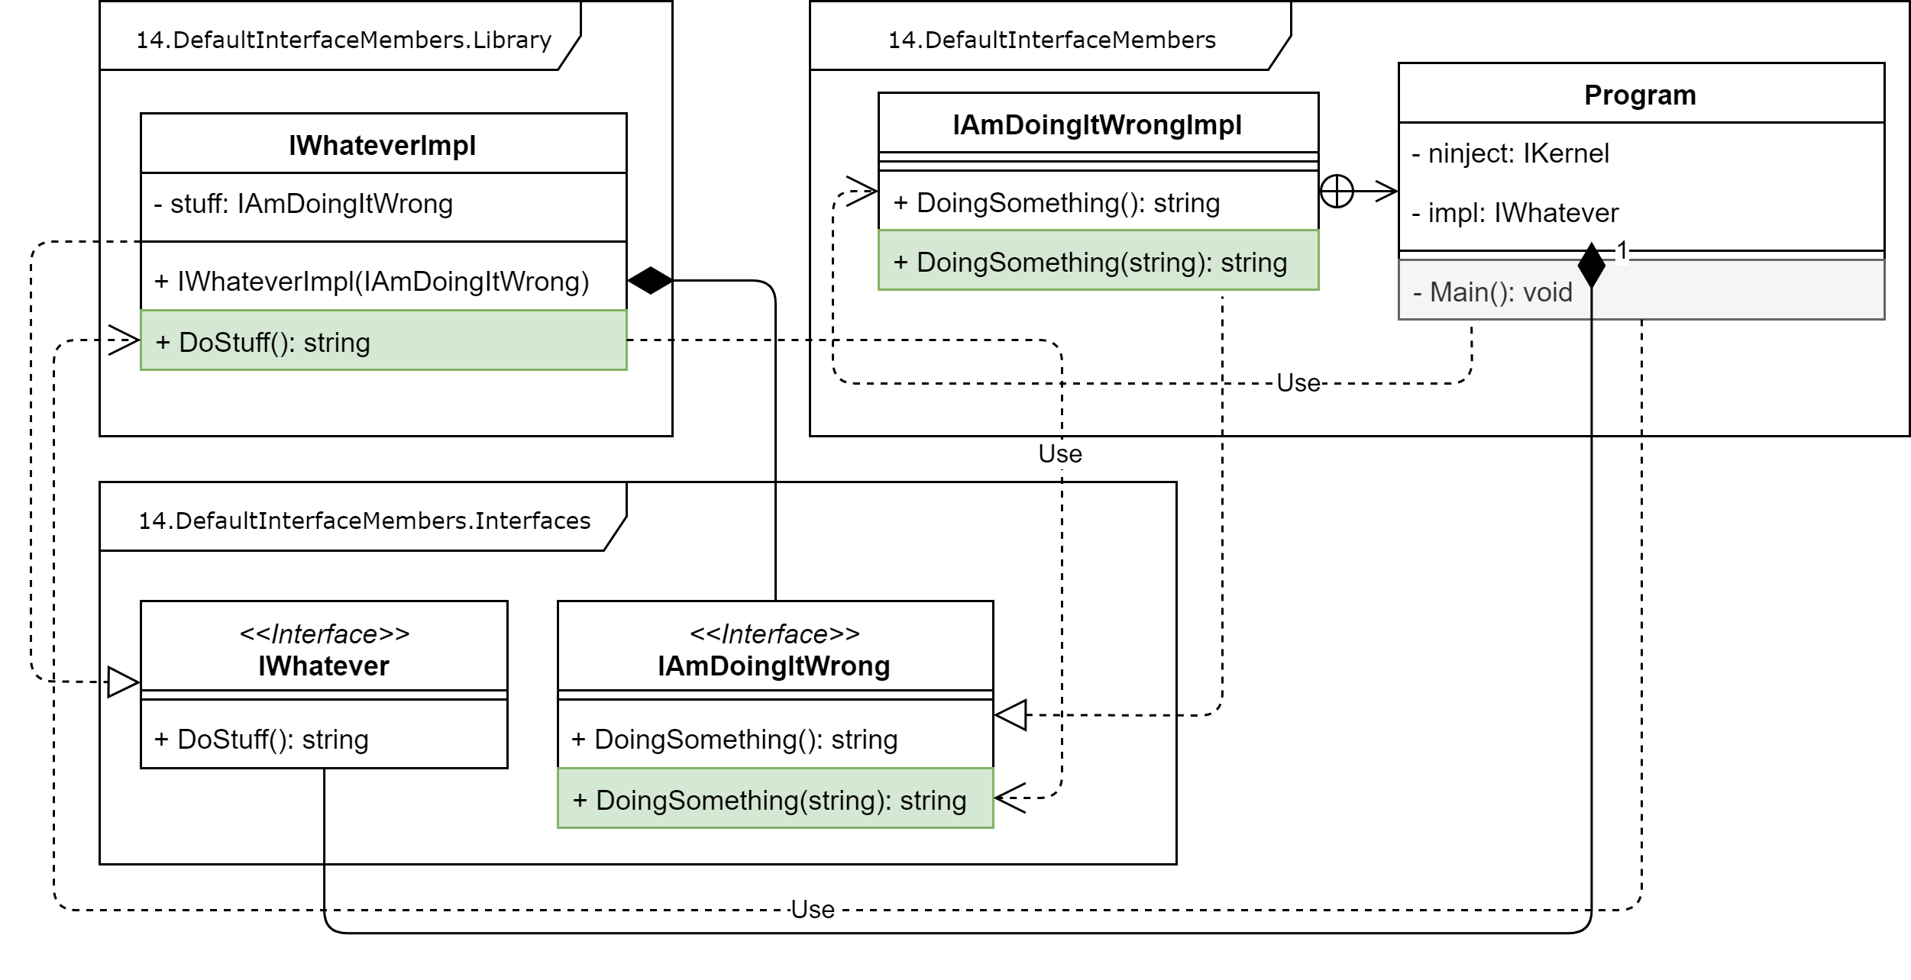
Default interface members
3
C# 7.3 Common interface

Slide 108
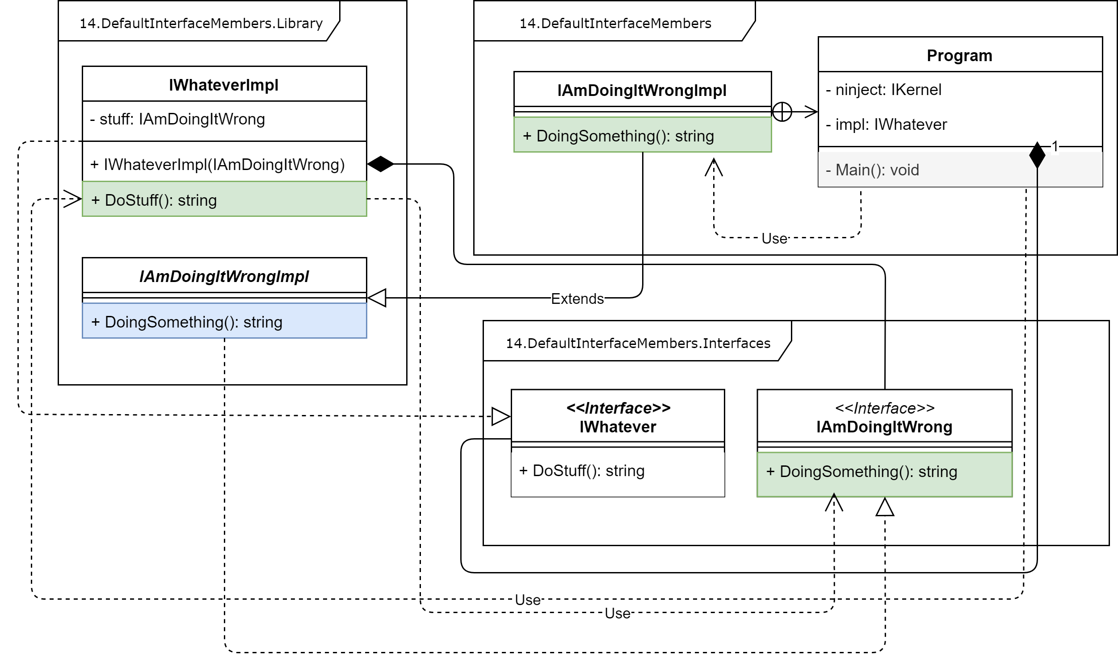
Default interface members
4
C# 7.3 Abstract classes

Slide 109
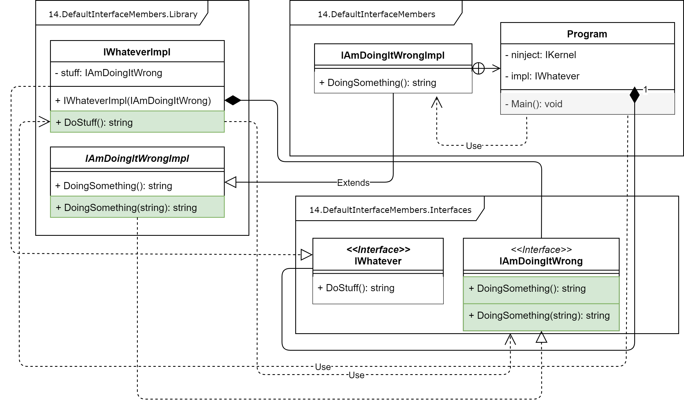
Default interface members
5
C# 7.3 Abstract classes

Slide 110
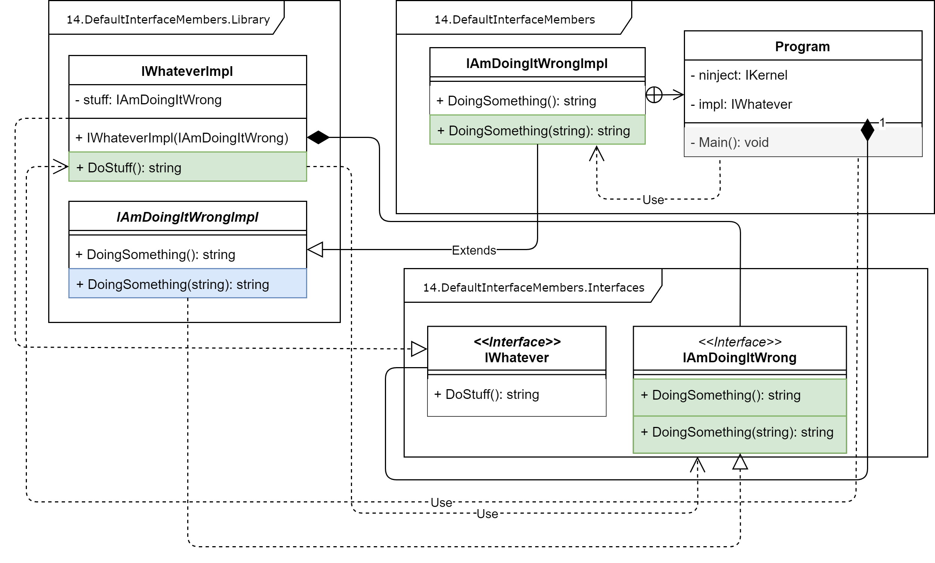
Default interface members
6
C# 7.3 Abstract classes

Slide 111
Default interface members
7
C# 7.3 Interface namespaces

Slide 112
Default interface members
8
C# 7.3 Interface namespaces

Slide 113
Default interface members
9
C# 7.3 Interface namespaces

Slide 114
Default interface members
10
C# 8.0

Slide 115
Agenda
We are going to talk about…
What’s new in C# 8.0
Nullable reference types,
async streams,
ranges and indices,
default interface members,
recursive patterns,
switch expressions,
target-typed new-expressions,
extension everything.
What’s new in C# 8.0
Nullable reference types,
async streams,
ranges and indices,
default interface members,
recursive patterns,

Slide 116
What’s new in C# 8.0
Recursive patterns

Slide 117
Recursive patterns
1
C# 7.3

Slide 118
Recursive patterns
2
C# 8.0

Slide 119
Agenda
We are going to talk about…
What’s new in C# 8.0
Nullable reference types,
async streams,
ranges and indices,
default interface members,
recursive patterns,
switch expressions,
target-typed new-expressions,
extension everything.
What’s new in C# 8.0
Nullable reference types,
async streams,
ranges and indices,
default interface members,
recursive patterns,
switch expressions,

Slide 120
What’s new in C# 8.0
Switch expressions

Slide 121
Switch expressions
1
C# 7.3

Slide 122
Switch expressions
2
C# 8.0

Slide 123
Agenda
We are going to talk about…
What’s new in C# 8.0
Nullable reference types,
async streams,
ranges and indices,
default interface members,
recursive patterns,
switch expressions,
target-typed new-expressions,
extension everything.
What’s new in C# 8.0
Nullable reference types,
async streams,
ranges and indices,
default interface members,
recursive patterns,
switch expressions,
target-typed new-expressions,

Slide 124
What’s new in C# 8.0
Target-typed new-expressions

Slide 125
Target-typed new-expressions
1
C# 7.3

Slide 126
Target-typed new-expressions
2
C# 8.0

Slide 127
Agenda
We are going to talk about…
What’s new in C# 8.0
Nullable reference types,
async streams,
ranges and indices,
default interface members,
recursive patterns,
switch expressions,
target-typed new-expressions,
extension everything.
What’s new in C# 8.0
Nullable reference types,
async streams,
ranges and indices,
default interface members,
recursive patterns,
switch expressions,
target-typed new-expressions,
extension everything.

Slide 128
What’s new in C# 8.0
Extension everything

Slide 129
Extension everything
1
C# 7.3

Slide 130
Extension everything
2
C# 8.0

Slide 133
Title (Work for 1 or 2 lines of title)
Header
Header
Header
Insert bullet point
Insert bullet point
Insert bullet point
Insert bullet point
Insert bullet point
Insert bullet point
Insert bullet point
Insert bullet point
Insert bullet point
Insert bullet point
Insert bullet point
Insert bullet point

Slide 134
Title (Work for 1 or 2 lines of title)
Insert name Insert Title/Role
Insert bullet point
Insert bullet point
Insert bullet point
Insert bullet point
Insert name Insert Title/Role
Insert bullet point
Insert bullet point
Insert bullet point
Insert bullet point
Insert name Insert Title/Role
Insert bullet point
Insert bullet point
Insert bullet point
Insert bullet point
Insert name Insert Title/Role
Insert bullet point
Insert bullet point
Insert bullet point
Insert bullet point

Slide 135
Title (Work for 1 or 2 lines of title)
1
2
3
4
5
6
7
8
9
10
11
12
Text sample
Text sample
Text sample
Text sample
Text sample
Text sample
Text sample
Text sample

Slide 136
Title (Work for 1 or 2 lines of title)
Insert Group Name
Click to insert bullet point
Click to insert bullet point
Click to insert bullet point
Insert Group Name
Click to insert bullet point
Click to insert bullet point
Click to insert bullet point
Insert Group Name
Click to insert bullet point
Click to insert bullet point
Click to insert bullet point
Group Name
Click to insert text
Click to insert text
Click to insert text
Click to insert text
Click to insert text

