Slide 1
Upgrade your .NET code! From C# 7.0 to C# 8.0 walkthrough
Wrocław, 10.03.2019, Tomasz Strzałka

Slide 2
Agenda
We are going to talk about…
Introduction
The recent C# versions timeline,
C# 8.0 pre-requirements,
dive into an example.
What’s new in C# 7.1
Async Main method,
default literal expressions,
inferred tuple element names.
What’s new in C# 7.2
Techniques for writing safe efficient code,
non-trailing named arguments,
leading underscores in numeric literals,
private protected access modifier,
conditional ref expressions.
Introduction
The recent C# versions timeline,
C# 8.0 pre-requirements,
dive into an example.
What’s new in C# 7.1
Async Main method,
default literal expressions,
inferred tuple element names.
What’s new in C# 7.2
Techniques for writing safe efficient code,
non-trailing named arguments,
leading underscores in numeric literals,
private protected access modifier,
conditional ref expressions.

Slide 3
Agenda
We are going to talk about…
What’s new in C# 7.3
Enabling more efficient safe code,
fixed fields without pinning access,
local ref variables reassignment,
array initializers with stackalloc,
extended fixed support for types,
enhanced generic constraints.
Make existing features better
equality comparator tuple support,
field attributes for auto-implemented properties,
in method overload,
extend expression variables in initializers.
What’s new in C# 7.3
Enabling more efficient safe code,
fixed fields without pinning access,
local ref variables reassignment,
array initializers with stackalloc,
extended fixed support for types,
enhanced generic constraints.
Make existing features better
equality comparator tuple support,
field attributes for auto-implemented properties,
in method overload,
extend expression variables in initializers.

Slide 4
Agenda
We are going to talk about…
What’s new in C# 8.0
Nullable reference types,
async streams,
ranges and indices,
default interface members,
recursive patterns,
switch expressions,
target-typed new-expressions,
extension everything.
What’s new in C# 8.0
Nullable reference types,
async streams,
ranges and indices,
default interface members,
recursive patterns,
switch expressions,
target-typed new-expressions,
extension everything.

Slide 5
Introduction
The recent C# versions timeline

Slide 6
Agenda
We are going to talk about…
Introduction
The recent C# versions timeline,
C# 8.0 pre-requirements,
Introduction
The recent C# versions timeline,
C# 8.0 pre-requirements,
dive into an example.

Slide 7




The recent C# versions timeline C# 8.0 pre-requirements
1
Overlook to the few past releases
 | C# 7.0 | C# 7.1 | C# 7.2 | C# 7.3 | C# 8.0
 | March, 2017 | August, 2017 | November, 2017 | May, 2018
 | .NET Framework 4.6.2 | .NET Framework 4.7 | .NET Framework 4.7.1 | .NET Framework 4.7.2 | .NET Framework 4.8
 | .NET Core 2.0 | .NET Core 2.0 | .NET Core 2.0 | .NET Core 2.1 | .NET Core 3.0
 | .NET Standard 2.0 | .NET Standard 2.0 | .NET Standard 2.0 | .NET Standard 2.0 | .NET Standard 2.0/ .NET Standard 2.1
 | Visual Studio 2017 | Visual Studio 2017 v15.3 | Visual Studio 2017 v15.5 | Visual Studio 2017 v15.7 | Visual Studio 2019
Notes:
https://docs.microsoft.com/pl-pl/dotnet/csharp/whats-new/csharp-version-history https://en.wikipedia.org/wiki/C_Sharp_(programming_language)

Slide 8
Agenda
We are going to talk about…
Introduction
The recent C# versions timeline,
C# 8.0 pre-requirements,
dive into an example.
Introduction
The recent C# versions timeline,
C# 8.0 pre-requirements,
dive into an example.

Slide 9
Dive into an example
2
How things will goanna to work here
Pre-requirement software
Microsoft Visual Studio Enterprise 2019 Preview Version 16.0.0 Preview 2.2,
Microsoft .NET Core SDK 3.0.100.010184.
Visual Studio solution structure
00.Example,
#region C#7.0 Example,
#region C#7.1 Example,
#define _02_CSharp71_EXAMPLE_Question
…
…
01.AsyncMain,
…
Pre-requirement software
Microsoft Visual Studio Enterprise 2019 Preview Version 16.0.0 Preview 2.2,
Microsoft .NET Core SDK 3.0.100.010184.
Visual Studio solution structure
00.Example,
#region C#7.0 Example,
#region C#7.1 Example,
#define _02_CSharp71_EXAMPLE_Question
…
…
01.AsyncMain,
…

Slide 10
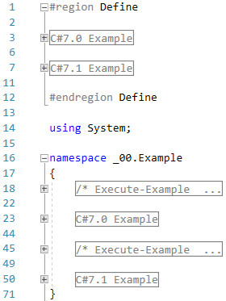
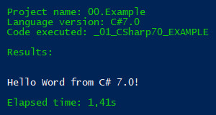
Example
3
C# 7.0 Hello Word

Slide 11
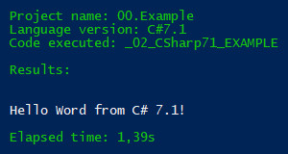
Example
4
C# 7.1 Hello Word

Slide 12
What’s new in C# 7.1

Slide 13
Agenda
We are going to talk about…
Introduction
The recent C# versions timeline,
C# 8.0 pre-requirements,
dive into an example.
What’s new in C# 7.1
Async Main method,
Introduction
The recent C# versions timeline,
C# 8.0 pre-requirements,
dive into an example.
What’s new in C# 7.1
Async Main method,
default literal expressions,
inferred tuple element names.
What’s new in C# 7.2
Techniques for writing safe efficient code,
non-trailing named arguments,
leading underscores in numeric literals,
private protected access modifier,
conditional ref expressions.

Slide 14
What’s new in C# 7.1
Async Main method

Slide 15
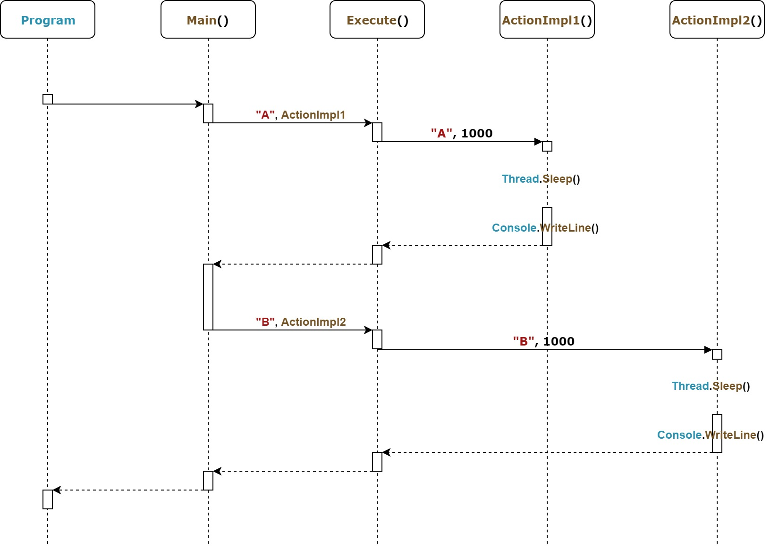
Async Main method
1
C# 7.0, totally synchronous, old fashioned way

Slide 16
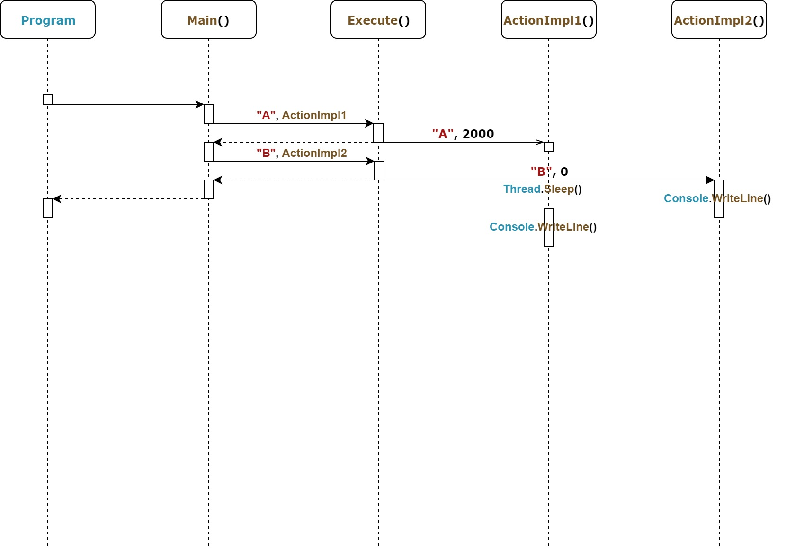
Async Main method
2
C# 7.0, asynchronous, Tasks

Slide 17
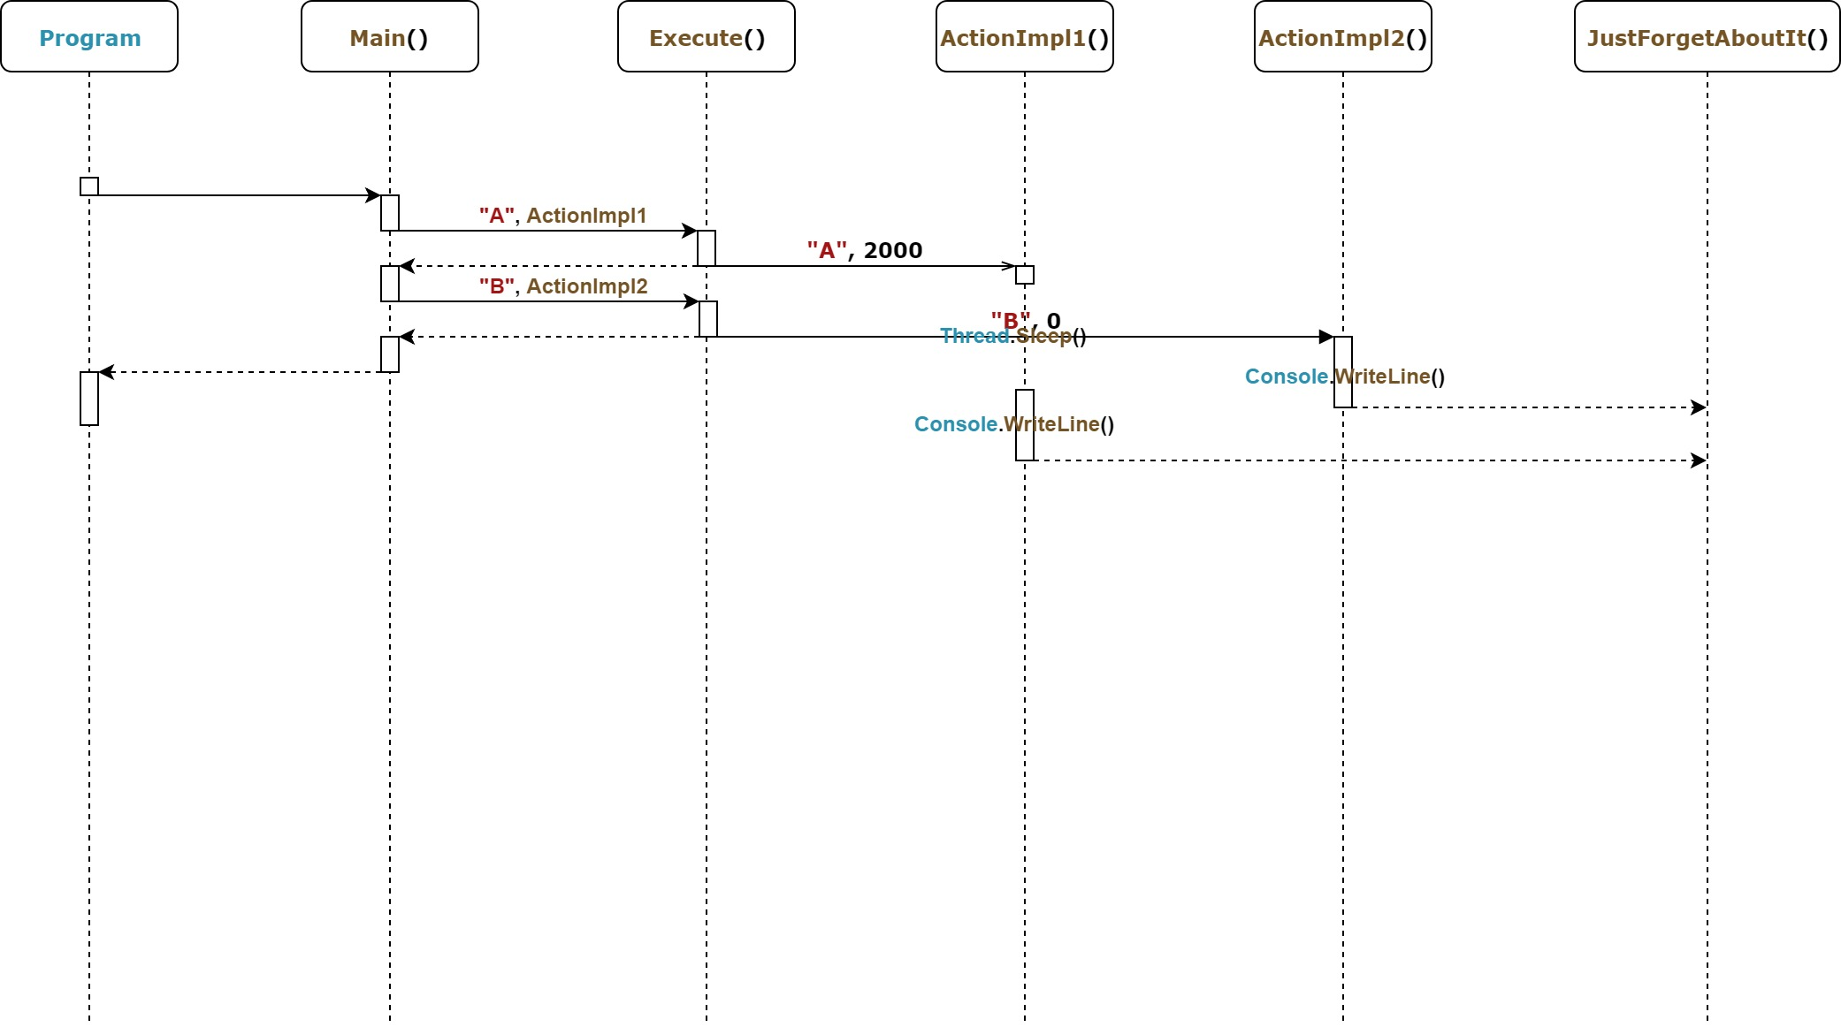
Async Main method
3
C# 7.0, async

Slide 18
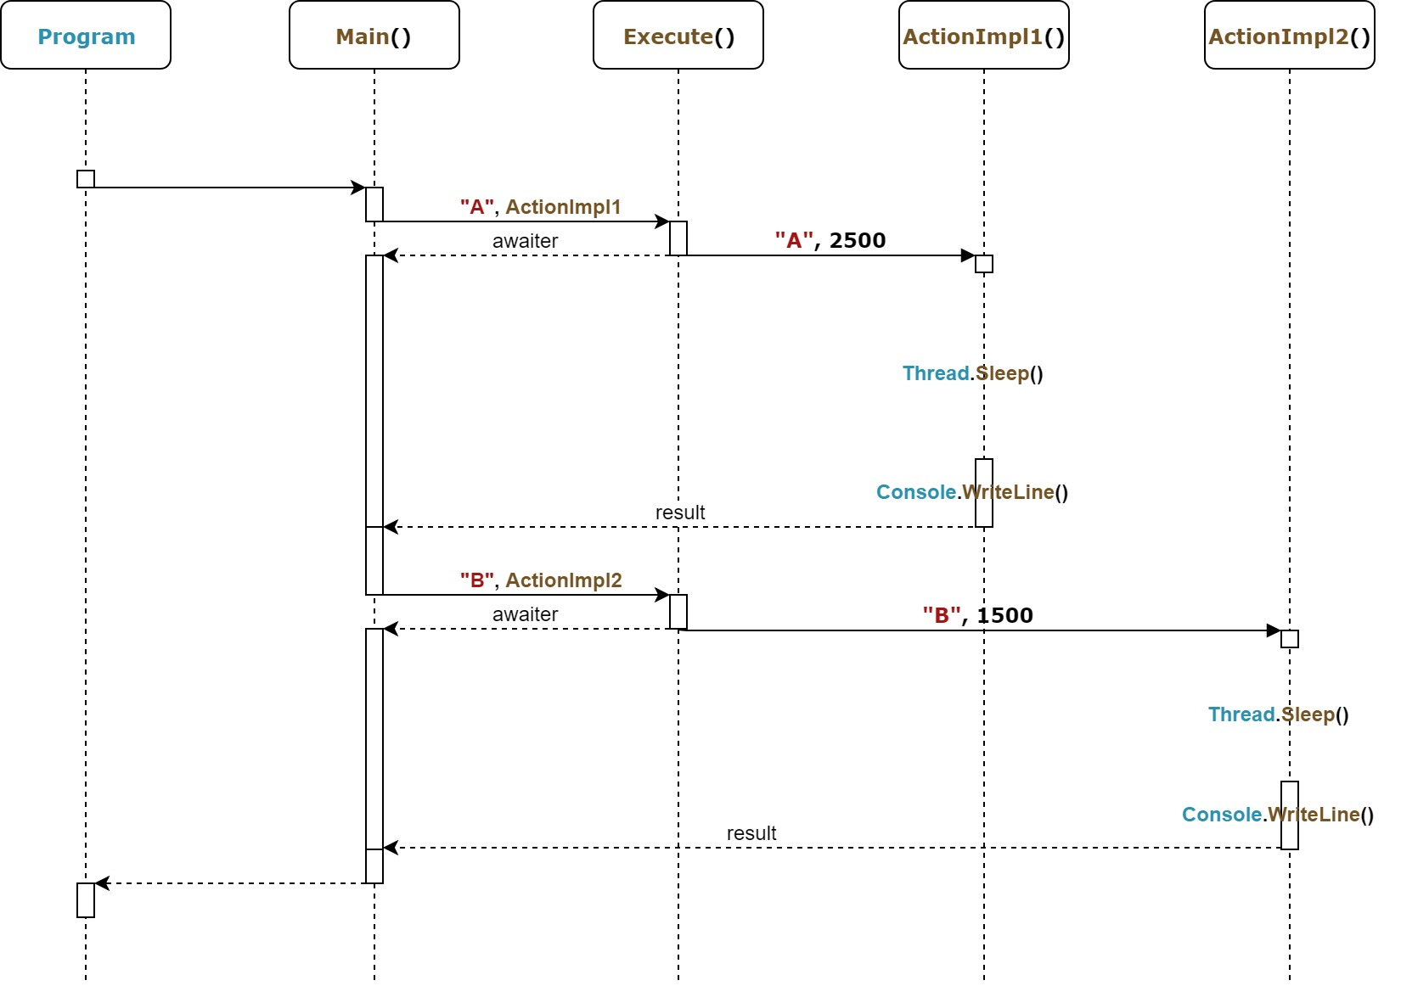
Async Main method
4
C# 7.0, async, awaiter

Slide 19
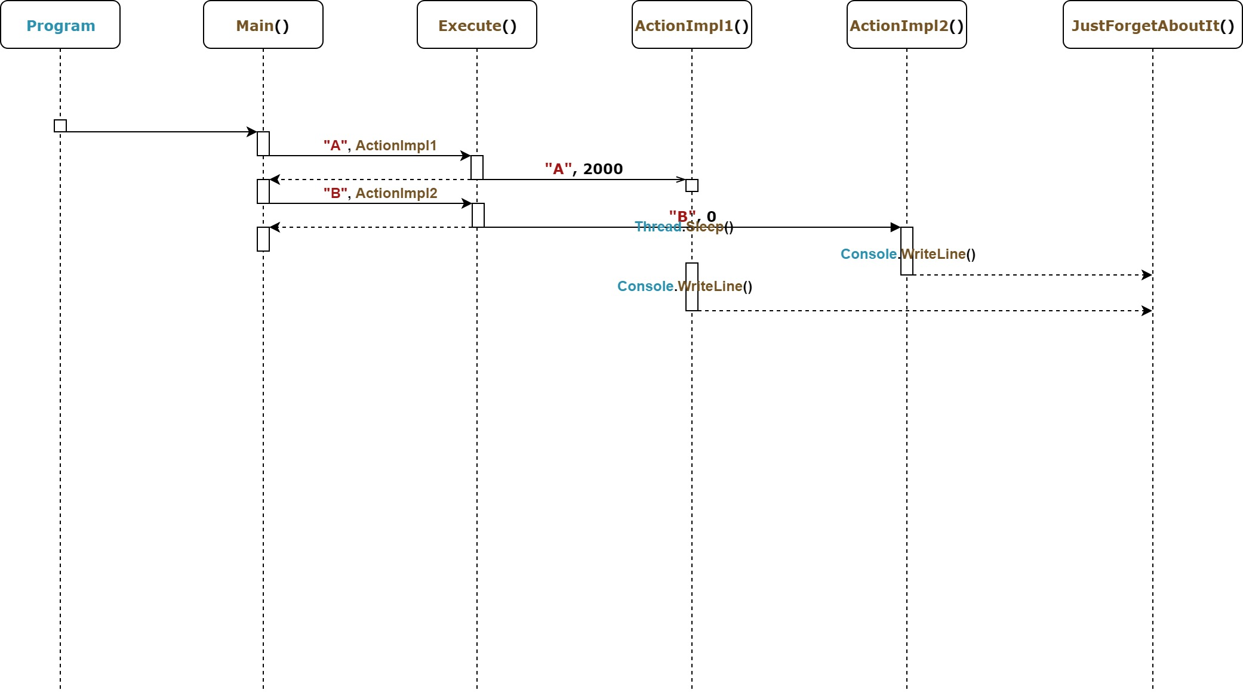
Async Main method
5
C# 7.1, async

Slide 20
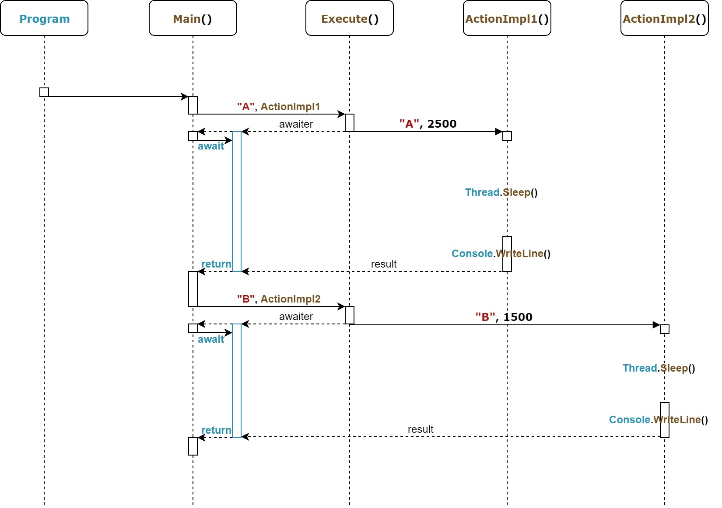
Async Main method
6
C# 7.1, async-await

Slide 21
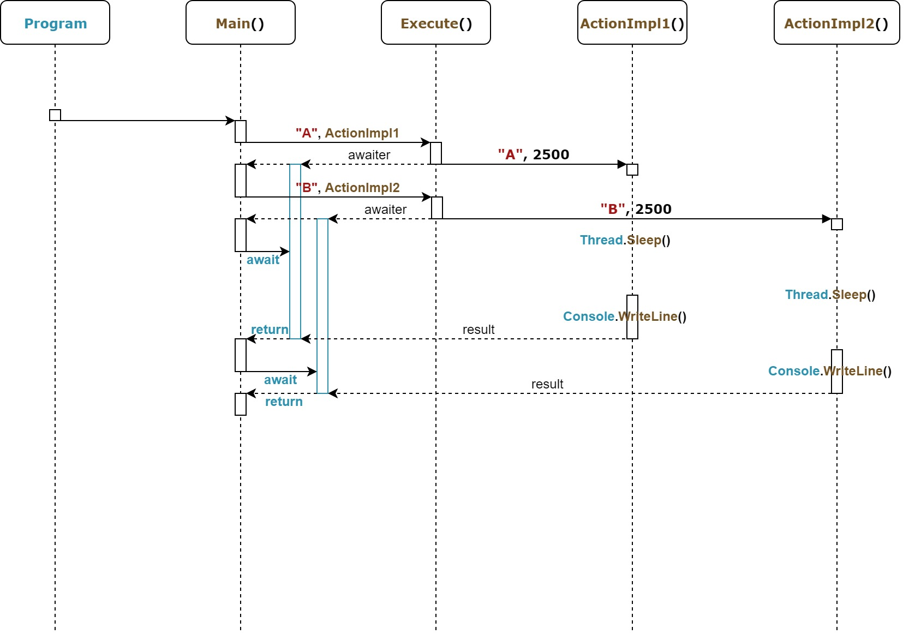
Async Main method
7
C# 7.1, async, await

Slide 22
Agenda
We are going to talk about…
Introduction
The recent C# versions timeline,
C# 8.0 pre-requirements,
dive into an example.
What’s new in C# 7.1
Async Main method,
default literal expressions,
Introduction
The recent C# versions timeline,
C# 8.0 pre-requirements,
dive into an example.
What’s new in C# 7.1
Async Main method,
default literal expressions,
inferred tuple element names.
What’s new in C# 7.2
Techniques for writing safe efficient code,
non-trailing named arguments,
leading underscores in numeric literals,
private protected access modifier,
conditional ref expressions.

Slide 23
What’s new in C# 7.1
Default literal expressions

Slide 24
Default literal expressions
1
C# 7.0

Slide 25
Default literal expressions
2
C# 7.1

Slide 26
Agenda
We are going to talk about…
Introduction
The recent C# versions timeline,
C# 8.0 pre-requirements,
dive into an example.
What’s new in C# 7.1
Async Main method,
default literal expressions,
inferred tuple element names.
Introduction
The recent C# versions timeline,
C# 8.0 pre-requirements,
dive into an example.
What’s new in C# 7.1
Async Main method,
default literal expressions,
inferred tuple element names.
What’s new in C# 7.2
Techniques for writing safe efficient code,
non-trailing named arguments,
leading underscores in numeric literals,
private protected access modifier,
conditional ref expressions.

Slide 27
What’s new in C# 7.1
Inferred tuple element names

Slide 28
Inferred tuple element names
1
C# 7.0

Slide 29
Inferred tuple element names
2
C# 7.1

Slide 30
What’s new in C# 7.2

Slide 31
Agenda
We are going to talk about…
Introduction
The recent C# versions timeline,
C# 8.0 pre-requirements,
dive into an example.
What’s new in C# 7.1
Async Main method,
default literal expressions,
inferred tuple element names.
What’s new in C# 7.2
Techniques for writing safe efficient code,
Introduction
The recent C# versions timeline,
C# 8.0 pre-requirements,
dive into an example.
What’s new in C# 7.1
Async Main method,
default literal expressions,
inferred tuple element names.
What’s new in C# 7.2
Techniques for writing safe efficient code,
non-trailing named arguments,
leading underscores in numeric literals,
private protected access modifier,
conditional ref expressions.

Slide 32
What’s new in C# 7.2
Writing safe efficient code

Slide 33
Writing safe efficient code
1
C# 7.1

Slide 34
Writing safe efficient code
2
C# 7.2

Slide 35
Agenda
We are going to talk about…
Introduction
The recent C# versions timeline,
C# 8.0 pre-requirements,
dive into an example.
What’s new in C# 7.1
Async Main method,
default literal expressions,
inferred tuple element names.
What’s new in C# 7.2
Techniques for writing safe efficient code,
non-trailing named arguments,
Introduction
The recent C# versions timeline,
C# 8.0 pre-requirements,
dive into an example.
What’s new in C# 7.1
Async Main method,
default literal expressions,
inferred tuple element names.
What’s new in C# 7.2
Techniques for writing safe efficient code,
non-trailing named arguments,
leading underscores in numeric literals,
private protected access modifier,
conditional ref expressions.

Slide 36
What’s new in C# 7.2
Non-trailing named arguments

Slide 37
Non-trailing named arguments
1
C# 7.1

Slide 38
Non-trailing named arguments
2
C# 7.2

Slide 39
Agenda
We are going to talk about…
Introduction
The recent C# versions timeline,
C# 8.0 pre-requirements,
dive into an example.
What’s new in C# 7.1
Async Main method,
default literal expressions,
inferred tuple element names.
What’s new in C# 7.2
Techniques for writing safe efficient code,
non-trailing named arguments,
leading underscores in numeric literals,
Introduction
The recent C# versions timeline,
C# 8.0 pre-requirements,
dive into an example.
What’s new in C# 7.1
Async Main method,
default literal expressions,
inferred tuple element names.
What’s new in C# 7.2
Techniques for writing safe efficient code,
non-trailing named arguments,
leading underscores in numeric literals,
private protected access modifier,
conditional ref expressions.

Slide 40
What’s new in C# 7.2
Leading underscores in numeric literals

Slide 41
Leading underscores in numeric literals
1
C# 7.1

Slide 42
Leading underscores in numeric literals
2
C# 7.2

Slide 43
Agenda
We are going to talk about…
Introduction
The recent C# versions timeline,
C# 8.0 pre-requirements,
dive into an example.
What’s new in C# 7.1
Async Main method,
default literal expressions,
inferred tuple element names.
What’s new in C# 7.2
Techniques for writing safe efficient code,
non-trailing named arguments,
leading underscores in numeric literals,
private protected access modifier,
Introduction
The recent C# versions timeline,
C# 8.0 pre-requirements,
dive into an example.
What’s new in C# 7.1
Async Main method,
default literal expressions,
inferred tuple element names.
What’s new in C# 7.2
Techniques for writing safe efficient code,
non-trailing named arguments,
leading underscores in numeric literals,
private protected access modifier,
conditional ref expressions.

Slide 44
What’s new in C# 7.2
Private protected access modifier

Slide 45
Private protected access modifier
1
C# 7.1

Slide 46
Private protected access modifier
2
C# 7.2

Slide 47
Agenda
We are going to talk about…
Introduction
The recent C# versions timeline,
C# 8.0 pre-requirements,
dive into an example.
What’s new in C# 7.1
Async Main method,
default literal expressions,
inferred tuple element names.
What’s new in C# 7.2
Techniques for writing safe efficient code,
non-trailing named arguments,
leading underscores in numeric literals,
private protected access modifier,
conditional ref expressions.
Introduction
The recent C# versions timeline,
C# 8.0 pre-requirements,
dive into an example.
What’s new in C# 7.1
Async Main method,
default literal expressions,
inferred tuple element names.
What’s new in C# 7.2
Techniques for writing safe efficient code,
non-trailing named arguments,
leading underscores in numeric literals,
private protected access modifier,
conditional ref expressions.

Slide 48
What’s new in C# 7.2
Conditional ref expressions

Slide 49
Conditional ref expressions
1
C# 7.1

Slide 50
Conditional ref expressions
2
C# 7.2

Slide 51
What’s new in C# 7.3

Slide 52
Agenda
We are going to talk about…
What’s new in C# 7.3
Enabling more efficient safe code,
fixed fields without pinning access,
local ref variables reassignment,
array initializers with stackalloc,
extended fixed support for types,
enhanced generic constraints.
Make existing features better
equality comparator tuple support,
field attributes for auto-implemented properties,
in method overload,
extend expression variables in initializers.
What’s new in C# 7.3
Enabling more efficient safe code,
fixed fields without pinning access,

Slide 53
What’s new in C# 7.3 Fixed fields without pinning access

Slide 54
Fixed fields without pinning access
1
C# 7.2

Slide 55
Fixed fields without pinning access
2
C# 7.3

Slide 56
Agenda
We are going to talk about…
What’s new in C# 7.3
Enabling more efficient safe code,
fixed fields without pinning access,
local ref variables reassignment,
array initializers with stackalloc,
extended fixed support for types,
enhanced generic constraints.
Make existing features better
equality comparator tuple support,
field attributes for auto-implemented properties,
in method overload,
extend expression variables in initializers.
What’s new in C# 7.3
Enabling more efficient safe code,
fixed fields without pinning access,
local ref variables reassignment,

Slide 57
What’s new in C# 7.3 Local ref variables reassignment

Slide 58
Local ref variables reassignment
1
C# 7.2

Slide 59
Local ref variables reassignment
2
C# 7.3

Slide 60
Agenda
We are going to talk about…
What’s new in C# 7.3
Enabling more efficient safe code,
fixed fields without pinning access,
local ref variables reassignment,
array initializers with stackalloc,
extended fixed support for types,
enhanced generic constraints.
Make existing features better
equality comparator tuple support,
field attributes for auto-implemented properties,
in method overload,
extend expression variables in initializers.
What’s new in C# 7.3
Enabling more efficient safe code,
fixed fields without pinning access,
local ref variables reassignment,
array initializers with stackalloc,

Slide 61
What’s new in C# 7.3 Array initializers with stackalloc

Slide 62
Array initializers with stackalloc
1
C# 7.2

Slide 63
Array initializers with stackalloc
2
C# 7.3

Slide 64
Agenda
We are going to talk about…
What’s new in C# 7.3
Enabling more efficient safe code,
fixed fields without pinning access,
local ref variables reassignment,
array initializers with stackalloc,
extended fixed support for types,
enhanced generic constraints.
Make existing features better
equality comparator tuple support,
field attributes for auto-implemented properties,
in method overload,
extend expression variables in initializers.
What’s new in C# 7.3
Enabling more efficient safe code,
fixed fields without pinning access,
local ref variables reassignment,
array initializers with stackalloc,
extended fixed support for types,

Slide 65
What’s new in C# 7.3 Extended fixed support for types

Slide 66
Extended fixed support for types
1
C# 7.2

Slide 67
Extended fixed support for types
2
C# 7.3

Slide 68
Agenda
We are going to talk about…
What’s new in C# 7.3
Enabling more efficient safe code,
fixed fields without pinning access,
local ref variables reassignment,
array initializers with stackalloc,
extended fixed support for types,
enhanced generic constraints.
Make existing features better
equality comparator tuple support,
field attributes for auto-implemented properties,
in method overload,
extend expression variables in initializers.
What’s new in C# 7.3
Enabling more efficient safe code,
fixed fields without pinning access,
local ref variables reassignment,
array initializers with stackalloc,
extended fixed support for types,
enhanced generic constraints.

Slide 69
What’s new in C# 7.3 Enhanced generic constraints

Slide 70
Enhanced generic constraints
1
C# 7.2

Slide 71
Enhanced generic constraints
2
C# 7.3

Slide 72
Agenda
We are going to talk about…
What’s new in C# 7.3
Enabling more efficient safe code,
fixed fields without pinning access,
local ref variables reassignment,
array initializers with stackalloc,
extended fixed support for types,
enhanced generic constraints.
Make existing features better
equality comparator tuple support,
field attributes for auto-implemented properties,
in method overload,
extend expression variables in initializers.
What’s new in C# 7.3
Enabling more efficient safe code,
fixed fields without pinning access,
local ref variables reassignment,
array initializers with stackalloc,
extended fixed support for types,
enhanced generic constraints.
Make existing features better
equality comparator tuple support,

Slide 73
What’s new in C# 7.3 Equality comparator tuple support

Slide 74
Equality comparator tuple support
1
C# 7.2

Slide 75
Equality comparator tuple support
2
C# 7.3

Slide 76
Agenda
We are going to talk about…
What’s new in C# 7.3
Enabling more efficient safe code,
fixed fields without pinning access,
local ref variables reassignment,
array initializers with stackalloc,
extended fixed support for types,
enhanced generic constraints.
Make existing features better
equality comparator tuple support,
field attributes for auto-implemented properties,
in method overload,
extend expression variables in initializers.
What’s new in C# 7.3
Enabling more efficient safe code,
fixed fields without pinning access,
local ref variables reassignment,
array initializers with stackalloc,
extended fixed support for types,
enhanced generic constraints.
Make existing features better
equality comparator tuple support,
field attributes for auto-implemented properties,

Slide 77
What’s new in C# 7.3 Field attributes for auto-implemented properties

Slide 78
Field attributes for auto-implemented properties
1
C# 7.2

Slide 79
Field attributes for auto-implemented properties
2
C# 7.3

Slide 80
Agenda
We are going to talk about…
What’s new in C# 7.3
Enabling more efficient safe code,
fixed fields without pinning access,
local ref variables reassignment,
array initializers with stackalloc,
extended fixed support for types,
enhanced generic constraints.
Make existing features better
equality comparator tuple support,
field attributes for auto-implemented properties,
in method overload,
extend expression variables in initializers.
What’s new in C# 7.3
Enabling more efficient safe code,
fixed fields without pinning access,
local ref variables reassignment,
array initializers with stackalloc,
extended fixed support for types,
enhanced generic constraints.
Make existing features better
equality comparator tuple support,
field attributes for auto-implemented properties,
in method overload,

Slide 81
What’s new in C# 7.3 In method overload

Slide 82
In method overload
1
C# 7.2

Slide 83
In method overload
2
C# 7.3

Slide 84
Agenda
We are going to talk about…
What’s new in C# 7.3
Enabling more efficient safe code,
fixed fields without pinning access,
local ref variables reassignment,
array initializers with stackalloc,
extended fixed support for types,
enhanced generic constraints.
Make existing features better
equality comparator tuple support,
field attributes for auto-implemented properties,
in method overload,
extend expression variables in initializers.
What’s new in C# 7.3
Enabling more efficient safe code,
fixed fields without pinning access,
local ref variables reassignment,
array initializers with stackalloc,
extended fixed support for types,
enhanced generic constraints.
Make existing features better
equality comparator tuple support,
field attributes for auto-implemented properties,
in method overload,
extend expression variables in initializers.

Slide 85
What’s new in C# 7.3 Extend expression variables in initializers

Slide 86
Extend expression variables in initializers
1
C# 7.2

Slide 87
Extend expression variables in initializers
2
C# 7.3

Slide 88
What’s new in C# 8.0

Slide 89
Agenda
We are going to talk about…
What’s new in C# 8.0
Nullable reference types,
async streams,
ranges and indices,
default interface members,
recursive patterns,
switch expressions,
target-typed new-expressions,
extension everything.
What’s new in C# 8.0
Nullable reference types,

Slide 90
What’s new in C# 8.0
Nullable reference types

Slide 91
Nullable reference types
1
C# 7.3

Slide 92
Nullable reference types
2
C# 8.0

Slide 93
Agenda
We are going to talk about…
What’s new in C# 8.0
Nullable reference types,
async streams,
ranges and indices,
default interface members,
recursive patterns,
switch expressions,
target-typed new-expressions,
extension everything.
What’s new in C# 8.0
Nullable reference types,
async streams,

Slide 94
What’s new in C# 8.0
Async streams

Slide 95
Async streams
1
C# 7.3

Slide 96
Async streams
2
C# 8.0

Slide 97
Agenda
We are going to talk about…
What’s new in C# 8.0
Nullable reference types,
async streams,
ranges and indices,
default interface members,
recursive patterns,
switch expressions,
target-typed new-expressions,
extension everything.
What’s new in C# 8.0
Nullable reference types,
async streams,
ranges and indices,

Slide 98
What’s new in C# 8.0
Ranges and indices

Slide 99
Ranges and indices
1
C# 7.3

Slide 100
Ranges and indices
2
C# 8.0

Slide 101
Agenda
We are going to talk about…
What’s new in C# 8.0
Nullable reference types,
async streams,
ranges and indices,
default interface members,
recursive patterns,
switch expressions,
target-typed new-expressions,
extension everything.
What’s new in C# 8.0
Nullable reference types,
async streams,
ranges and indices,
default interface members,

Slide 102
What’s new in C# 8.0
Default interface members

Slide 103
Default interface members
1
C# 7.3

Slide 104
Default interface members
2
C# 8.0

Slide 105
Agenda
We are going to talk about…
What’s new in C# 8.0
Nullable reference types,
async streams,
ranges and indices,
default interface members,
recursive patterns,
switch expressions,
target-typed new-expressions,
extension everything.
What’s new in C# 8.0
Nullable reference types,
async streams,
ranges and indices,
default interface members,
recursive patterns,

Slide 106
What’s new in C# 8.0
Recursive patterns

Slide 107
Recursive patterns
1
C# 7.3

Slide 108
Recursive patterns
2
C# 8.0

Slide 109
Agenda
We are going to talk about…
What’s new in C# 8.0
Nullable reference types,
async streams,
ranges and indices,
default interface members,
recursive patterns,
switch expressions,
target-typed new-expressions,
extension everything.
What’s new in C# 8.0
Nullable reference types,
async streams,
ranges and indices,
default interface members,
recursive patterns,
switch expressions,

Slide 110
What’s new in C# 8.0
Switch expressions

Slide 111
Switch expressions
1
C# 7.3

Slide 112
Switch expressions
2
C# 8.0

Slide 113
Agenda
We are going to talk about…
What’s new in C# 8.0
Nullable reference types,
async streams,
ranges and indices,
default interface members,
recursive patterns,
switch expressions,
target-typed new-expressions,
extension everything.
What’s new in C# 8.0
Nullable reference types,
async streams,
ranges and indices,
default interface members,
recursive patterns,
switch expressions,
target-typed new-expressions,

Slide 114
What’s new in C# 8.0
Target-typed new-expressions

Slide 115
Target-typed new-expressions
1
C# 7.3

Slide 116
Target-typed new-expressions
2
C# 8.0

Slide 117
Agenda
We are going to talk about…
What’s new in C# 8.0
Nullable reference types,
async streams,
ranges and indices,
default interface members,
recursive patterns,
switch expressions,
target-typed new-expressions,
extension everything.
What’s new in C# 8.0
Nullable reference types,
async streams,
ranges and indices,
default interface members,
recursive patterns,
switch expressions,
target-typed new-expressions,
extension everything.

Slide 118
What’s new in C# 8.0
Extension everything

Slide 119
Extension everything
1
C# 7.3

Slide 120
Extension everything
2
C# 8.0

Slide 123
Title (Work for 1 or 2 lines of title)
Header
Header
Header
Insert bullet point
Insert bullet point
Insert bullet point
Insert bullet point
Insert bullet point
Insert bullet point
Insert bullet point
Insert bullet point
Insert bullet point
Insert bullet point
Insert bullet point
Insert bullet point

Slide 124
Title (Work for 1 or 2 lines of title)
Insert name Insert Title/Role
Insert bullet point
Insert bullet point
Insert bullet point
Insert bullet point
Insert name Insert Title/Role
Insert bullet point
Insert bullet point
Insert bullet point
Insert bullet point
Insert name Insert Title/Role
Insert bullet point
Insert bullet point
Insert bullet point
Insert bullet point
Insert name Insert Title/Role
Insert bullet point
Insert bullet point
Insert bullet point
Insert bullet point

Slide 125
Title (Work for 1 or 2 lines of title)
1
2
3
4
5
6
7
8
9
10
11
12
Text sample
Text sample
Text sample
Text sample
Text sample
Text sample
Text sample
Text sample

Slide 126
Title (Work for 1 or 2 lines of title)
Insert Group Name
Click to insert bullet point
Click to insert bullet point
Click to insert bullet point
Insert Group Name
Click to insert bullet point
Click to insert bullet point
Click to insert bullet point
Insert Group Name
Click to insert bullet point
Click to insert bullet point
Click to insert bullet point
Group Name
Click to insert text
Click to insert text
Click to insert text
Click to insert text
Click to insert text

