Slide 1
Introduction to Blazor – part 1
Wrocław, 04.12.2020, Tomasz Strzałka

Slide 2
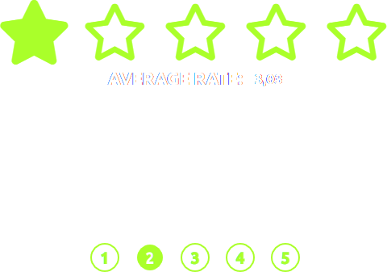

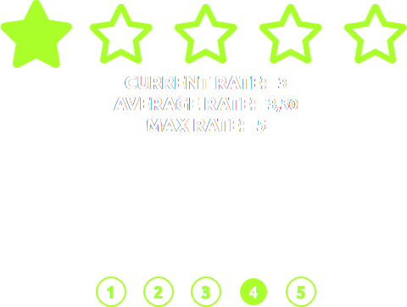
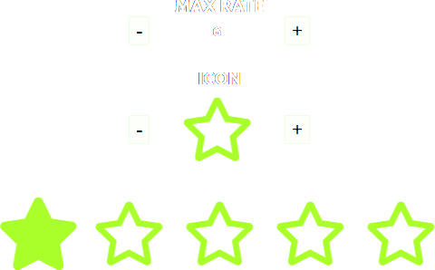

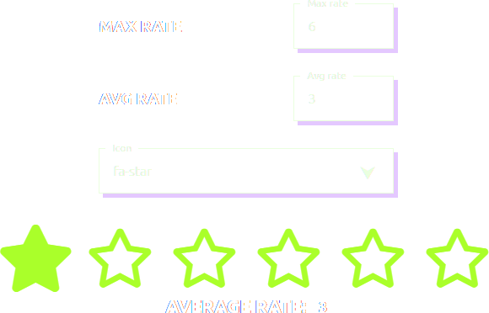
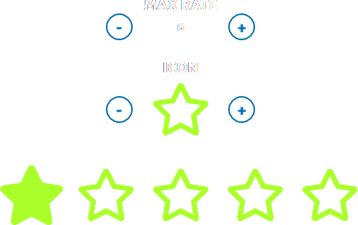
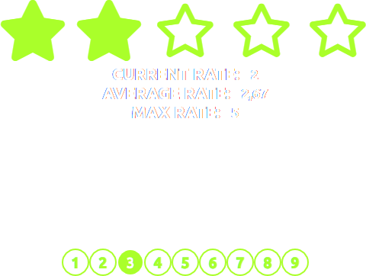
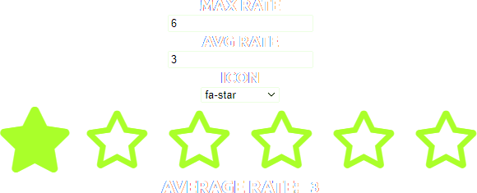
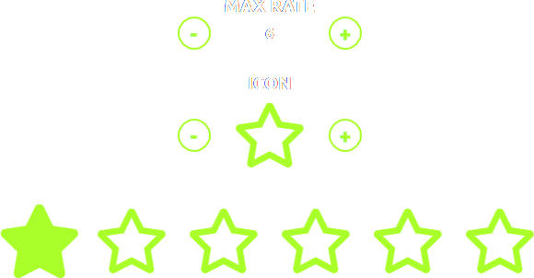
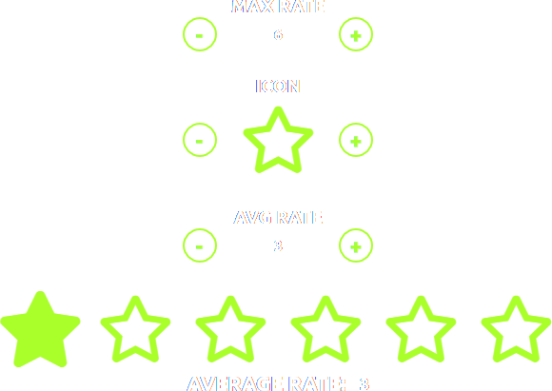
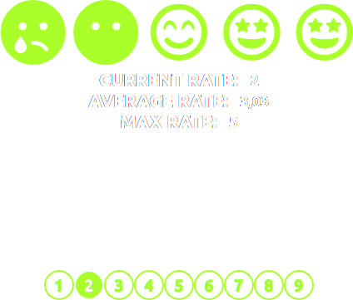

Slide 3
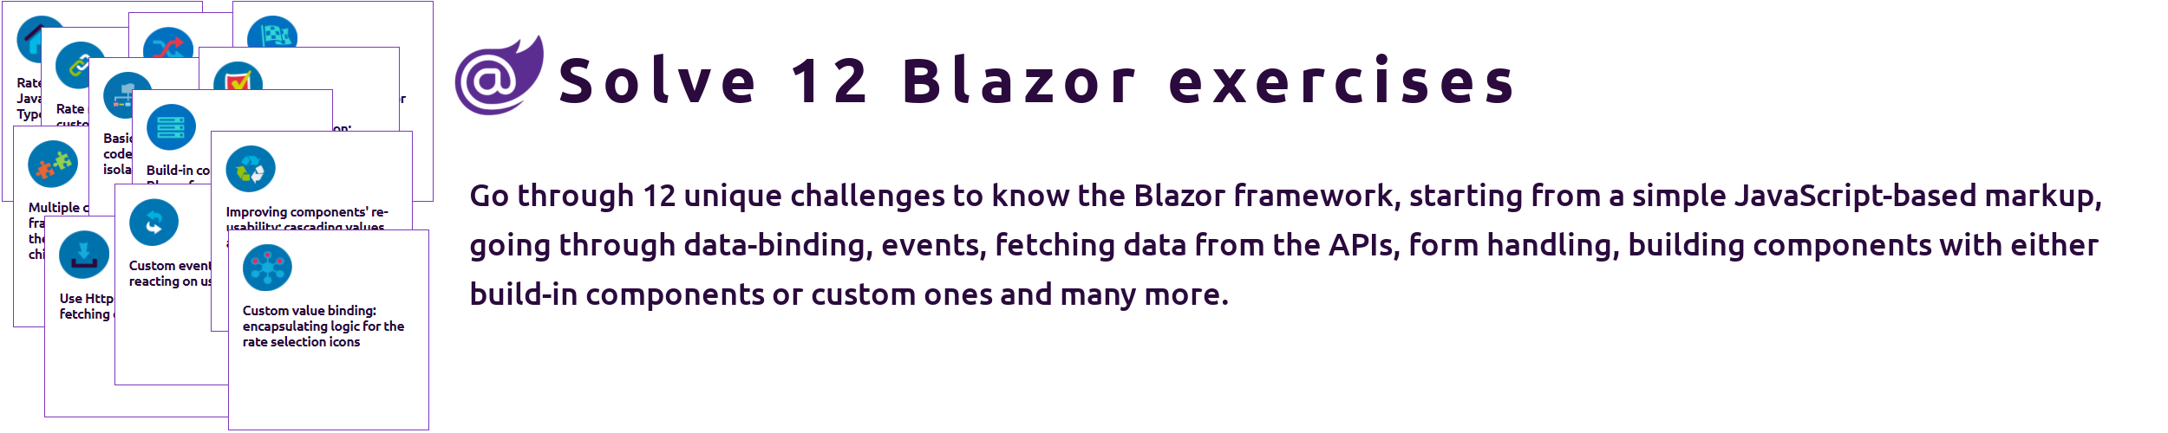
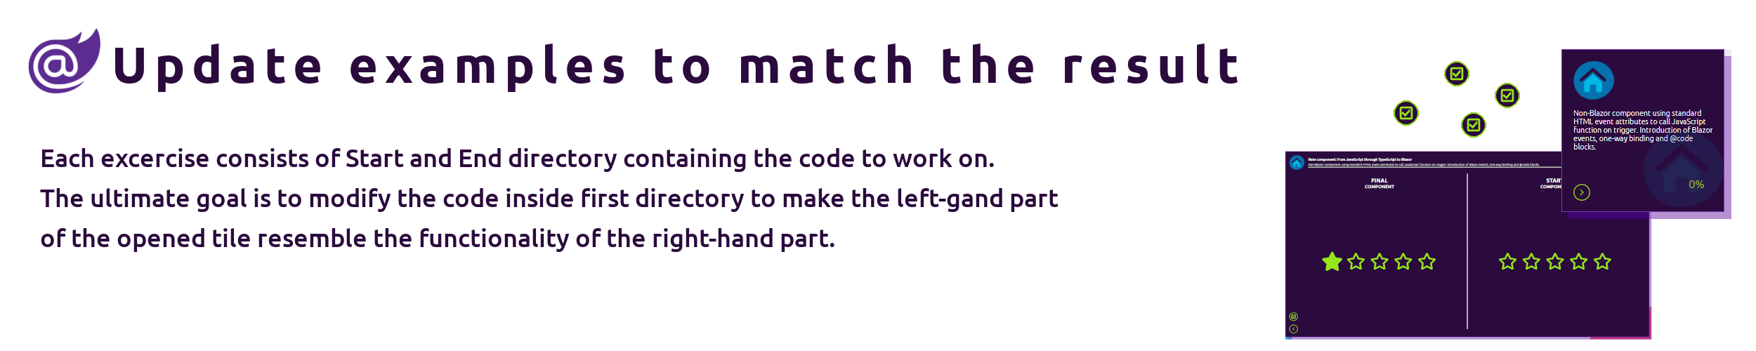

Slide 4
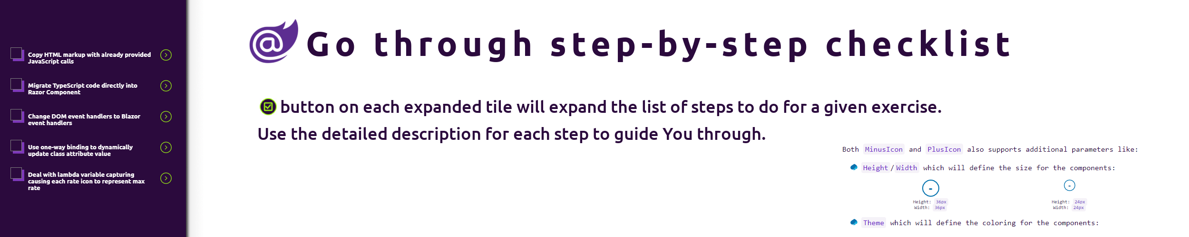
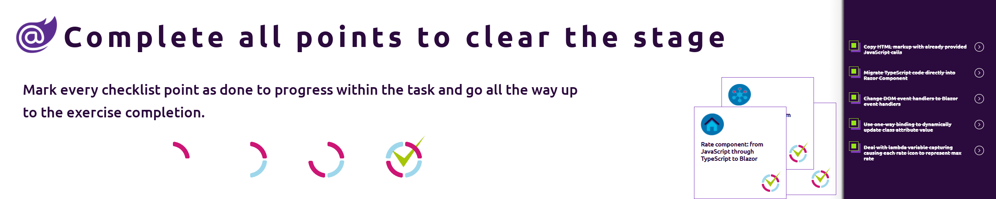

Slide 5
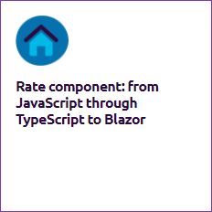
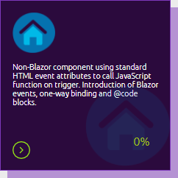
Demo #01

Slide 7

Razor components
Razor code blocks
One-way binding
Lambda variable capturing

Slide 8

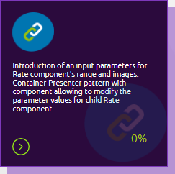
Demo #02

Slide 10
Nested components
Partial classes
Blazor directives
Namespace hierarchy
Library components
Component parameters

Slide 11
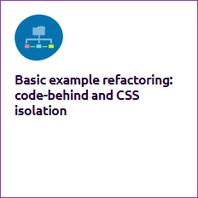
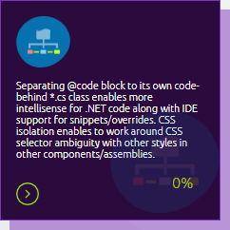
Demo #03

Slide 13
CSS isolation
Web Essentials
@inherits directive
Lifecycle

Slide 14
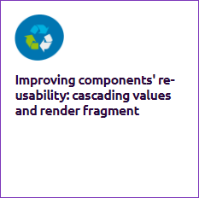
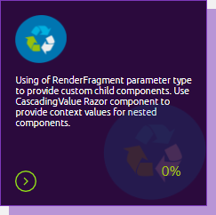
Demo #04

Slide 16
Child content
Render fragments
Cascading values

Slide 17
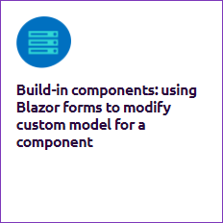
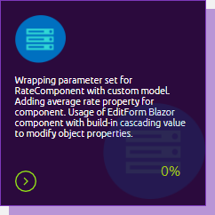
Demo #05

Slide 19
Fixed cascading value
EditForm component
Built-in input components
EditContext

Slide 20
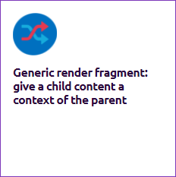
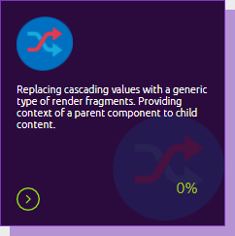
Demo #06

Slide 22
Generic render fragments
Template parameters
Template context parameters

Slide 23
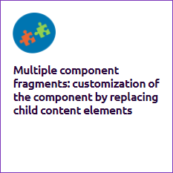
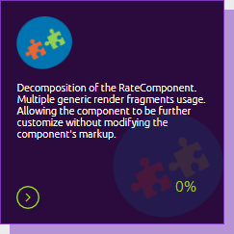
Demo #07

Slide 25
Multiple generic render fragments
Template parameters
Template context parameters

Slide 26

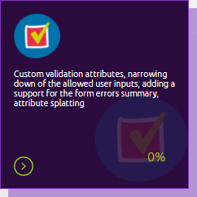
Demo #08

Slide 28
Built-in validation attributes
Custom validation attributes
Validation built-in components
Generic components
Extending built-in components
Attribute splatting
EditForm events
Disposing component
Directive attributes

Slide 29

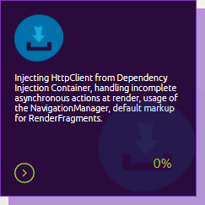
Demo #09

Slide 31
Dependency injection
HttpClient
Calling API
NavigationManager service
JSON helpers
NavLink component
Handling API exceptions
Routing parameters
Ilogger service
Routing constraints
Incomplete async actions handling
Reusable render fragments

Slide 32
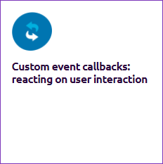
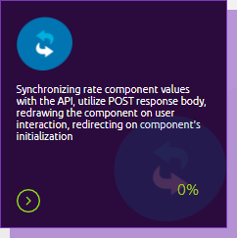
Demo #10

Slide 34
Component events
Capture references to component
Posting data to API
StateHasChanged method

Slide 35
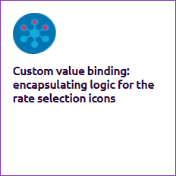
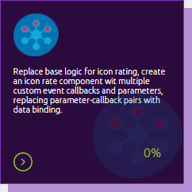
Demo #11

Slide 37
Bind across components
Data binding
Fixed cascading parameters

Slide 38
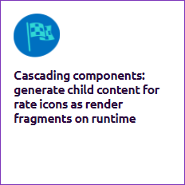
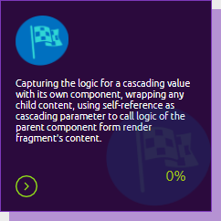
Demo #12

Slide 40
Self-referencing cascading value

