Slide 1
Introduction to Blazor – part 2
Wrocław, 10.12.2020, Tomasz Strzałka

Slide 2










Application Frameworks
Blazor
MVC Framework
Utility Frameworks
Razor Pages
Identity
Entity Framework
Platform
Razor
Configuration & Logging
Model Binding
Caching
URL Routing
Dependency Injection
gRPC
Middleware
HTTP Server
SignalR
.NET 5

Slide 3
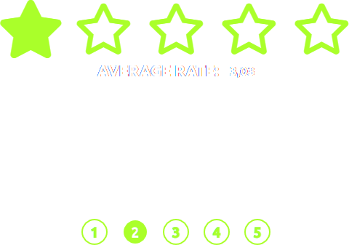

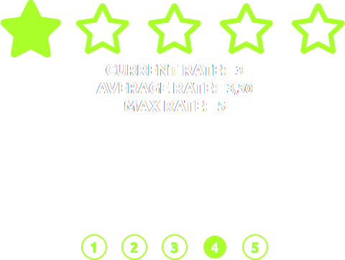
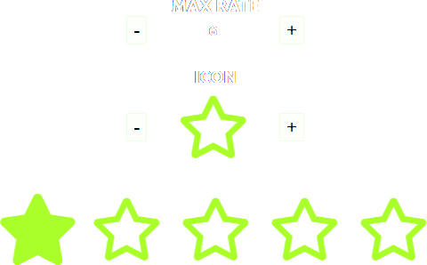

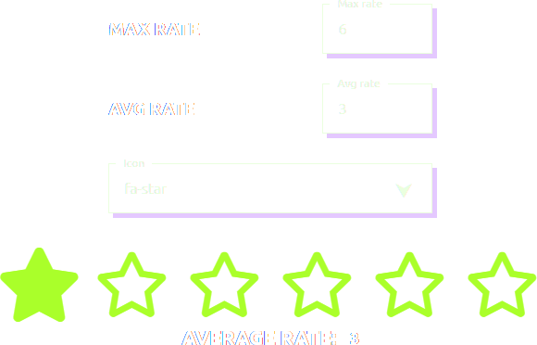
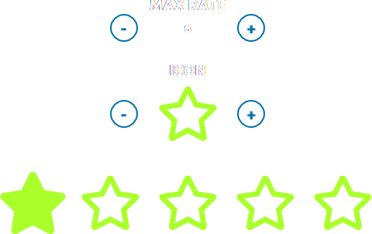
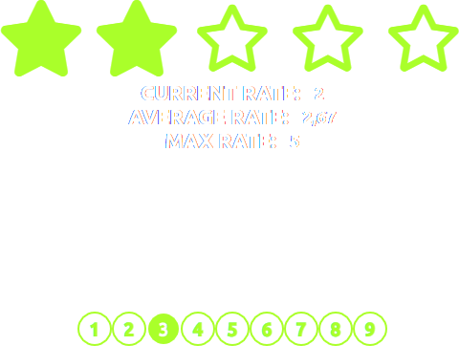
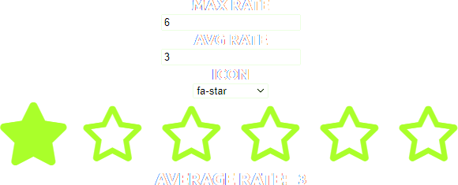

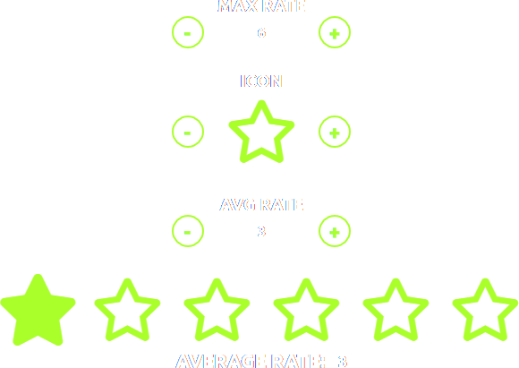
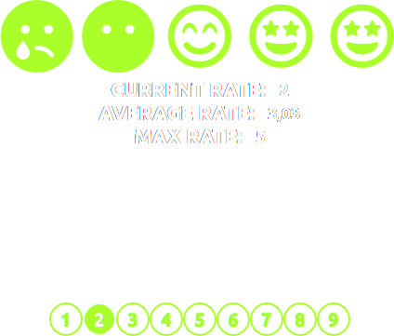

Slide 4
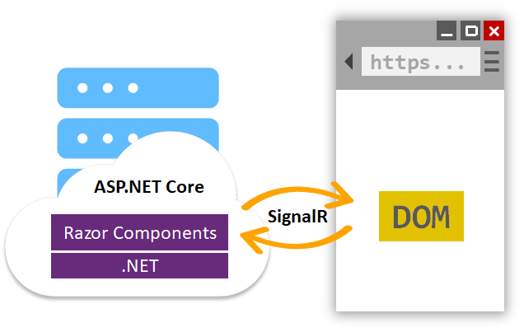
Blazor Server

Slide 5
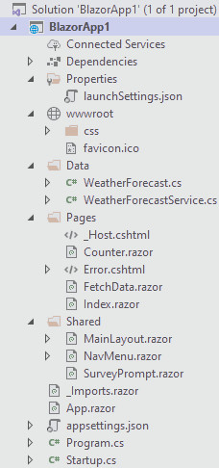
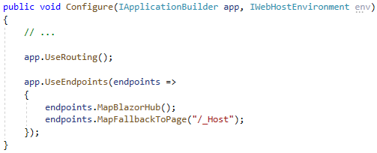
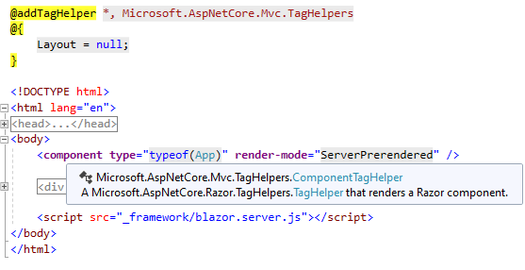



Slide 6
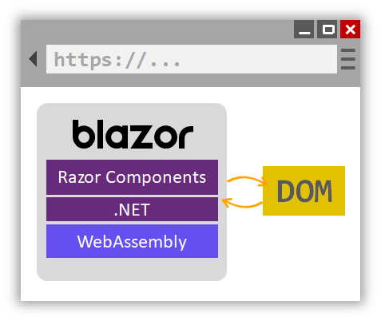
Blazor WebAssembly

Slide 7
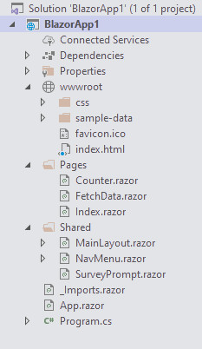
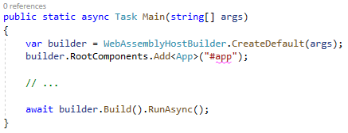
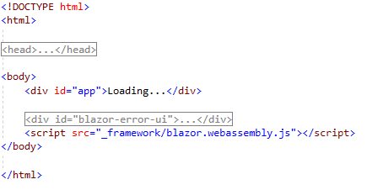


Slide 8
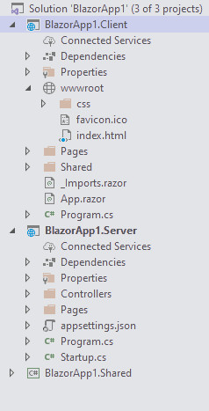
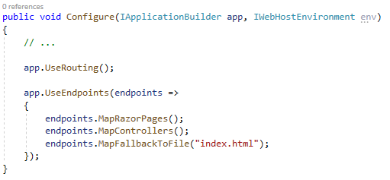

Slide 9
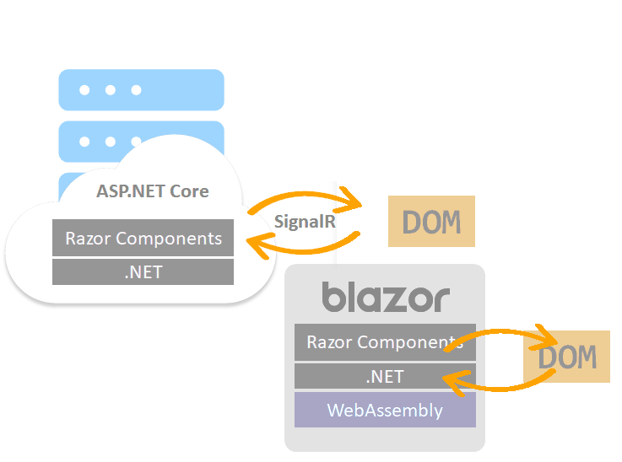
How Blazor renders content

Slide 10
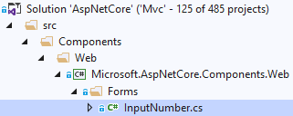
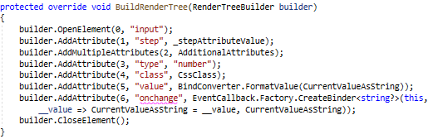
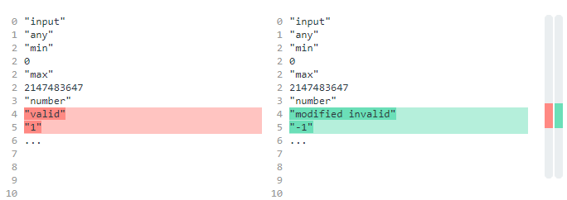
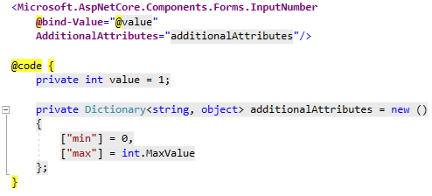
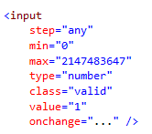
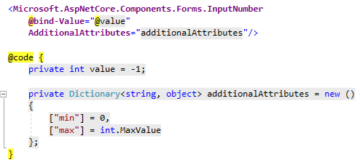
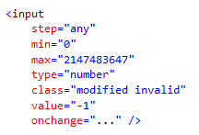

Slide 11

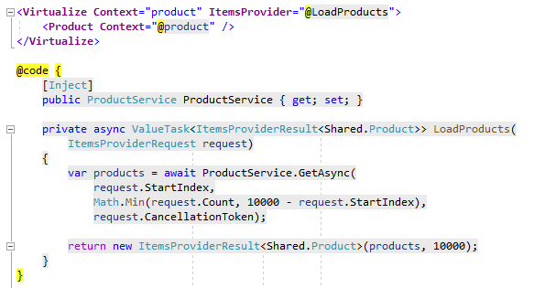
Some other ways to improve
Virtualizing components
Manual change detection
Manual redrawing
Manual Render Tree building
Manual parameter set
Inline components

Slide 12

Some other ways to improve
Virtualizing components
Manual change detection
Manual redrawing
Manual Render Tree building
Manual parameter set
Inline components

Slide 13
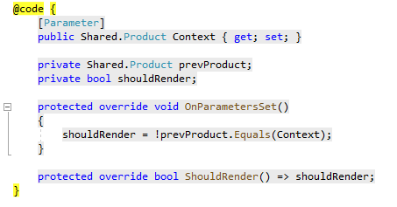
Some other ways to improve
Virtualizing components
Manual change detection
Manual redrawing
Manual Render Tree building
Manual parameter set
Inline components

Slide 14
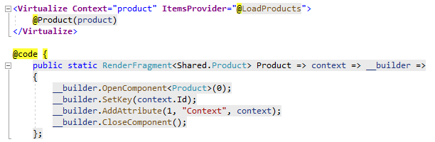
Some other ways to improve
Virtualizing components
Manual change detection
Manual redrawing
Manual Render Tree building
Manual parameter set
Inline components

Slide 15
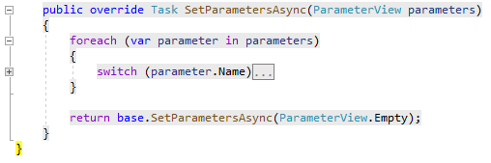
Some other ways to improve
Virtualizing components
Manual change detection
Manual redrawing
Manual Render Tree building
Manual parameter set
Inline components

Slide 16


Some other ways to improve
Virtualizing components
Manual change detection
Manual redrawing
Manual Render Tree building
Manual parameter set
Inline components

Slide 17
Some other ways to improve
Fixed CascadingValues
Avoid attribute splatting
JS INTEROP – TAKE IT EASY! - not call to often, - synchronous JS calls, - unmarshalled calls
IL trimming, compression, feature switching
Assembly lazy load

Slide 18
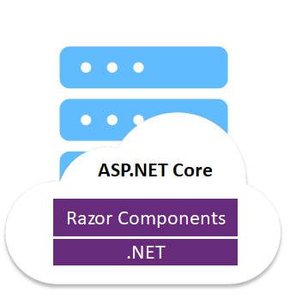
Blazor Server render modes

Slide 19
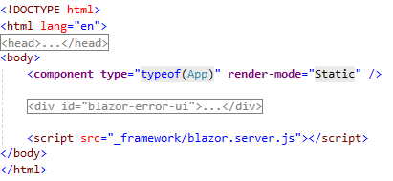
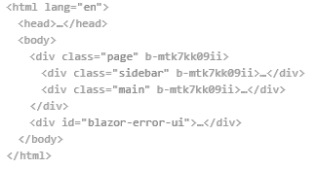
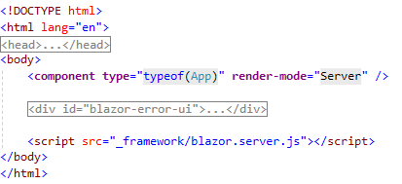
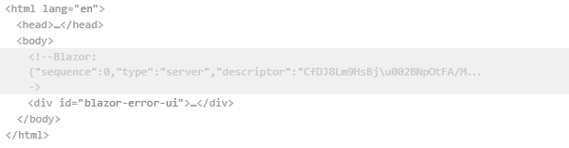

Slide 20
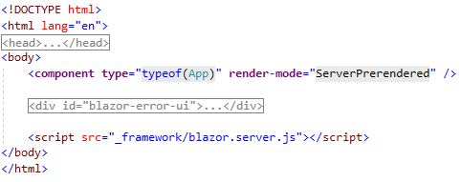
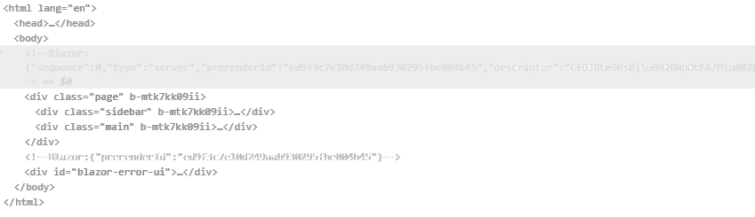

Slide 21
Blazor WebAssembly render modes

Slide 22
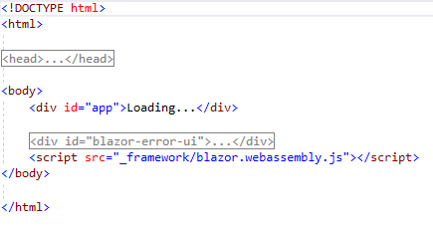
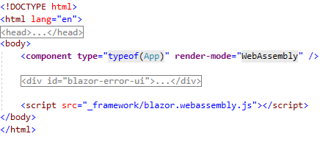
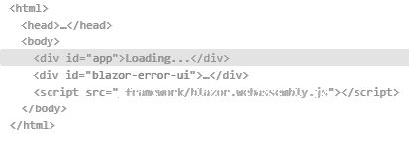
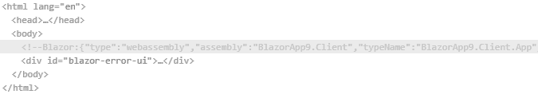
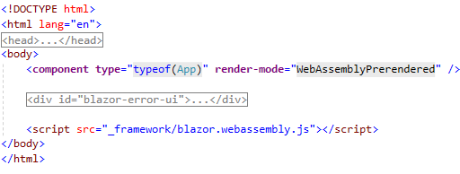
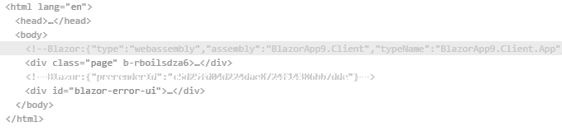

Slide 23

JS Interoperability
.NET
JavaScript
Asynchronous
.NET -> JSON -> .NET
IJSRuntime – async, .NET -> JSON -> .NET
InvokeVoidAsync
InvokeAsync<Tvalue>
IJSInProcessRuntime – sync, .NET -> JSON -> .NET
InvokeVoid
Invoke<Tvalue>
Cannot be used for Server Blazor
IJSUnmarchalledRuntime - sync, .NET
InvokeUnmarchaled<T0,… Tresult>
Cannot be used for Server Blazor

Slide 24
JS Interoperability
JavaScript
.NET
JS DotNet namespace, [JSInvokable]
For static methods
invokeMethod
invokeMethodAsync
DotNetObjectReference<TValue>
For instance methods
Need to be disposed

Slide 25
JS Interoperability
Cannot handle circular dependencies (JSON serialization)
Hard time updating UI (Blazor diffs)
Payload limited by SignalR
Timeout limits
Sever/WeAssembly prerendering

Slide 26

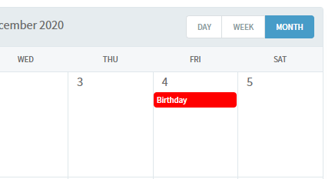
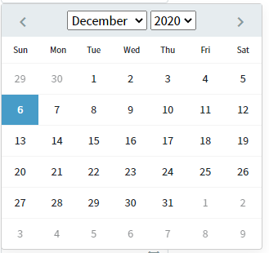
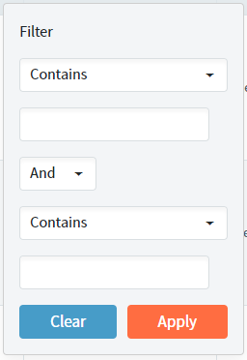
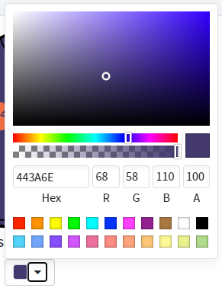
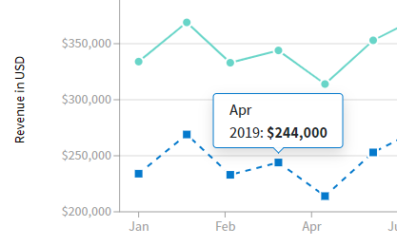
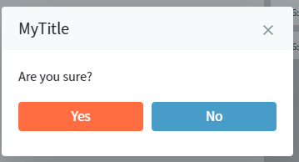






Blazor component libraries
Radzen.Blazor

Slide 27















Blazor component libraries
Syncfusion.Blazor

Slide 28













Blazor component libraries
Telerik.Blazor

Slide 29

Performance optimization for WebAssmebly
FieldCssClassPovider
InputRadioGroup
InputFile
Assembly lazy loading
Optional routing parameters
What’s new in .NET 5
CSS isolation
JS isolation
ElementReference’s methods
FocusAsync
Virtualization

Slide 30
What the future holds?
Blazor AOT (.NET 6)
Mobile Blazor
Blazor Electron

Slide 31
Readings
Microsoft Docs,
Pro ASP.NET Core MVC 3 (Adam Freeman),
Microsoft Blazor (Peter Himschoot),
Blazor University,
Visual Studio Magazine,
Stack Overflow Blog,
Awesome Blazor

