Slide 1
Soldering station.
Why and the goal.

Slide 2
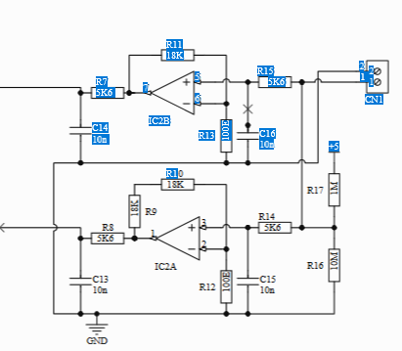
The original design

Slide 3
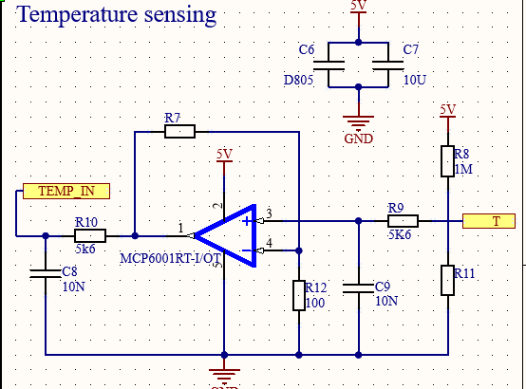
Redesign it removing the nonessential
Can only use one of the two type of soldering irons now.

Slide 4
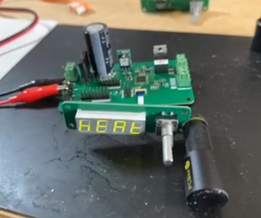
Did it work?
No

Slide 5
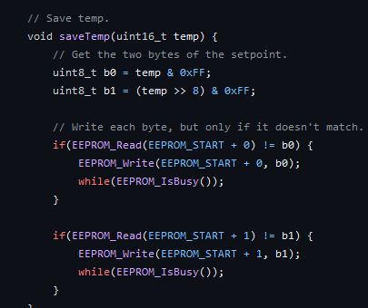
Software and its issues.

Slide 6
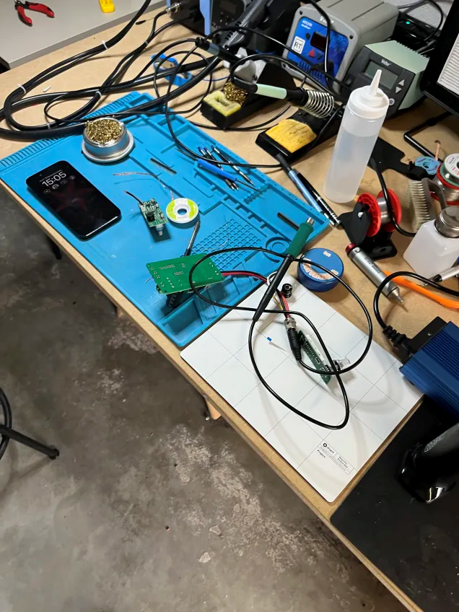
Temperature measurement and its issues

Slide 7
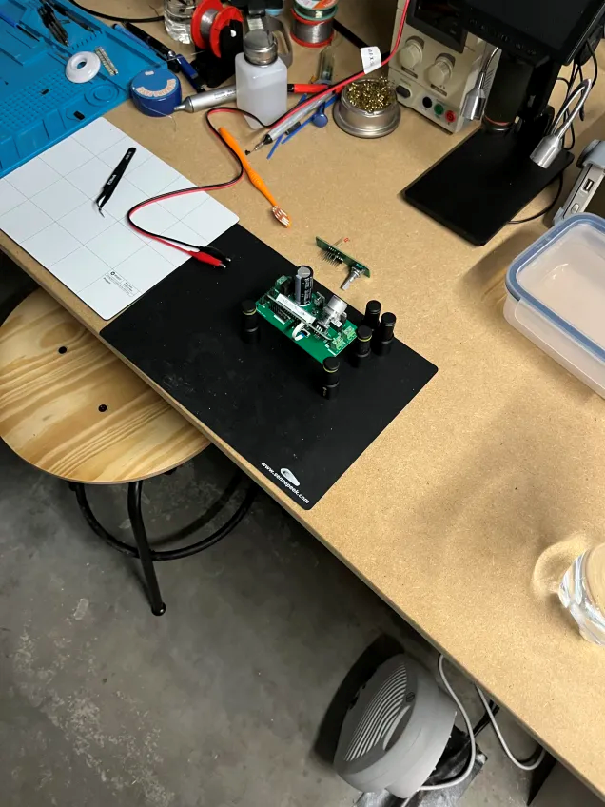
Its done now. Right?

Slide 8
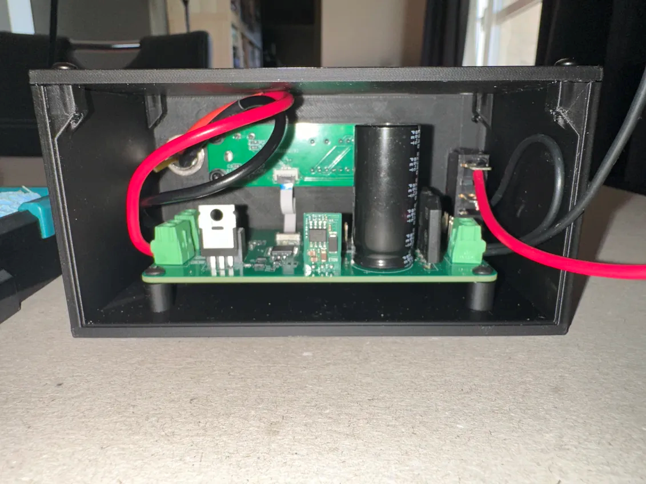
The case.

Slide 9
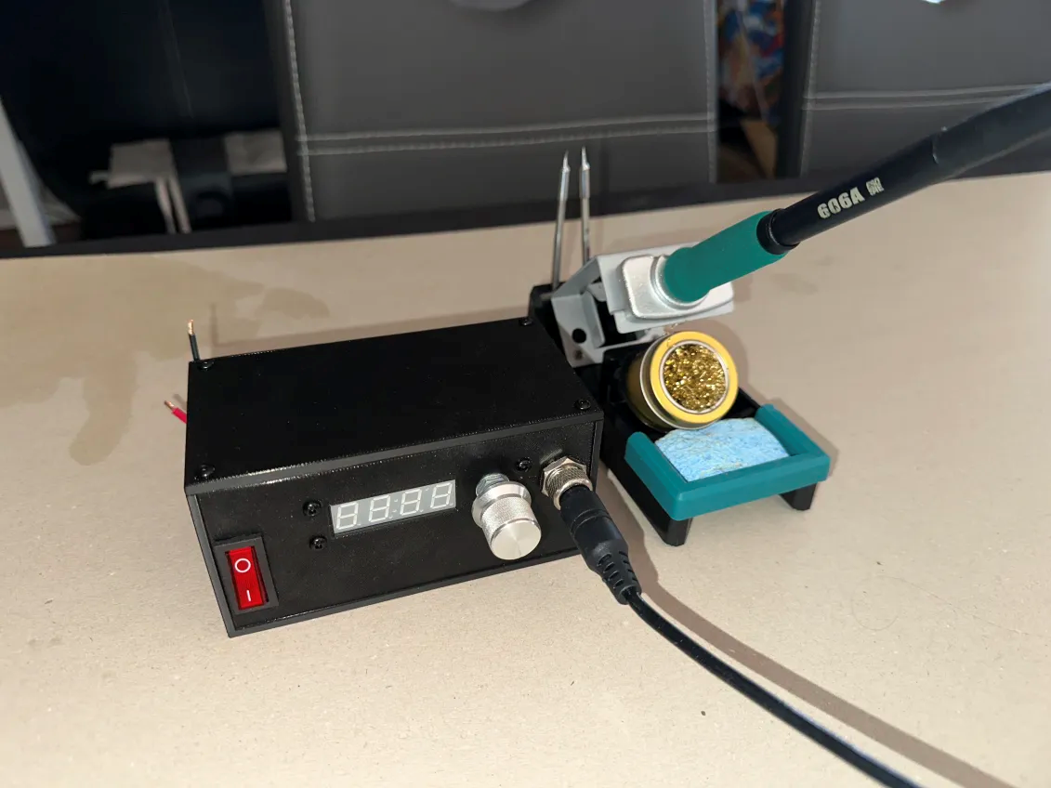
The finishes product.

Slide 10
Some issues that need to be fixed.
Thank you
Any questions?

