Slide 1

TrafficSign AI: Traffic Sign Alert System
-- Image Classification Problem

Slide 2
About Me
PYARASANI SRINIVAS
B.Tech (Computer science and Engineering)
Git Hub | Linked In

Slide 3
Agenda
Problem Statement
Objective of the project
Dataset Overview
Work Flow of the project
Technologies
Conclusion
Q&A

Slide 4

Background
Traffic sign recognition is an important application of computer vision and machine learning, with applications in intelligent transportation and driver-assistance systems.
Traffic signs provide essential information about speed limits, road conditions, warnings, and restrictions. Automatically recognizing these signs can improve road safety and support intelligent vehicle systems by providing timely alerts to drivers.

Slide 5
Problem Statement
This project uses an Artificial Neural Network (ANN) to recognize and classify traffic signs from images, videos, and live camera input.
The system displays the predicted traffic sign and confidence score and provides a voice alert for the detected sign, creating a smart and user-friendly traffic sign warning system.

Slide 6
Objective of the Project
Develop an ANN-based traffic sign recognition and warning system.
Enable users to provide images, videos, and live camera input for traffic sign recognition.
Preprocess and normalize traffic sign images for accurate prediction.
Classify traffic signs using a trained Artificial Neural Network (ANN).
Display the predicted traffic sign along with its confidence score.
Provide a voice alert for the detected traffic sign to improve user awareness.
Build an interactive Streamlit application for traffic sign recognition and real-time warning.

Slide 7
Dataset Overview
The Traffic Sign Dataset is an image classification dataset designed for recognizing and classifying different types of traffic signs.
It contains images organized into different classes, with each class representing a specific traffic sign. The dataset includes various signs related to warnings, restrictions, road conditions, and other traffic regulations.
The dataset contains a total of 13770 images used for training and evaluating the traffic sign recognition model.

Slide 8
Work Flow of the project
Exploratory Data Analysis
Image Transformation
converting into dataframe
Validating the data
checking the null
checking the duplicates
Model Building
Selecting the X and y
Splitting the data
Hyperparameter tuning
Best ANN Model Building
Application building
Deployement

Slide 9
Technologies
1. Numpy
2. Pandas
3. Scikit-learn
4. Opencv-python
5. Mediapipe
6. keras

Slide 10
Exploratory Data Analysis

Slide 11
Image Transformation
Image Loading: Load the input image.
Conversion: Convert the image to BGR to RGB.
Image Compression: Resize the image to 32 × 32.
Array Conversion: Convert the image into a NumPy array.
Feature Extraction: Flatten the image into a feature vector.
Model Input Preparation: Store the transformed image for training and prediction.

Slide 12
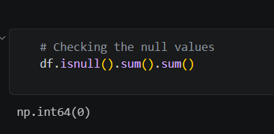
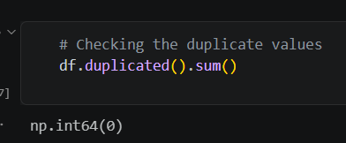
Validating the data
Checking the null values
Checking Duplicates

Slide 13
Model Building and Evalution

Slide 14
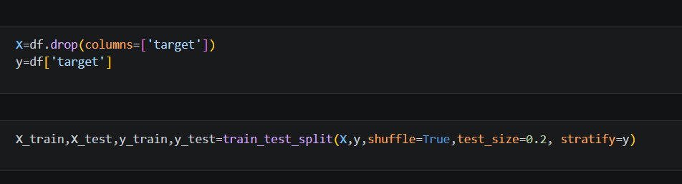
Selecting the X and y & Splitting the data
Selecting the target and input variable
Splitting the train and test data
Note :
1. target as target variable
2. Image as input variable

Slide 15
Hyperparameter tuning
Number of Layers: Tested ANN architectures with 1, 2, 3, and 4 hidden layers.
Neurons: Evaluated different numbers of neurons in each hidden layer, ranging from 32 to 256.
Dropout: Tested different dropout rates between 0.0 and 0.5 to reduce overfitting.
Learning Rate: Evaluated different learning rates ranging approximately from 0.0001 to 0.006.
Batch Size: Tested batch sizes of 16, 32, 64, and 128.
Random Search: Used hyperparameter optimization to explore different ANN parameter combinations.
Final Training: Trained the final ANN model using the best-performing hyperparameters.

Slide 16
Best Model Building
3 hidden layers
160, 192, and 160 neurons
Dropout: 0.1 and 0.3
Learning rate: 0.000321
Batch size: 16
Achieved a 75.41% validation accuracy using the best parameter combination:

Slide 17
Conclusion
An end-to-end traffic sign recognition and Alert system using an Artificial Neural Network (ANN).
The system accepts images, videos, and live camera input, preprocesses the traffic sign images, and predicts the corresponding traffic sign using an ANN classifier with 75.41% validation accuracy. The system also displays the prediction and confidence score and provides a voice alert for the detected traffic sign.

Slide 18
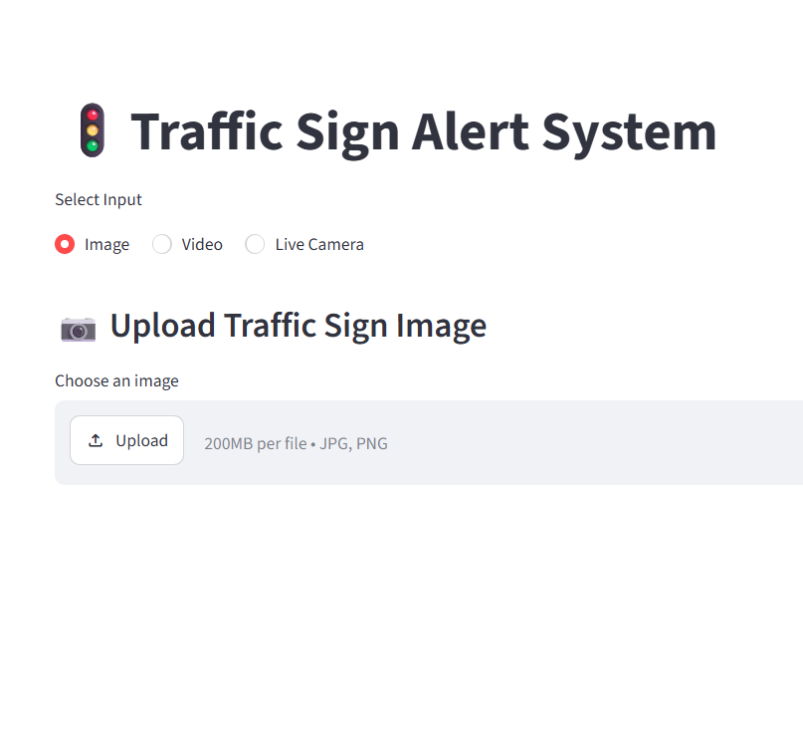
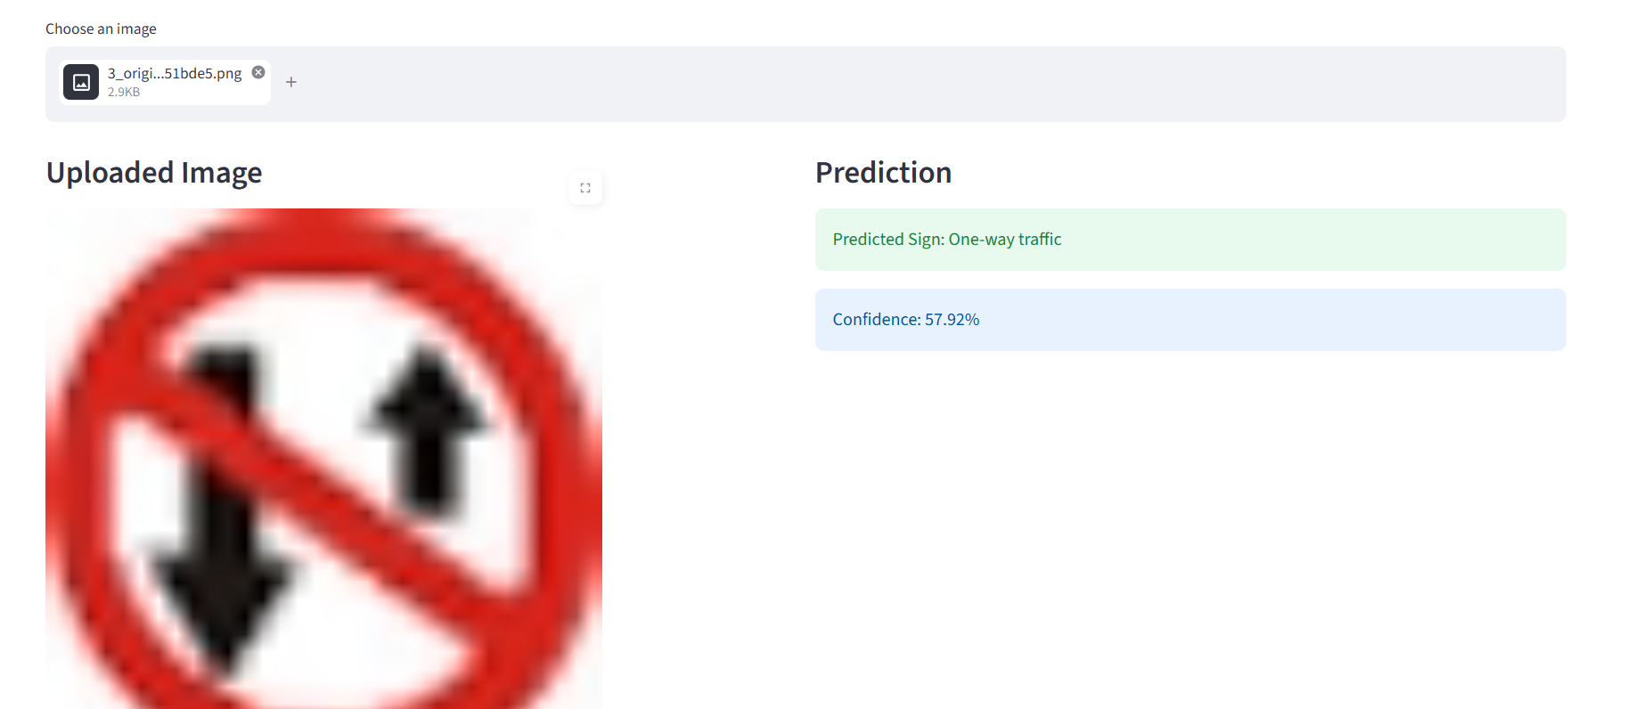
Sample Image

Slide 19
Q&A

Slide 20

THANK YOU

