Slide 1






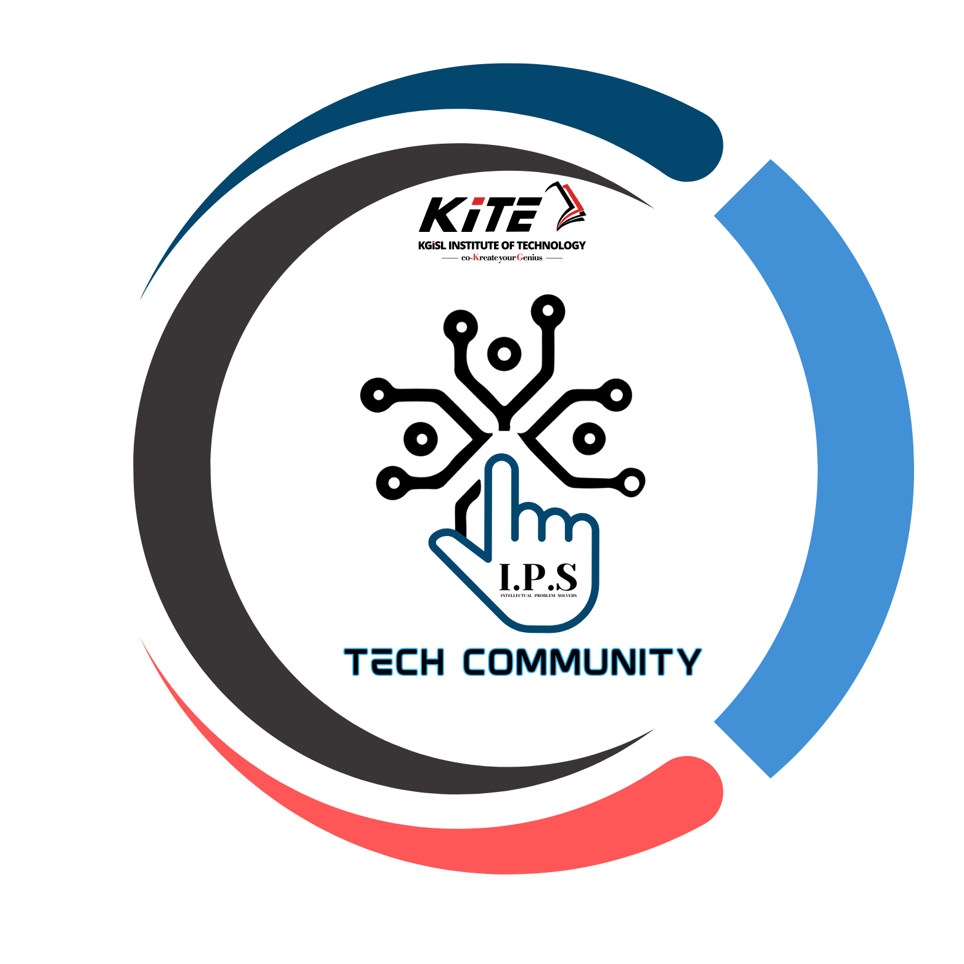
PYEXPO25
Genius innovation leaves behind a legacy...
Team ID: T012
Team Name : Ctrl Alt Elite
PS Number: PY088
PS Title: Smart energy meter for household consumption
Domain: Internet of Things(IOT)
Category: Hardware
PYEXPO 2025
IPS TECH COMMUNITY

Slide 2
Problem Statement:
➢Smart energy meter tracks your home’s electricity use in real-time and connects to a mobile app. It alerts you to high usage and gives tips to save energy, cut costs, and reduce environmental energy consumption .
➢Our target audience is common people who consume more electricity . And this idea is to make their electricity usage low and reduce their bill amount .
PYEXPO 2025
IPS TECH COMMUNITY

Slide 3
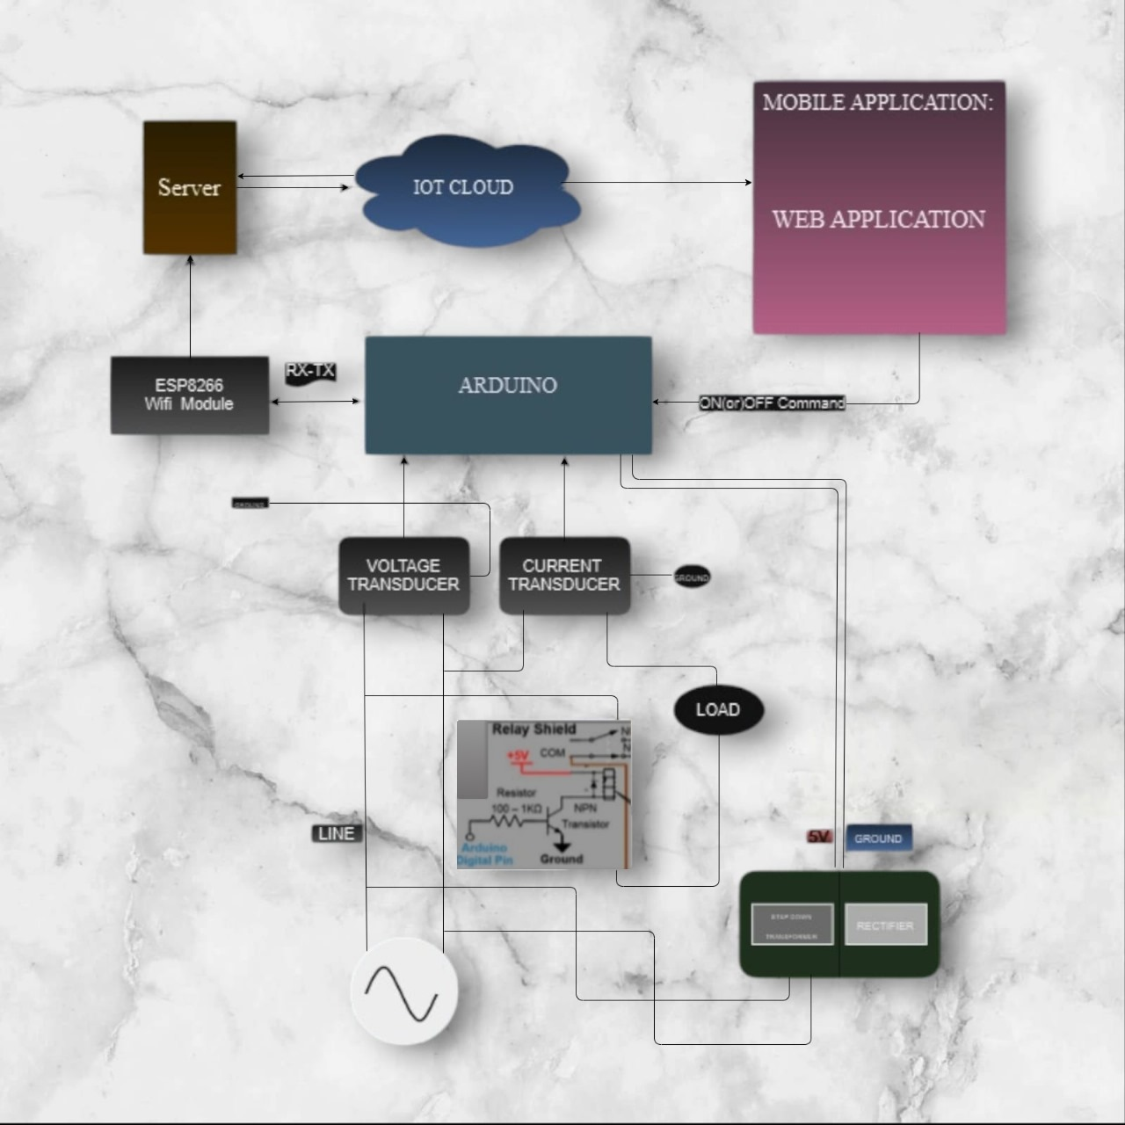
Proposed Solution:
➢We use sensors to detect electricity. We use server to transfer the data.
➢This app is efficient to conserve the electricity and notify the extra usage of electricity.
➢ Users can access and control their energy use statistics by cell phones or PCs. This allows them to control and alter their energy
Consumption and resulting in energy savings.
➢ It programs smart devices to operate when
electricity rates are low.
➢ Regularly review energy usage reports.
➢ Maintain appliances and devices
to ensure optimal performance.
PYEXPO 2025
IPS TECH COMMUNITY

Slide 4
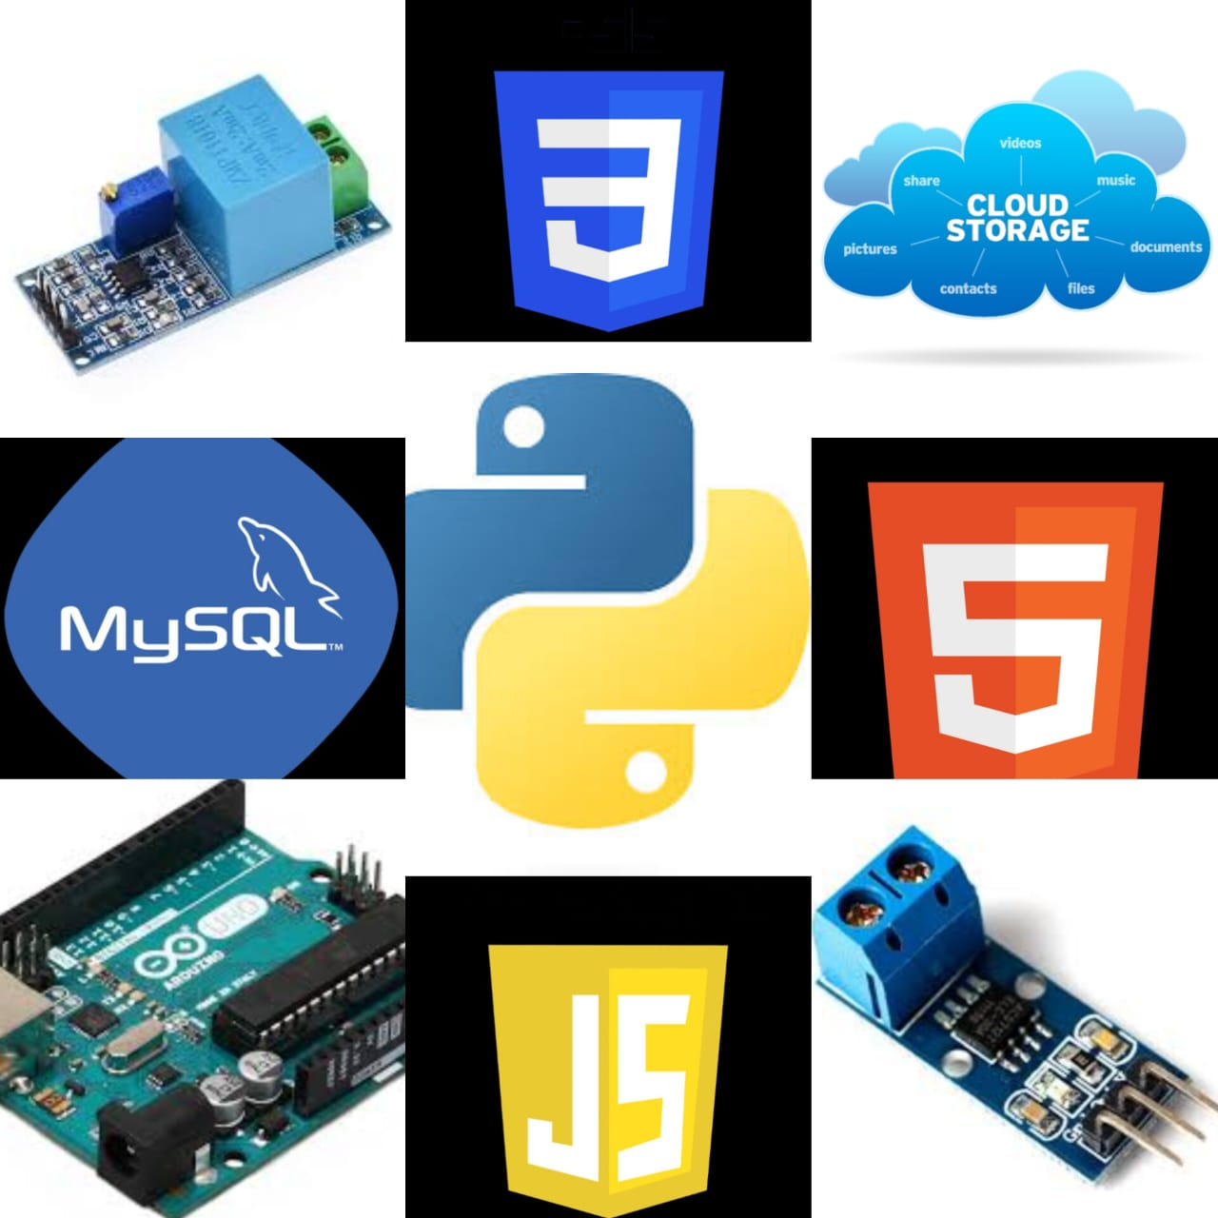
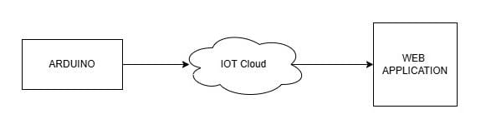
Architecture & Hardware-Software:
➢ SOFTWARE:
➢HARDWARE:
• Frontend – HTML , CSS , JS
• Backend – PYTHON,C
• Database – MySQL is used to store user data.
• File storage – Cloud storage to upload file.
• Frame work – React Js
• Arduino Uno R3
• Current Sensor
• Voltage sensor
• Server
• Microcontroller(ESP32S)
PYEXPO 2025
IPS TECH COMMUNITY

Slide 5
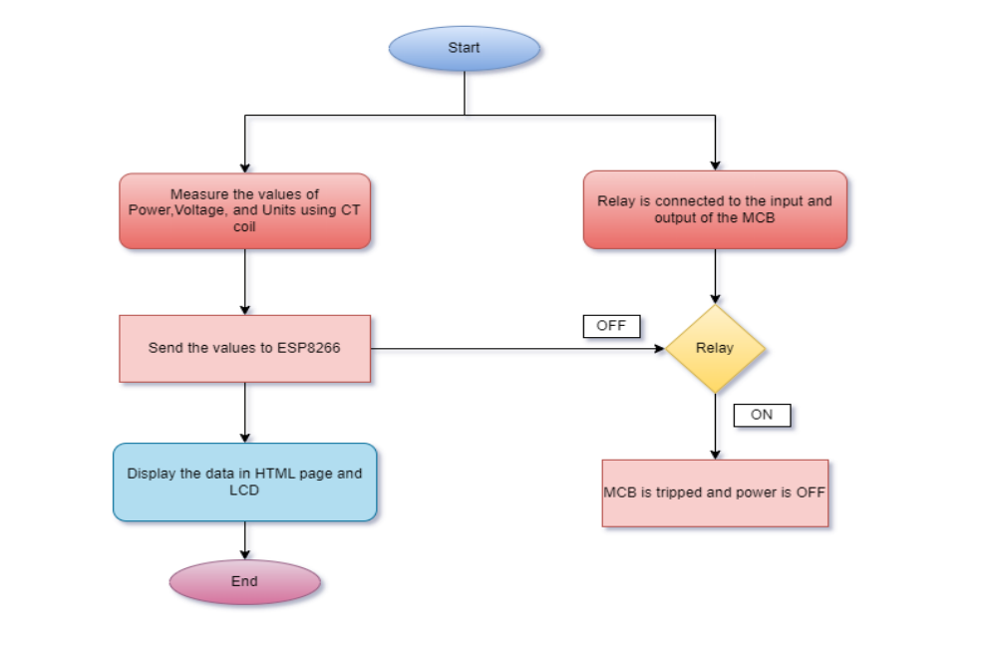
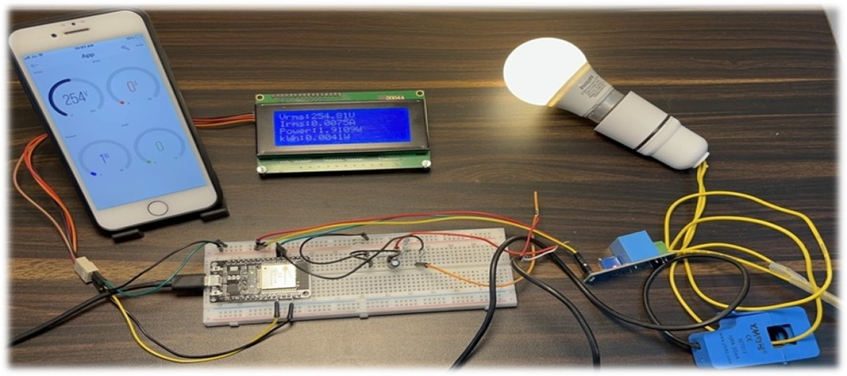
We can reduce current usage by applying this application.
We can easily notify the current usage in the house through message.
We can find the amount of voltage consumed, by this specific application.
Humans can access this app anywhere in the world by using server/cloud.
IOT ecosystems can integrate the meter with smart home platforms like Alexa , Google Home.
Increasing consumer awareness on energy efficiency and sustainability.
User friendly which can be accessed by all humans.
It is easily applied in smart homes.
Feasibility and Viability :
PYEXPO 2025
IPS TECH COMMUNITY

Slide 6
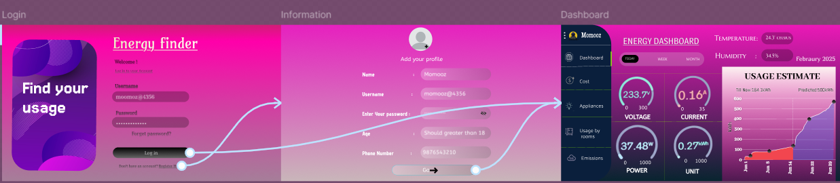
Impact and Future Scope:
➢By using this application, users can reduce the wastage of current even though they are in the absent mindedness.
➢By using this application in many areas,
we can make our cities smart.
➢This dashboard is for real time energy tracking.
➢Helps utilities manage demand more efficiently,
potentially leading to lower energy costs for
consumers in the long run.
➢This dashboard is for real time energy tracking.
➢This is used to contribute to create a smart city.
Research and References:
https://www.ijraset.com/research-paper/blynk-2-point-0-based-smart-electricity-monitoring-meter#references
https://youtu.be/FVGvR9qlEc8?feature=shared
PYEXPO 2025
IPS TECH COMMUNITY

Slide 7
Team Member Details:
KAVINILA L 24UAD149 AI&DS
BOOMATHI P 24UCS119 CSE
DHARSHIKA S 24UCS125 CSE
YOGHESWAR T 24UIT163 IT
ANUSHRI THIRUMAVALAVAN 24UEC113 ECE
PRAVIN S 24UEC217 ECE
PYEXPO 2025
IPS TECH COMMUNITY

Slide 8
THANK YOU !

