Slide 1







PYEXPO25
Genius innovation leaves behind a legacy...
Team ID:T019
Team Name:Techie Zeals
PS Number: PYS120
PS Title:Aqua Sentinel Device
Domain:Open Domain
Category:Hardware
PYEXPO 2025
IPS TECH COMMUNITY

Slide 2
Problem Statement:
Aqua Sentinel - Concern
Unseen poisoning of water badly impacts health, agriculture, and even industries. Aqua Sentinel can assist for real-time contamination monitoring. With pH level disturbance, turbidity, increase in temperature, and decrease in oxygen levels, ensuring safety is of utmost importance.
Focus Group
Households- Safe for human consumption.
Farmers – Higher quality irrigation.
Industries – Compliance to regulatory policies.
Fisheries – Good health of aquatic ecosystems.
Government – Monitoring pollution
PYEXPO 2025
IPS TECH COMMUNITY

Slide 3
Proposed Solution:
நீர்இன்று அமையாது உலகெனின் யார்யார்க்கும்வான் இன்று அமையாது ஒழுக்கு
Aqua Sentinel – IoT System
Goal: For use in homes, agriculture, and industries to ensure real-time water quality monitoring. It monitors pH levels, TDS, and temperature, notifying users of dangerous events and also to prevent the device and work in the efficient way . The main motive of the project is to detect and rectify the problem in the water purifier as soon as possible and also use the sensors to make sure that the output water consumable and ensure that it is in good quality
PYEXPO 2025
IPS TECH COMMUNITY

Slide 4
Architecture & Hardware-Software:
Aqua Sentinel Software Tools
MQTT
AWS IoT and Google Cloud IoT and Azure IoT
Firebase
Arduino IDE
Node-RED
Grafana and Things Board
Flutter and React Native
React and Angular
Aqua Sentinel Hardware Tools
ESP32
pH Sensor
TDS Meter
Temperature Sensor
IoT Module (Wi-Fi/GSM)
Power Supply (Battery/Solar)
PCB (Printed Circuit Board)
Jumper Wires & Connectors
Waterproof Enclosure
PYEXPO 2025
IPS TECH COMMUNITY

Slide 5
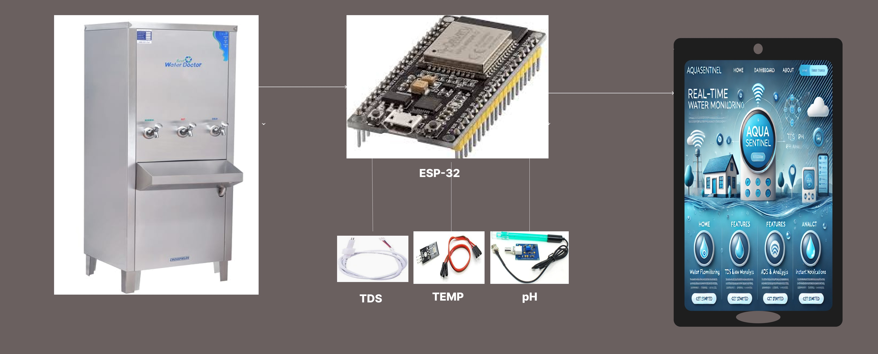
Demo:
PYEXPO 2025
IPS TECH COMMUNITY

Slide 6
Impact and Future Scope:
Efficiency & Problems Resolutions
They prevent any chances of contamination with real-time monitoring.
They lessen the need for manual testing through automated alerts.
They are a cheap option compared to lab testing.
Potential for Expansion
They use cloud technology for efficient handling of enormous amounts of data.
Use of many sensors expands the area of monitoring.
They take proactive measures through AI forecasts
Other Advancements
They detect leaks using flow of water sensors.
Remote usage is possible due to the provision of solar energy.
Access to the system is made simple by using mobile app dashboard.
Research and References:
www.dgahgsgi
PYEXPO 2025
IPS TECH COMMUNITY

Slide 7
Team Member Details:
Name Roll No Dept
VIJAYA DHANUSH V 24UME156 MECH
SANJAY RAM J 24UME145 MECH
SABARINATHAN S 24UME143 MECH
SUBHASINI M 24UAD246 MECH
SAI JANANI SK 24UAD226 MECH
PYEXPO 2025
IPS TECH COMMUNITY

Slide 8
THANK YOU !

