Slide 1






PYEXPO25
Genius innovation leaves behind a legacy...
Team ID: T028
Team Name: HackAholics
PS Number: PY090
PS Title: SMART FARMING SYSTEM FOR PRECISION AGRICULTURE
Domain: IoT
Category: Hardware
PYEXPO 2025
IPS TECH COMMUNITY

Slide 2

Problem Statement:
Conventional irrigation methods are quite ineffective and waste much water and other resources. They also result in soil degradation and reduced crop yield.
Ultimately, there is a need for a smart system that will optimize the resource requirements based on the weather, predictive analysis, and the real-time soil moisture data.
Farmers and agricultural businesses seeking sustainability and improved crop yield will benefit from this project.
PYEXPO 2025
IPS TECH COMMUNITY

Slide 3
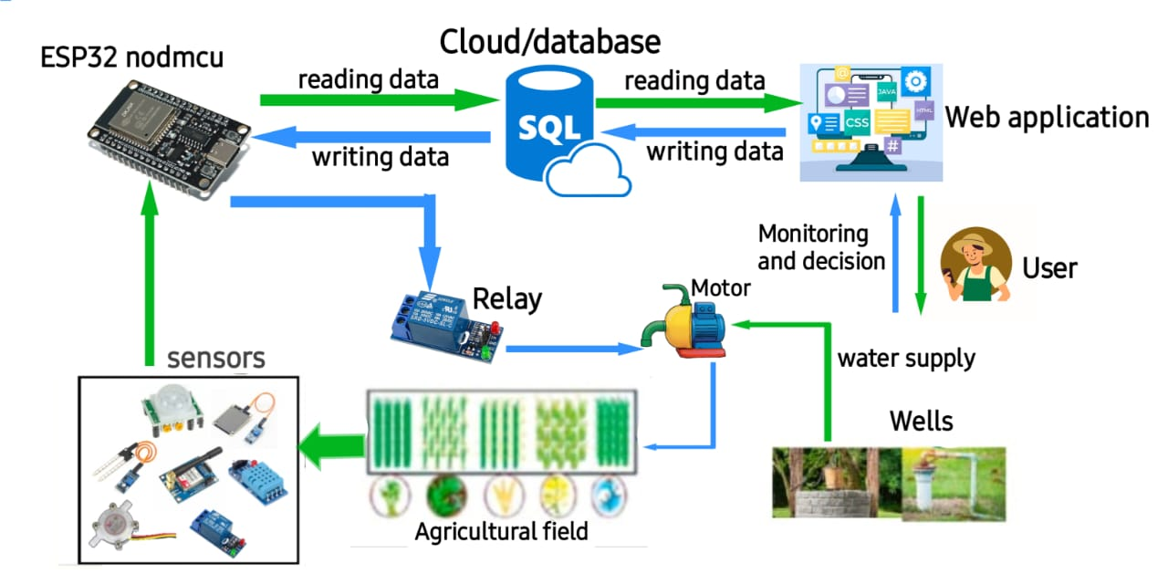

Proposed Solution:
Powered by an ESP32, this smart farming system utilizes various sensors for condition monitoring, automated irrigation, and a mini Python script for data processing and Wi-Fi transmission to ensure precision in agriculture.
Innovation/Uniqueness:
PIR sensor is used in the field for motion detection.
Efficient web application for compact use.
PH calibration ensures accuracy by correcting drifts and using buffer solution, leading to better yield.
AI-driven chatbot that enhance decision-making and efficiency for farmers.
PYEXPO 2025
IPS TECH COMMUNITY

Slide 4
Architecture & Hardware-Software:
HARDWARE (DEVICES):
ESP32,Temperature and humidity sensor,
pH sensor, GSM module, Relay Module,
PIR sensor, Buzzer module, Solenoid Pump,
Moisture sensor, LCD display
SOFTWARE:
Front-End: HTML-CSS, Bootstrap
Back-End: Flask, SQL
API key: Weather API
PYEXPO 2025
IPS TECH COMMUNITY

Slide 5
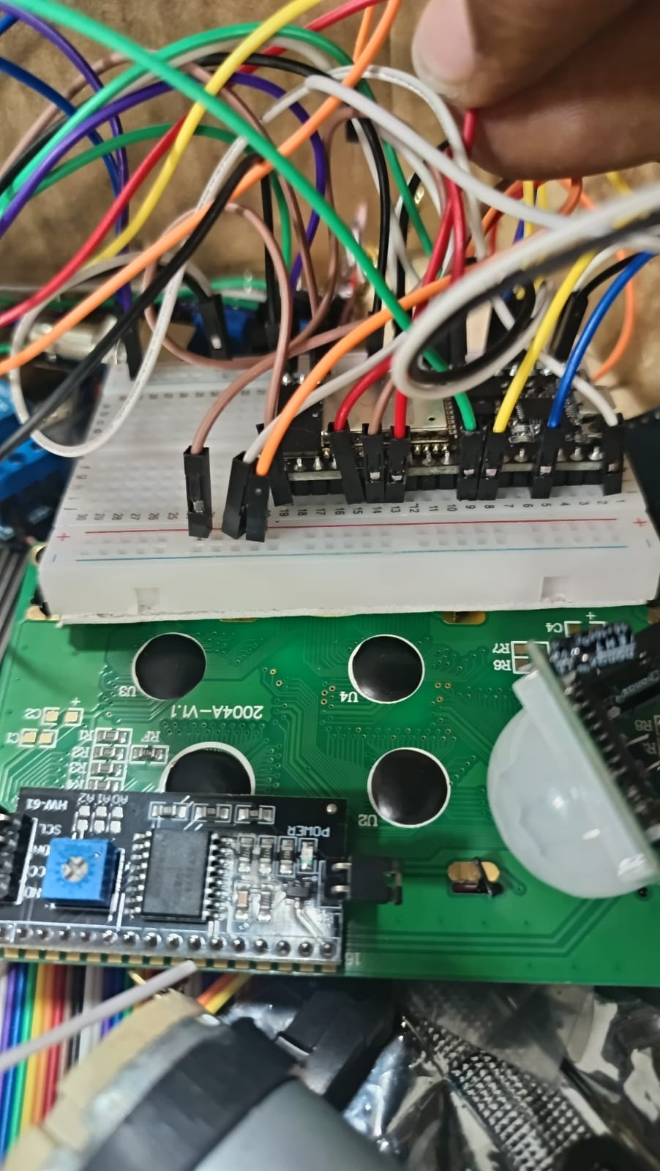
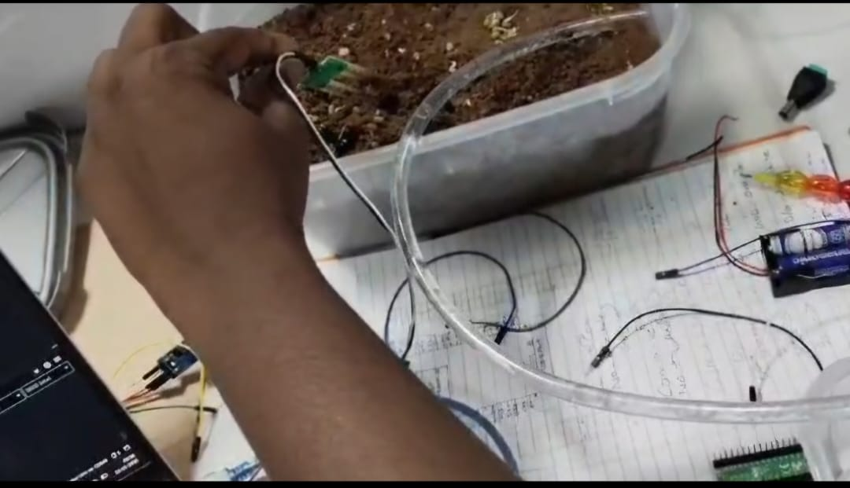
Demo:
PYEXPO 2025
IPS TECH COMMUNITY

Slide 6
Impact & Future Scope:
Reduces resource wastage and improves efficiency.
Conserves water with smart irrigation.
Can be integrated with weather APIs for better accuracy.
Scalable for large farms with additional sensors.
FUTURE IMPROVEMENTS: AI-based water prediction and mobile app integration(Real-time updates via mobile app).
Research & References:
https://www.ijraset.com/research-paper/paper-on-smart-irrigation
https://smartertechnologies.com/guides/the-complete-guide-to-smart-agriculture-farming
PYEXPO 2025
IPS TECH COMMUNITY

Slide 7
Team Member Details:
NAME ROLL NO DEPT
DHARSHIKA PUGALENTHI (TL)
ABIRAMI R
PRANEASH SHIVA S R
SANTHOSH KUMAR G
BALAMURUGAN R
SAMRUTHI G P​
24UAD124
24UCB103
24UCY137
24UEC232
24UEC118
24UAD229
AI&DS
CSBS
CYS
ECE
ECE
AI&DS
PYEXPO 2025
IPS TECH COMMUNITY

Slide 8
THANK YOU !

