Slide 1







PYEXPO25
Genius innovation leaves behind a legacy...
Team ID: T035
Team Name Grit Coders(Registered in portal):
PS Number: PY019
PS Title: Task Management app
Domain: Web development
Category: Software
PYEXPO 2025
IPS TECH COMMUNITY

Slide 2
Problem Statement:
TASK MANAGEMENT APP
PROBLEM:
Legacy Task management app Lacks in Plagiarism detection functionality
Inadequate functionality and features to support academic workflows
Generic task categorisation framework
Limited in configuration of task system and Faculty control
TARGET AUDIENCE :
Empowering the students and faculty in academic task management
PYEXPO 2025
IPS TECH COMMUNITY

Slide 3
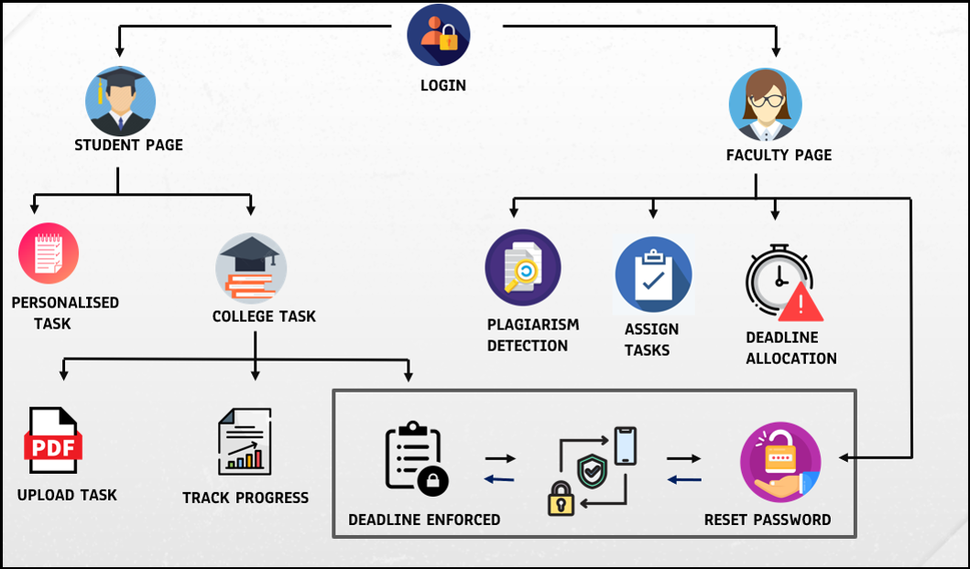
Proposed Solution:
Implementation of User-friendly platform to streamline Management for students and faculty .
KEY FEATURES:
ROLE-SPECIFIC ACCESS FOR STUDENTS
AND FACULTY
AUTOMATED TASK LOCK UPON
DEADLINE EXPIRY
EMBEDDED PLAGIRISM COLLABORATION TOOL
STUDENT TASK BIFURCATION : PERSONAL AND INSTITUTIONAL
PYEXPO 2025
IPS TECH COMMUNITY

Slide 4






Technology Stack:
FRONTEND
1. FRONTEND:
Build responsive pages with Full Calendar and deadline system
using HTML, CSS, JavaScript.
2. BACKEND :
Develop a secure, scalable backend with Django (PYTHON), including authentication
and task management models.
3. DATABASE:
Use SQLite3 for lightweight and efficient database storage with relational tables
and indexing for fast query retrieval.
4. API INTEGRATION:
Incorporate APIs by securing access keys, making HTTP requests, processing
responses, and implementing effective error handling to enhance app capabilities.
BACKEND
DATABASE
PYEXPO 2025
IPS TECH COMMUNITY

Slide 5



Impact and Future Scope:
Categorizing task based on personal and university.
Minimizes Time Consumption and Increases Accountability.
Enhances Student Engagement and Accessibility.
Assists in Academic Improvement and Detects Plagiarism
Addresses Market Demand with Customizable Features in educational
institutions
Enhances students time management skill.
Research and References:
https://www.geeksforgeeks.org/django-tutorial/
https://www.geeksforgeeks.org/how-to-learn-python-from-scratch/
https://www.w3schools.com/html/
Enables to track progress and assist in improvement.
PYEXPO 2025
IPS TECH COMMUNITY

Slide 6
Team Member Details:
Name Roll No Dept
K.Devadharshini 24UIT110 IT
N.Manujana 24UAM129 AIML
M.FathimaRidhuwana 24UCS131 CSE
D.Bhavani 24UIT108 IT
M.SonikaSri 24UEC241 ECE
M.Deekshith 24UIT109 IT
PYEXPO 2025
IPS TECH COMMUNITY

Slide 7
THANK YOU !

