Slide 1

Unit 4
Simplification and K-map
College of Computer and Information Sciences
Department of Computer Science
CSC 220: Computer Organization

Slide 2
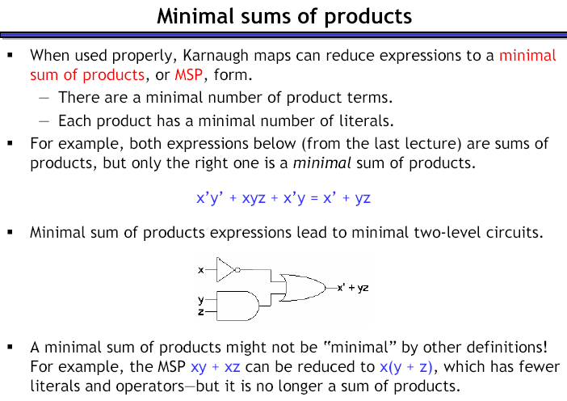
Prove?

Slide 3
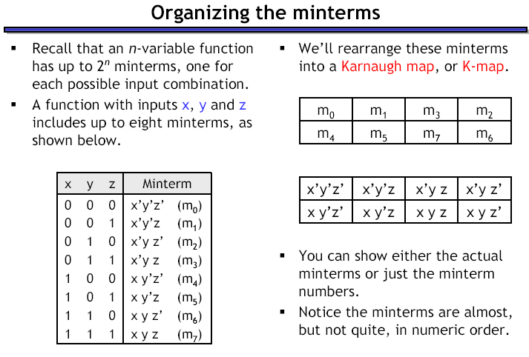

Slide 4
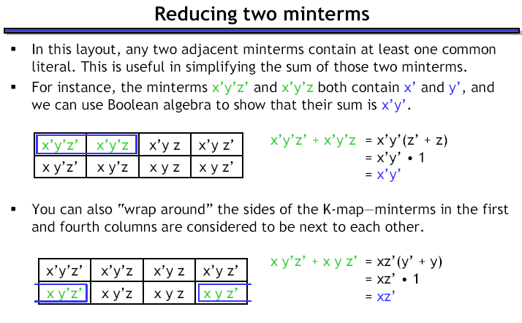

Slide 5
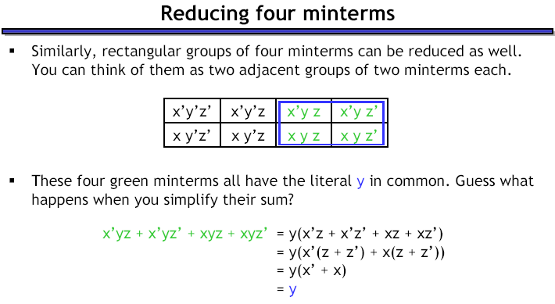

Slide 6
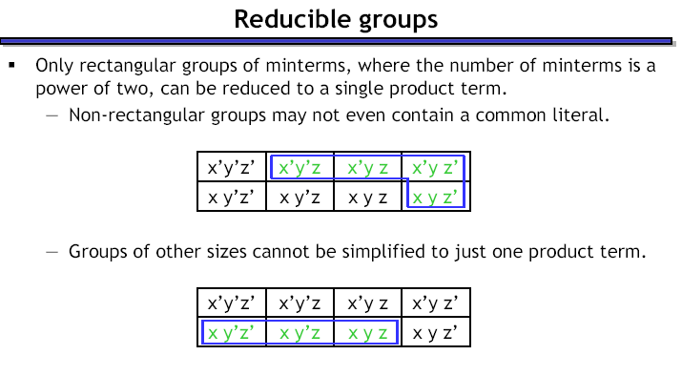

Slide 7
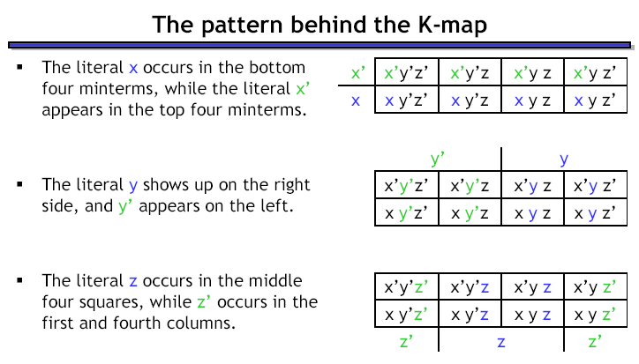

Slide 8
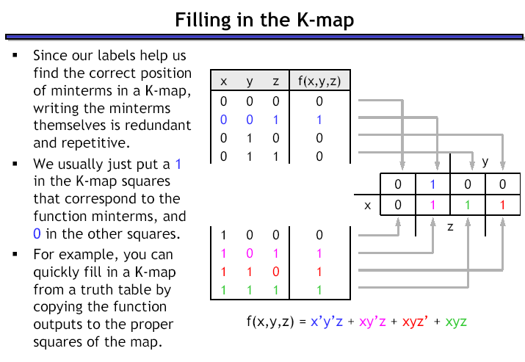
Example 1

Slide 9
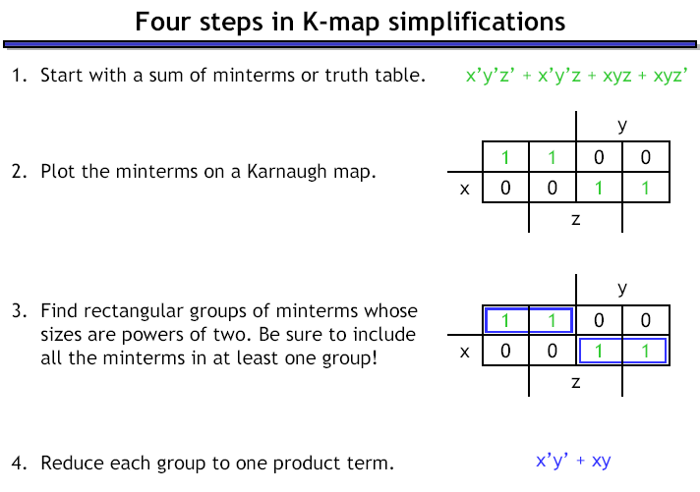
Example 2

Slide 10
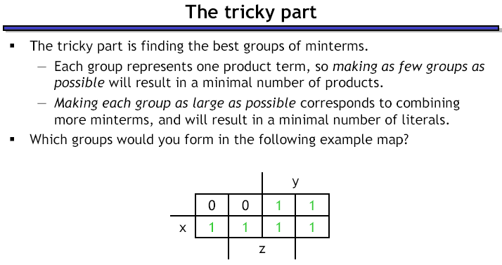
Example 3

Slide 11
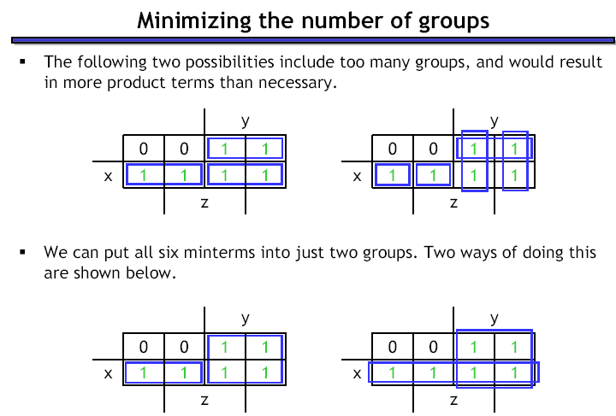

Slide 12
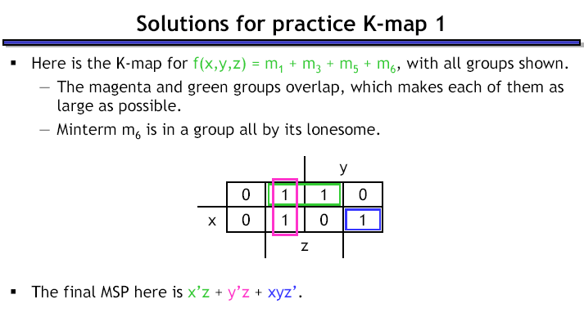
Example 4
MSP
Minimal Sum of Product

Slide 13
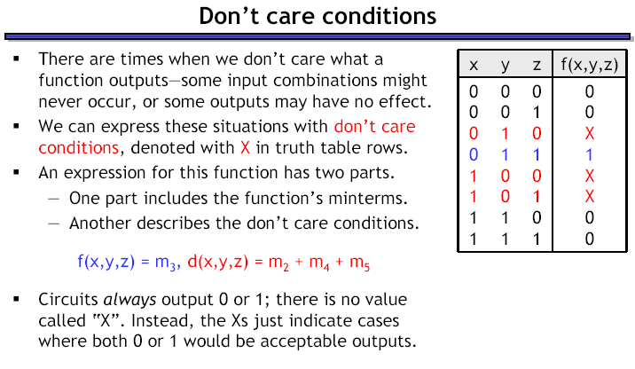
Example 5

Slide 14
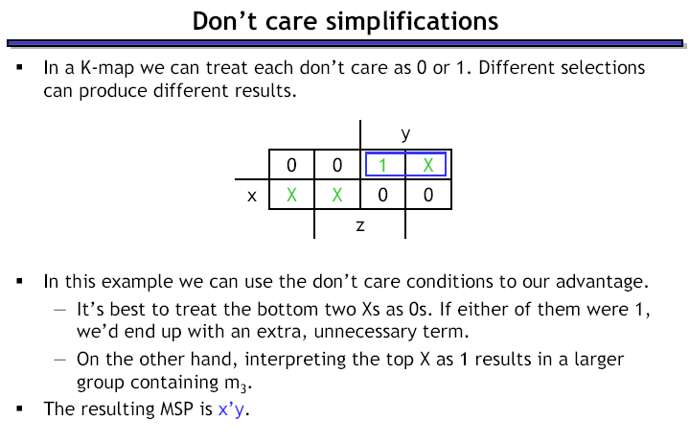
Example 5

Slide 15
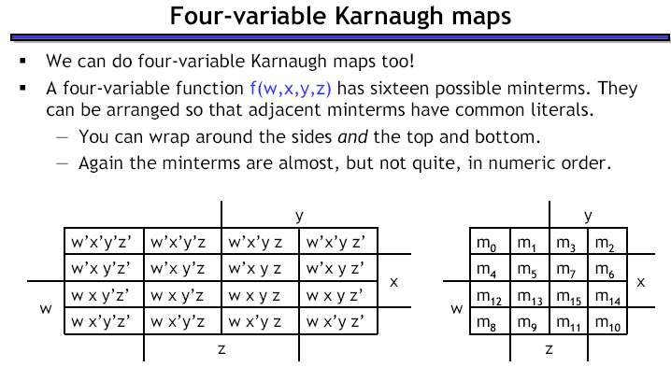
yz
wx

Slide 16
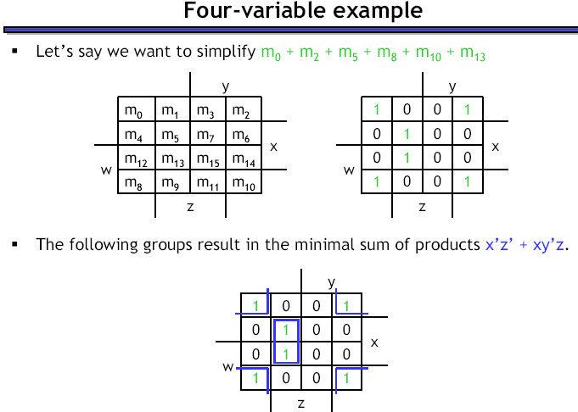
Example 6

Slide 17
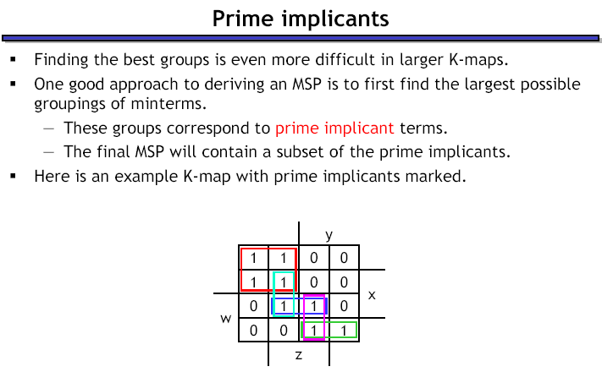
Example 7

Slide 18
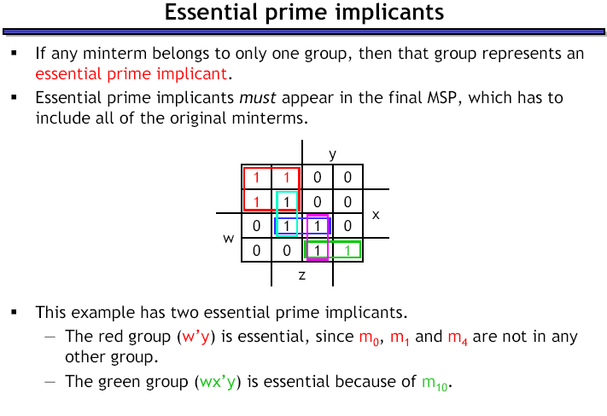
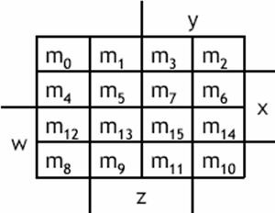

Slide 19
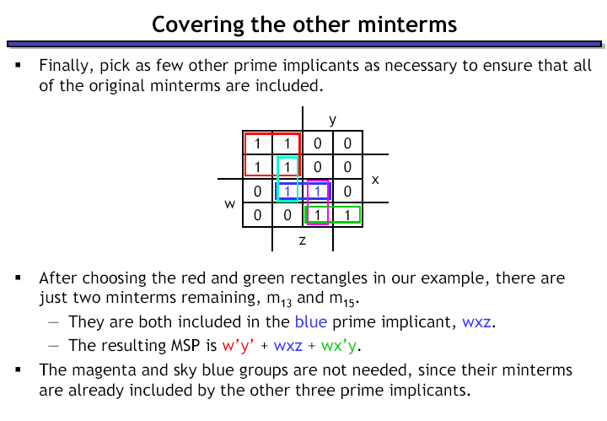
Example 7

Slide 20
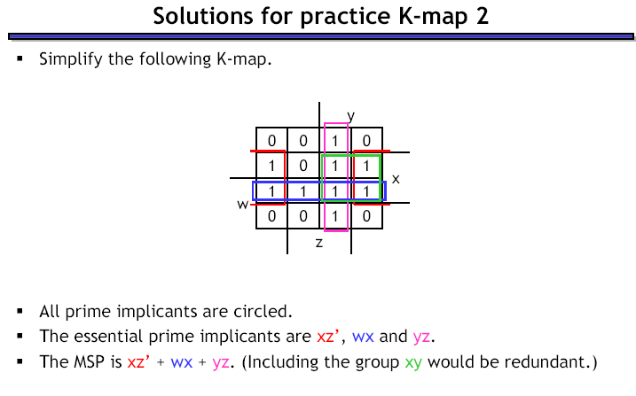
Example 8

Slide 21
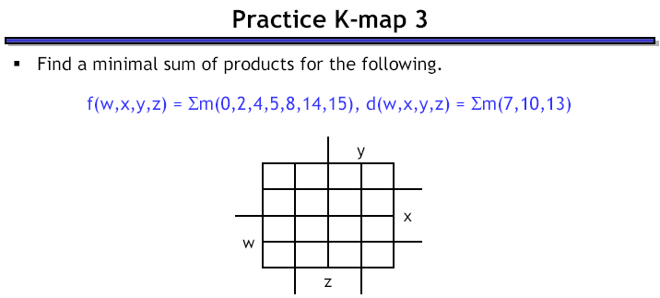
Example 9

Slide 22
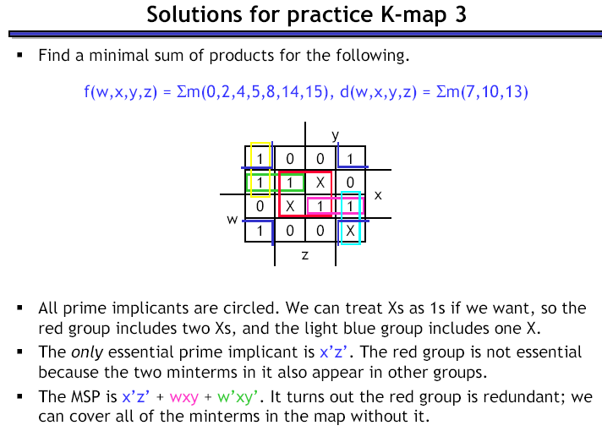
Example 9
Dr Mohamed A Berbar

Slide 23
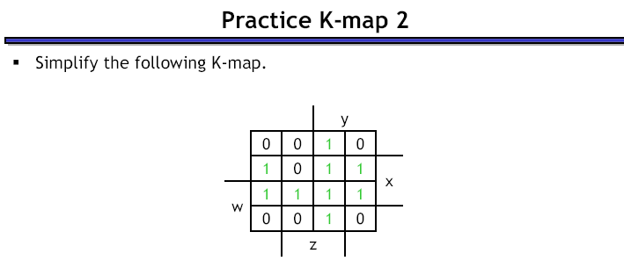
Example 8

Slide 24
Conclusion
Kmaps provide an easy graphical method of simplifying Boolean expressions.
A Kmap is a matrix consisting of the outputs of the minterms of a Boolean function.
In this section, we have discussed 2- 3- and 4-input Kmaps. This method can be extended to any number of inputs through the use of multiple tables.

Slide 25
Conclusion
Recapping the rules of Kmap simplification:
  Groupings can contain only 1s; no 0s.
  Groups can be formed only at right angles; diagonal groups are not allowed.
  The number of 1s in a group must be a power of 2 – even if it contains a single 1.
  The groups must be made as large as possible.
  Groups can overlap and wrap around the sides of the Kmap.
  Use don’t care conditions when you can.

