Slide 1
JavaScript-History
JavaScript first appeared in the Netscape Navigator 2 (NN2) browser.
Microsoft version of JavaScript is called Jscript.
 | Netscape | Microsoft
JavaScript 1.0 | NN2 | IE3 (early releases)
JavaScript 1.1 | NN3 | IE3 (later releases)
JavaScript 1.2 | NN4 | IE4

Slide 2
JavaScript-DOM
Document Object Model (DOM) is the architecture around which JavaScript operates.
The DOM is the structure of a document.
DOM objects are organized in a document.
It is a "roadmap" with which we access all the objects in the document.
The DOM defines what aspects of a browser window and a document within a window are scriptable.
A scriptable object is one that can be accessed by means of your script.

Slide 3
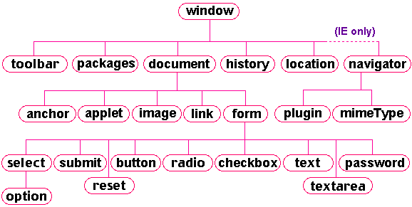
JavaScript-DOM

Slide 4
JavaScript-DOM
DOM is predefined by the browser makers and cannot be modified.
In order to be scriptable, an html feature must be loaded as an object into the browser’s document object model.
For example, textboxes are scriptable in JavaScript in a sense that you can change textbox content on the fly.

Slide 5
JavaScript-Intro
The HTML objects (DOM representation of html elements) have hierarchal relationship with each other.
Topmost object is basically navigator.
Next level is window. Then the document displayed in browser window.

Slide 6
DOM-Referencing Method 1
<body>
<form name="boxes"> Enter first name: <input type="text" name="fName"> <br> Enter last name: <input type="text" name="lName"> </form>
</body>
To reference a text object you must follow this path: window → document → form → text
using dot syntax: window.document.form.text or
document.form.text.
For the HTML above it would be: document.boxes.fName

Slide 7
DOM-Referencing Method 2
When the document is fully loaded, your browser creates arrays for the images, forms, links and anchors (and the rest).
It then places all the objects of each type into these arrays, indexed as they appear in the source code.
So, the reference to the first image to appear on the page will be document.images[0], and the third form will be document.forms[2].
For the second textbox in html above it would be document.form[0].elements[1] or document.forms[1].lname

Slide 8
JavaScript-Intro
JavaScript is an object-oriented programming language.
It is not fully object oriented though.
It does not support OO programming capabilities such as inheritance, encapsulation.
In an object-oriented setting, the objects are related to one another in a hierarchical fashion. For JavaScript, the relationship of the browser objects is predefined by the DOM.

Slide 9
JavaScript-What Happens
Browser basically paints the HTML received from server.
A copy of all the elements reside in browsers memory.
Once the HTML page is painted in the browser window, these elements are lost.
To make a page interactive (dynamic) these elements must be preserved.
Browsers use DOM to keep a copy of each element as an object in DOM.

Slide 10
JavaScript-DOM Object
Objects in the DOM have three important item attached to them: properties, methods and event handlers.
Properties are data elements of objects. For example for document object some properties are: bgcolor, title, URL
Methods are built-in actions or functions that an object can perform. For example for document object one common method is: write(). We use document.write(‘Hello’).
Most objects in the DOM have specific events to which they can respond. For example for form object we have onReset event that will fire when the text in textbox changes.

