Slide 1
Internet Technologies
CSC457

Slide 2
Internet – Various Views
A common man view:
WWW
ftp
telnet
email
Instant messaging
…

Slide 3
Internet – Various Views
A bit technical view:
A network of networks, joining many government, university and private computers together and providing an infrastructure for the use of e-mail, bulletin boards, file archives, hypertext documents, databases and other computational resources.

Slide 4
Internet – Various Views
Another view:
The vast collection of computer networks which form and act as a single huge network for transport of data and messages across distances which can be sent to anywhere from the same office to anywhere in the world.

Slide 5
Internet – Various Views
The largest network of networks in the world.
Uses TCP/IP protocols and packet switching.
Because it spans many countries Internet is called the global network.

Slide 6
Internet – Various Views
A bit different perspective
Internet provides an infrastructure for communications like postal system, telegraph, and telephone did earlier.
Telephones enabled voice communication. Internet enables data (text, voice etc) communication.

Slide 7
Evolution of the Internet - Reason
Why was it needed?
With lots of computers in an organization data sharing became necessary.
Data sharing thru disks is difficult and limited.
Direct communication/sharing became necessary.
LAN was the solution.

Slide 8
Evolution of the Internet - Reason
There are many different LAN technologies:
Ethernet
Token Ring etc
Each has different ways to connect computers, data packets format, data transmission rates, etc and thus incompatible.
Desirability of a single network to enable resource sharing.

Slide 9
Evolution of the Internet - Reason
WAN came into existence.
Still compatibility problem persists.
Desirability of a single network to enable resource sharing.

Slide 10
Evolution of the Internet - PC
1960: All large, mainframe computers
Mid 1970s: Initial personal computers
Altair: Box with blinking lights
Late 1970s: Apple 2.
1981: IBM PC.
1984: Apple Macintosh.
1986: Modem becomes option on PCs.

Slide 11
Evolution of the Internet - PC
Windows 95 GUI made computing easier for PC-bound masses.
Huge increase in number of home PCs.
Computer on every desk in workplace.

Slide 12
Evolution of the Internet
US DoD starts funding research on how to interconnect the networks.
1969 ARPANET was developed this was the first Internet.
1972 e-mail was adapted for ARPANET.
The telnet protocol, enabling logging on to a remote computer started in 1972.
The ftp protocol, enabling file transfers between Internet sites, started in 1973.

Slide 13
Evolution of the Internet
In 1993 first graphical browser Mosaic was developed by Marc Anderson and Eric Bina.
First point-and-click browser
Before it was not that way.
Later developed into Netscape Navigator.
It extended html with some new tags.
Mosaic made it possible for images and text to appear on the same page.

Slide 14
Evolution of the Internet
1957 – Communication between operational base and sub-contracters.
1962 – Breakthrough research.
First paper on packet-switching theory.
1965 – first “wide area network” created.
Connection between Berkeley and MIT.
1967 – plans for ARPANET were published.
1969 – Interface Message Processor (IMP).
4 computers (UCLA, SRI, UCSB and UTAH).
1971 – 23 host computers (15 nodes).

Slide 15
Evolution of the Internet
1972 – ARPANET went ‘public’
First program for person-to-person communication
(e-mail).
1973
75% of all ARPANET traffic is e-mail
First international connection (University College of London).

Slide 16
Evolution of the Internet
1974 – TCP/IP
Each network should work on its own.
Within each network there would be a gateway.
Packages would be routed through the fastest available route.
Large mainframe computers.
Several years of modification and redesign.

Slide 17
Evolution of the Internet
1974/1982 – Networks launched
Telenet – first commercial version of ARPANET
MFENet – researchers into Magnetic Fusion Energy
HEPNet – researchers into High Energy Physics
SPAN – space physicists
Usenet – open system focusing on e-mail and newsgroups
Bitnet – university scientists using IBM computers
CSNet – Computer Scientists in universities, industry and government
Eunet – European version of the Unix network
EARN – European version of Bitnet

Slide 18
Evolution of the Internet
1974/1982
Different competing techniques and protocols
ARPANET is still the backbone
1982
The internet is born using the TCP/IP standard

Slide 19
Developments
System expands
Advances in computer capacities and speeds
Introduction of glass-fibre cables
Problems created by its own success
More computers are linked (1984 – 1000 hosts).
Large volume of traffic (success of e-mail).
1984 – Introduction of DNS
Distributed and scalable mechanism for resolving host names into IP addresses.

Slide 20
Developments
Use of internet throughout the higher educational system.
British government – Joint Academic Network
US National Science Foundation – NSFNet
NSFNet
Use of TCP/IP
Federal Agencies share cost of infrastructures
NSFNet shared infrastructure
Support behind the ‘Internet Activities Board’
NSFNet provided the ‘backbone’

Slide 21
Evolution of the Internet
1990 – ARPANET was wound up
1990 – first search-engine (Archie)
1990 – first browser/editor program
1991 – NSF removed restrictions on private access.
Around 1990: Commercial users

Slide 22
Evolution of the Internet
Some facts
1994 – Hotmail starts web based email
1994 – World Wide Web Consortium (W3C) was founded
1995 – JAVA source code was released
1998 – Google is founded

Slide 23
Evolution of the Internet
1967 Ted Nelson attempted Xanadu similar to hypertext (text that contains links to other text) today.
1990 Tim Berners-Lee proposal for WWW (world wide web).
He invented html.
First web page on November 13, 1990

Slide 24
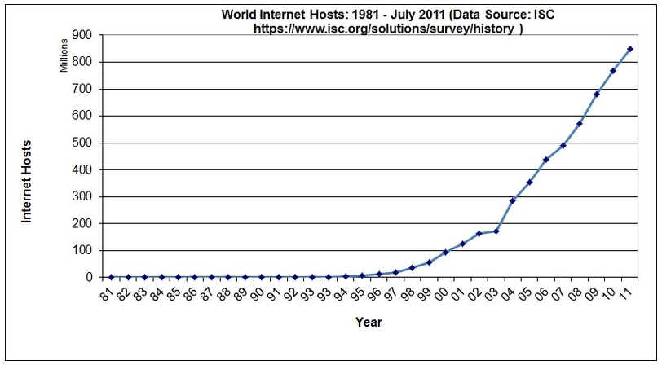
Internet Growth

Slide 25
Internet Growth
World Internet Usage And Population Statistics
30-Jun-12
World Regions | Population | Internet Users | Internet Users | Penetration | Growth | Users %
 | ( 2012 Est.) | Dec. 31, 2000 | Latest Data | (% Population) | 2000-2012 | of Table
Africa | 1,073,380,925 | 4,514,400 | 167,335,676 | 15.60% | 3606.70% | 7.00%
Asia | 3,922,066,987 | 114,304,000 | 1,076,681,059 | 27.50% | 841.90% | 44.80%
Europe | 820,918,446 | 105,096,093 | 518,512,109 | 63.20% | 393.40% | 21.50%
Middle East | 223,608,203 | 3,284,800 | 90,000,455 | 40.20% | 2639.90% | 3.70%
North America | 348,280,154 | 108,096,800 | 273,785,413 | 78.60% | 153.30% | 11.40%
Latin America / Caribbean | 593,688,638 | 18,068,919 | 254,915,745 | 42.90% | 1310.80% | 10.60%
Oceania / Australia | 35,903,569 | 7,620,480 | 24,287,919 | 67.60% | 218.70% | 1.00%
World total | 7,017,846,922 | 360,985,492 | 2,405,518,376 | 34.30% | 566.40% | 100.00%

Slide 26
Internet Growth
1977: 111 hosts on Internet
1981: 213 hosts
1983: 562 hosts
1984: 1,000 hosts
1986: 5,000 hosts
1987: 10,000 hosts
1989: 100,000 hosts
1992: 1,000,000 hosts
2001: 150 – 175 million hosts
2002: over 200 million hosts
By 2010, about 80% of the planet will be on the Internet

Slide 27
Internet Growth – Host Count
January 1993 the count was 1,313,000
January 2011 the count was 818,374,269.
63000% growth in 18 years
Definitely a tremendous growth!

Slide 28
Internet Growth – Domain Count
1998 the count was 2,154,634.
2009 the count was 111,889,734.
Some countries have 20% growth over year
Daily Around 22,000 new .com domain are registered not counting other domains (.edu, .net etc).
These figures are not very accurate and not possible to get them but they give the picture.

Slide 29
Internet Growth
To reach 50 million people:
Radio took 38 years.
TV took 13 years.
Internet took just 4 years.

