Slide 1

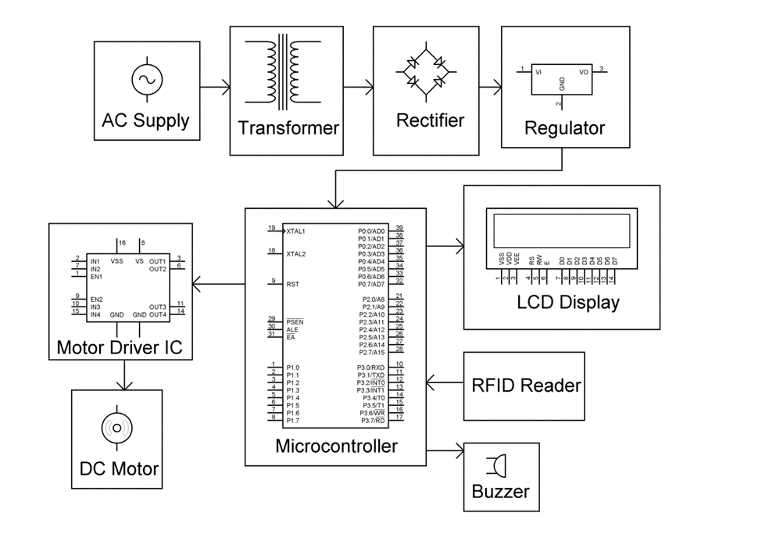
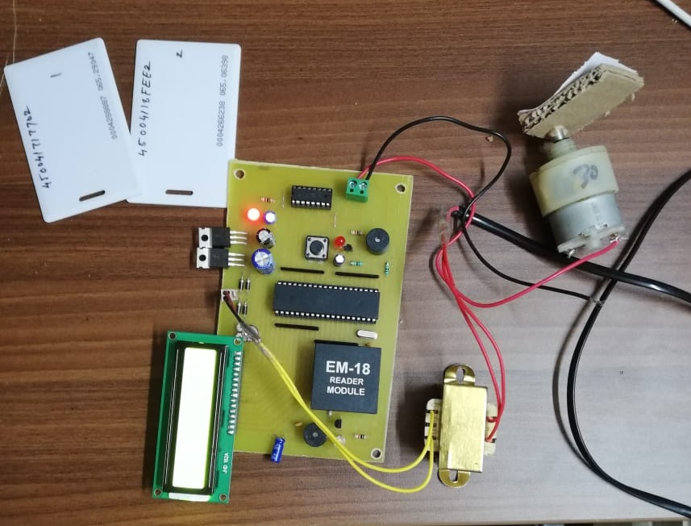
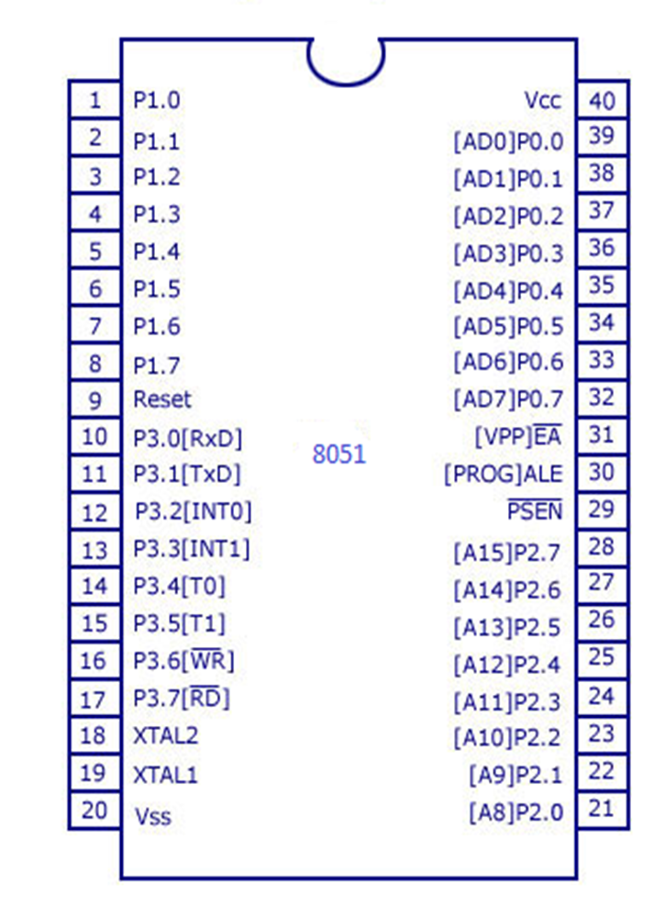
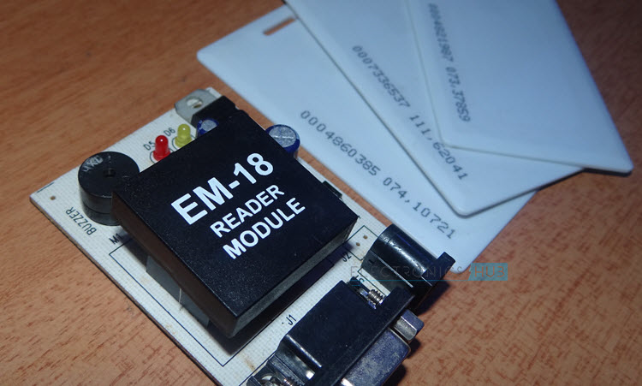
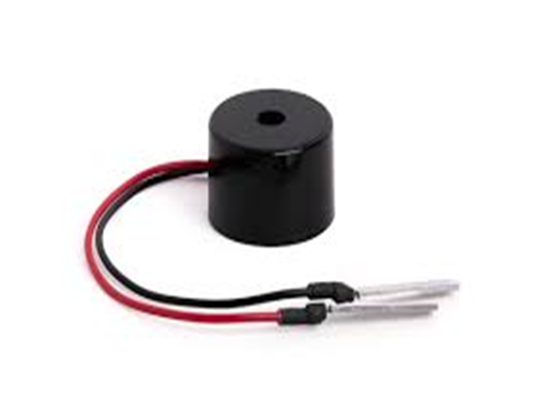
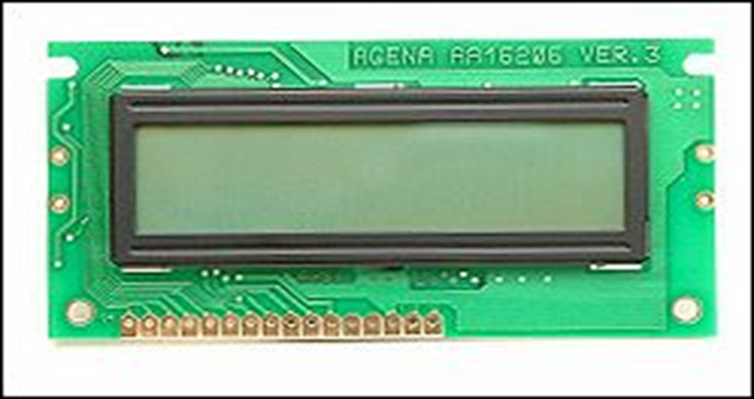
RFID BASED HOME SECURITY SYSTEM
Guided by-Dr. Rama Sreekanth Sir
Motivation/ Introduction
Results
Automatic identiﬁcation and access control system has become necessary to overcome the security threats faced by many. By installing the system at the entrance will only allow the authorized persons to enter the premises. The system can also be installed at various points inside the premises to track the person’s movement and to restrict their access to sensitive areas in the premises
RFID- it stands for radio-frequency identification. RFID based access-control system allows only authorized people to enter a particular area of an establishment. With the help of RFID technology we can create smart systems that can be used personnel identiﬁcation. RFID systems usually comprises of three components: an RFID Card, an RFID Reader Module and a host device. Active RFID Tags are battery powered and they have an electronically erasable and programmable memory so we use Passive RFID beside Active RFID(Passive RFID-coil and microchip charges through induction).
With the help of suitable programming, we need to compare the received card no. with the numbers that are already stored in the microcontroller or any database like external memory unit.
If the received number is matched with the already stored number, then the microcontroller will display the name of the card holder on the LCD and activates the motor driver IC. As a result, the door is opened for a predefined duration after which the door is automatically closed.
If there is no match for the received numbers with the stored numbers, then the microcontroller will not open the door and displays a message as “Access Denied” on the LCD display
SCOPE of the Project
We can add voice recognition to the system. Even though RFID Technology is secure, the security can be increased by integrating other security measures like facial detection, ﬁnger print scanner etc. As the card details are stored in the micro controller, only a limited number of card details can be stored. This can be increased by implementing a memory unit like EEPROM.{electrically erasable PROM}.
Methodology
The principle of operation of this project is based on the working of the RFID Circuit. A Passive type RFID Card is used in this project. When this card is placed near the RFID Reader Module, the antenna coil in the Reader energies the coil in the RFID card through mutual induction. As a result, the microchip in the reader also gets enough power to turn it on. Now the coil in the reader acts as an antenna and transfers the data in the microchip to the reader module through radio communication. The reader module, then communicates with the microcontroller through UART protocol to transfer the data received from the card . When the circuit is powered ON, the microcontroller will initially display a message as “Swipe the Card” on the LCD display.
When the RFID Card or Tag is swiped against the RFID reader, it will detect the ID card and sends the unique card no. to the microcontroller via serial terminal. With the help of suitable programming, we need to compare the received card no. with the numbers that are already stored in the microcontroller or any database like external memory unit . If the received number is matched with the already stored number, then the microcontroller will display the name of the card holder on the LCD and activates the motor driver IC. As a result, the door is opened for a predefined duration after which the door is automatically closed.
If there is no match for the received numbers with the stored numbers, then the microcontroller will not open the door and displays a message as “Access Denied” on the LCD display.
Conclusion/ Summary
Even though RFID Technology is secure, the security can be increased by integrating other security measures like facial detection, ﬁnger print scanner etc. As the card details are stored in the micro controller, only a limited number of card details can be stored. This can be increased by implementing a memory unit like EEPROM.{electrically erasable PROM}.
Contact Details
Vbhupathi.g@vitap.ac.in
Acknowledgments/ References-
Electroicshub.com

