Slide 1


King County Housing Price Model
Sunita Chand and Peter Zimmerman

Slide 2
Introduction/Overview
Project Goals:
Explore and analyse data influencing factors.
Predict housing prices in King County (Seattle area) using linear regression.
Data: Market sales from years 2014-2015 (KC source)
21613 sales records and 20 features. Range of target variable min(price)=$134,000.0 and max(price)=$2,450,000.
Features influencing price?
Expectations - size, location, amenities, construction cost, # of rooms, waterfront, …

Slide 3
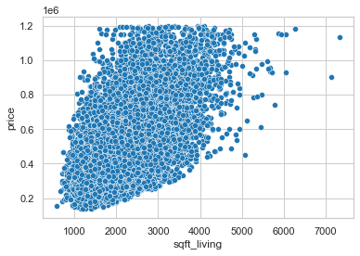
Key Price Indicators: Size
We find that price is most strongly correlated with living space

Slide 4
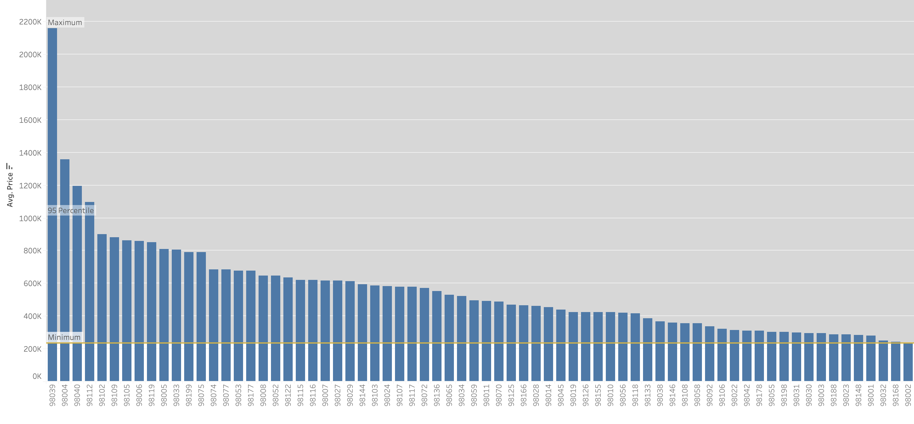
Key Price Indicators: Location
Zipcode
Zipcode acts a categorical feature. It has no natural
ranking but it’s discrete.
Medina & Bellevue regions

Slide 5
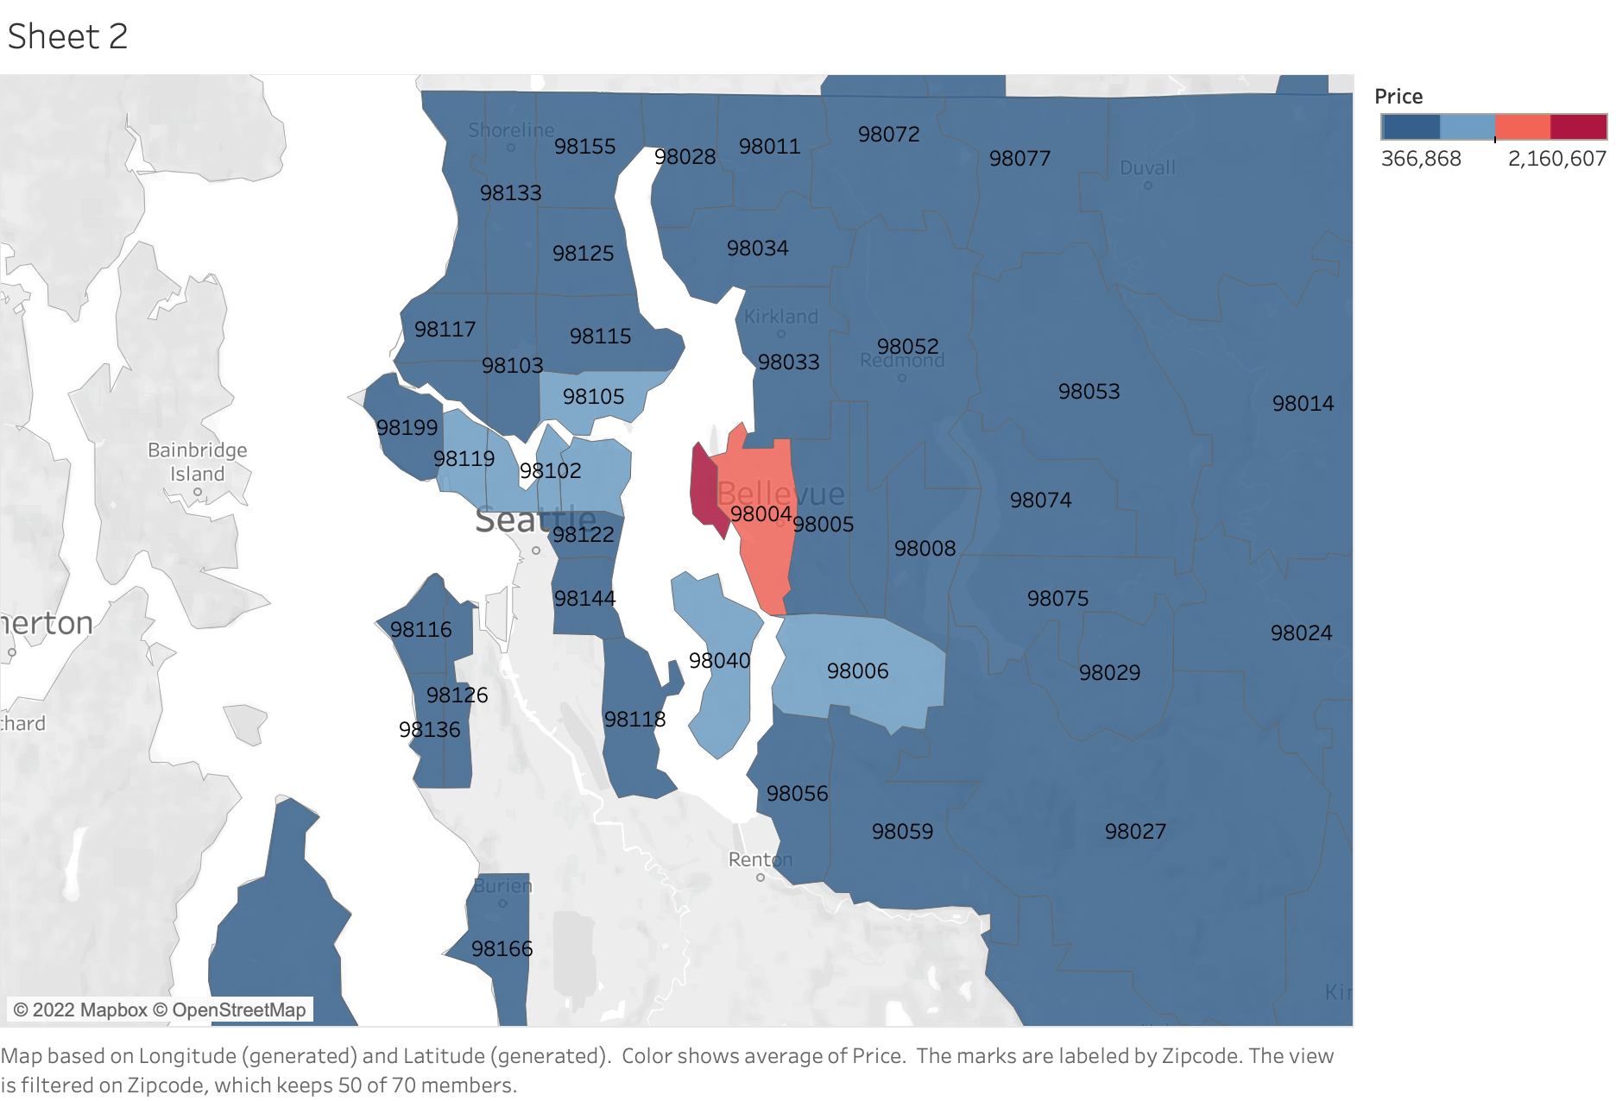


Price variation by region

Slide 6
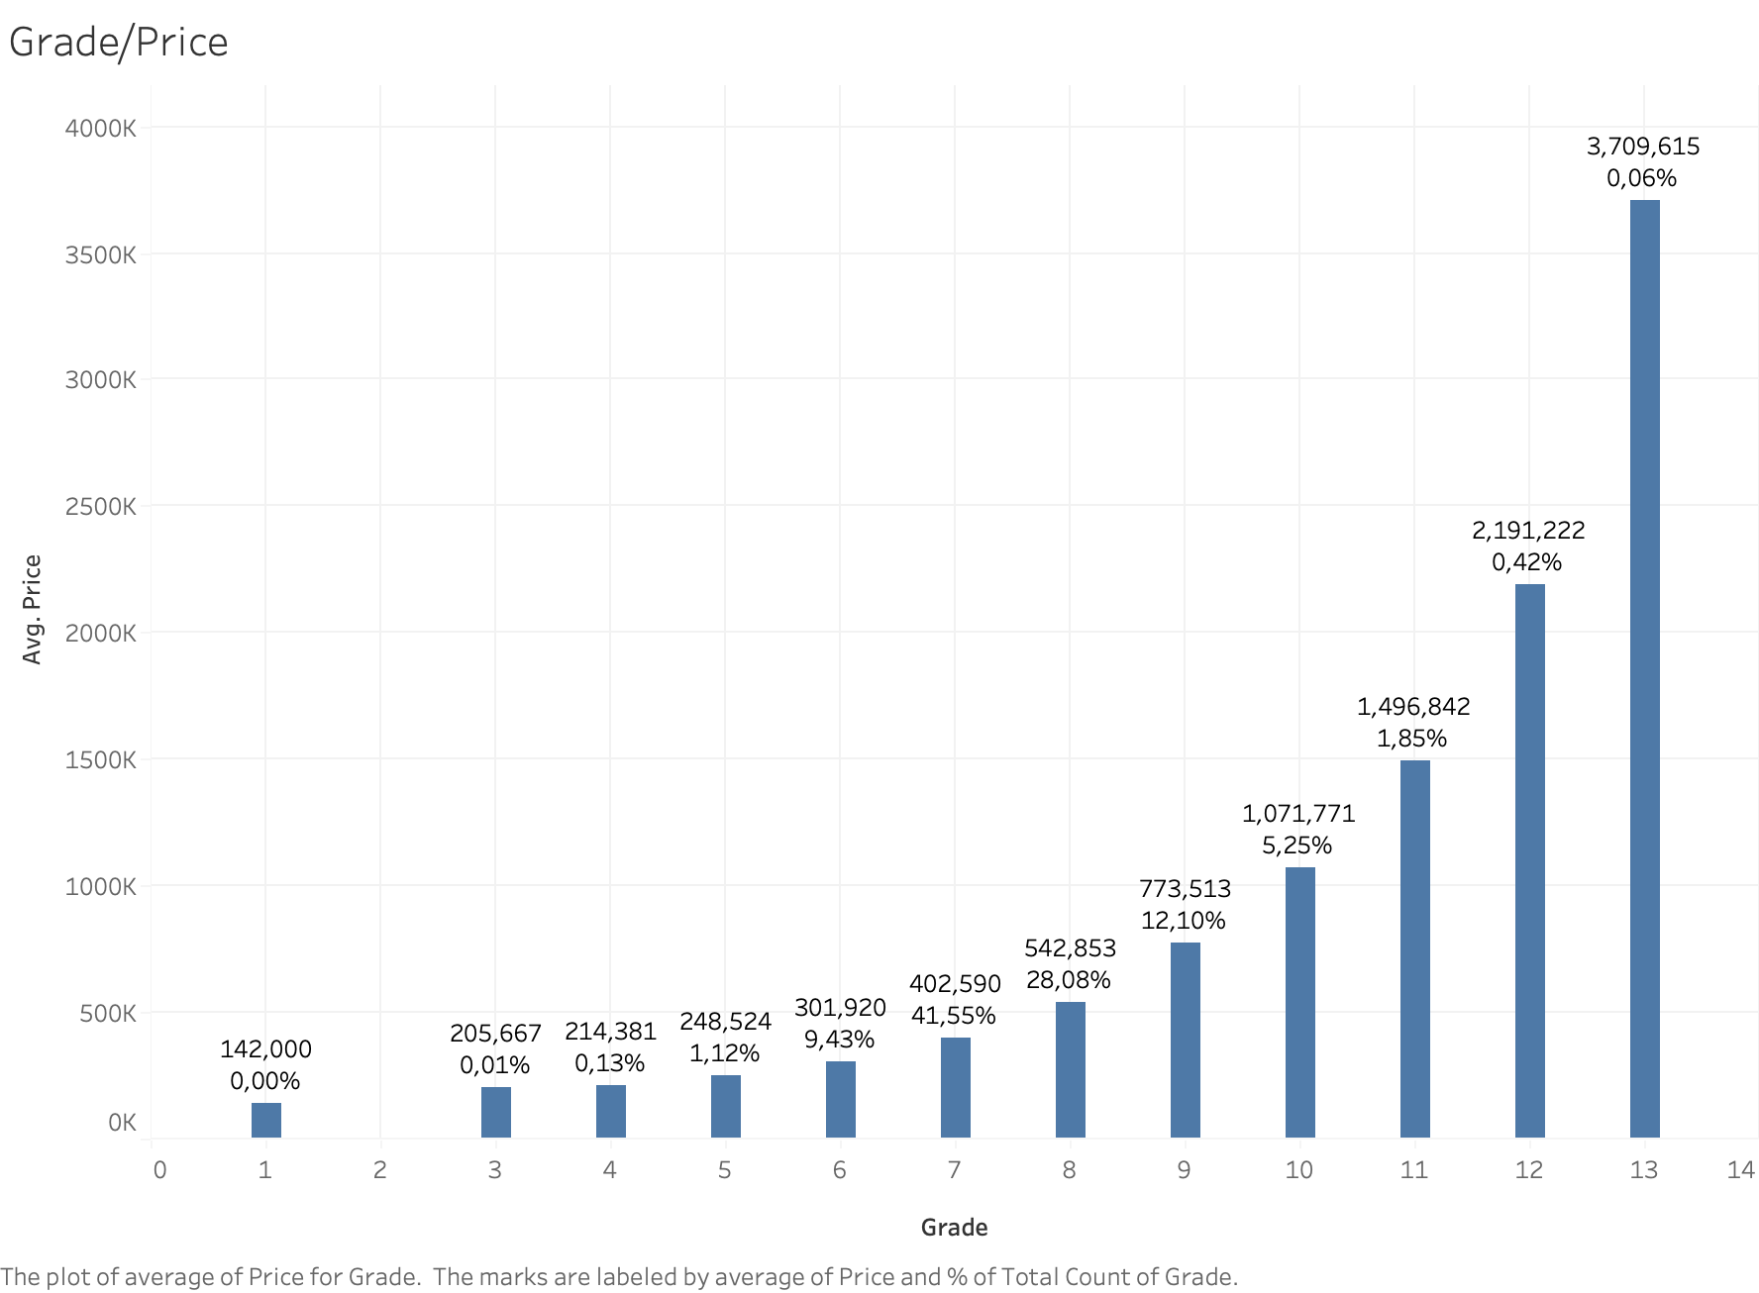
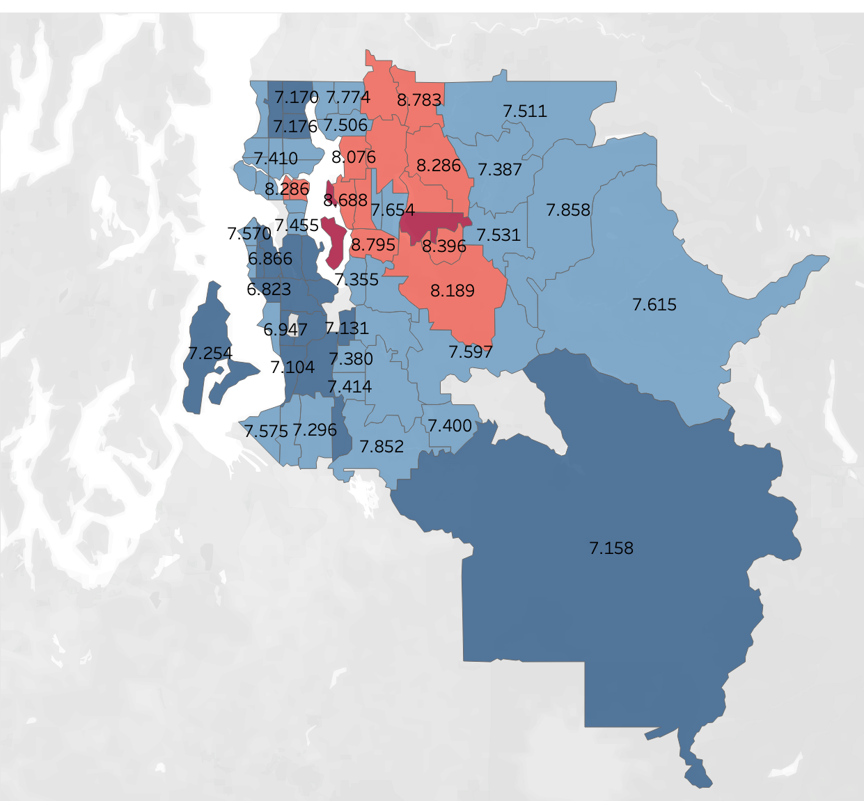
Key Price Indicators: Grade
Grade is determined by the construction costs (materials, etc). We see that building on the island is the very costly!

Slide 7
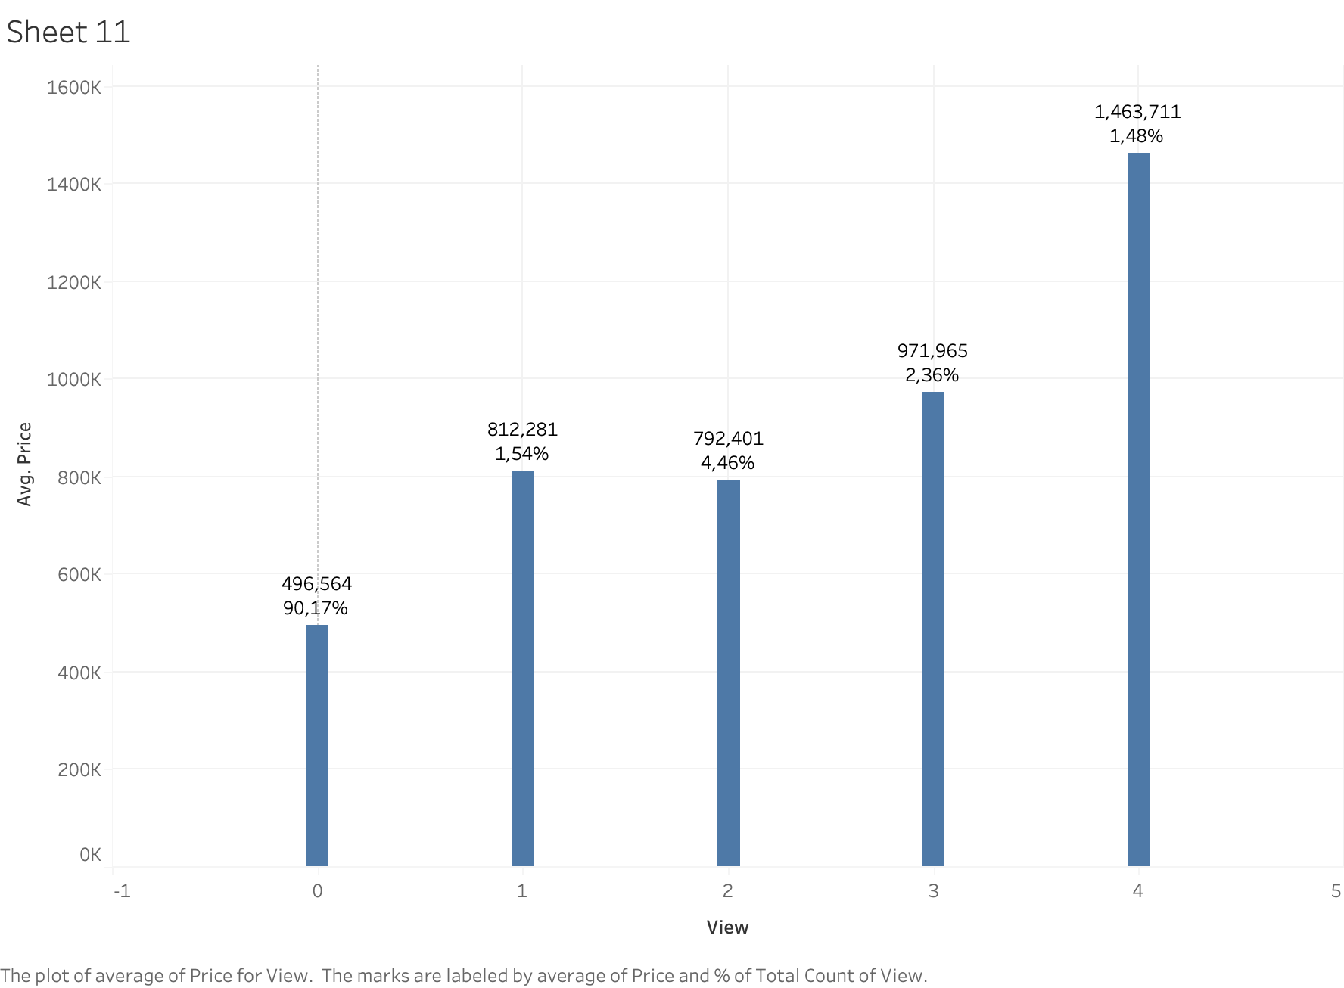
Secondary Price Indicators: View and Waterfront
Waterfront (yes or no)
Houses with waterfront cost roughly 3x more on average.
View is given as rank from 0 to 4.
90% of houses sold have a view rank 0. However, those with a view see an increases the price of around 20%.

Slide 8
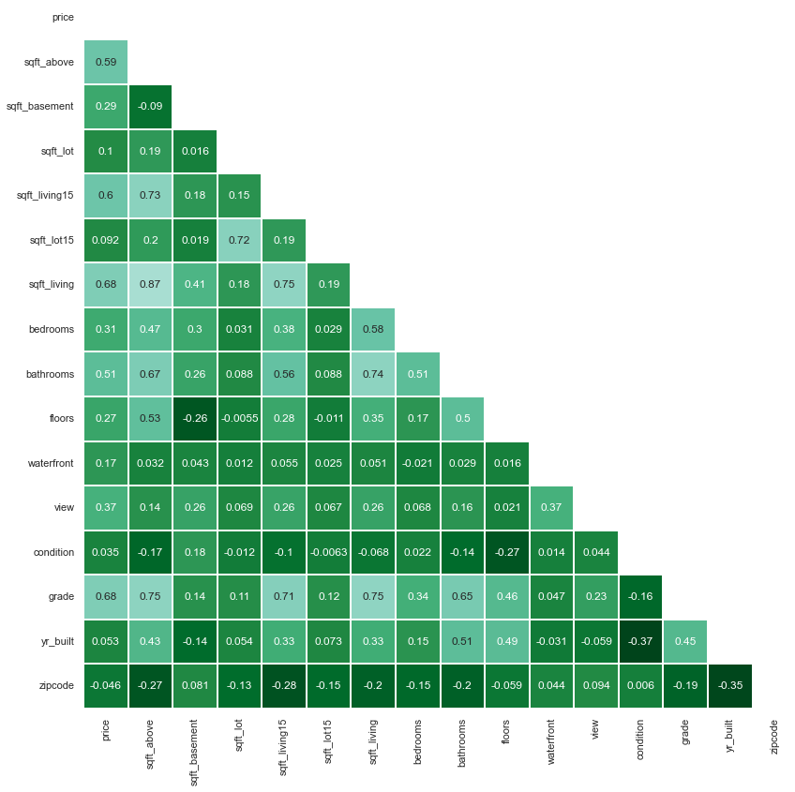
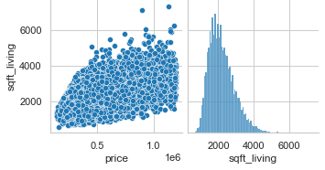
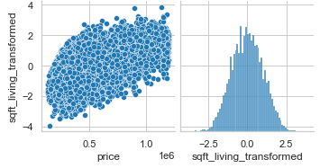
Encoded
Dropped
Transformed
Important
Transformed

Slide 9
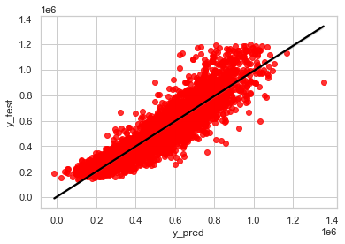
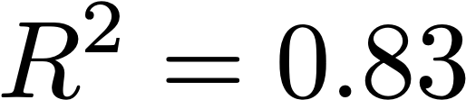
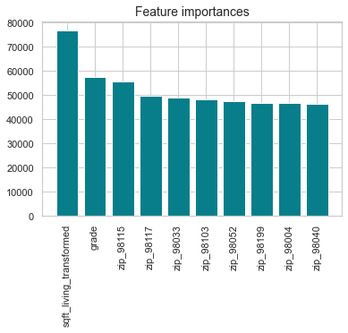

Modeling Results
Linear regression predicts the KC house price to within an error of 65k on average.
The model is influenced primarily by size, grade, and zip code as expected.
Residuals

Slide 10

Conclusions and future directions
EDA insights:
KC County house cost depends mostly on size, grade, and location. Additional factors such as waterfront and view serve to increase price.
Model results:
Linear regression provides housing predictions to reasonable accuracy after data conditioning, with an error of about 65k on average and
Improvements:
Adding more features like school quality, crime, income, etc could improve the model.

