Slide 2
Master Thesis Concept Presentation – Design and Implementation of a web-based User Interface for the guided Assessment of Reliability of Classification Results using the Perturbation Approach
Speaker: Pascal Badzura
Supervisors: Assoz.-Prof. Mag. Dr. Christoph Schütz; Simon Staudinger, MSc
Master‘s Thesis Seminar (239.705)

Slide 3
Agenda
Motivation
Reference Process
Perturbation Approach
Perturbation Options
Example - Perturbation Table
Knowledge Graph
Methodical Approach
Goals
Status & Plan

Slide 4
Motivation

Slide 5
Motivation
Organizations develop and use predictive classification models
How reliable are my results?
Reference Process for assessing the Reliability of individual Classification results

Slide 6
Reference Process

Slide 7
Reference Process
Business Understanding
Data Understanding
CRISP DM
Methodology for data mining and machine learning projects
Assessing the reliability of classification results
Along each CRISP-DM step, knowledge is gathered and saved in a knowledge graph
Deployment
Data Preparation
Evaluation
Modeling

Slide 8
Perturbation Approach

Slide 9
Perturbation Options
Create new feature values with perturbation options
Influencing factors
Scale
Volatility
Restrictions
Binning
Missing values
Cardinal
Percent
Range
Sensor
Fixed Amount
Ordinal
In Order
All Values
Nominal
All Values

Slide 10
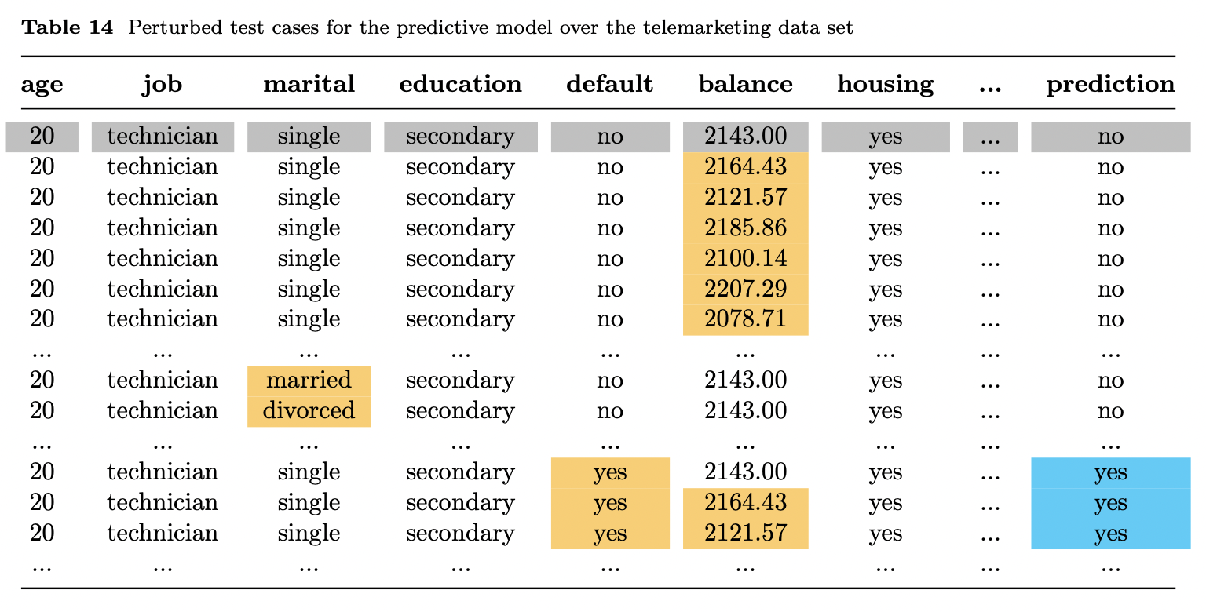
Example – perturbation table
Generate perturbation case
Receive prediction for perturbed case
Predict classification case
Source: Staudinger, S., Schütz C., Schrefl M.: A Reference Process for Assessing the Reliability of Predictive Analytics Results

Slide 11
Knowledge Graph

Slide 12











Knowledge Graph
What is a Knowledge Graph?
Type of data model that represents entities and the relationships between them
Subject
Predicate
Object
Business Understanding
WasDerivedFrom
Data Understanding
Perturbation Option
Data Preparation
Goals
Design and documentation
Recommendation
Quality management / Decision Audit

Slide 13
Methodical Approach

Slide 14
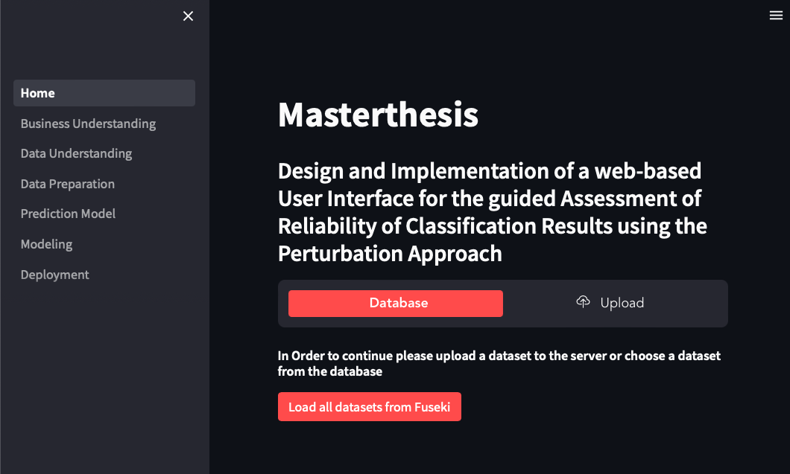











Methodical approach
Graph
Database

Slide 15
Goals
Notes:
In their paper Mr. Staudinger, Schütz and Schrefl introduced a knowledge graph which records how the collected data is generated and stored

Slide 16
Goals
1
Generic web app which maps the entire process
2
Automatically generate and store knowledge graph to store historical decisions
3
Recommendation system

Slide 17








Current status and plan
Writing thesis
New cases in form of data can be uploaded
Pipeline for model prediction
Modeling Phase
Creation of perturbation options
Further steps
Stability
UI/UX
Implementation of Business & Data Understanding phase
Upload perturbation cases to graph database
Connect Web-App to Fuseki
Create recommendation system
Implementation of Data Prepation activities

