Slide 1
Understanding Diabetes Progression
What the data can — and can't — tell us about patient risk
Analysis of 442 patients · Prepared for a health-service decision-maker

Slide 2
The question and the data
We asked: which patient characteristics go along with faster diabetes progression?
442
10
1
patients in the dataset
baseline characteristics recorded per patient — age, sex, BMI, blood pressure, and six blood measures
outcome: a progression score measured one year later
The data came from patient records, not from an experiment , patients were measured as they were, not assigned to different conditions. This matters for how we can interpret the results (see slide 5).
2

Slide 3
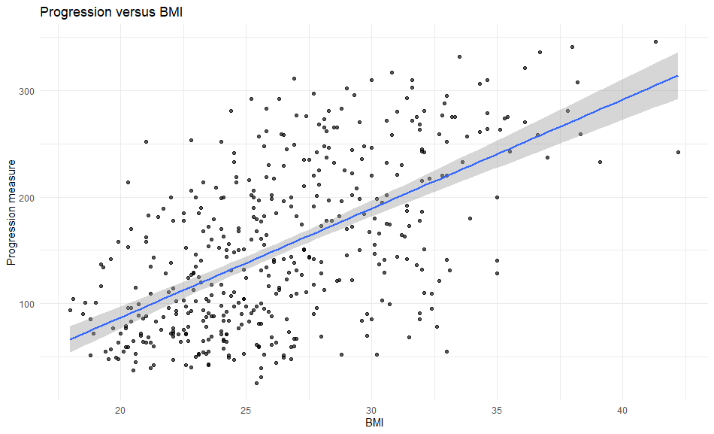
The clearest patterns in the data
Three factors stand out
Body mass index (BMI) — the strongest single factor
A blood-lipid measure (labelled s5 in the data)
Blood pressure
Patients who were higher on all three tended to show noticeably more progression than patients who were lower on all three. Age and sex, on their own, were much weaker signals.
Higher BMI goes with higher progression
3

Slide 4
What this means in practical terms
A model combining BMI, blood pressure and the blood-lipid measure explains about half of the differences in progression scores between patients.
In plain terms
Knowing a patient's BMI, blood pressure and blood-lipid level gives a genuinely useful read on their general risk profile although it still leaves roughly half the picture unexplained by other, unmeasured factors.
4

Slide 5
The main limitation to keep in mind
This is an observational study, not an experiment.
Patients were simply measured as they were, they were not randomly assigned to different BMI or blood-pressure levels the way patients might be assigned to a treatment in a clinical trial.
What that means:
The patterns are real associations, but we cannot say BMI or blood pressure causes faster progression.
Other unmeasured factors as medication, diet, activity levels, how long someone has had diabetes could explain some of what we're seeing.
We don't know how representative these 442 patients are of your own patient population, so the exact numbers may not transfer directly.
5

Slide 6
The bottom line
This analysis DOES support
This analysis does NOT support
• BMI, blood pressure and a blood-lipid measure are reliably linked to diabetes progression in this sample.
• Together they capture a genuinely useful, moderate share of patient-to-patient differences, useful for flagging higher-risk patients for closer attention.
• That changing these measures would cause progression to slow down.
• Precise, individual-level prediction because half the picture is still unexplained.
• Assuming the same pattern applies unchanged to a different patient population.
6

