Slide 1
Exploring Suburbs in Great Sydney

Slide 2
Introduction
Sydney is the capital city of New South Wales (NSW) and home to over 60% percent of the state's popolation. The city is made of 658 suburbs and spreads over 33 local government areas. Sydney is ranked in the top ten most livable cities but also one of the most expensive cities in the world. It's the financial capital of Australia, and some of Australian top universities are also located in Sydeny. Sydney has attracted both domestic and oversea people to start a new life here.
The aim of this project is to explore top venues in boroughs of Sydney and help residents fresh off the boat find optimal residence locations and adjust to the new living environment. The target object includes both students and people who want to pursue their career in Sydney.

Slide 3
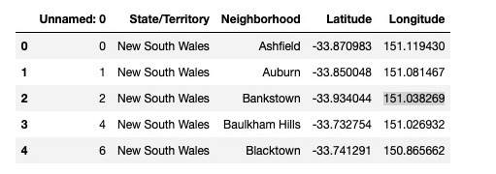
Data
The spatial data utilized in this project is imported from New York University's (NYU) Spatial Data Repository.
Second-level Administrative Divisions, Australia, 2015 (https://geo.nyu.edu/catalog/stanford-fc944xn1421)
Four columns are defined as State/Territory, Borough, Latitude and Longitude, and relevant data are imported from the spatial data.

Slide 4
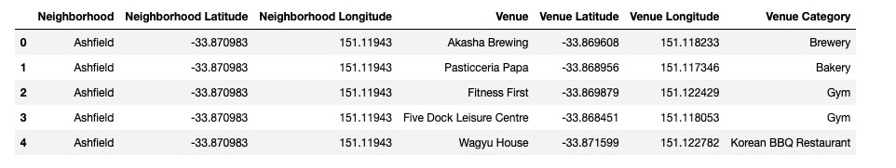
Data
Then Foursquare location data was applied to exlore the top venues in each suburb.
For each suburb in Sydney, the top 10 venues within the radius of 1km are selected for further explorations, including 78 unique categories.

Slide 5
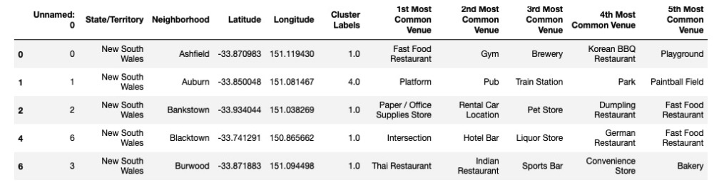
Methodology
The data are fit into the unsupervised K-means clustering algorithm in order to divide the neighborhoods into different clusters basing on the top 5 venues of each neighborhoods.

Slide 6
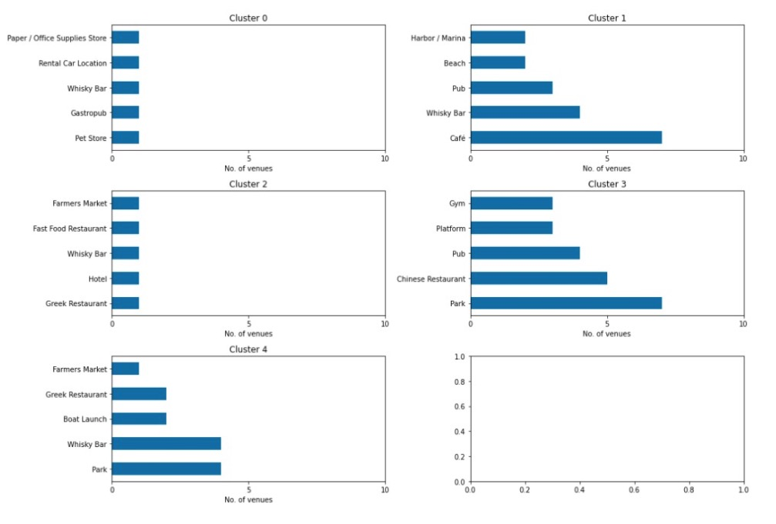
Results

Slide 7
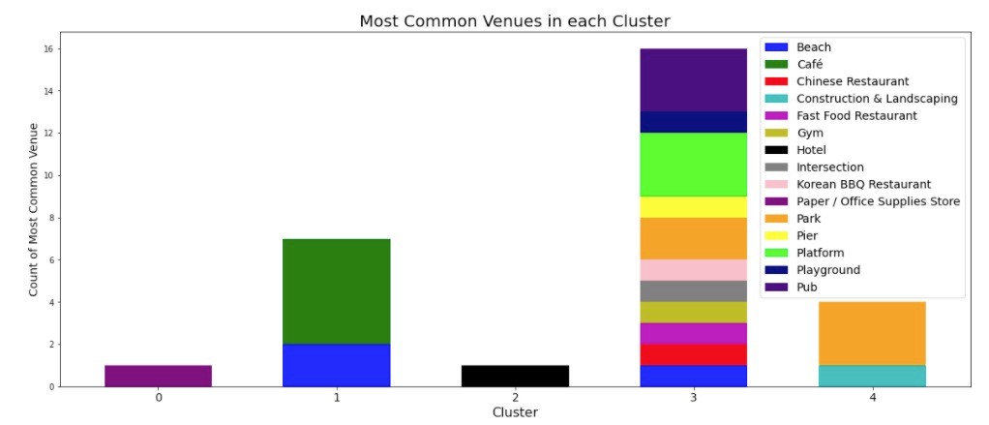
Results

Slide 8
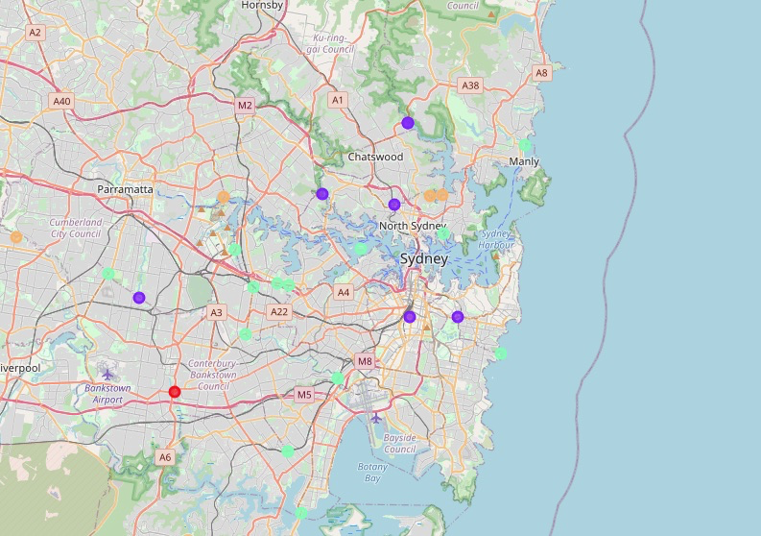
Results

Slide 9
discussion
The neighborhoods are not evenly distributed into the five clusters. Each cluster has its unique features and shares similarities with others.
For similarities, cluster 0, 1, 2 and 4 all have whisky bar as the top 3 or 4 venue; moreover, the five clusters all have common venues related to alcohol drinks such as whisky bar, pub and hotel.
As for features, cluster 0 has more frequent visits to office supplies store, retal car location, gastropub and pet stores that do not appear in top venues of other clusters. Cluster 1 holds higher part of seaside locations like harbor and beach. Food and drinks cover the top venues of cluster 2. Cluster 3 has more number of gym, platform and park. Cluster 4 is similar to cluster 2 to some extent, but it has more number of boat launch and park.

Slide 10
conclusion
If a person is an office supply and pet lover, willing to drive around, it will be nice to live in Bankstown.
If a person is interested in seas and drinks, living in neighborhoods like Hunters Hill, Parramata and Sydney etc. will be ideal.
If a person is a food and drink lover, Pittwater is a good choice.
If a person is sporty and likes to hang out, it is a good choice to live in Ashfiels, Canada Bay and Blacktown etc.
If a person is a food lover but also loves boating, Holroyd, Mosman and Ryde etc. are on top of the list.

