Slide 1
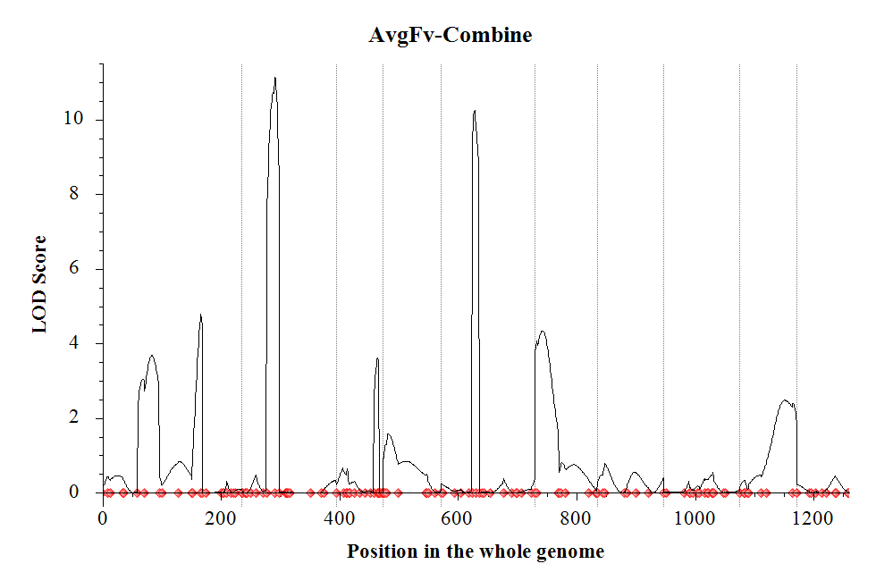
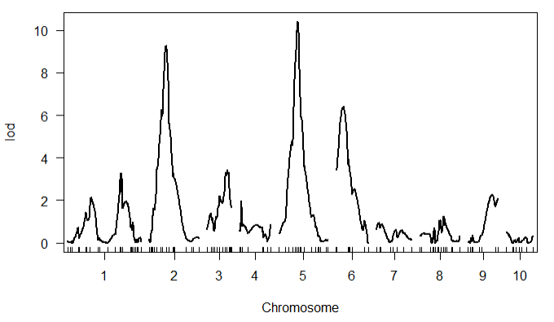
Population1
R/QTL
ICI Mapping
Chromosome | Position | LeftMarker | RightMarker | LOD | PVE(%) | Add
1 | 83 | PZA03168_5 | PZA01267_3 | 3.6801 | 5.6822 | 4.5519
1 | 166 | PHM5480_17 | PHM14614_22 | 4.7742 | 5.986 | -4.684
2 | 56 | PZA00590_1 | PZA02378_7 | 11.1481 | 15.4103 | 7.5735
3 | 70 | PZA03647_1 | PHM13673_53 | 3.621 | 4.2584 | 3.9565
5 | 56 | PHM12992_5 | PHM2524_4 | 10.2444 | 13.5598 | 7.1035
 | chr | pos | lod
c1.loc170 | 1 | 170 | 3.3
c2.loc53 | 2 | 53 | 9.27
c3.loc64 | 3 | 64 | 3.45
c5.loc62 | 5 | 62 | 10.42
c6.loc23 | 6 | 23 | 6.4
LOD threshold 3.42

Slide 2
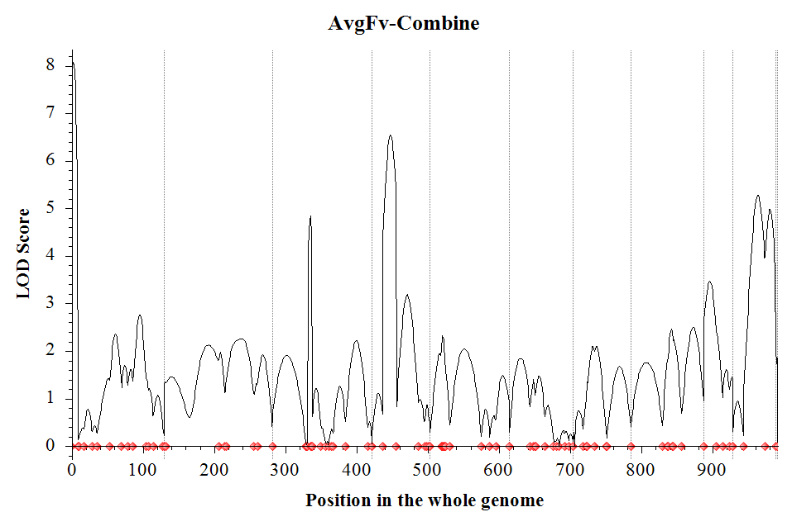
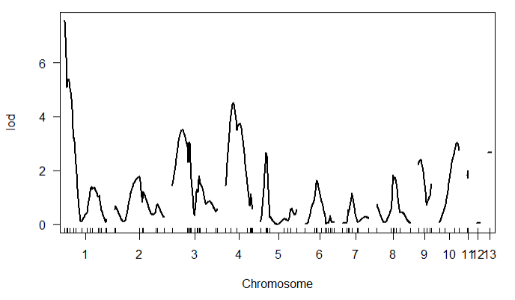
Population2
Chromosome | Position | LeftMarker | RightMarker | LOD | PVE(%) | Add | Dom
1 | 2 | PZA02490_1 | PZA00240_6 | 8.0807 | 11.3574 | 6.668 | -0.534
1 | 96 | PHM14475_7 | PHM595_30 | 2.7628 | 4.0143 | -3.8529 | -1.4356
3 | 54 | PZB02179_1 | PHM9914_11 | 4.8452 | 6.1119 | -4.5802 | 2.1489
4 | 26 | PZA02358_1 | PHM3112_9 | 6.5348 | 9.2691 | -5.8284 | 0.0881
4 | 50 | PHM5572_19 | PHM14618_11 | 3.1862 | 3.934 | -1.0305 | 5.2871
9 | 8 | sh1_12 | PHM9374_5 | 3.4669 | 3.9399 | 3.7433 | 1.1165
10 | 36 | PHM4066_11 | PZA03607_1 | 5.275 | 7.8202 | 5.451 | 0.0575
10 | 53 | PZA03607_1 | PZA01001_2 | 4.9806 | 6.9607 | 5.1526 | -0.8868
 | chr | pos | lod
PZA02490_1 | 1 | 0 | 7.57
c3.loc30 | 3 | 30 | 3.51
c4.loc23 | 4 | 23 | 4.5
c10.loc54 | 10 | 54 | 3.02
LOD threshold 3.28

Slide 3
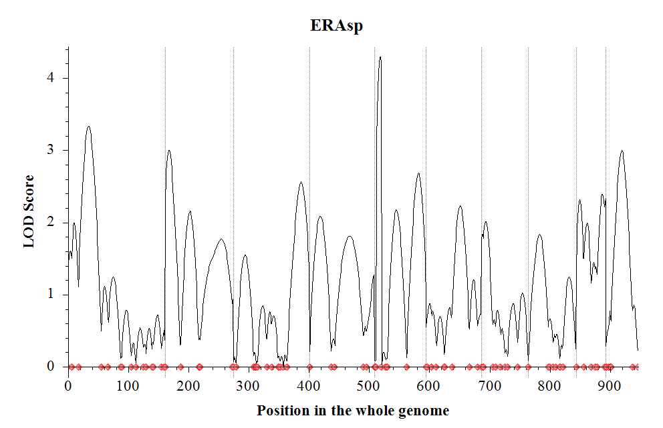
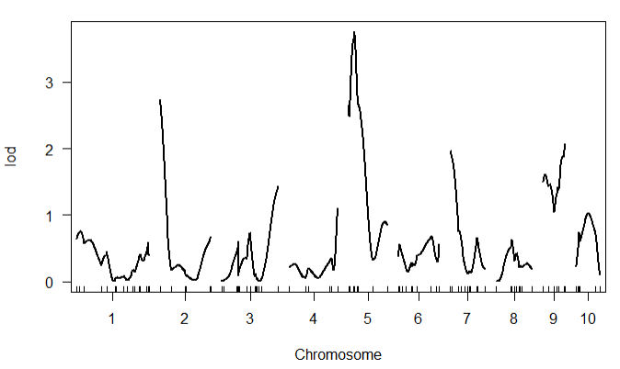
Population3
Chromosome | Position | LeftMarker | RightMarker | LOD | PVE(%) | Add | Dom
1 | 34 | PHM1653_31 | PZA03189_4 | 3.3343 | 3.8091 | -0.0805 | -0.0226
2 | 7 | PZA02681_8 | zfl2_9 | 2.9993 | 4.4668 | 0.0578 | -0.0959
3 | 112 | PZA02616_1 | PZA01931_17 | 2.5611 | 3.3533 | -0.0766 | -0.0443
5 | 9 | PZA02207_1 | PZA00148_3 | 4.2967 | 7.2871 | 0.113 | -0.0192
5 | 73 | PZA01680_3 | PZA02769_1 | 2.6857 | 2.7516 | 0.0022 | -0.1009
10 | 26 | PZA01292_1 | PZA00007_1 | 2.9955 | 5.7731 | -0.059 | -0.1187
 | chr | pos | lod
PZA02981_2 | 5 | 11.8 | 3.76
LOD threshold 3.27

Slide 4
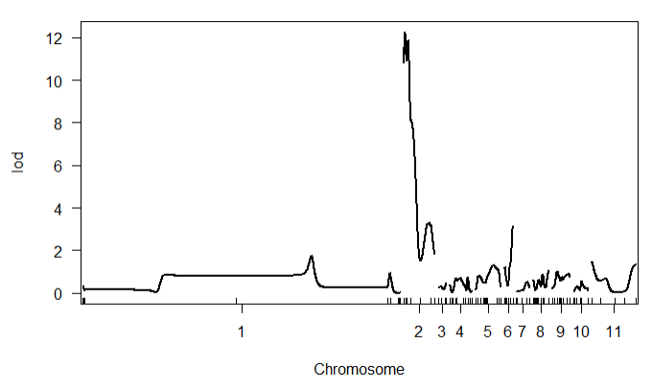
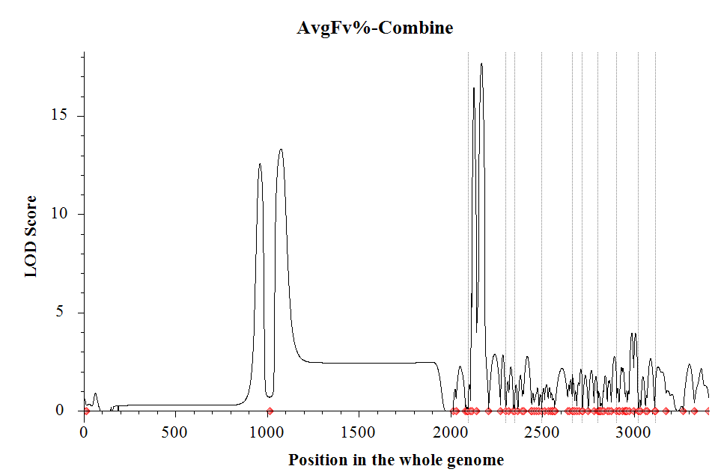
Population4
Chromosome | Position | LeftMarker | RightMarker | LOD | PVE(%)
1 | 961 | PHM5622_21 | PZA01462_1 | 12.5675 | 47.8239
1 | 1076 | PZA01462_1 | PZA00664_3 | 13.3239 | 50.3541
2 | 30 | PZA00224_4 | PHM793_25 | 16.4211 | 38.3247
2 | 71 | PHM793_25 | PHM3668_12 | 17.6998 | 53.0033
2 | 143 | PHM3668_12 | PZA00803_3 | 2.8669 | 0.4361
2 | 187 | PZA00803_3 | PZB01103_2 | 2.853 | 0.4176
 | chr | pos | lod
c2.loc6 | 2 | 6 | 12.28
PZA00910_1 | 6 | 55.2 | 3.16
LOD threshold 3.23

