Slide 1
QTL discovery: Two methods
ICIMapping v3.2 software
Chen et al., provided .bip files for analysis
Able to reproduce their results, except discovered additional QTLs not listed in the paper
Errors in their data file
R/QTL
Wrote an R script to easily QC data, plot missing data, determine LOD threshold, plot QTL graphs and display a summary chart

Slide 2
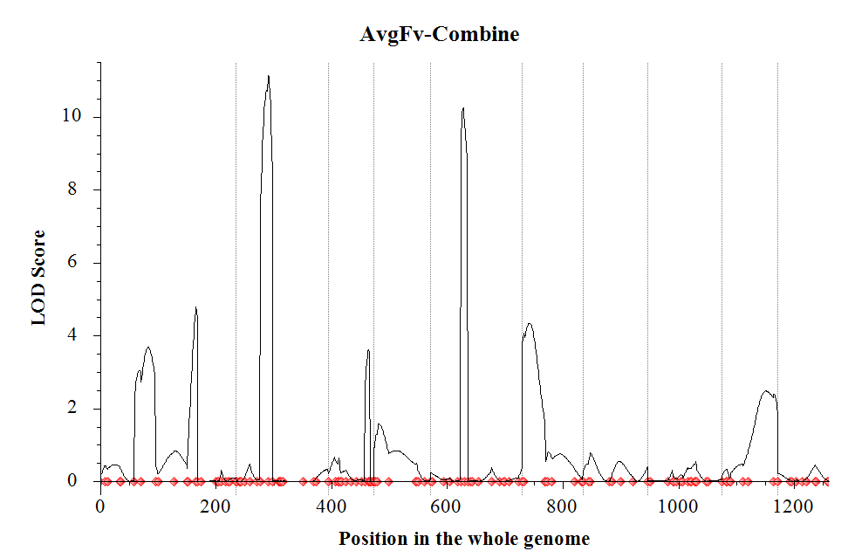
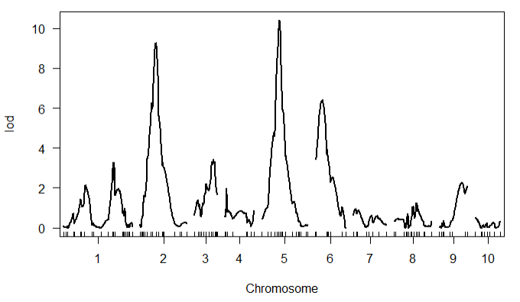
Population1
Resistant parent | Susceptible parent
CML495 | LAPOSTASEQ.C7F64-2-6-2-2-B*3
ICI Mapping
R/QTL
Chr | Position | LeftMarker | RightMarker | LOD | PVE(%) | Add
1 | 83 | PZA03168_5 | PZA01267_3 | 3.6801 | 5.6822 | 4.5519
1 | 166 | PHM5480_17 | PHM14614_22 | 4.7742 | 5.986 | -4.684
2 | 56 | PZA00590_1 | PZA02378_7 | 11.1481 | 15.4103 | 7.5735
3 | 70 | PZA03647_1 | PHM13673_53 | 3.621 | 4.2584 | 3.9565
5 | 56 | PHM12992_5 | PHM2524_4 | 10.2444 | 13.5598 | 7.1035
 | chr | pos | lod
c1.loc170 | 1 | 170 | 3.3
c2.loc53 | 2 | 53 | 9.27
c3.loc64 | 3 | 64 | 3.45
c5.loc62 | 5 | 62 | 10.42
c6.loc23 | 6 | 23 | 6.4
LOD threshold 3.42

Slide 3
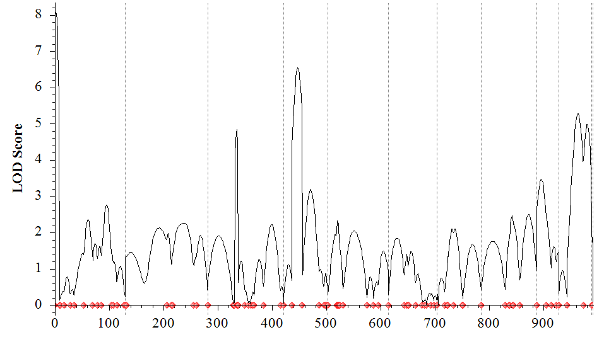
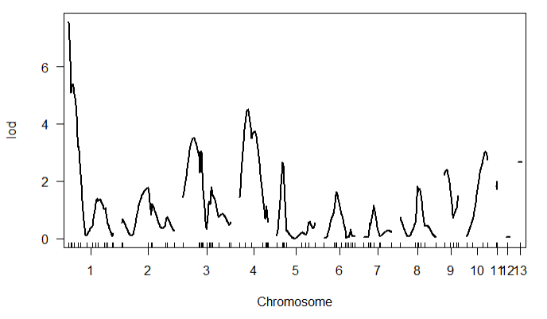
Population2
Resistant parent | Susceptible parent
CML492 | LPSMT
ICI Mapping
R/QTL
Chromosome | Position | LeftMarker | RightMarker | LOD | PVE(%) | Add | Dom
1 | 2 | PZA02490_1 | PZA00240_6 | 8.0807 | 11.3574 | 6.668 | -0.534
1 | 96 | PHM14475_7 | PHM595_30 | 2.7628 | 4.0143 | -3.8529 | -1.4356
3 | 54 | PZB02179_1 | PHM9914_11 | 4.8452 | 6.1119 | -4.5802 | 2.1489
4 | 26 | PZA02358_1 | PHM3112_9 | 6.5348 | 9.2691 | -5.8284 | 0.0881
4 | 50 | PHM5572_19 | PHM14618_11 | 3.1862 | 3.934 | -1.0305 | 5.2871
9 | 8 | sh1_12 | PHM9374_5 | 3.4669 | 3.9399 | 3.7433 | 1.1165
10 | 36 | PHM4066_11 | PZA03607_1 | 5.275 | 7.8202 | 5.451 | 0.0575
10 | 53 | PZA03607_1 | PZA01001_2 | 4.9806 | 6.9607 | 5.1526 | -0.8868
 | chr | pos | lod
PZA02490_1 | 1 | 0 | 7.57
c3.loc30 | 3 | 30 | 3.51
c4.loc23 | 4 | 23 | 4.5
c10.loc54 | 10 | 54 | 3.02
Yellow highlight indicates QTLs not present in the paper
LOD threshold 3.28

Slide 4
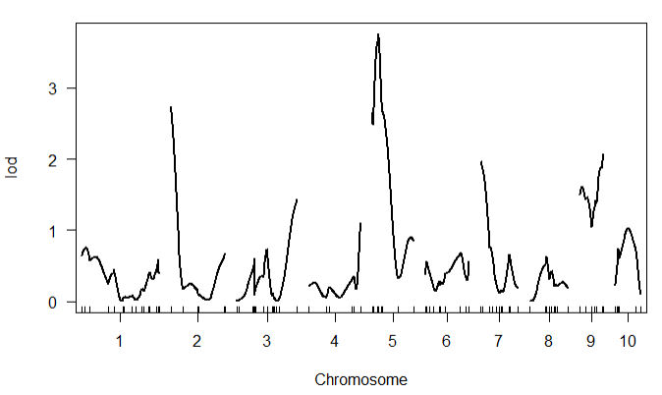
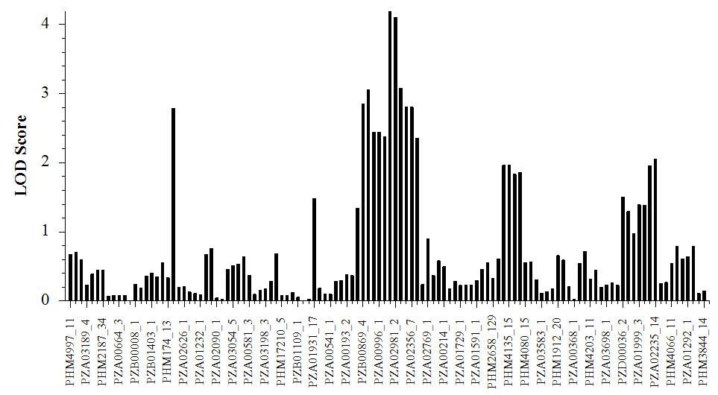
Population3
Resistant parent | Susceptible parent
CML495 | LPSMT
ICI Mapping
R/QTL
MarkerName | Chr | Position | LOD | PVE(%) | Add | Dom
PZA02681_8 | 2 | 0 | 2.7854 | 4.5253 | 0.0675 | -0.0823
PZB00869_4 | 5 | 0 | 2.8492 | 4.6264 | 0.0909 | -0.0162
PHM4647_8 | 5 | 0.19 | 3.0604 | 4.9605 | 0.0938 | -0.0215
PZA00148_3 | 5 | 11.24 | 4.1937 | 6.7346 | 0.1093 | -0.0106
PZA02981_2 | 5 | 11.81 | 4.1027 | 6.5935 | 0.108 | -0.0071
PHM1899_157 | 5 | 18.34 | 3.0799 | 4.991 | 0.0911 | 0.0211
PZA02633_4 | 5 | 20.41 | 2.8076 | 4.5604 | 0.0872 | 0.0296
PZA02356_7 | 5 | 20.81 | 2.808 | 4.5609 | 0.0879 | 0.025
 | chr | pos | lod
PZA02981_2 | 5 | 11.8 | 3.76
LOD threshold 3.27
Yellow highlight indicates QTLs not present in the paper

Slide 5
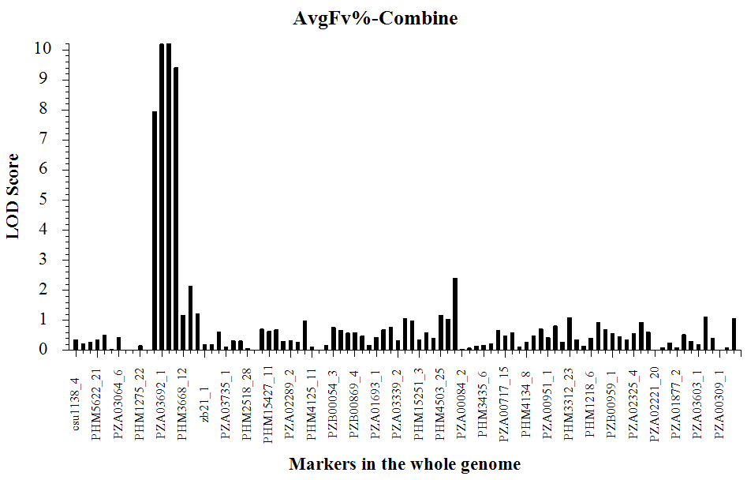
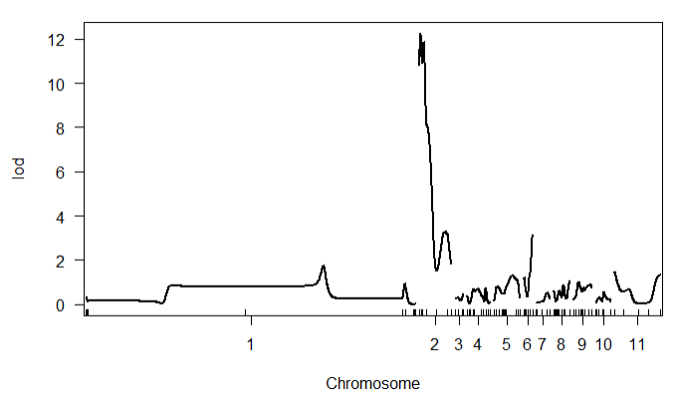
Population4
Resistant parent | Susceptible parent
CML449 | LPSMT
ICI Mapping
R/QTL
MarkerName | Chr | Position | LOD | PVE(%) | Add | Dom
PHM10404_8 | 2 | 0 | 7.9547 | 12.5574 | 3.8966 | -0.5541
PZA03692_1 | 2 | 12.46 | 10.195 | 15.8002 | 4.1173 | -1.1051
PZA00224_4 | 2 | 18.7 | 10.2196 | 15.8353 | 4.0441 | -0.594
PHM793_25 | 2 | 42.34 | 9.4177 | 14.6888 | 4.0047 | -0.7449
 | chr | pos | lod
c2.loc6 | 2 | 6 | 12.28
PZA00910_1 | 6 | 55.2 | 3.16
LOD threshold 3.23
The Pop4 datafile contains errors in the marker positions on chr1.
The positions listed for half of the chr1 markers are incorrect by ~1000 cM

Slide 6
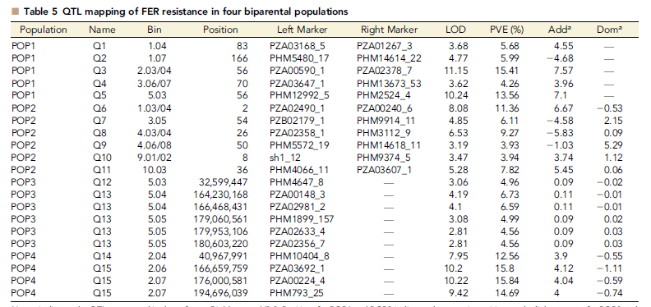
Reproducing Table 5
In general, our analysis provided the same results as published
Our analysis had 4 additional QTLs with LODs of between 2.8 and 5.0.

