Slide 1
Project Story
Excel

Slide 2
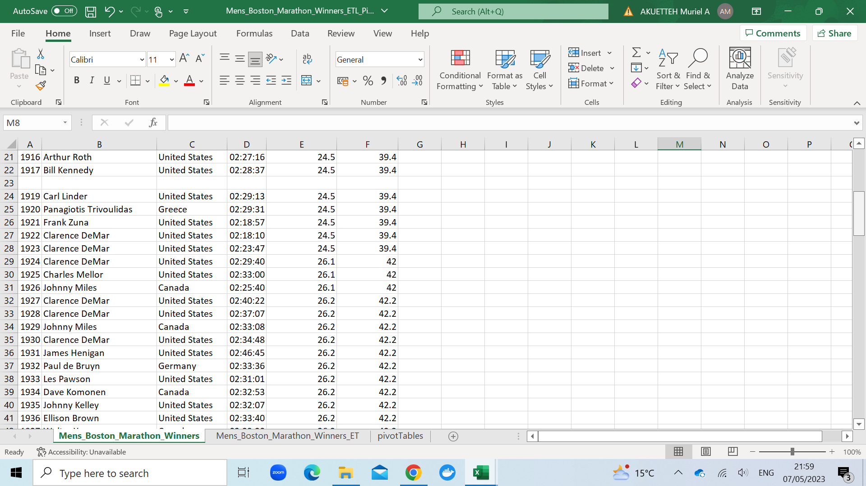
Raw Data
Table with some gaps in the data.

Slide 3
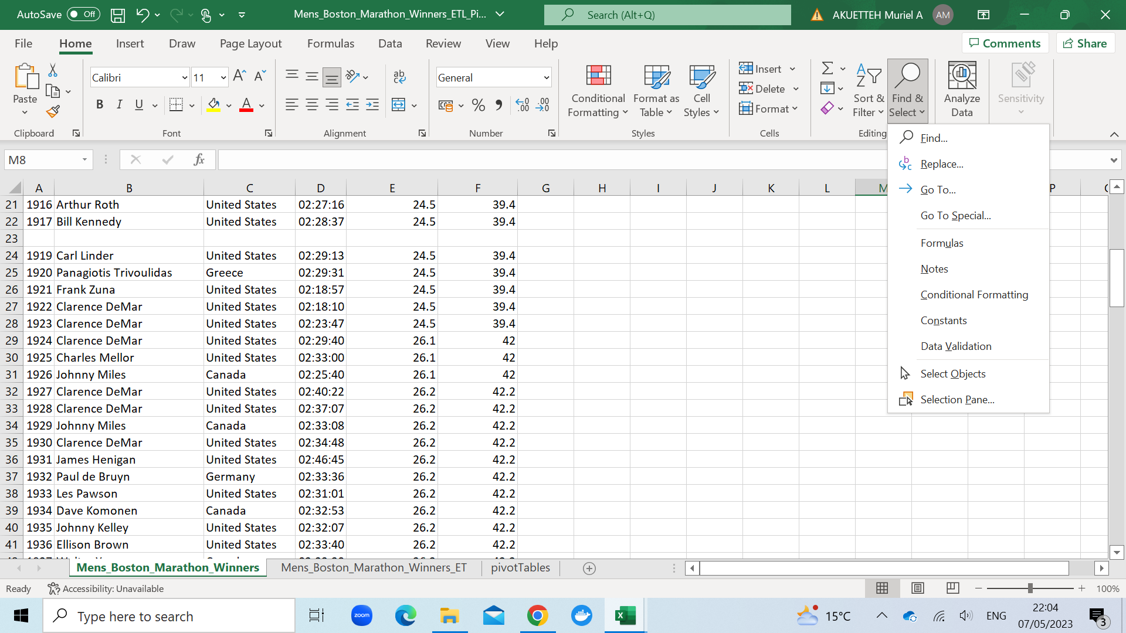
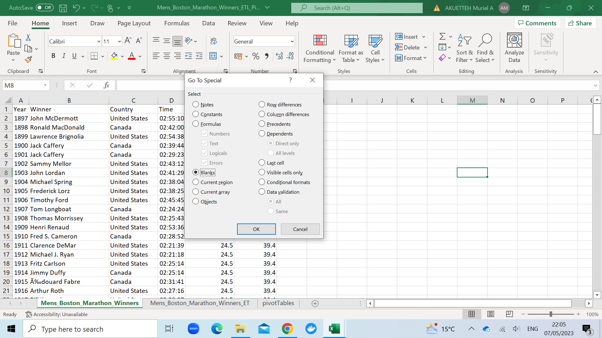
Cleaning Data
Use ‘go to special’ tool, select blank and remove blanks by clicking ok.

Slide 4
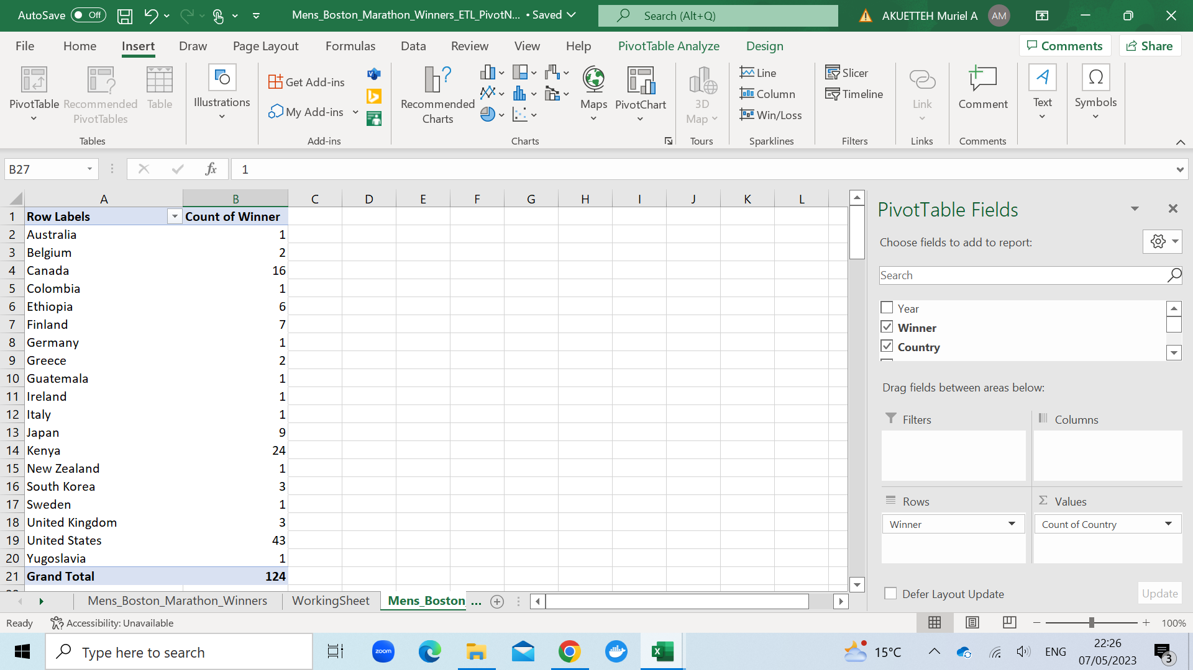
Pivot Table
Pivot tables were created from the cleaned tables.

