Slide 1

Text Summarization Using Machine Learning
Final Year Project
Supervisor - Dr. Bahubali Shiragapur
Mentor Sulaxan Jadhav
STAGE - 03 - PPT - FiY - PROJECT
Submitted by:
Paarth Borole - 20190802032
Suman Kumar - 20190802080

Slide 2

B.Tech Final Year DYPIU
On
Text Summarization Using Machine Learning
By
Paarth Borole-20190802032
Suman Kumar-20190802080
Semester VIII
Supervisor : Dr. Bahubali Shiragapur
Mentor: Sulaxan Jadhav
School of Computer Science Engineering and Applications D. Y. Patil International University
Akurdi, Pune - 411044, Maharashtra, India.

Slide 3
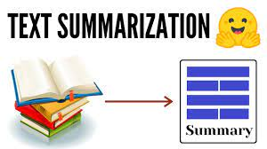
Introduction
Text summarization is the process of creating a shorter version of a longer text, while preserving the most important information and the main ideas. The goal of text summarization is to provide a condensed version of the original text that is easier to read and understand, without losing its meaning or essential information. Text summarization can be done manually by humans, but it can also be done automatically using natural language processing techniques and machine learning algorithms. There are two main types of text summarization: extractive summarization and abstractive summarization, which differ in how they generate the summary.

Slide 4

Introduction
There are two main approaches to text summarization using machine learning: extractive and abstractive. Extractive summarization involves selecting and combining the most important sentences or phrases from the original text, while abstractive summarization involves generating new sentences that capture the essence of the original text.
Text summarization has many applications, such as in news and content curation, document management, and search engine optimization. It can help users quickly and efficiently identify the most important information in a large volume of text, saving time and effort.

Slide 5
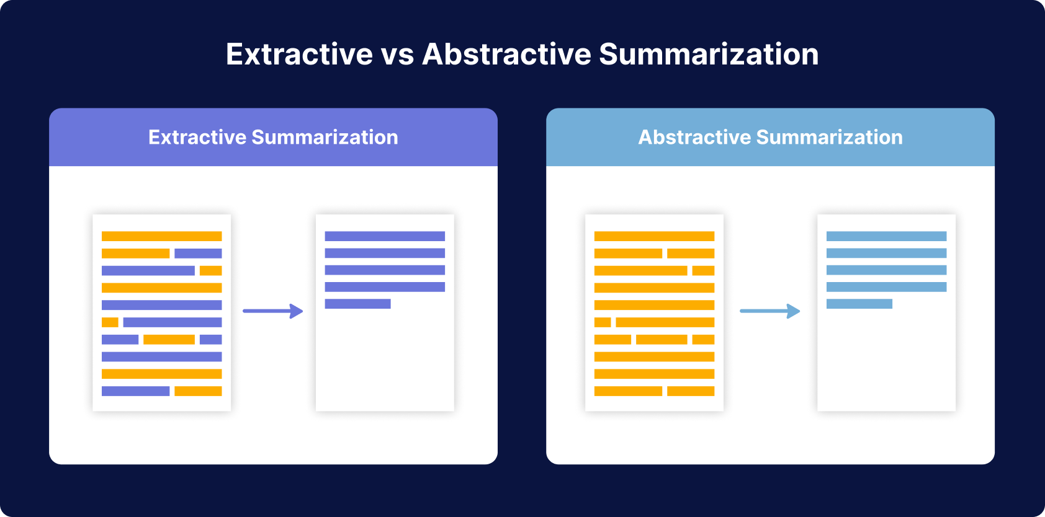
Introduction
Fig.1

Slide 6
2: LITERATURE REVIEW
Machine Learning
SERIAL NO. | Paper Title | Year | Technique Use | Limitation | Future Scope | Steps for Text Summarization
1 | A review paper on text summarisation of Hindi Documents | 2015 | Based on a combination of two techniques. | Interpretation Summarization | Refining the Data | Import the Libraries
2 | Survey on Text Summarization | 2017 | Machine Learning Based Summarization Approaches | Summary Generation | Help to Learn | Parse the Dataset file.
3 | Text Summarization | 2018 | Sklearn (based on extractive methods) | Evaluation | Focus On worth Text | Pre-processing.
4 | Recent Progress on Text Summarization | 2020 | Abstractive methods (Structure-based methods) | Practical Text | Advance Learning | Splitting the records.
5 | Text Summarization Techniques and Applications | 2020 | Statistical-based algorithms using keras |  | Help to Industry OR Other Work | Text Vectorization
6 | Text Summarization Using Machine Learning LSTM | 2021 | Summarization through Abstractive Approaches |  |  | Build the model.
7 | Text Summarisation and its evaluation technique | 2021 | Graph based Methods |  |  | Train the model.
 |  |  |  |  |  | Text Summarizer Output

Slide 7
2.Deep learning
 |  |  | Text Summarization Using Deep Learning
SERIAL NO. | Paper Title | Year | Technique Used | Limitation | Future Scope | Steps for Text Summarization
1 | Automatic Evaluation of Summaries | 2004 | Based On The computer-generated summary , summaries cre- ated by humans. |  |  | Import the Libraries
2 | AUTOMATIC TEXT SUMMARIZATION USING DEEP LEARNING AND NLP MODEL | 2010 | Using LSTM Model Create Summary Repetitive to Precise data | shifting from extractive to abstractive summarization | Building the Model And predefined | Parse the Dataset file.
3 | Abstractive Text Summarization using Sequence-to-sequence RNNs and Beyond | 2016 | Based On Encoder-Decoder Recurrent Neural Networks, | The Decode use of search size 5 to generate the summary, and limited the size summary max 30 words. | consisting of multi-sentence summaries, | Pre-processing.
4 | The Transformer generalizes | 2017 | Effective self-training for parsing. | Limited training data. | would Be increase the maximum path length to O(n/r). | Splitting the records.
5 | Automatic Document Summarization Using Deep Learning Mechanism with Competent Analysis | 2019 | Deep Learning Algorithm with the help of RBM Algorithms | It is defined over a vocabulary of words in a file. | summary generation from the multiple documents. | Text Vectorization
6 | Pre-training with Extracted Gap-sentences for Abstractive Summarization | 2020 | LM and autoencoder pretraining on in-domain data | Data validated our results using human evaluation and Show multiple dataset. | Datasets measured by ROUGE Scores. | Build the model.
7 | Abstractive text summarization of low-resourced languages using deep learning | 2023 | (NLP),manageable reading and search information from many papers by creating smaller versions without losing significance. | Sentences are limited to non-summary or summary based on each attribute. | Urdu Text Document Summarization | Train the model.
8 |  |  |  |  |  | Inference Model.
 |  |  |  |  |  | Text Summarizer Output

Slide 8
3.HYBRID
 |  |  | Hybrid Model
S.No. | Title | Year Published | Technique Used | Limitation | Accuracy
1 | Hybrid Approach To Abstractive Summarization | 2018 | Anaphoric Relation, Transition Relation, Sentence Position | Only Simple and Compound sentences are considered for sentence fusion task. | 71%
2 | A Hybrid Approach to Text Summarization | 2017 | Fuzzy Logic, Feature extraction, Sentiment scoring |  | 65%
3 | A Hybrid Approach for Text Summarization | 2020 | Introduction of merging algorithm, Use of Fuzzy logic, Use of semantic graph approach, Use of graph positioning algorithm. | Assigning various weights to every technique utilized, The proposed method can be implemented using standard data sets. | 70%
4 | Hybrid Extractive/Abstractive Summarization Using Pre-Trained Sequence-to-Sequence Models | 2020 | Sequence-to-sequence pre-trained Transformer model | Weak validation for transferability of our approaches to other domains.
5 | Hybrid Model For Abstractive Text Summarization | 2020 | Tex Rank algorithm, LEX Rank method, LSA algorithm, Fuzzy logic
6 | Top approaches to abstractive text summarization: A survey | 2020 | Machine learning approach, Graph Based approach, | Costly, Time taking and likely to suffer from Human variability.
7 | Towards a New Hybrid Approach for abstractive text summarization | 2018 | Combining both Extractive and Abstractive techniques in Arabic Language | Get good results for short and simple sentences

Slide 9
DRAWBACKS OF EXISTING SYSTEM.
Text summarization includes topic identification, interpretation, summary generation, and evaluation of the generated summary. Most practical text summarization systems are based on some form of Abstractive summarization.
Quality and Coherence
Information Loss
Lack of Control
Evaluation Challenges
Ethical Considerations

Slide 10
OBJECTIVE
The goal of text summarization is to reduce the size of the text, while preserving its important information and overall meaning.
Enhancing machine understanding of text by extracting the most important features of the text and facilitating further analysis or processing.
Improving the accessibility and usability of information by presenting key points in a clear and concise manner
Supporting a wide range of applications, such as news aggregation, document summarization.
The main objective of text summarization using machine learning is to automatically generate a concise and coherent summary of a long document, while preserving its key information and meaning.

Slide 11
3.1 PROPOSED METHODOLOGY
Importing the Libraries - Firstly we will import all the necessary libraries.
Parse the Dataset file - We will traverse to the dataset file and extract all
the input and target texts.
Preprocessing - Preprocessing all the texts and converting them into presentable form.
Splitting the records - Split the dataset records into training and testing sets. We will be splitting in the 80:20 ratio where 80% record will be for training sets and 20% for testing sets.
Text Vectorization - We will convert our word into integer sequence using vectorization technique.
Build the model - We are using 3 Layers of LSTM. This will make our prediction much better. We will build it using an encoder and decoder model.
Train the model - We will initialize our Model class with input and output data from the encoder and decoder layers.
Inference Model - The inference model is used to test the new sentences for which the target sequence is not known.

Slide 12
Tools Used
Seq2Seq Modelling
Encoder & Decoder Model
Attention Mechanism
Stemming

Slide 13
Advantages:
Abstractive summarization is considered to produce higher quality summaries compared to extractive methods. It can capture the essence of the original text and generate more coherent and fluent summaries. This leads to improved readability as abstractive summarization can rephrase the original text in a more natural and concise manner.
Furthermore, abstractive summarization is more flexible and can handle a wider range of text types, including documents with complex structures, technical jargon, and domain-specific language. It retains the meaning of the original text by generating a summary that conveys the essence of the original in a more concise way, unlike extractive summarization which simply selects and copies sentences.
Overall, abstractive summarization provides higher quality summaries, improved readability, flexibility in handling various text types, better retention of meaning, and the ability to generate new sentences.

Slide 14
Disadvantages:
Computationally intensive: Abstractive summarization is computationally intensive and requires more resources, including data and computing power, compared to extractive methods.
Risk of introducing errors: Abstractive summarization involves generating new sentences that are not present in the original text, which increases the risk of introducing errors or conveying unintended meaning.
Difficulty in maintaining accuracy: Because abstractive summarization generates new sentences, there is a risk of the summary including inaccurate or misleading information.
Time-consuming and resource-intensive: Abstractive summarization requires significant computational resources and can be time-consuming to train and implement.

Slide 15
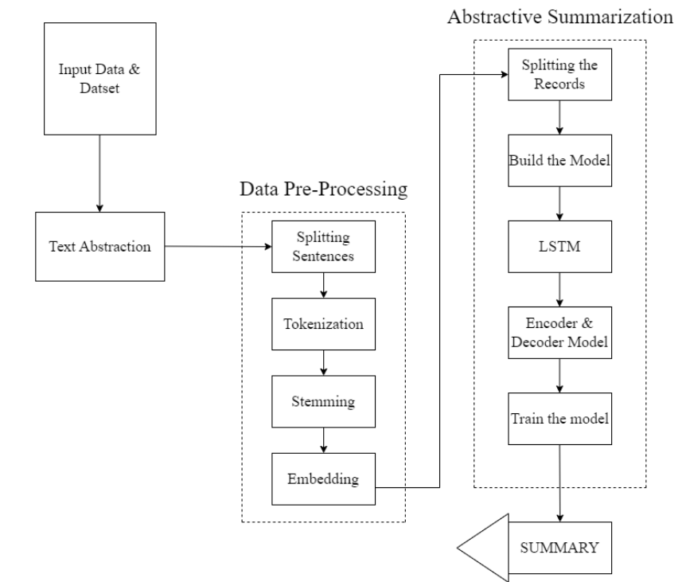
CHAPTER 4: ANALYSIS AND DESIGN
4.1 ER diagram
Fig.1

Slide 16
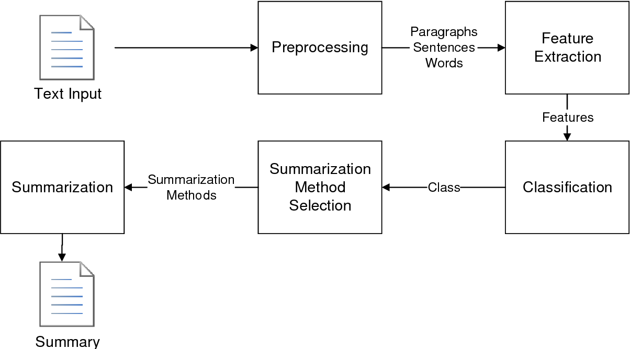
4.2 Class & Object Diagram
Fig.2

Slide 17
4.3 Data flow diagram(DFD)
Situational & Non-
Non Situational Research
Dataset Collections
Data Pre-Processing
Model Building
Interface Model
(Encoder & Decoder)
Accuracy & Precision
Output
Summary

Slide 18
CHAPTER 5: RESULTS AND DISCUSSION
5.1 DISCUSSION
Text summarization is an important natural language processing and Machine Learning (NLP & ML) technique that aims to condense a longer piece of text into a shorter version while preserving its key information. It plays a crucial role in various applications, such as document summarization, news summarization, and even chatbot responses.
There are two main approaches to text summarization: extractive and abstractive summarization. Extractive summarization involves selecting the most important sentences or phrases from the original text and combining them to create a summary. This approach relies on identifying the most relevant information and does not generate new sentences. On the other hand, abstractive summarization involves generating new sentences that capture the essence of the original text. It uses advanced techniques like natural language generation and paraphrasing to produce coherent and concise summaries.

Slide 19
5.2 RESULTS
In this project, we have developed a Text Summarizer model which generates the summary from the provided review using the LSTM model and Attention Mechanism. In 1,00,000 dataset row we have used we have used 80% of the dataset for training and 20% dataset for testing to validate a correct result.
Abstractive Summarization: Abstractive methods, which generate new sentences to capture the essence of the text, have also made significant progress. Transformer-based models, such as LSTM and Seq2Seq, have shown impressive results in generating coherent and concise summaries.

Slide 20

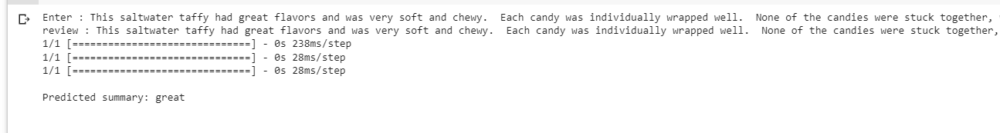
5.2 RESULTS

Slide 21
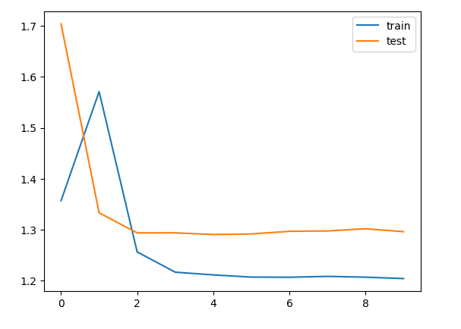
5.2 RESULTS

Slide 22
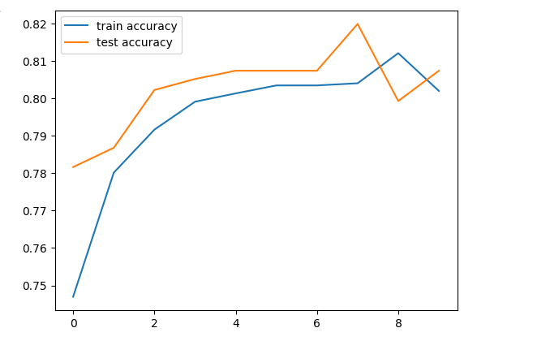
5.2 RESULTS

Slide 23
6.1 FUTURE SCOPE
CHAPTER 6: CONCLUSION AND FUTURE SCOPE
Text summarization is a rapidly growing field, and there is enormous potential and future development. Here are some areas of growth of it:
Domain-specific summarization: Different industries and fields have their own unique language and terminology, making it challenging to summarize text accurately. There is an opportunity for text summarization systems to be developed that can summarize text for specific industries or domains.
Personalized summarization: Individuals have unique preferences and interests, and there is an opportunity for text summarization systems to be developed that can summarize text based on a person's interests and preferences.
Summarization of multimedia content: With the explosion of multimedia content, there is a growing need for text summarization systems that can summarize audio, video, and image content.
Real-time summarization: As the world becomes more fast-paced, there is a growing need for real-time text summarization systems that can quickly summarize text as it is generated.
Multilingual summarization: As the world becomes more interconnected, there is a growing need for text summarization in multiple languages. In the future, we may see advancements in multilingual summarization techniques that can accurately summarize text in multiple languages.

Slide 24
CHAPTER 6: CONCLUSION AND FUTURE SCOPE
6.2 CONCLUSION
In conclusion, abstractive text summarization is a powerful technique in natural language processing that aims to generate concise and coherent summaries by understanding the meaning and context of the original text. It offers the advantage of flexibility and the ability to create summaries that go beyond simply extracting sentences from the source.
Abstractive summarization techniques, often based on advanced machine learning models such as transformer-based architectures, have made significant progress in recent years. These models leverage large-scale pre-training and fine-tuning to generate summaries that capture the essence of the original text while maintaining coherence and fluency.

Slide 25
7. REFERENCES
https://ieeexplore.ieee.org/document/9458057
https://www.researchgate.net/publication/354291874_Text_Summarization_Approaches_Using_Machine_Learning_LSTM
https://blog.floydhub.com/gentle-introduction-to-text-summarization-in-machine-learning/
https://towardsdatascience.com/a-quick-introduction-to-text-summarization-in-machine-learning-3d27ccf18a9f
https://www.ripublication.com/ijaer19/ijaerv14n7_41.pdf
https://peerj.com/articles/cs-1176/
https://www.researchgate.net/publication/363860140_AUTOMATIC_TEXT_SUMMARIZATION_USING_DEEP_LEARNING_AND_NLP_MODEL
https://towardsdatascience.com/text-summarization-using-deep-neural-networks-e7ee7521d804

Slide 26
7. REFERENCES
https://ieeexplore.ieee.org/document/9396855
https://www.rgnpublications.com/journals/index.php/jims/article/view/760#:~:text=Text%20summarization%20is%20a%
20process,fuzzy%20logic%20to%20select%20sentence.
https://www.sciencedirect.com/science/article/pii/S1877050918322026
https://www.sciencedirect.com/science/article/pii/S1877050918307701

Slide 27
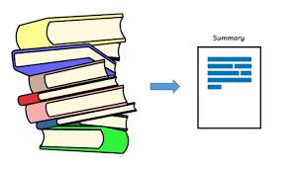
THANK YOU

Slide 29
MEETING OBJECTIVES
MARS
JUPITER
VENUS
Despite being red, Mars is a cold place
It’s the biggest planet in the Solar System
Venus is the second planet from the Sun

Slide 30
PROJECT DETAILS
Do you know what helps you make your point clear?
Lists like this one:
They’re simple
You can organize your ideas clearly
You’ll never forget to buy milk!
And the most important thing: the audience won’t miss the point of your presentation

Slide 31
This is a quote. Words full of wisdom that someone important said and can make the reader get inspired
“
—SOMEONE FAMOUS

