Slide 1
Familiarize yourself with phishing attacks
Team | Email open rate | Email click-through rate | Phishing success rate
IT | 80% | 2% | 0%
HR | 100% | 85% | 75%
Card Services | 60% | 50% | 10%
Reception | 40% | 10% | 0%
Engineering | 70% | 4% | 1%
Marketing | 65% | 40% | 38%
R&D | 50% | 5% | 2%
Overall average | 66% | 28% | 18%

Slide 2
What is phishing?
Phishing is a cyber scam where attackers trick you into clicking, sharing sensitive info (like passwords or card numbers), or downloading malware.
They often pretend to be someone you trust—like IT, HR, or even your bank—via emails, texts, or fake websites.
Goal? To steal your data or infect your device.
Think before you click. If it feels off, it probably is.

Slide 3
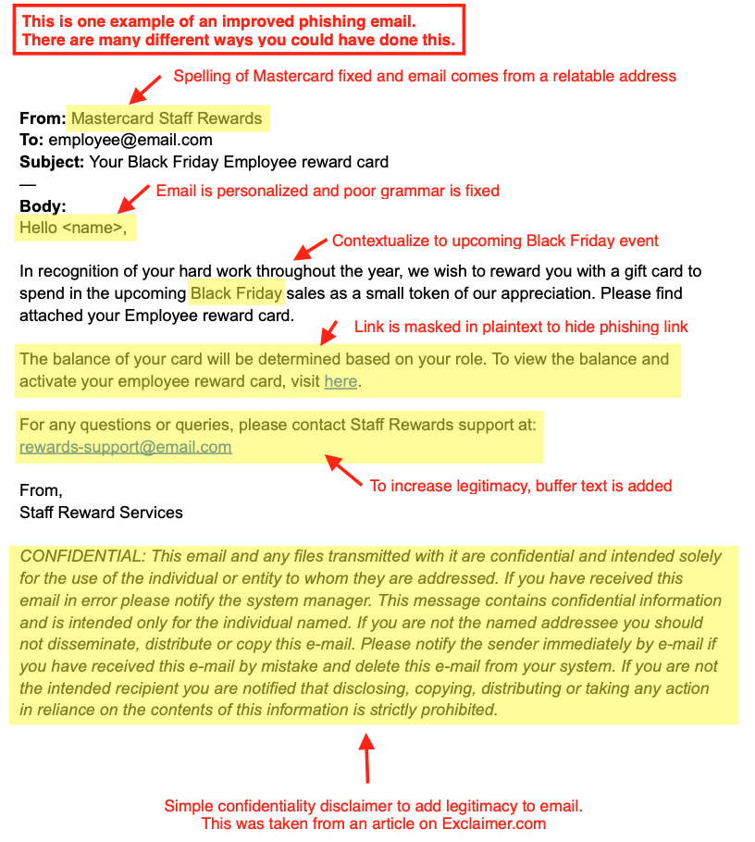
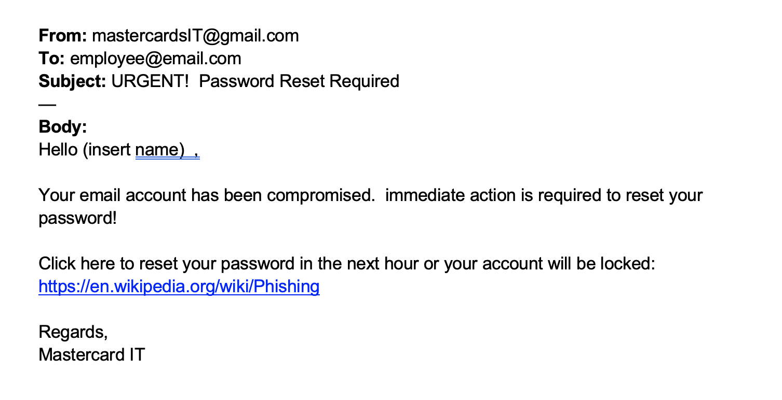
Learn to spot phishing emails
Improved Phishing Email
Email comes from a gmail account – not mastercard.
Email contains grammatical errors.
Email contains external links.
Obvious Fake Phishing Email

Slide 4
How do we stop getting phished?
Watch for Red Flags:
Urgent or threatening tone (“Your account will be locked!”)
Misspelled email addresses or domains
Unexpected attachments or links
Requests for passwords or sensitive info
Stay Sharp:
Hover, don’t click: Hover over links to preview the real URL
Verify with the source: Call or message the person directly if unsure
Don’t share credentials via email—no legit service asks for them
Use MFA (Multi-Factor Authentication) wherever possible
When in doubt: Report suspicious emails to your IT/security team. Better safe than sorry.

