Slide 1
PAAS
Pronunciation as a service

Slide 2
Problem
Our names are entwined with our personal identities, often chosen with care and laden with meaning.
They can represent who we are, where we come from or who we strive to be.
Yet people live with a name they do not feel is their own.
Because they feel compelled to adapt their name or adopt a new name entirely to “fit in”, or because their name is routinely mispronounced.

Slide 3
What is PAAS
Add a voice to your name!
Paas has the ability to render standard pronunciations from trusted third party softwares/api and also has the ability to record own preferred pronunciations.
Paas has the ability to produce pronunciations from an open source library and also licensed software both , with just a toggle of a switch.
Paas provides options for the employee to multiple pronunciations
Eg : Rajappa, Primary pronunciation : raajappa , Secondary pronunciation: raaj

Slide 4
Why PAAS
The Name:
In the age of distributed systems and cloud offerings where platforms and infrastructures are available as reusable services (paas/Iaas), the name PAAS resonates and echoes the need to build solutions similar to Platform as a service.
Paas offers
A robust GUI to enable employees to listen, add and manage pronunciations
A reusable api which can be used across the enterprise on their respective implementation.
Hosted on cloud, managing is not anybody’s headache.

Slide 5
How Paas?
Paas has three major components
React UI at the front end
Java Spring Boot at the backend
Yugabyte DB
A pluggable and reusable api hosted on the azure cloud, which can be used from anywhere from across the enterprise, which conforms to W3C standards.

Slide 6
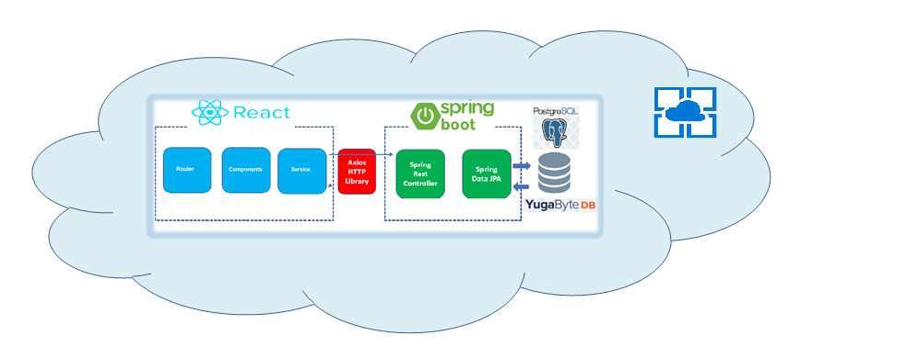
Architecture

Slide 7
Future
Ability to differentiate primary and secondary preferred pronunciation
Add other rules like gender, county to get better pronunciation.
Diversity friendly
Add ADA complaint features to make it friendly for employees with disability
Fetch phonetic strings to enable people with hearing disability
Integrate with Teams/Skype to listen before starting a conversation.

Slide 8
Team
Chandra
Suresh
Krishna
Ashwin

Slide 9
Questions
Thank You

