Slide 1

PROFESSIONAL DESIGN PORTFOLIO
Mohiddin
Moghal
Oracle VBCS / OIC Developer with a design focus on enterprise workflows, dashboards, integrations, and Agentic AI in OIC.
VBCS UI Design
OIC Workflows
Agentic AI
3+
10+
AI
years VBCS / OIC
solution areas
Agentic AI in OIC
mohiddinmughal786@gmail.com | +91 7330160274
Mohiddin Moghal | Oracle VBCS / OIC | Design Portfolio
01

Slide 2
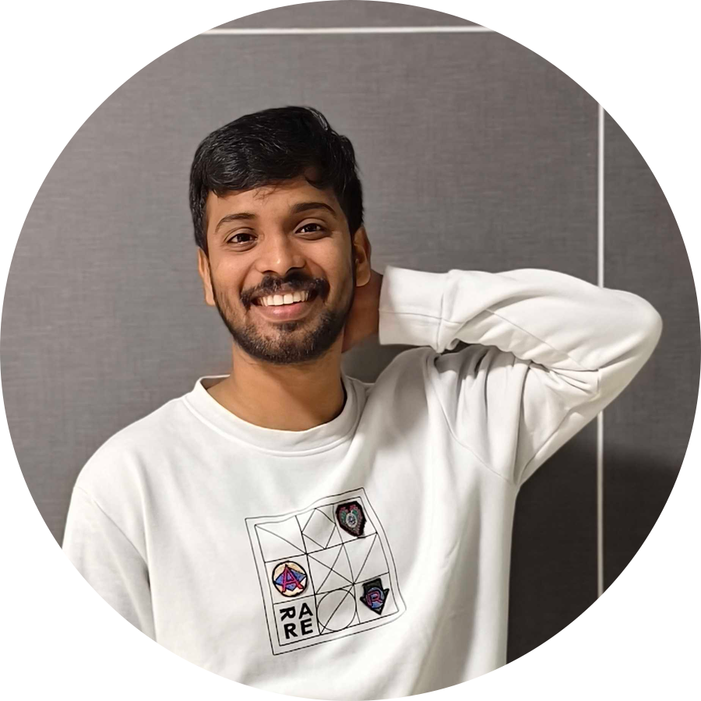
PROFILE SNAPSHOT
Design clarity backed by technical execution.
I translate complex Oracle processes into usable screens, workflow states, automation patterns, and support-ready dashboards.
01
Workflow-first thinking
02
Integration visibility
Approvals, exceptions, timecards, payroll cycles, and role-based steps made easier to follow.
OIC flows designed around triggers, transforms, routing, failure recovery, and audit traces.
Mohiddin Moghal
03
Data-aware interfaces
04
AI-assisted automation
Oracle VBCS / OIC Developer
Dashboards and pages that expose status, ownership, validation results, and next action.
Learned and worked on Agentic AI in OIC for governed decision-support automation.
Enterprise workflow design | dashboards | integrations | Agentic AI in OIC
Oracle
INFOLOB
Mohiddin Moghal | Oracle VBCS / OIC | Design Portfolio
02

Slide 3
DESIGN CAPABILITIES
What I bring to enterprise product design.
A balanced mix of UI thinking, integration logic, data understanding, security awareness, and automation discipline.
VBCS interface design
OIC workflow design
Dashboard thinking
Responsive pages, reusable components, approval screens, guided forms, and dashboard layouts.
Trigger, validate, transform, route, observe, recover, and improve patterns for integrations.
Status-first views for payroll, OTL, billing, exceptions, audits, approvals, and decisions.
Security journey design
Data and API design
Agentic AI in OIC
Page restrictions, role-aware access, approval tiers, and controlled enterprise experiences.
Fusion REST APIs, BIP, FBDI, ATP sync, SQL, PL/SQL, APEX ORDS, Postman, and SOAP UI.
Agent-style orchestration, AI-assisted decisions, governed actions, escalation, and audit-aware automation.
Mohiddin Moghal | Oracle VBCS / OIC | Design Portfolio
03

Slide 4
SELECTED WORK - ORACLE
Payroll, OTL, VBCS applications, and database automation.
Projects: KCB, Boutique, QIA, and QSA. Confidential implementation details are omitted.
Payroll processing and support
OTL module maintenance
VBCS application development
Database development
Delivered payroll support and enhancements for accurate payroll cycles.
Managed OTL configuration, issue resolution, and timecard validations.
Designed VBCS applications for internal tools and payroll/OTL dashboards.
Created PL/SQL scripts, packages, and procedures for automation.
Implemented payroll rule changes and PL/SQL-based data corrections.
Integrated OTL data with payroll systems using OIC workflows.
Created responsive UI components for approvals and submissions.
Generated audit and compliance reports with SQL and OIC pipelines.
Built automated OIC scripts for payroll data integrations.
Designed compliance-aware validation and support flows.
Supported real-time data visualization and user-focused workflows.
Improved process traceability and correction readiness.
Mohiddin Moghal | Oracle VBCS / OIC | Design Portfolio
04

Slide 5
SELECTED WORK - INFOLOB / ETISALAT
Subscription management, data sync, billing, CDR automation, and security workflow design.
A portfolio view of the outcomes behind the VBCS/OIC, SQL, PL/SQL, and APEX ORDS work.
Custom Subscription Management
FBDI Customer Onboarding
ATP Data Sync
Tailored Oracle Fusion REST API application for subscription handling tasks and operational control.
Efficient customer data imports into Oracle Fusion with PAAS-scale reliability and accuracy.
Real-time ATP sync from Oracle Fusion to ATP database through BIP-based data transfer.
Subscription Billing Generation
CDR Automation and Security
Monthly, quarterly, one-time, and usage-based billing design aligned to subscription terms.
CSV-driven usage billing automation, page restrictions, and two-tier approval workflow design.
Mohiddin Moghal | Oracle VBCS / OIC | Design Portfolio
05

Slide 6
AGENTIC AI IN OIC
Learned and worked on agent-style orchestration in Oracle Integration Cloud.
How AI-assisted automation can observe events, reason about context, call integrations, and escalate safely.
01
02
03
04
Observe
Reason
Act
Govern
Events, logs, payloads, exceptions
Classify, prioritize, recommend
OIC flows, APIs, approvals, alerts
Audit, escalation, safe handoff
Use AI for classification, recommendations, exception triage, and guided follow-up.
Keep humans in the loop for approvals, risk-sensitive decisions, and final accountability.
Design with governance: audit trails, escalation, policy boundaries, and traceable actions.
Mohiddin Moghal | Oracle VBCS / OIC | Design Portfolio
06

Slide 7
DESIGN SYSTEM MINDSET
From screens to reliable enterprise experiences.
A clean visual structure helps users understand where they are, what changed, and what action is needed next.
User experience layer
System reliability layer
1
Screens
4
Integration
Responsive views, guided forms, approval panels, and dashboard pages.
Triggers, transformations, routing, payload mapping, and recovery paths.
2
States
5
Observability
Draft, submitted, approved, rejected, synced, failed, corrected, and completed.
Logs, statuses, audits, reports, exception handling, and support traces.
3
Validation
6
Governance
Business-rule checks, timecard accuracy, billing terms, and data-quality flags.
Role restrictions, two-tier approvals, policy boundaries, and safe AI escalation.
Mohiddin Moghal | Oracle VBCS / OIC | Design Portfolio
07

Slide 8
TECHNOLOGY AND TOOLSET
Technical depth that supports better design decisions.
The portfolio highlights design skill, while the stack shows the implementation depth behind the work.
Oracle platform
Data and backend
Oracle Integration Cloud (OIC) | Oracle VBCS | Oracle Fusion REST APIs | APEX ORDS
SQL and PL/SQL | Packages and procedures | BIP reports | ATP database sync
Testing and APIs
AI and learning
Postman | SOAP UI | Payload validation | Integration debugging
Oracle Generative AI | AI Vector Search | Python - NLP using NLTK | Agentic AI in OIC
Mohiddin Moghal | Oracle VBCS / OIC | Design Portfolio
08

Slide 9
CREDENTIALS AND EXPERIENCE
A compact view of certifications, employment history, and ongoing learning.
Certifications
Employment history
Oracle Certified Application Integration Professional
Feb 2025 - Present
Oracle Redwood Application Associate
Oracle
Oracle Generative AI Professional
VBCS / OIC
Oracle AI Vector Search Professional
Sep 2022 - Feb 2025
Cyber Security certificates - Supraja Technologies
INFOLOB Global, Inc.
National Cadet Corps - NCC C Certificate
VBCS / OIC
Activities: NCC, bug tracking / bug hunting, creative photography, learning, research, and development in Generative AI.
Mohiddin Moghal | Oracle VBCS / OIC | Design Portfolio
09

Slide 10
THANK YOU
Let us build clear, reliable enterprise experiences.
I bring design thinking to Oracle VBCS and OIC implementation - from interface clarity and integration visibility to AI-assisted workflow automation.
mohiddinmughal786@gmail.com
+91 7330160274
VBCS
OIC
SQL / PL/SQL
Agentic AI in OIC
Mohiddin Moghal | Oracle VBCS / OIC | Design Portfolio
10

