Slide 1

Restaurant Management System
Java • Swing • MySQL • Object-oriented programming
Project demonstration / v1.0
Notes:
Test des commentaires

Slide 2
One place to manage daily operations
A four-tab interface backed by business rules and a SQL or demo data store
Stock
Dishes & menus
Manage ingredient levels, prices, low-stock alerts and bulk deletes.
Edit recipes, check availability, prepare dishes and sum prices.
Employees
Customers
Create, edit and remove staff records with validation.
Track subscriptions, renew them and apply a member discount.
OUT-N-IN • JAVA RESTAURANT MANAGEMENT
October 19th 2026
2
Notes:
We put ourselves in the shoes of a restaurant manager

Slide 3
Architecture: responsibilities stay separate
Swing interface
Domain rules
Data access
Four reusable, searchable tables
Forms and confirmation prompts
No direct SQL in the screens
Person / Employee / Customer
Ingredient / Dish / Menu
Subscriptions, availability & pricing
RestaurantStore interface
MySQL DAO implementation
Standalone in-memory demo mode
The same business actions work with the persistent SQL database or offline demo data.
OUT-N-IN • JAVA RESTAURANT MANAGEMENT
3
October 19th 2026
Notes:
And exception control (we forgot)
To handle wrong/incorrect inputs

Slide 4
Business logic that prevents invalid actions
Inventory & recipes
Menus & subscribers
Check every ingredient before preparing a dish.
Deduct exact fractional quantities.
Block shortages; no partial stock updates.
A menu must contain available dishes.
Base price = sum of dish prices.
Renew subscriptions without overlap.
10% demo discount for active members.
OUT-N-IN • JAVA RESTAURANT MANAGEMENT
4
October 19th 2026

Slide 5
Database model
MySQL foreign keys keep related data consistent
Core business entities
Relational implementation
Ingredient ↔ Dish recipe
Dish ↔ Menu
Customer → Subscription
Employee records
dish_ingredient stores required quantity
menu_dish links each menu to dishes
UNIQUE names / emails
ON DELETE restrictions or cascade
Recipe/menu writes and dish preparation use SQL transactions.
OUT-N-IN • JAVA RESTAURANT MANAGEMENT
5
October 19th 2026

Slide 6
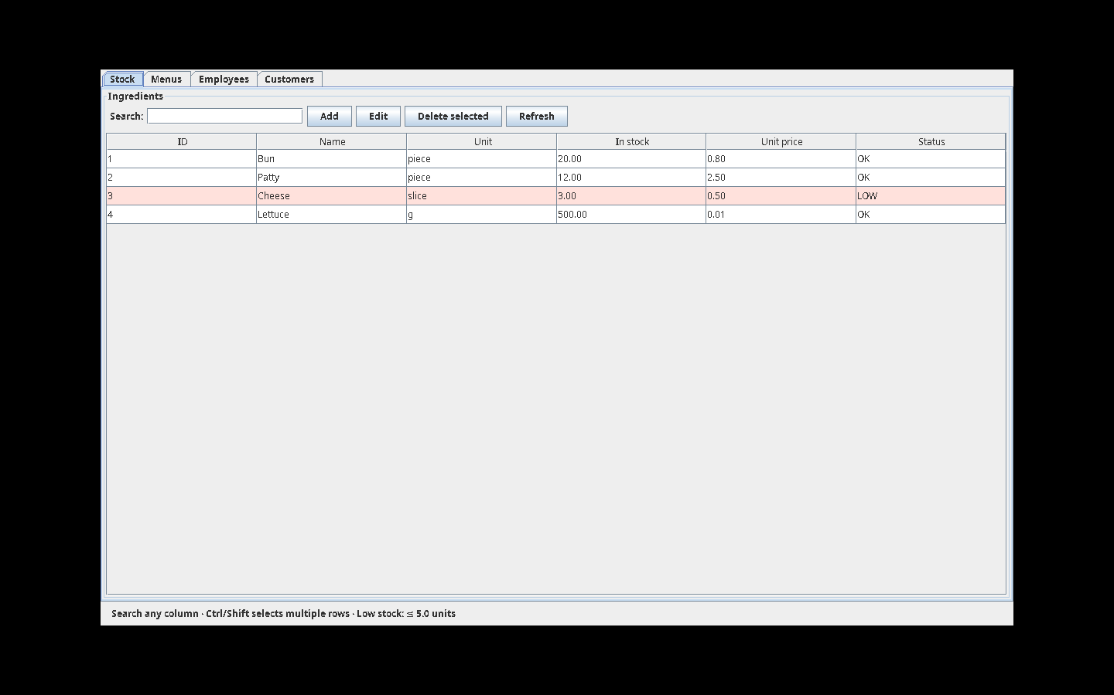
Live GUI — Stock tab
Running in offline demo mode on Java Swing
OUT-N-IN • JAVA RESTAURANT MANAGEMENT
6
October 19th 2026

Slide 7
Validation and verification
Automated
Manual integration
33 passing assertions
Duplicate emails and invalid inputs
Stock depletion and safe failure
Subscription renewal and pricing
Employee operations
Check all four GUI tabs
Run and verify MySQL persistence
Test foreign-key constraints
Try disconnection and backup mode
Rehearse on the target laptop
MySQL validation requires a live local database and Connector/J driver.
OUT-N-IN • JAVA RESTAURANT MANAGEMENT
7
October 19th 2026

Slide 8
How to run and present the project
Demonstrate it
What to hand in
run.bat (Windows)
./run.sh --demo (Mac/Linux)
Stock → Recipes → Menus
Employees → Subscriptions
Complete Java sources + SQL
README and installation instructions
UML / ER diagrams
Manual test plan and demo script
Editable presentation slides
Final check: verify the MySQL installation before submission.
OUT-N-IN • JAVA RESTAURANT MANAGEMENT
8
October 19th 2026
Notes:
If people want to run it at home

