Slide 1

open source xbrl platform
XBRL Arelle® Tutorial
May 7, 2014

Slide 2
Topics
Installation
Validation (GUI, CmdLine, WebService)
Saving to files, import Excel to DTS
Databases
Plug-ins (existing, developing)
Packages (and remappings)
Performance & Profiling
Integration (Java, C#, other)
Testing

Slide 3
Installation
Executable app
Windows installer exe from website
Unix: Mac .dmg installer; Linux/Solaris zip
Python sources
gitHub.com/arelle, issues: arelle.atlassian.net
Install Python 3.3, lxml, regex, isodate, gzip, zlib
Windows from: www.lfd.uci.edu/~gohlke/pythonlibs/
Others: easy_install-3.3 {package}
Plugins: rdflib, pg8000, pymysql, sqlite3, pyodbc
Distribution: cx_Freeze

Slide 4
Validation, GUI
Select disclosure system (SEC, SBR)
Check (√) Disclosure system checks if SEC, SBR
File – open ( )
A single file or a zip archive
Validate ( )

Slide 5
Validation, Command Line
arelleCmdLine –f “file name” –v --disclosureSystem efm-pragmatic
File name can be URL, local file, or path into a zip archive (e.g., …foo.zip/bar.xml)
Looks inside file to determine whether
Instance, inline XBRL
DTS file (schema, linkbase)
Testcase file, testcase index file

Slide 6
Validation, Web Service
Start web service (bat or sh file)
http://localhost:8080/help (for details)
Simple validation:
http://localhost:8080//rest/xbrl/validation?
file=c:/a/b/c.xbrl

Slide 7
Saving to csv, html, xml…
arelleCmdLine –f “file name”
--concepts filename.{csv, html, xml, …}
--pre {f} –cal {f} –dim {f} –formulae {f}
--viewArcrole {arcrole} –viewFile {f}
--roleTypes {f} --arcroleTypes {f}
--logFile f.{xml, json, …} --log{Level|Code}Filter
--internetConnectivity {online|offline}

Slide 8
Excel Plug-in
Do extension taxonomies in Excel
XBRL-US, IFRS, EDINet, bare taxonomy
Plug-in:
Save XBRL DTS into Excel
Load/validate from Excel
Save from Excel into XBRL files

Slide 9
Excel example
Sheet 1: Taxonomy
Link role
Concepts
Property Plant Equipment Extended Link
科目分類 | 冗長ラベル（英語） | 名前空間プレフィックス | 要素名 | type | substitutionGroup | periodType | balance | abstract | depth | calculation parent | calculation weight
B | Property, Plant, and Equipment, Net, Movements [Abstract] | test | PPENetAbstract | xbrli:stringItemType | xbrli:item | instant |  | true | 0
B | Property, Plant, and Equipment, Net | test | PPENet | xbrli:monetaryItemType | xbrli:item | instant |  | false | 1
B | Land | test | Land | xbrli:monetaryItemType | xbrli:item | instant |  | false | 2 | test:PPENet | 1
B | Buildings, Net | test | Bldg | xbrli:monetaryItemType | xbrli:item | instant | debit | false | 2 | test:PPENet | 1
B | Furniture and Fixtures, Net | test | Furn | xbrli:monetaryItemType | xbrli:item | instant |  | false | 2 | test:PPENet | 1
B | Computer Equipment, Net | test | CompEqp | xbrli:monetaryItemType | xbrli:item | instant | debit | false | 2 | test:PPENet | 1
B | Other Property, Plant, and Equipment, Net | test | OtherProp | xbrli:monetaryItemType | xbrli:item | instant | debit | false | 2 | test:PPENet | 1
specification | file type | prefix (schema) type (linkbase) argument (other) | file, href or role definition | namespace URI
extension | schema | test | test.xsd | http://abc.com/test
extension | linkbase | presentation | test-pre.xml
extension | linkbase | calculation | test-cal.xml
extension | linkbase | label en | test-lab.xml
extension | role |  | Property Plant Equipment Extended Link | http://abc.com/role/PPE
Sheet 2: Import and extension parameters
Extension files
Extension link role

Slide 10
Databases Support
Bulk load & update database
From SEC RSS, UK & FSA websites
From GUI, files & scripts
Database Schemas:
XBRL-US Public
Postgres only
XBRL Abstract Model
SQL (Postgres, SQLite, MySQL, MS SQL, Oracle)
Graph (Cassandra, RDF, JSON)

Slide 11
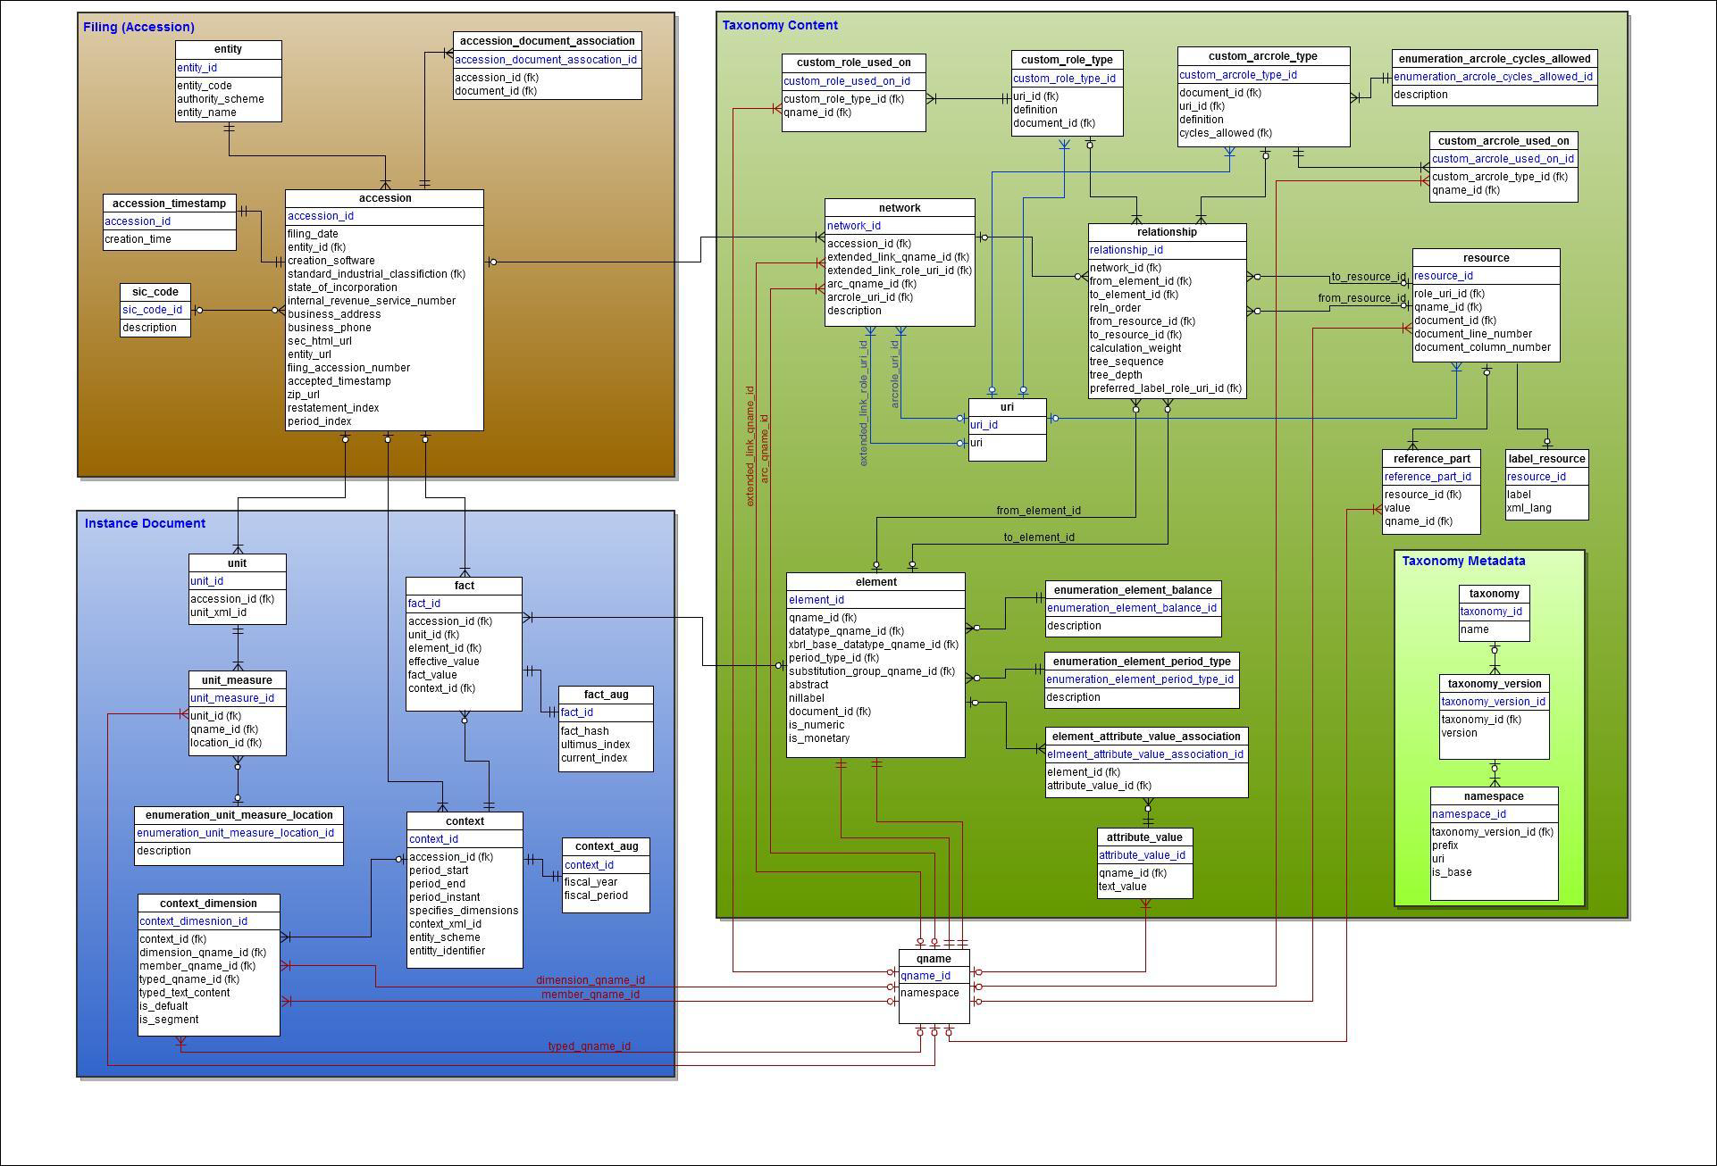
XBRL-US Public schema

Slide 12
Installing XBRL-US Postgres DB
Install Postgres
Create database, user, password, load DDL
Install Arelle & xbrlDB plugin
Run RSS feeds or cmd scripts
arelleCmdLine -f c:\temp\test.rss -v --disclosureSystem efm-pragmatic-all-years --store-to-XBRL-DB "host, port,user,pwd,database,90,postgres“

Slide 13
Graph Model

Slide 14
Graph Databases
Social networking technology (Facebook)
Rexter interface, Titan data store
Multiple backends (Cassandra, HBase)
Gremlin / Groovy query (tinkerpop)
Run RSS feeds or cmd scripts
arelleCmdLine -f c:\temp\test.rss -v --disclosureSystem efm-pragmatic-all-years --store-to-XBRL-DB "host, port,user,pwd,database,90,rexter”

Slide 15
Graph to Data Points

Slide 16
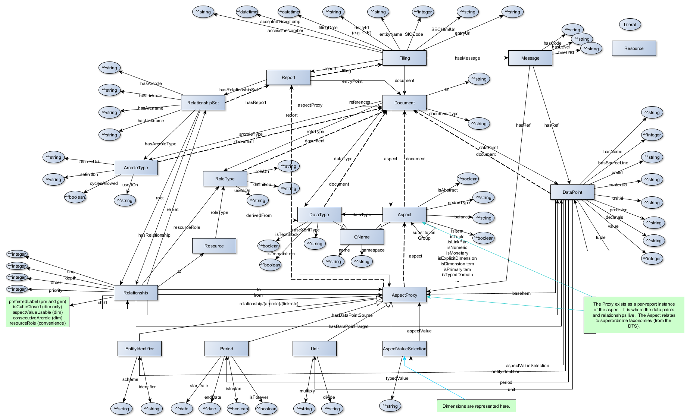
RDF Model

Slide 17
Storing into to RDF
RDF stores
Files (turtle, XML)
Database NanoSparqlServer
Run RSS feeds or cmd scripts
arelleCmdLine -f c:\temp\test.rss -v –disclosureSystem efm-pragmatic-all-years --store-to-XBRL-DB rdfFile,,,, c:\abc\test.turtle,600,rdfDB”

Slide 18
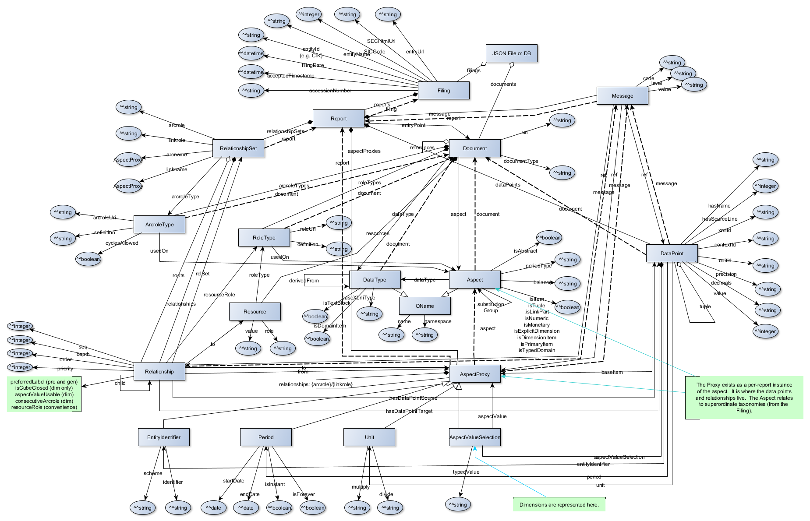
JSON Model

Slide 19
Storing into JSON Database
JSON file sytax
MongoDB interesting, size issues
Run RSS feeds or cmd scripts
arelleCmdLine -f c:\temp\test.rss -v –disclosureSystem efm-pragmatic-all-years --store-to-XBRL-DB jsonFile,,,, c:\abc\test.json,600,json”

Slide 20
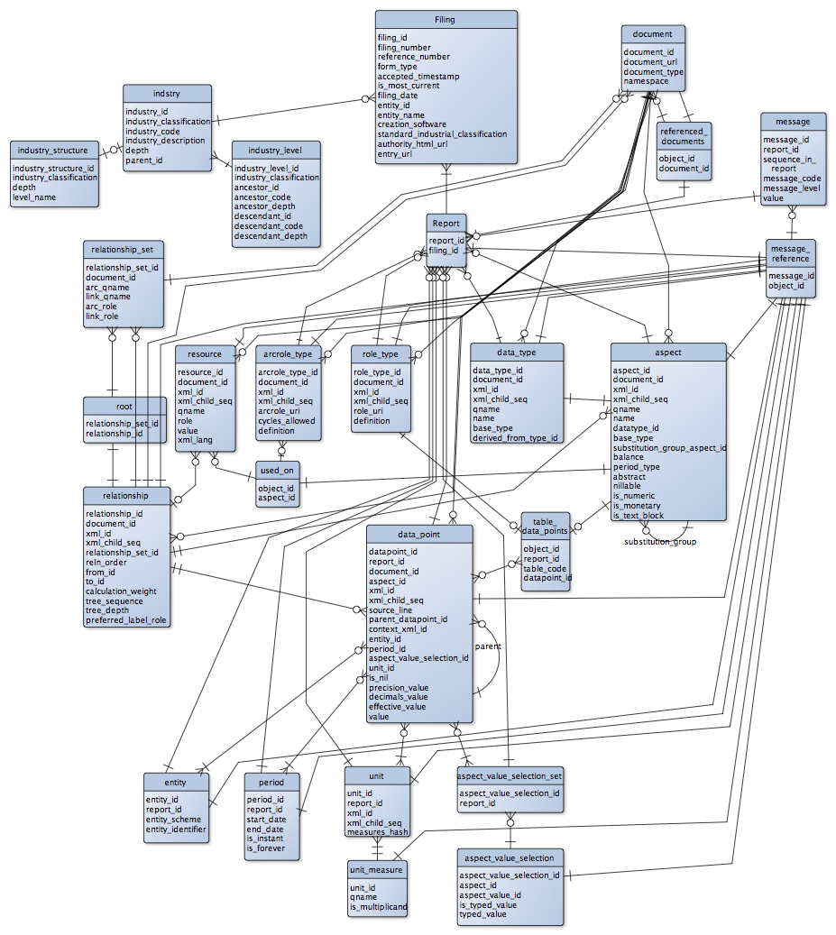
SQL Abstract Model

Slide 21
Storing into SQL
Postgres, SQLite, MySQL, MSSQL & Oracle
arelleCmdLine -f c:\temp\test.rss -v –disclosureSystem efm-pragmatic-all-years --store-to-XBRL-DB host,port,user,pwd,database600,pgSemantic
pgSemantic – Postgres
mysqlSemantic – MySql & Cloud SQL (GAE)
mssqlSemantic – MS SQL Server (2011)
orclSemantic – Oracle 11g
sqliteSemantic – SQLite

Slide 22
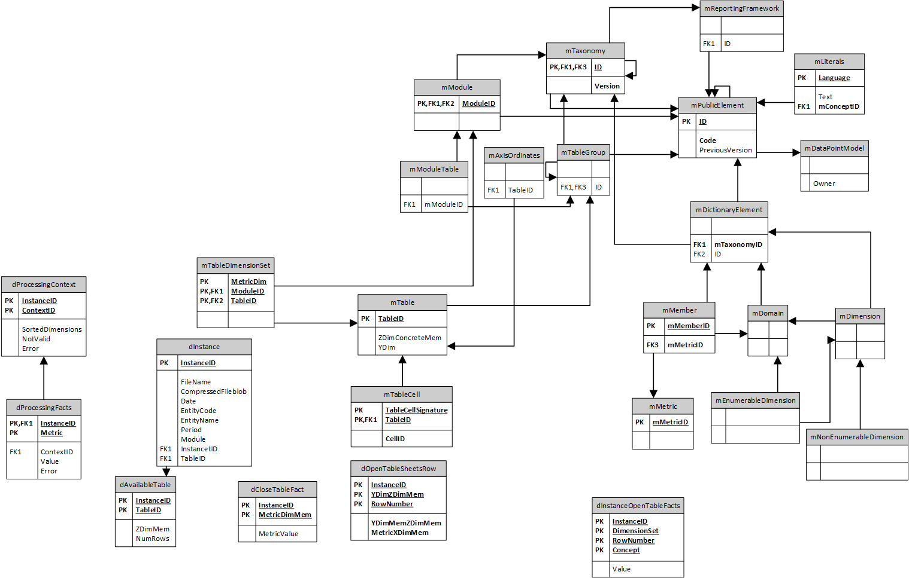
DPM
Model

Slide 23
Plug-ins
GUI
Command line
Standard plug-ins
Developing custom plug-ins

Slide 24
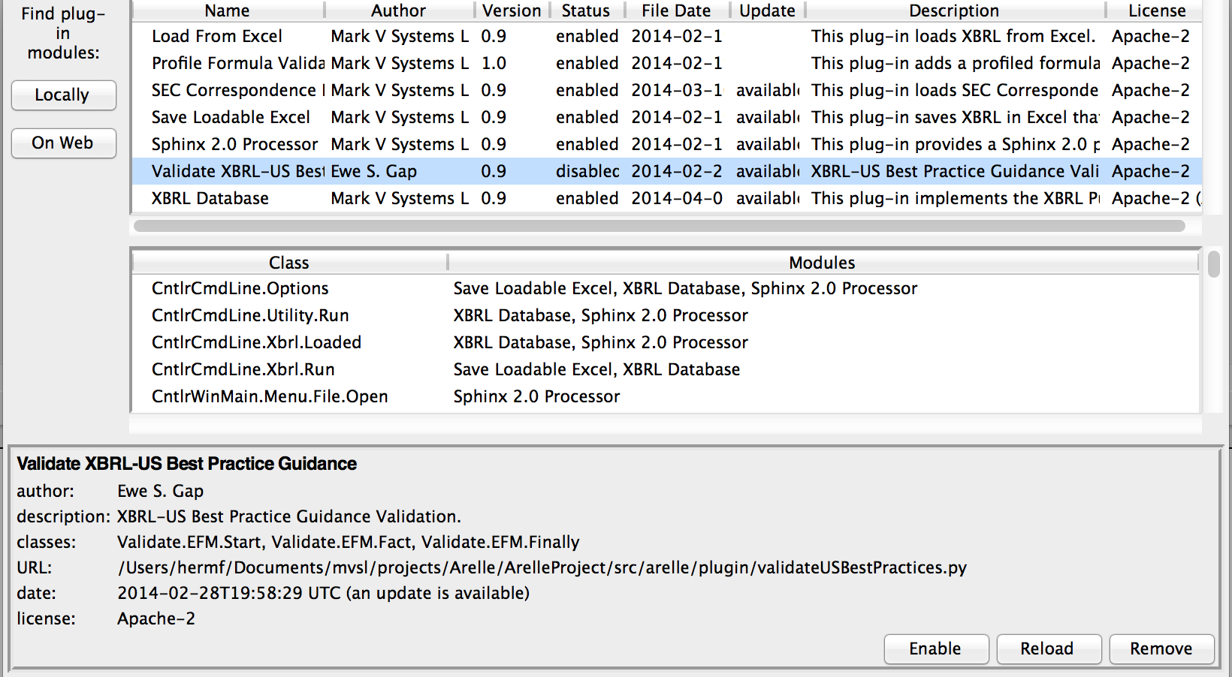
GUI Plug-in Manager

Slide 25
Command Line Plug-in Use
--plugins=PLUGINS
Modify plug-in configuration.
Re-save unless 'temp’ is in the module list.
'show' to show current plug-in configuration.
'|' separator (multiple plugins and commands)
+url to add plug-in by its url or filename, (relative to installation plugin directory)
~name to reload a plug-in by its name,
-name to remove a plug-in by its name
name for temporary plug-in (not saved)

Slide 26
Writing a Plug In
Production code in …/plugin
Examples in …examples/plugin
Structure:
Methods for plugin
CmdLine & GUI interfaces
__pluginInfo__ : plug-in class methods
Plugin distributed as source incl for binary app

Slide 27
Packages
Zip manifests (Oasis Catalog, XII Package)
(currently only first oasis catalog is found)
Entry points given names (vs fishing for files)
URL redirection catalog entries
Eliminate copying into cache
Support multiple packaged versions

Slide 28
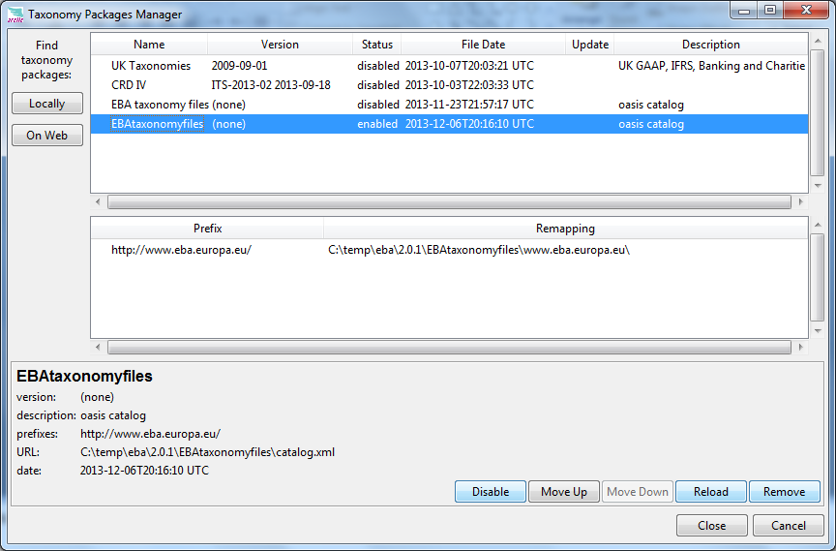
GUI Package Manager

Slide 29
Command Line Package Use
--packages=PACKAGES
Modify package configuration.
Re-save unless 'temp’ is in the module list.
'show' to show current package configuration.
'|' separator (multiple packages and commands)
+url to add package by its url or filename, (url is full path)
~name to reload a package by its name,
-name to remove a package by its name
name for temporary package (not saved)

Slide 30
Other mapping redirection
Config/mappings.xml
Maps URL or File to file, directory or into a zip

Slide 31
Performance & Profiling
--collectProfileStats - collect profile statistics
(time and memory by processing phase)
GUI tools log menu: collect/log profile stats
--plugins=profileCmdLine.py --saveProfilerReport=filename
GUI plugin profileFormula.py validation menu: Profile formula validation

Slide 32
Integration Topics
C# interface
Java interface
iOS future planned
Error messages txt/xml/json interfaces
Table linkbase error reporting

Slide 33
Interface “wrapper”
Prepare parameters
Prepare cache if offline, or Package file(s)
Initiate in background as appropriate
runtime.exec or Process.start
If run from GUI, named pipe to display status info
Process resulting log file (txt, .xml or .json)
Integrate error results to source files/tables/etc
href’s for each log entry with tooltip info in .xsml/.json

Slide 34
Testing
Most testing using XBRL validation suite files
Run either by:
Command .bat/.sh files in scripts directory
GUI: open test index or test suite
pyTest
Control file config/arelle_test.ini – tests & parameters
junitxml output for test integration
Test wrapper is arelle_test.py

