Slide 1
GRIP-Task1
Exploratory Data Analysis - Retail
Presented by-
Pabba Abhishek
File created on:
6/2/2021 2:55:56 PM

Slide 2
Situation presented
As a business manager of a superstore retail chain, should analyse the data about sales and profits of the company. The following is the data gathered to analyse.
Ship Mode | Segment | Country | City | State | Postal Code | Region | Category | Sub-Category | Sales | Quantity | Discount | Profit
Standard Class | Consumer | United States | Seattle | Washington | 98115 | West | Furniture | Tables | 1747.25 | 5 | 0 | 629.01
Standard Class | Corporate | United States | Seattle | Washington | 98103 | West | Furniture | Tables | 3393.68 | 8 | 0 | 610.8624
First Class | Home Office | United States | Harrisonburg | Virginia | 22801 | South | Furniture | Tables | 2244.48 | 7 | 0 | 493.7856
Second Class | Home Office | United States | Seattle | Washington | 98105 | West | Furniture | Tables | 1913.4 | 9 | 0 | 401.814
Second Class | Home Office | United States | Seattle | Washington | 98115 | West | Furniture | Tables | 2348.82 | 9 | 0 | 399.2994
. . . | . . . | . . . | . . . | . . . | . . . | . . . | . . . | . . . | . . . | . . . | . . . | . . .
Standard Class | Consumer | United States | Jackson | Mississippi | 39212 | South | Furniture | Tables | 2430.08 | 8 | 0 | 388.8128

Slide 3
Goal of the project
Find the weak areas
Recommend solutions to increase profits in those areas
Visually present the findings and let the shareholders know the suggestions.
Show the predicted results from the suggestions.

Slide 4
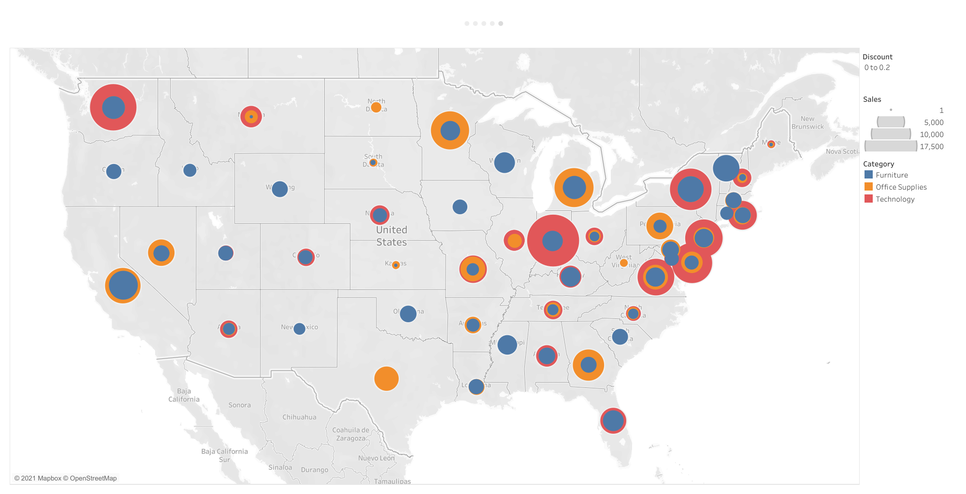
Sales based on states

Slide 5
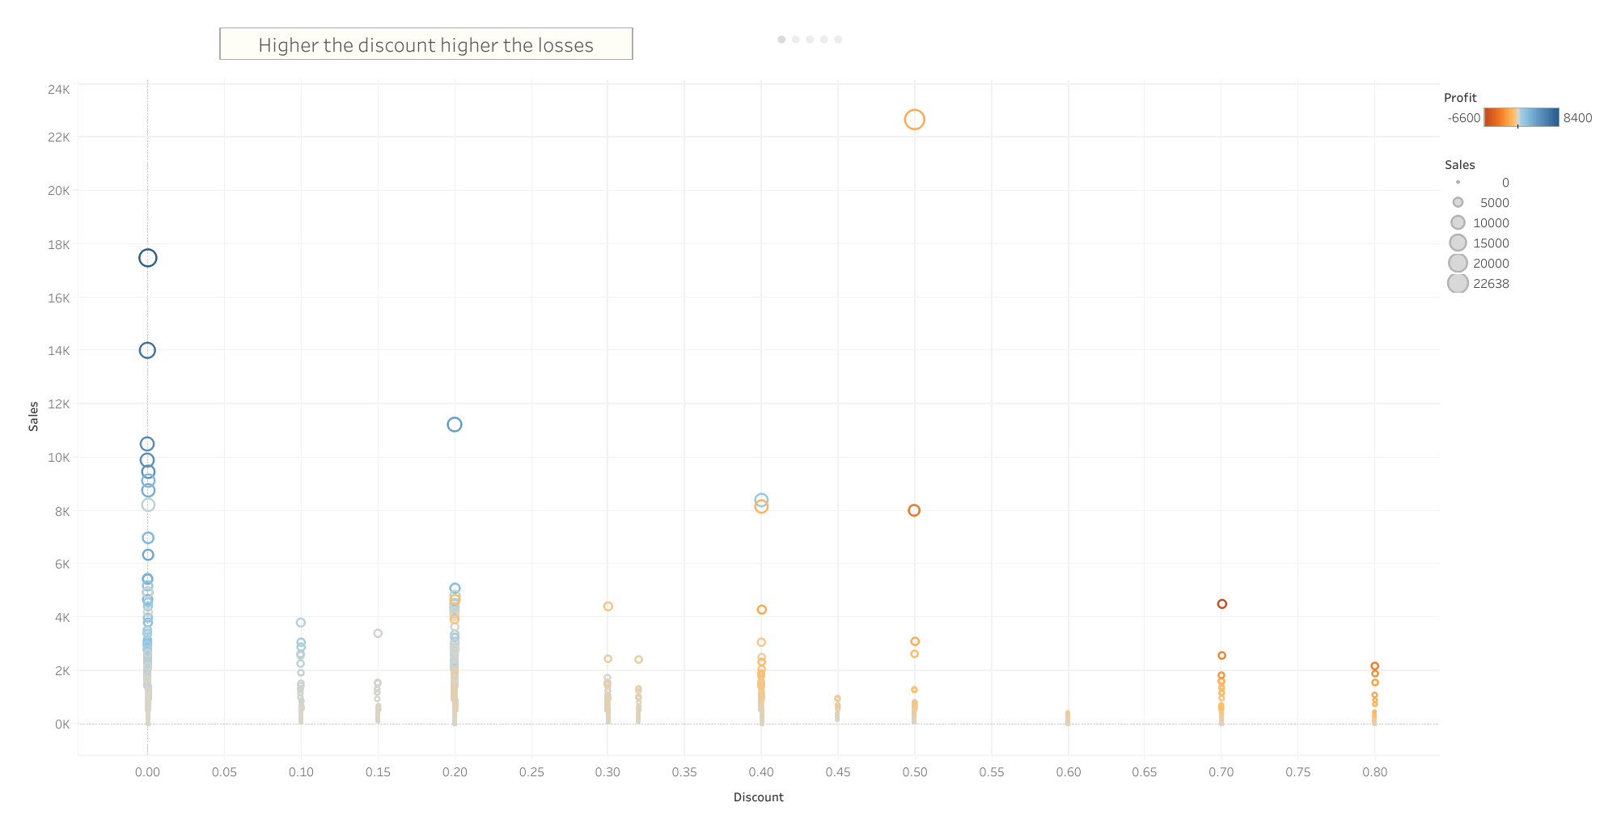
Discount vs Sales

Slide 6
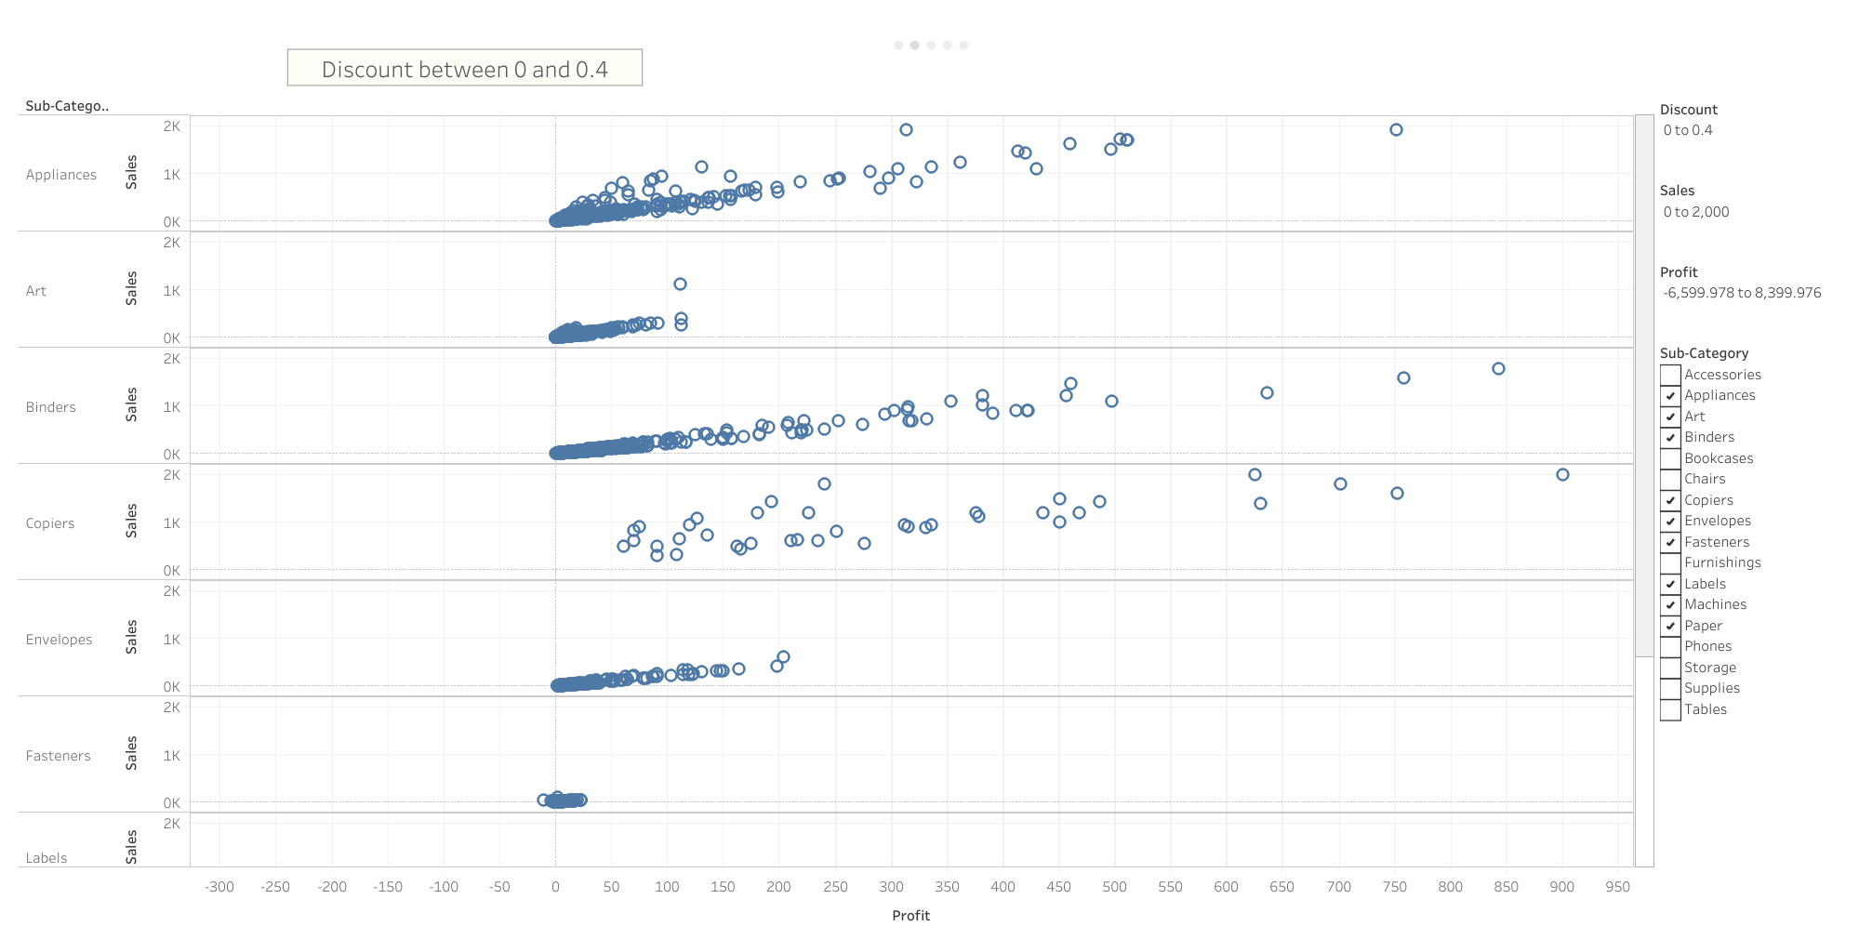
Sub-categories showing good amount of sales with discount between 0 and 0.4

Slide 7
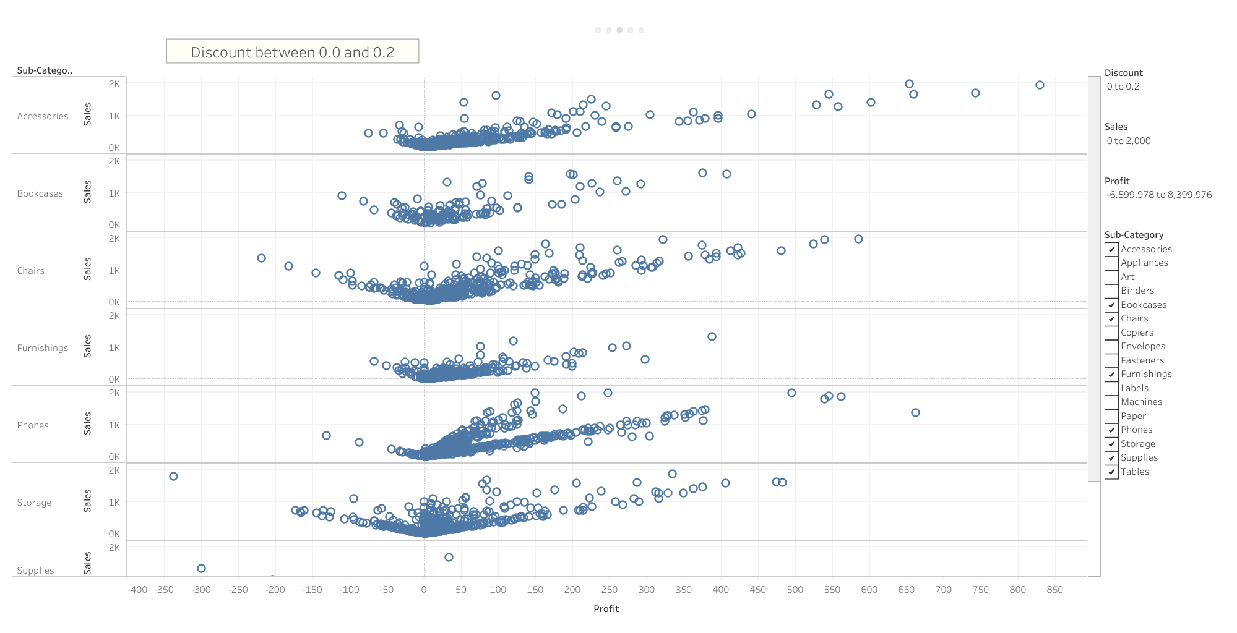
Sub-categories showing good amount of sales with discount between 0 and 0.2

Slide 8
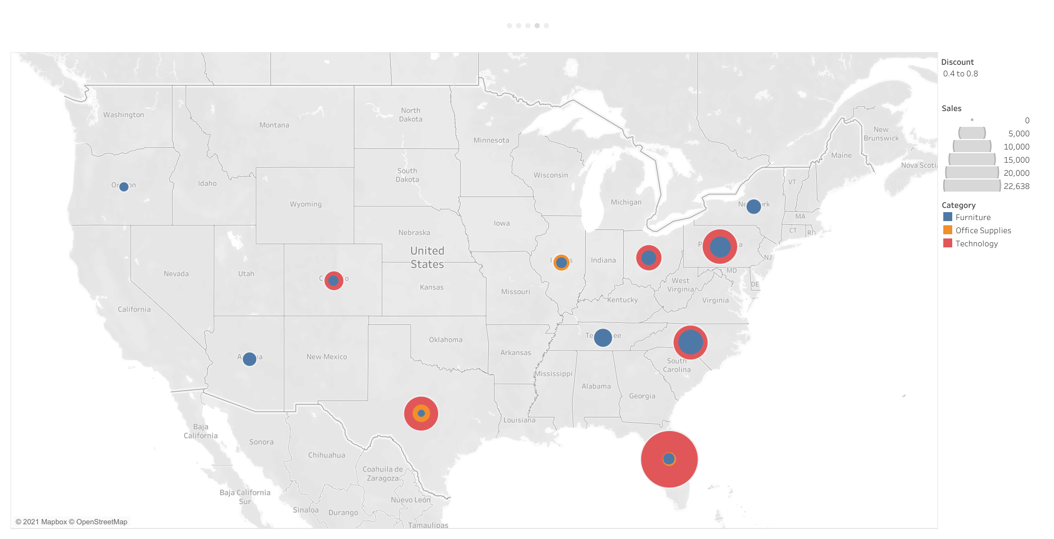
States which gave more than 0.4 discount

