Slide 1



Major Project Review-2
MATRUSRI ENGINEERING COLLEGE
Department of CSE
An Ensemble Model for Glioma sub region segmentation with CNN
B5
Project Guide : Mrs. k. Bhagya Laxmi, Asst professor
Student Names Roll No
1.A.Yugendhar Reddy 1608-20-733-062
2.P.Akhil 1608-20-733-084
3.A.Arundhathi 1608-20-733-109

Slide 2
Content Page
MATRUSRI ENGINEERING COLLEGE
Department of CSE
Abstract
Introduction
Problem Statement
Existing Models
Objectives
Methodology
Architecture Diagram
Technical Stack
UML Diagrams
Output Screens
Conclusion
Future Scope
References

Slide 3
Abstract
MATRUSRI ENGINEERING COLLEGE
Department of CSE
Glioma tumor sub-region segmentation is pivotal for precise diagnosis and treatment planning, delineating distinct regions within gliomas. Advanced computational techniques, including machine learning and deep learning algorithms, have revolutionized this process, enhancing accuracy and efficiency. By leveraging sophisticated imaging modalities like MRI and PET scans, clinicians can identify and characterize glioma sub-regions with unprecedented detail, enabling comprehensive assessment of tumor heterogeneity. Accurate segmentation facilitates ongoing monitoring of disease progression and empowers clinicians to tailor treatment strategies to individual patient needs, ultimately improving outcomes in the management of gliomas

Slide 4
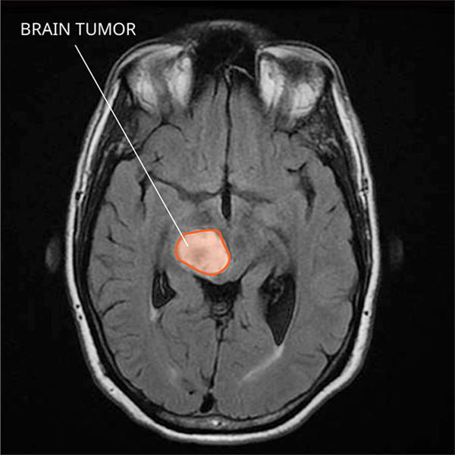
Introduction
MATRUSRI ENGINEERING COLLEGE
Department of CSE
Glioma tumors, a type of brain tumor, originate from glial cells, which are supportive cells in the brain and spinal cord. These tumors can arise from different types of glial cells, such as astrocytes, oligodendrocytes, and ependymal cells. Gliomas are classified based on their cell origin and characteristics, with grades ranging from I to IV according to their aggressiveness and growth pattern.

Slide 5
Problem Statement
MATRUSRI ENGINEERING COLLEGE
Department of CSE
The primary problem is to develop an ensembling model focused on glioma sub-region segmentation which is very useful for medical purposes to detect the spread area of disease and their sub-regions.

Slide 6
Existing Models
MATRUSRI ENGINEERING COLLEGE
Department of CSE
1) VGG-Based Segmentation Networks
Limitations:
Limited Contextual Information: VGG-based networks, while deep, may not capture sufficient contextual information due to the lack of skip connections. This can result in less accurate segmentation boundaries.
Computational Efficiency: VGG networks can be computationally expensive and slow, which might not be ideal for practical applications requiring real-time processing.

Slide 7
Existing Models
MATRUSRI ENGINEERING COLLEGE
Department of CSE
2) SegNet
Limitations:
Decoder Simplicity: SegNet uses a simpler decoder compared to U-Net, which can result in less accurate reconstructions of the segmentation map.
Feature Detailing: The absence of detailed feature extraction mechanisms in the decoder path might lead to poorer performance in capturing intricate tumor subregions.

Slide 8
Existing Models
MATRUSRI ENGINEERING COLLEGE
Department of CSE
How Your Model is Better
Your ensemble model combines the strengths of three state-of-the-art architectures to overcome the limitations mentioned above:
U-Net: Provides detailed spatial information and precise boundary delineation through its encoder-decoder structure with skip connections.
InceptionResNetV2: Enhances multi-scale feature extraction and deep feature learning, which is crucial for capturing the variability in glioma subregions.
W-Net: Offers a two-stage segmentation process that refines initial segmentation results, improving accuracy and detail.

Slide 9
Objectives
MATRUSRI ENGINEERING COLLEGE
Department of CSE
To study the literature on glioma segmentation using Convolutional Neural Network and to segment sub regions of glioma, in order to improve diagnosis and treatment planning for patients with Glioma.
To preprocess the dataset for glioma sub region segmentation
Image data generation
To analyze the images and classify and segment the tumor using multiple deep learning algorithms and combine these three algorithms to develop an ensemble model.
The result of this project is building a model that can automatically classify and segment glioma in medical images with better accuracy rate so it can take part in real-time application.
We use an ensembling technique to improve the segmentation model's generalization and resilience. Combining predictions from many sources .

Slide 10
Methodology
MATRUSRI ENGINEERING COLLEGE
Department of CSE
The main aim of this study is to develop a brain tumor segmentation algorithm in order to segment the four sub-tumor parts for all the modalities by comparing the existing deep learning models.
Here we proposed a two-layered ensemble deep model which segments the whole tumor and its subparts in three main steps:
A data pre-processing step to remove biases and do the normalization of the given MRI dataset.
First layer to train U-Net, InceptionResNetV2 , and WNet models for learning the parameter of segmentation through all four modalities.
An ensemble layer which extracts the maximized feature maps from different model and concatenation of feature maps for better segmentation accuracy .

Slide 11
Methodology
MATRUSRI ENGINEERING COLLEGE
Department of CSE
U-Net features a contraction path, bottleneck layer, and expansion path with doubling feature channels.
U-Net includes five encoding and decoding blocks each, with up-sampling and convolutional layers.
InceptionResNetV2 processes the initial segmentation map to further refine and enhance the segmentation.
With its inception modules and residual connections, allows it to capture more complex patterns and relationships within the segmentation map
This final output is expected to be more accurate due to the additional processing and feature refinement done by the InceptionResNetV2 model.
W-Net processes it through two U-Net networks stacked together, enabling further refinement of the segmentation results.

Slide 12
Methodology
MATRUSRI ENGINEERING COLLEGE
Department of CSE
All models conclude with a 1x1 convolutional layer and sigmoid activation for probability maps.
In the second layer, feature map fusion is performed based on maximized feature extraction.
Fusion involves convolutional layers with ReLU activation and concatenation for intermediate outputs.
Connectivity equations represent segmented outputs for core tumor, enhancing tumor, whole tumor, and edema.
The ensemble method leverages diverse architectures and operations for robust glioma segmentation.

Slide 13
Methodology
MATRUSRI ENGINEERING COLLEGE
Department of CSE
Unet Model :-
U-Net is a convolutional neural network with an encoder-decoder structure and skip connections.
Benefits of using
Localization and Precision:- U-Net's skip connections ensure that spatial information is preserved and passed directly from the encoder to the decoder. This helps in accurately segmenting the fine details and boundaries of glioma subregions.
Data Efficiency:- U-Net is known to perform well with limited training data, a common scenario in medical imaging. This is due to its efficient architecture that maximizes the use of available information.
Symmetry and Context:- The symmetrical structure allows for effective combination of contextual information (captured by the encoder) with precise localization (facilitated by the decoder). This is crucial for delineating complex structures within gliomas, such as the tumor core and surrounding edema.

Slide 14
Methodology
MATRUSRI ENGINEERING COLLEGE
Department of CSE
InceptionResNetV2 Model :-
InceptionResNetV2 combines the Inception architecture (which uses multiple parallel convolutional filters) with residual connections (which help in training very deep networks).
Multi-scale Feature Extraction:- The Inception modules in InceptionResNetV2 allow the model to extract features at multiple scales simultaneously. This is beneficial for capturing the varied sizes and shapes of glioma subregions, from small necrotic cores to larger areas of edema.
Deep Learning Capabilities: Residual connections enable the training of very deep networks by mitigating the vanishing gradient problem. This allows InceptionResNetV2 to learn complex features and patterns that are crucial for accurate segmentation of glioma subregions.
Robustness and Generalization: The combination of inception and residual modules makes the model robust to various input variations and helps it generalize well across different datasets. This is particularly important in medical imaging, where variability between patients is high.

Slide 15
Methodology
MATRUSRI ENGINEERING COLLEGE
Department of CSE
WNet Model :-
W-Net consists of two stacked U-Nets, where the output of the first U-Net is fed into the second U-Net for further refinement.
Refinement and Accuracy: The two-stage architecture of W-Net allows for initial segmentation followed by refinement. This two-step process helps in correcting errors from the first stage and improving the overall accuracy of the segmentation.
Improved Detail: By refining the segmentation output in a second stage, W-Net can achieve higher detail and precision in the final segmentation. This is crucial for distinguishing between closely situated subregions like the enhancing tumor and the non-enhancing core.

Slide 16
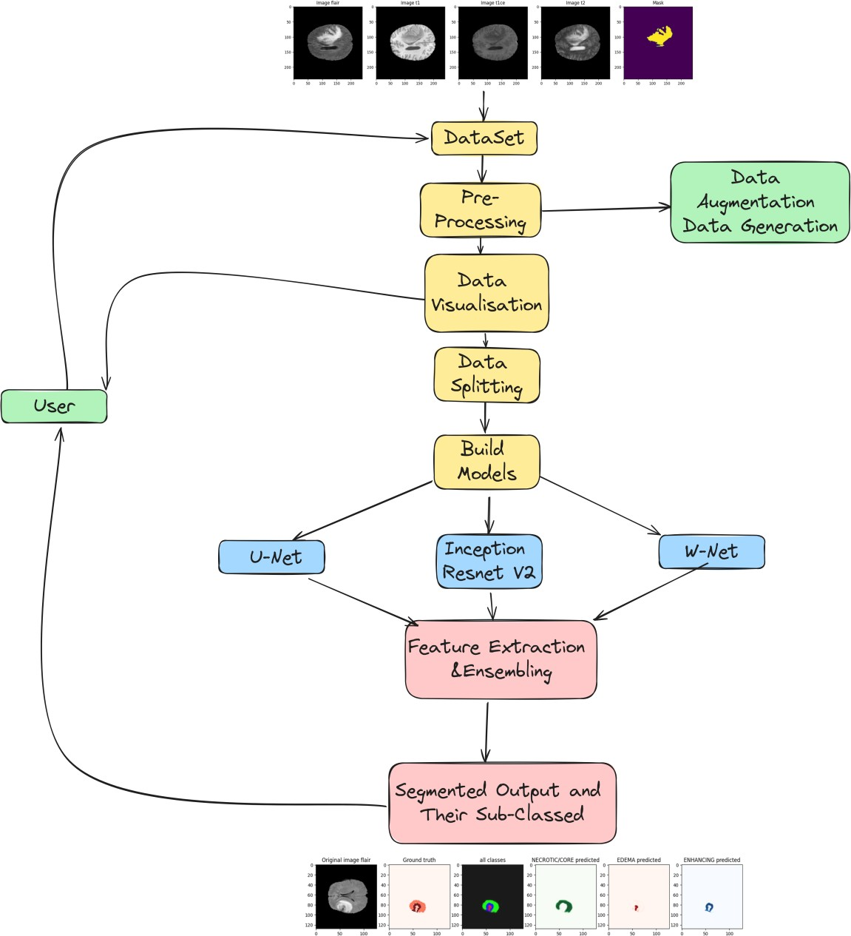
Methodology - Architecture Diagram
MATRUSRI ENGINEERING COLLEGE
Department of CSE
Architecture Diagram

Slide 17
Technical Stack
MATRUSRI ENGINEERING COLLEGE
Department of CSE
1. Hardware
High-Performance Computing (HPC)
GPUs: NVIDIA GPUs such as Tesla V100 or A100 for training deep learning models.
2. Software
Operating System
Ubuntu Linux: Preferred for compatibility with deep learning libraries and tools.
Windows: Optional, with compatibility layers like WSL for Linux-based tools.
b. Programming Languages
Python: Primary language for deep learning, data preprocessing, and model implementation.
c. Deep Learning Frameworks
TensorFlow: For building and training U-Net, InceptionResNetV2, and W-Net models.
Keras: High-level API for TensorFlow to simplify model building.
d. Libraries and Tools
NumPy: For numerical operations and array manipulations.
Pandas: For data manipulation and analysis.
scikit-learn: For machine learning utilities and metrics.
Matplotlib/Seaborn: For data visualization.

Slide 18
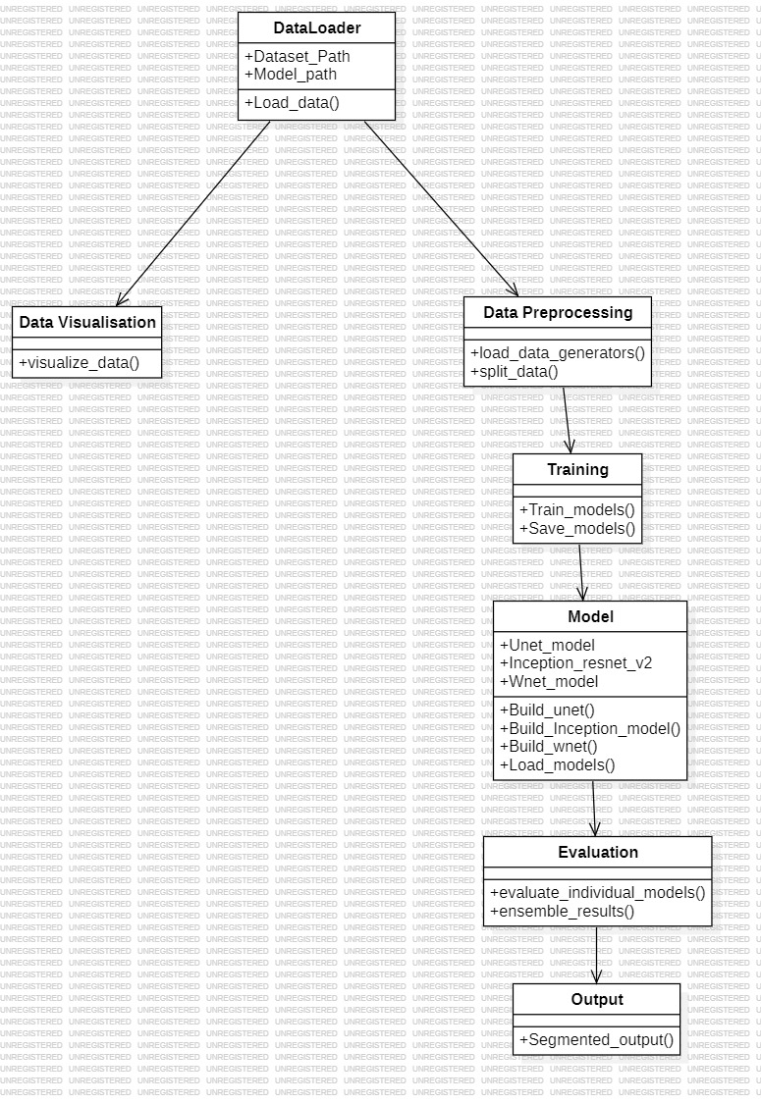
UML Diagrams
MATRUSRI ENGINEERING COLLEGE
Department of CSE
Class Diagram

Slide 19
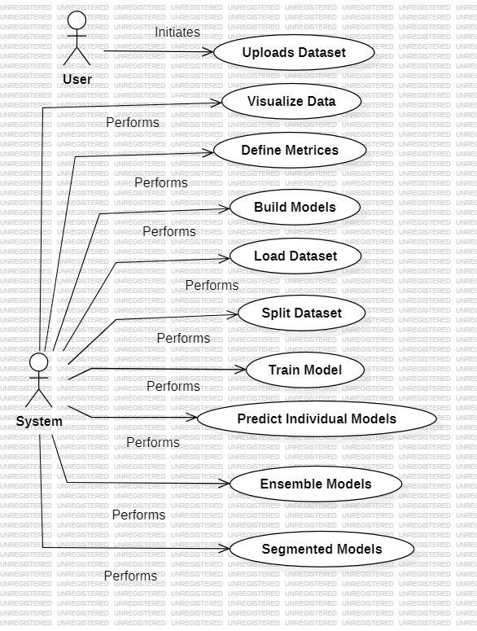
UML Diagrams
MATRUSRI ENGINEERING COLLEGE
Department of CSE
UseCase Diagram

Slide 20
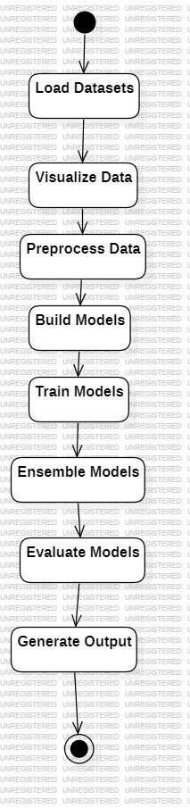
UML Diagrams
MATRUSRI ENGINEERING COLLEGE
Department of CSE
State Diagram

Slide 21
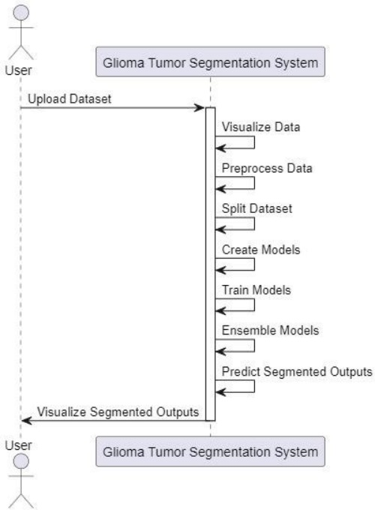
UML Diagrams
MATRUSRI ENGINEERING COLLEGE
Department of CSE
Sequence Diagram

Slide 22
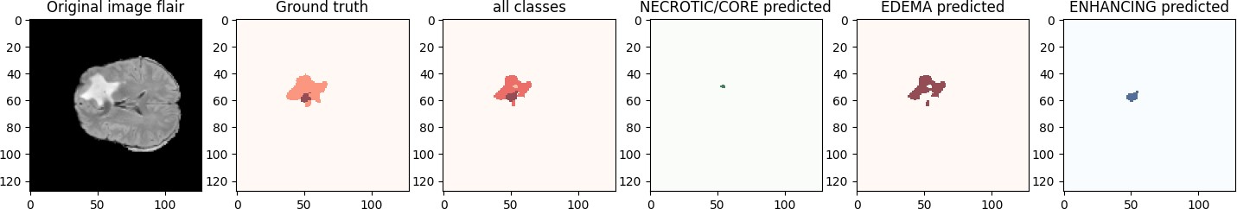
Output Screens
MATRUSRI ENGINEERING COLLEGE
Department of CSE
Predicting using Unet:

Slide 23
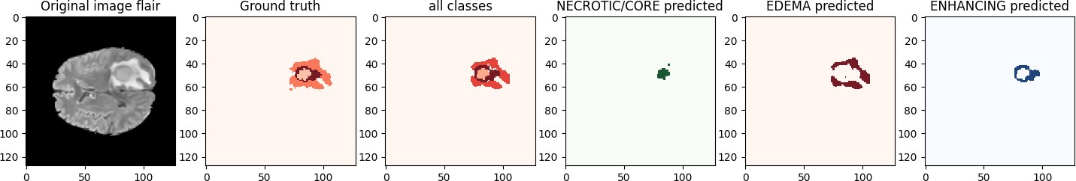
Output Screens
MATRUSRI ENGINEERING COLLEGE
Department of CSE
Predicting using InceptionResnetV2:

Slide 24
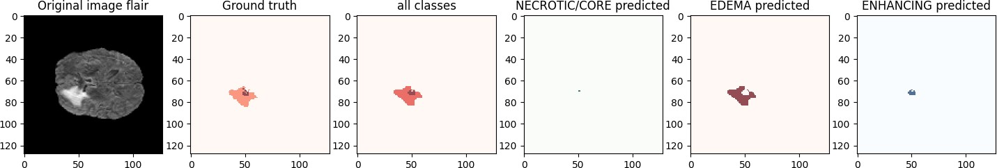
Output Screens
MATRUSRI ENGINEERING COLLEGE
Department of CSE
Predicting using WNet:

Slide 25
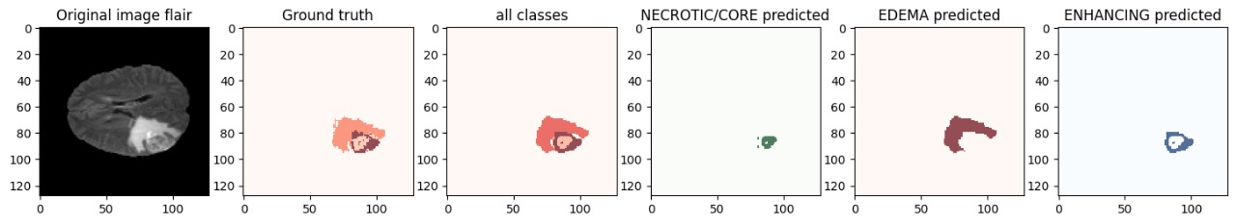
Output Screens
MATRUSRI ENGINEERING COLLEGE
Department of CSE
Predicting using Ensemble model:

Slide 26
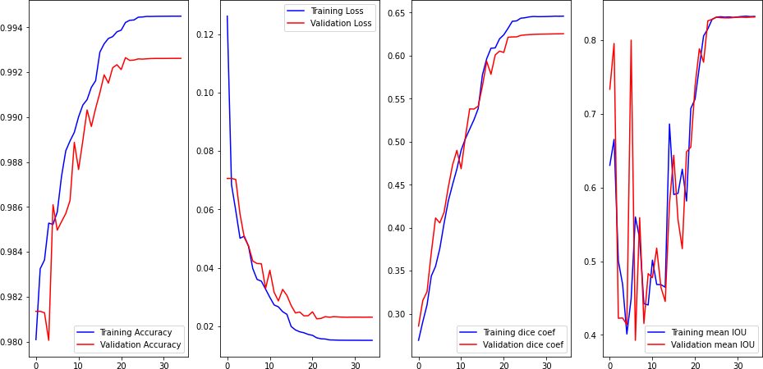
Output Screens
MATRUSRI ENGINEERING COLLEGE
Department of CSE
Graphical Representation of Metrices (Accuracy , Losses , Dice Coeff , Mean IOU)of the Ensembling Model:

Slide 27
Conclusion
MATRUSRI ENGINEERING COLLEGE
Department of CSE
In conclusion, our project introduces a novel approach to glioma subregion segmentation through the integration of deep learning ensembling techniques. By combining the strengths of U-Net, InceptionResnetV2 and WNet architectures.
We address the challenge of segmenting glioma subregions into four distinct types with enhanced accuracy and robustness.
The utilization of average prediction and stacking methods for ensembling allows us to harness the diverse predictions of both models, leading to more comprehensive and precise segmentation outcomes.
Through this innovative approach, we aim to advance the field of neuro-oncology by providing clinicians with powerful tools for accurate diagnosis and treatment planning, ultimately improving patient care and outcomes in the management of gliomas.

Slide 28
Future Scope
MATRUSRI ENGINEERING COLLEGE
Department of CSE
Advanced Imaging and Data Fusion:Incorporating Multi-modal Data: Integrate additional imaging modalities (e.g., PET, CT, functional MRI) to enhance segmentation accuracy and provide more comprehensive tumor characterization.
Multi-Parametric Analysis: Utilize multi-parametric MRI data to capture more detailed information about tumor subregions, improving the precision of segmentation.
Enhanced Model Performance and Validation:Robust Validation: Validate the ensemble model across diverse and larger datasets from multiple institutions to ensure its robustness and generalizability.
Personalized Medicine and Treatment Planning: Personalized Treatment Strategies: Use segmented subregions to inform personalized radiotherapy and chemotherapy plans, improving treatment efficacy and minimizing side effects.Prognostic Models: Develop prognostic models that leverage segmented subregion data to predict patient outcomes and guide clinical decision-making.

Slide 29
References
MATRUSRI ENGINEERING COLLEGE
Department of CSE
K. Farmanfarma, M. Mohammadian, Z. Shahabinia, S. Hassanipour, and H. Salehiniya, “Brain cancer in the world: an epidemiological review,” World Cancer Res. J., vol. 6, no. 5, pp. 1–5, 2019.
D. N. George, H. B. Jehlol, and A. S. Oleiwi, “Brain tumor detection using shape features and machine learning algorithms,” Int. J. Adv. Res. Computer Sci. Softw. Eng., vol. 5, no. 10, pp. 454–459, 2015.
D. N. Louis, A. Perry, G. Reifenberger, A. Von Deimling, D. Figarella-Branger,W. K. Cavenee, et al., “The 2016 World Health Organization classification of tumors of the central nervous system: a summary,” Acta Neuropathol., vol. 131, no. 6, pp. 803–820, 2016.
H. Dong, G. Yang, F. Liu, Y. Mo, and Y. Guo, “Automatic brain tumor detection and segmentation using U-Net based fully convolutional networks,” in: Annual Conference on Medical Image Understanding and Analysis, Springer, 2017.

Slide 30
Thank You…!
MATRUSRI ENGINEERING COLLEGE
Department of CSE

