Slide 1
SPOTIFY DATA ANALYSIS PROJECT
Objective :
This is the Spotify Insight Data Analysis Project.
Our objective is to find the Top 20 artist who has sung maximum songs, Top 20 popular songs, Yearly Trend chart for total number of Track and Total Artist, Top 20 Genre by Popularity.
In this project we used Spotify datasets from Kaggle and then We used Azure Databricks for Data load and Transformations.
After made all transformation in Databricks, we load these tables into Power BI and build some meaningful insight
Dataset link: https://www.kaggle.com/datasets/amitanshjoshi/spotify-1million-tracks?resource=download

Slide 2



Project Architecture
FACT_SPOTIFY_FOUNDATION_TABLE
DIM_SPOTIFY_ARTIST_TABLE
DIM_SPOTIFY_TRACK_TABLE
Spotify_Data_Analysis.pbix
Spotify_raw.csv

Slide 3
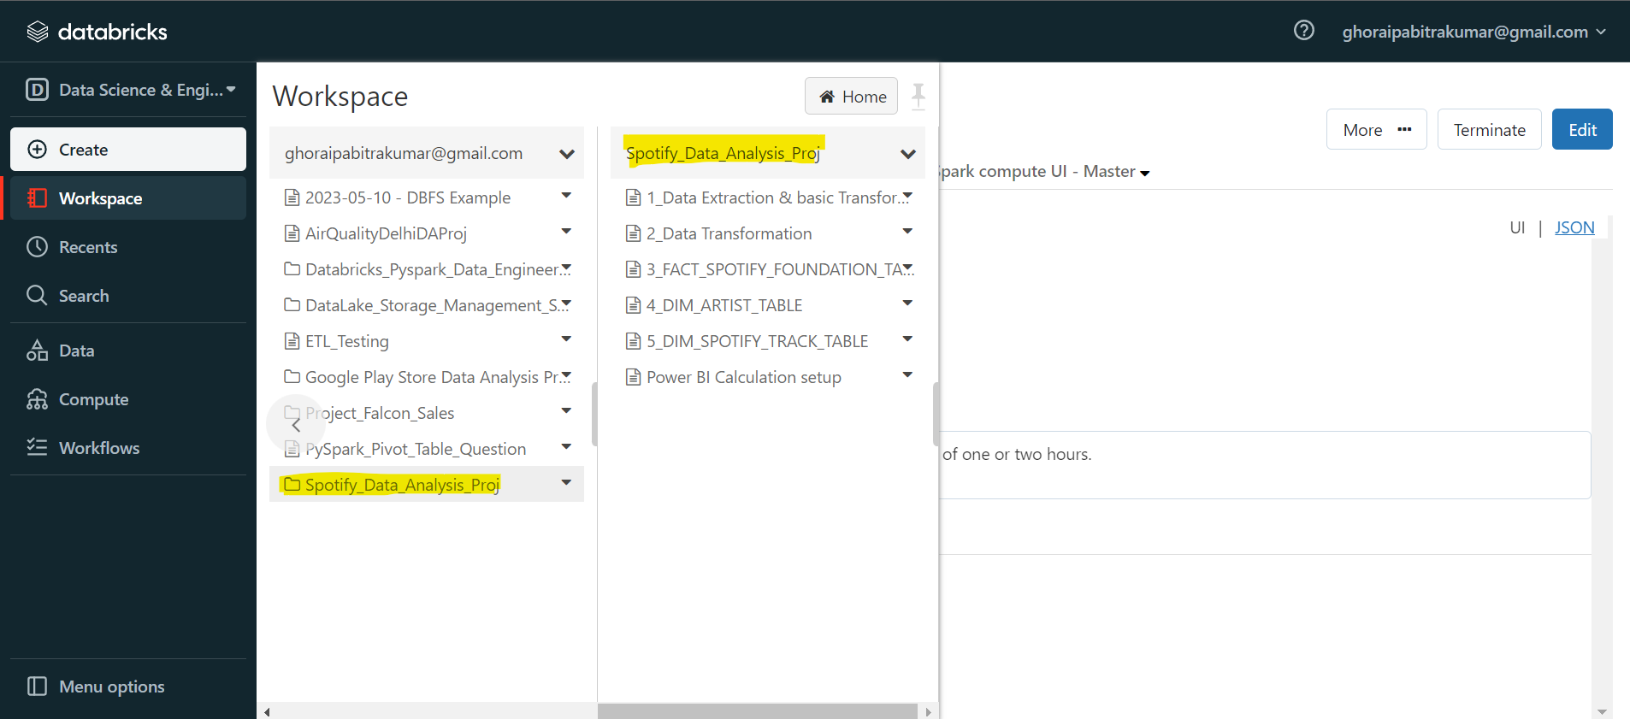
Azure Databricks :
Azure Databricks is a Microsoft Azure implementation of Apache Spark. Spark clusters, which are completely managed, are used to process big data workloads and also aid in data engineering, data exploration, and data visualization utilizing machine learning.
Here we use Azure Databricks for load csv files and transform csv files into SQL tables.

Slide 4
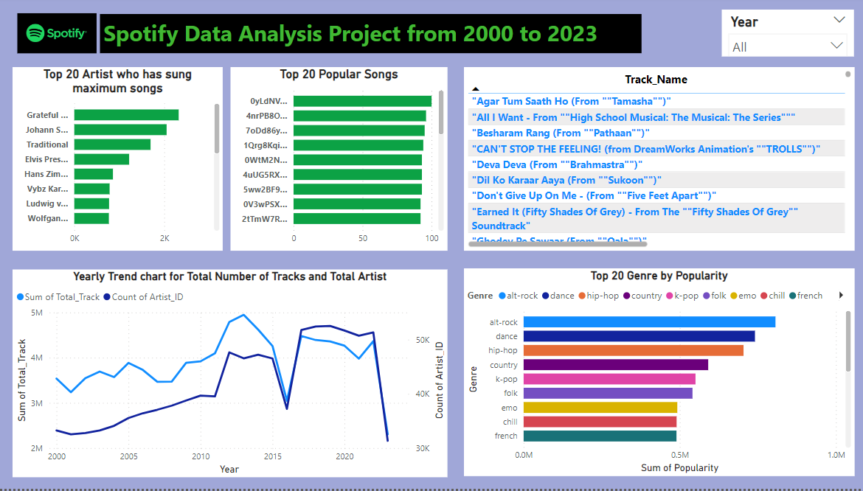
Data Insight in Power BI :

