Slide 1
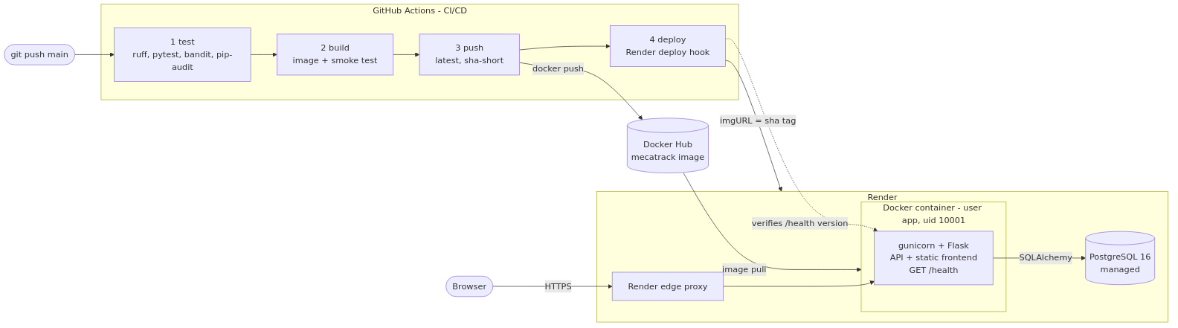
One container, one public URL
Flask API and vanilla frontend in a non-root container, PostgreSQL managed by Render
436 MB
uid 10001
/health
image, vs 2.27 GB naive (−81 %)
non-root user, code is read-only
checks PostgreSQL: 200 or 503
Notes:
One container serves the API and the frontend, so there is a single URL and no CORS. The image is multi-stage on python:3.12-slim: 436 MB instead of 2.27 GB for a naive build. It runs as an unprivileged user that cannot modify its own code. /health runs SELECT 1, so Docker, compose and Render stop sending traffic when the database is down. On start the entrypoint applies migrations; demo data is never loaded automatically.

Slide 2
Every push to main ships itself
GitHub Actions: four chained jobs; pull requests stop after the build
1
Test
2
Build
3
Push
4
Deploy
ruff, pytest with a 90 % coverage gate, bandit, pip‑audit
multi-stage image, smoke test: healthy and not root
Docker Hub tags latest and sha-<short>
Render hook pinned to the sha image, waits for /health
Paste here: screenshot of the green CI/CD run (Actions tab, 4 jobs)
Notes:
Stage 1 blocks bad code: lint, 257 tests on a real PostgreSQL with a 90 % coverage gate, bandit for the code and pip-audit for dependencies. Stage 2 builds the image and starts it next to a database: it must be healthy, report this commit as its version and not run as root. Stages 3 and 4 only run on main: push to Docker Hub, then call the Render deploy hook with the sha tag, so Render deploys exactly this image, and wait until the public /health reports the new commit.

Slide 3
Quality gates and JWT, measured
Live from scripts/quality_report.sh and scripts/demo_jwt.sh
257 / 257
97.4 %
JWT case | HTTP
Valid client token | 200
Client on admin route | 403
No token | 401
Role claim tampered | 401
Expired token | 401
Reused after logout | 401
tests passing
line coverage, gate 90 %
0
0
bandit high or medium
vulnerable packages
Notes:
All numbers are produced by scripts, not typed by hand: quality_report.sh runs the same gates as the pipeline. For JWT we run demo_jwt.sh live: a valid token gets 200, a client on an admin route 403, and five ways of cheating get 401 - no token, a tampered role claim (the signature no longer matches), garbage, an expired token signed with the real key, and a token reused after logout, revoked by its jti.

