Slide 1
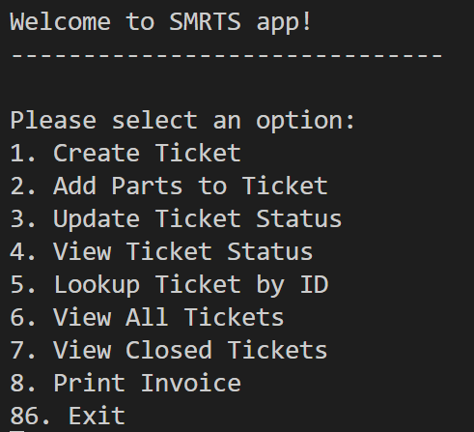
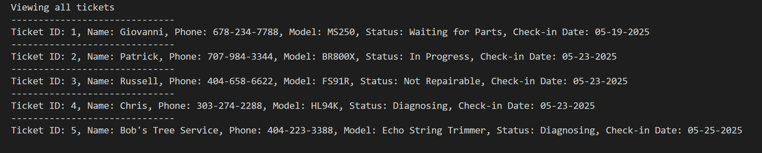
SMRTS: Small Engine Repair Ticket System
SMRTS is a lightweight, Python-powered terminal application designed to streamline service ticket tracking for small repair teams. With intuitive menu options, users can create, update, and review tickets, log parts, print invoices, and quickly locate service history. Built for simplicity and speed, SMRTS operates entirely through the command line, making it efficient and scalable without the overhead of complex software.
Key Features:
- 🧾 Create and manage service tickets
- 🔍 Lookup by ID & update ticket status
- 🛠️ Add parts, view closed & open history
- 🖨️ Print invoices via terminal interface
Whether you're tracking repairs or managing workflows, SMRTS gets it done — fast, clean, and smart.
Solo Project by: Pablo Cesar Chavez-Lopez

