Slide 1
PROJECT: Seeing the Uncanny: Neural Classification of Artificial Faces
P.I. prof Alice Mado proverbio, Univ. Milano-Bicocca
Pablo Rimoldi pablo.rimoldi01@universitadipavia.it
Tommaso Godino tommaso.godino01@universitadipavia.it
Andrea De Paola andrea.depaola02@universitadipavia.it
Giacomo Colombo giacomo.colombo04@universitadipavia.it
(Prof Claudia Casellato)
Università di Pavia, Bachelor of Artificial Intelligence

Slide 2
Background
Recent advances in generative artificial intelligence have produced hyper-realistic synthetic faces that are increasingly difficult to distinguish from real human faces, raising critical questions about how artificial faces are represented in the human brain. Behavioral studies indicate that observers frequently misclassify AI-generated faces as real and often judge them as more familiar or attractive than genuine faces, a phenomenon referred to as AI hyperrealism. The present study investigated whether neural processing differentiates real from highly realistic AI-generated faces despite observers’ limited behavioral discrimination ability, and whether such differentiation is modulated by face sex. Twenty-six participants (30 before artifact rejection) viewed 440 real and GAN-generated male and female faces while EEG was recorded.
More recently, advances in AI, particularly Generative Adversarial Networks (GANs), have enabled the creation of increasingly realistic artificial faces (Karras et al., 2019). GANs, which are trained on photographs of real people to generate realistic images of entirely new faces (Goodfellow et al., 2014), have made it progressively more difficult to distinguish real from artificial faces, with important real-world consequences such as deepfakes and social media scams (Moshel et al., 2022).

Slide 3
Indeed, the variability characterizing real human faces and GAN-generated faces arises from fundamentally different generative processes. While natural facial variability emerges from complex biological and developmental constraints, resulting in subtle asymmetries and highly idiosyncratic configurations, GAN-generated faces are shaped by algorithmic optimization over learned statistical regularities. As a consequence, synthetic faces often exhibit increased global symmetry and reduced extreme individuality compared to real faces, positioning them closer to the center of the learned face distribution. This structural regularity may enhance perceptual fluency and, in turn, elicit a heightened sense of familiarity, despite a reduction in authentic facial uniqueness.

Slide 4
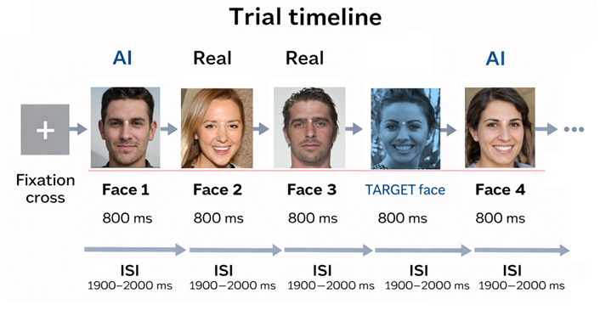

Slide 5
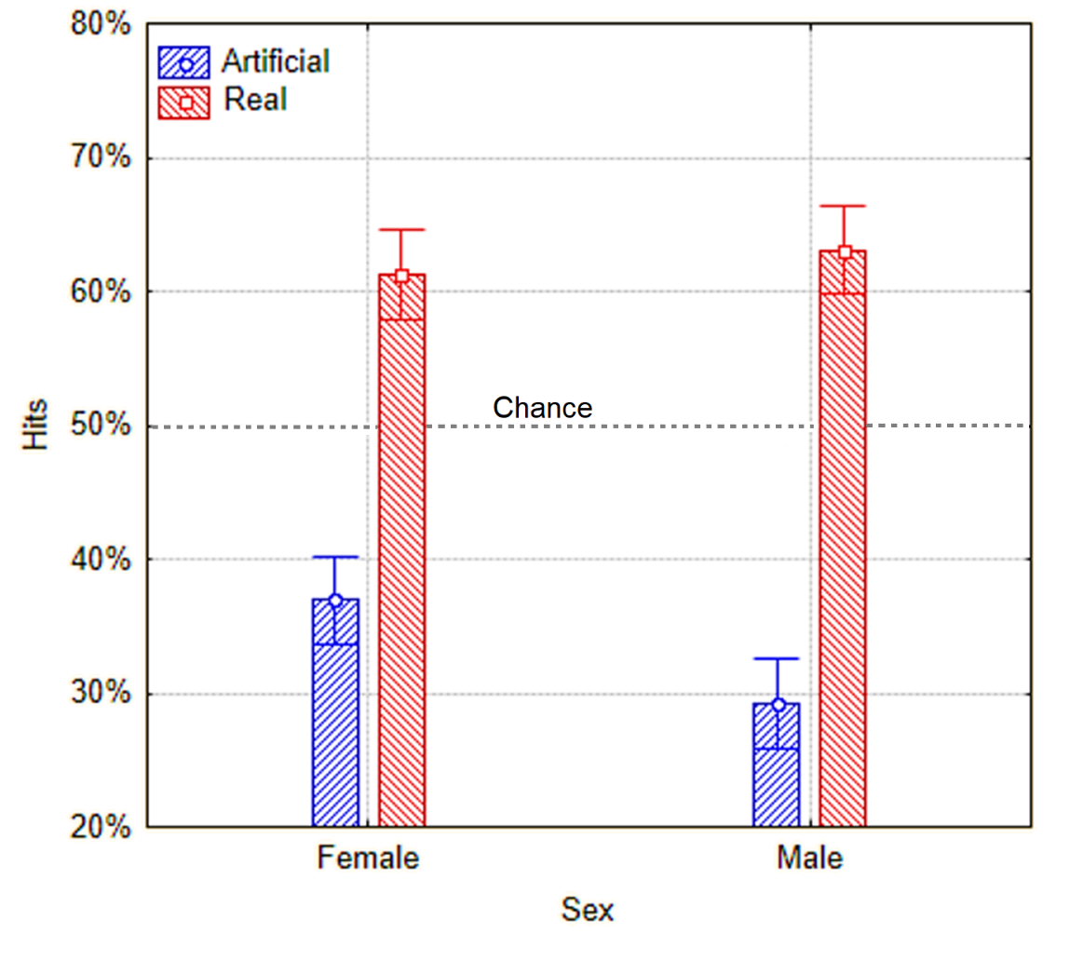

Slide 6
Brain bioelectric activity was recorded using a Compumedics quick cap neo-net with 128 sensors arranged according to the 10/5% system (Oostenveld & Praamstra, 2001), with a sampling frequency of 512 Hz. Eye movements (saccades and blinks) were detected via vertical and horizontal electro-oculograms (VEOG and HEOG), via bipolar electrodes placed on the side of the eye (outer canthus), and below/above the right eye. Signals were referenced to a common average reference (CAR) to optimize source reconstruction.
The EEG signals were filtered offline with a 0.01-70 Hz bandpass filter. Eye blinks were reduced using the covariance reduction method, and excessively noisy electrodes were interpolated with the four neighbouring electrodes. The EEG was filtered using the threshold method at ± 75 μV, and a 50 Hz notch filter was applied.
The EEG epochs were synchronized with the onset of the stimuli and analysed using Curry9 software (Compumedics Neuroscan), segmented into epochs extending from 100 ms pre-stimulus to 800 ms post-stimulus onset.
Event-Related Potentials (ERPs) were extracted using the offline averaging technique. The electrophysiological data of four subjects were excluded after ERP averaging, because of excessive EEG/EOG artifacts and an insufficient number of trials (belew 30%). The final sample comprised twenty-six participants (13 M, 13 F).

Slide 7
Partecipanti
Si sono sottoposti alla registrazione EEG 25 soggetti volontari, di cui 13 femmine tra i 20 e i 26 anni (M =23.15, SD = 1.63) con scolarità media pari a 15.31 anni (SD =2.06) e 12 maschi dai 24 ai 29 anni (M = 25, SD =1.85), con scolarità media di 15.25 anni (SD =2.14). Tutti i soggetti hanno riportato una preferenza laterale destra al Questionario di Salmaso e Longoni (1985) e avevano vista normale o corretta; nessuno di essi riferiva una storia di danni neurologici o di problemi di lettura. Hanno tutti dato il proprio consenso scritto. 2 femmine e 2 maschi sono stati eliminati dal processo di averaging a causa di un numero eccessivo di artefatti EEG.

Slide 8
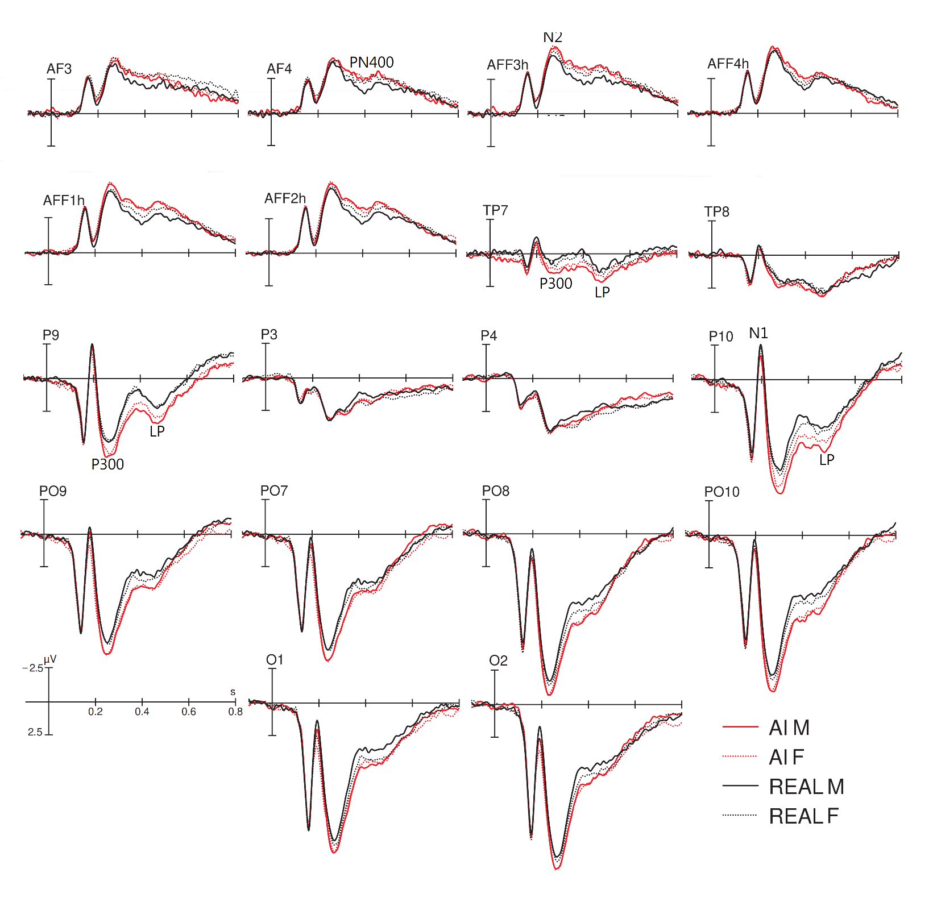

Slide 9
Facce Ai maschi codice 50
Facce Ai femmine codice 60
Facce Reali maschi codice 70
Facce Reali femmine codice 80

Slide 10
Suggested electrodes and time window
O1, O2, PO9, PO10, TP7, TP8, P3, P4, AF3, AF4, AFF1h, AFF2h, AFF3h, AFF4h
200-600 ms

