Slide 1

Applied Data Science Program
Final Submission
Classification
Pablo Aguirre Solana

Slide 2
Key Take Aways
Understanding credit loan/default behaviour is critical to the bank in two main ways; to widen the client base, and to increase revenue. In this regard, it is important, strategically, what the bank is pursuing in the short and long term.
Based on several statistical analysis we found out:
Which clients are more likely to be eligible for a loan (defaulting or not) and those who are not, with an accuracy of around 90%.
The main variables, that increase the likelihood to be eligible or not for a loan, and defaulting or not; are: debt to income ratio, age of the oldest credit line, current value of the property, and the amount of the loan approved.

Slide 3
Next Steps
Based on the above results I would suggest the following:
Develop a client segmentation model, to establish and limit the threshold of the variables that impact the most on eligibility and defaulting. Knowing the thresholds of the variables that impact the most, will help us further understand the behaviour of past and future clients. That is, for example, which level of debt income ratio, is critical for defaulting and which not.
Include and Retrieve demographical information of the banks clients. One of the main limitations of the analysis that we made, is that the models we ran are based only on records of clients, with no demographic information.
Demographic information can be decisive in contributing to explain why a person is eligible or not for a loan and why a person defaults or not.
For example; variables, such as income, education level, employment, marital and family status, and geographical area can explain the nuances and variations among the different client segments, and thus increase or decrease the likelihood of defaulting or not.

Slide 4
Problem Solution
The problem being solved in this analysis was:
To predict if a client is eligible or not for a loan, and also if she/he will default or not.
I. First we ran an Exploratory Data Analysis
II. Second we ran multiple machine learning models

Slide 5
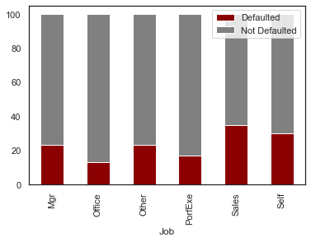
Problem Solution. Key Points 1/3
EDA (Exploratory Data Analysis)
The data set, for its origin, contained a lot of missing values, that had to be treated in order not to bias the results, and in order to run the models properly.
The numerical variables of the data set present few significant linear relationships between them, that is, the are not related to each other. This matter, because if some strong relationships were to be found, this could contribute to the explanation of what causes a default.
The categorical variables of the data seem to reflect that clients who are in sales as an occupation tend to default more. But with no influence in the final prediction as well see.

Slide 6
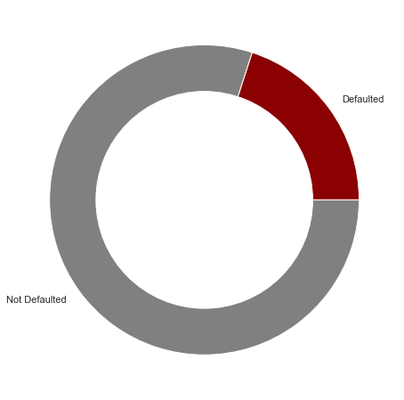
Problem Solution. Key Points 2/3
EDA (Exploratory Data Analysis)
One thing that was crucial for the models is that, in our data set, only 20% of the clients in it have defaulted.
The consequence of this, is that the predictability of this class will be more difficult (since there are few in the data set)
20%
80%

Slide 7


Problem Solution. Key Points 2/3
The bank losses money
(More likely to default)
MACHINE LEARNING MODELS
The first thing we had to deal with; is to avoid making wrong predictions with the banks clientele.
Predict a client who is eligible when in reality she/he is not.
Predict a client who is not eligible when in reality she/he is.
Predict = Eligible
Reality = Not Eligible
Not Eligible
Reality
Predict = Not Eligible
Reality = Eligible
Eligible
The aim of our models should be to minimize the probability of losing money and losing a client.
Not Eligible
Eligible
Predicted
The bank losses a client
(More likely to NOT default)

Slide 8
Solution Design
To minimize the wrong predictability of classes (Eligibility or not) we focused on having a high score in three metrics, for all the models that we made: Accuracy, Precision and Recall.
A total of 10 models were made with different techniques (LDA, QDA, Logistic Regression, Decision Trees and Random Forest) to have the best prediction of eligibility and defaulting for our business problem.
All these different techniques present trade-offs: some perform better in predicting one class and others are better in predicting the other class . This depends mainly in the weight of the class in the parameters of the models, which was crucial for the final model selected.
The selection of our final model, was made based on the highest Precision and Accuracy, which is most relevant in terms of revenue.
(Predicting wrongly a person who is eligible for a loan when is not)

Slide 9
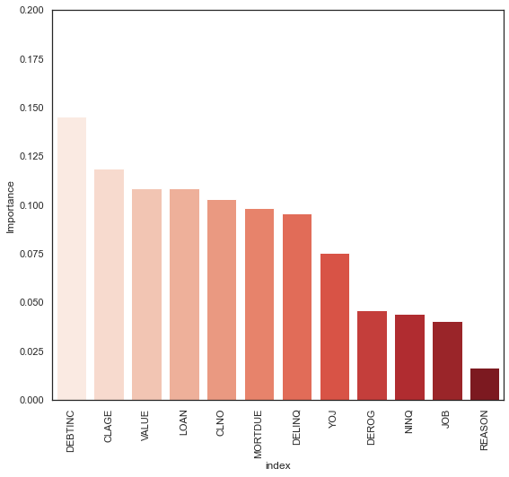
Implementation
The final model based on the highest Precision and Accuracy is far for solving a good way to predict correctly eligibility/defaulting:
Variable Importance in predicting class 1
We are failing to predict correctly 14% of clients who are eligible when in reality they are not.
We are failing to predict correctly 34% of clients who are not eligible when in reality they are.
The model tells us which variable is more important in predict clients who are not eligible (defaulters)
But does not provide the thresholds, and levels for which these variables decrease or decrease the likelihood, as well as a path (decision tree) for these.
*Random Forest tunned model

Slide 10
Recomendations
Include and Retrieve demographical information; will help to further explain and predict eligibility/defaulting; based on variables that have a direct influence on clients income and way of life, such as education, family status, employment and geography
The key actionable for these analysis would be to establish some strategic thresholds and minimum levels on debt to income rate, age of the oldest credit line, current value of the property and the amount of the loan approved, based on the levels of defaulters, and from there to establish a client segmentation for new clients.
A new way to improve client profiling, can be done based on the different levels of these variables and demographic variables, establishing thus a criteria and thresholds (decision-tree), by which the bank can pre-screen, automatize, and further analyse the status of a client, that can help, prevent detect and monitor future defaulters and also gain new clients.

