Slide 1
OptMA^{lab} – Laboratório para Optrônica e Microtecnologias Aplicadas
Universidade Federal de Minas Gerais - UFMG
LiFi Simulator
Pablo Nunes Agra Belmonte

Slide 2

The simulator is a software!
Let’s develop like a real one

Slide 3

Pillars
What is important?
Development control
Track evolution
Assign task / bug
Version Control
Communication

Slide 4



Tools
JIRA
Git
Teams

Slide 5

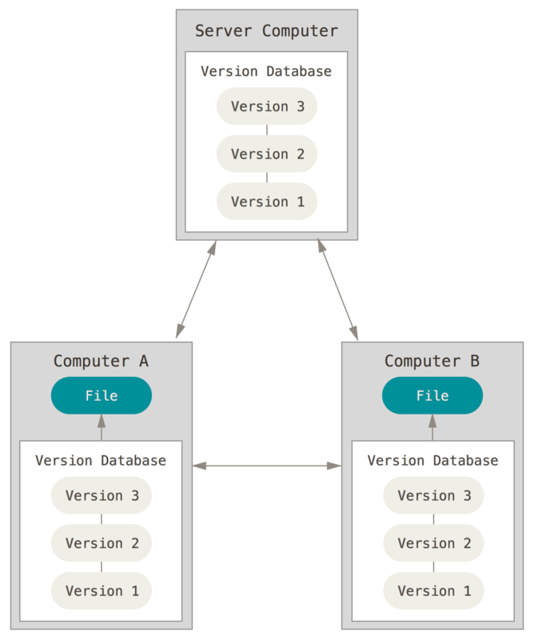
Git
Version Control
Stable versions
Rollback
Branches
Check-in/out

Slide 6
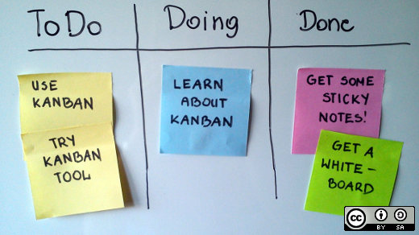
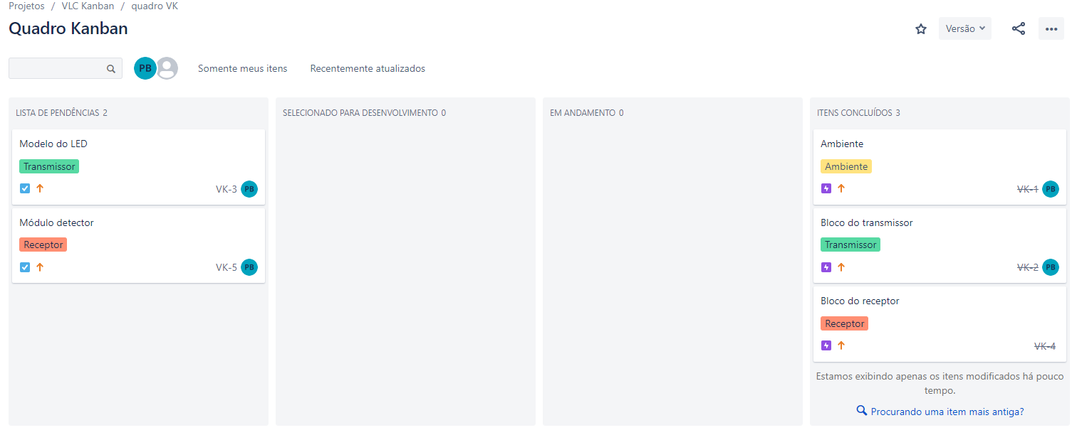
Jira
Kanban board
Simple
Tasks
Epics
Bugs

Slide 7

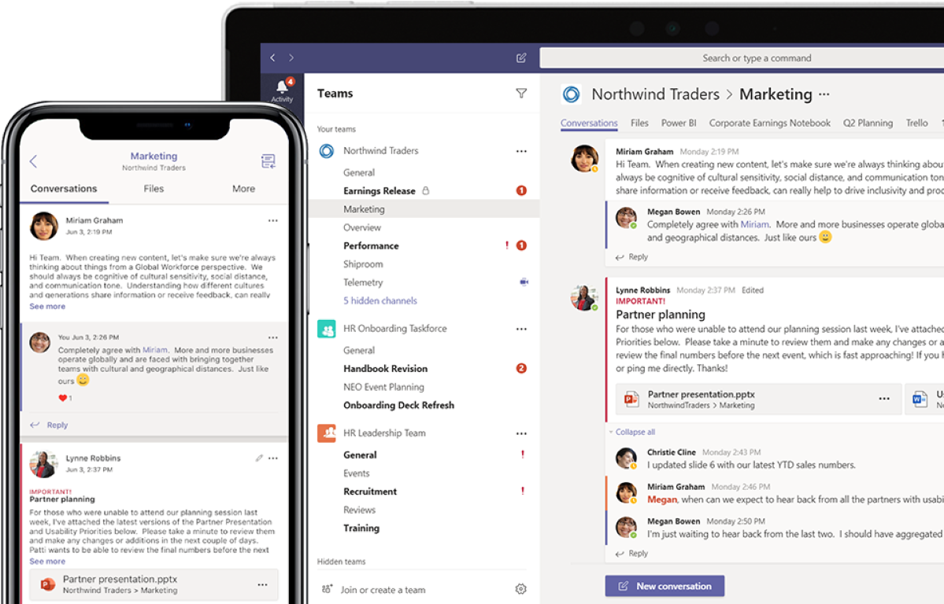
Teams
Chat
Video-conferences
Centralized info transactions
Access to Sharepoint / OneDrive

Slide 8
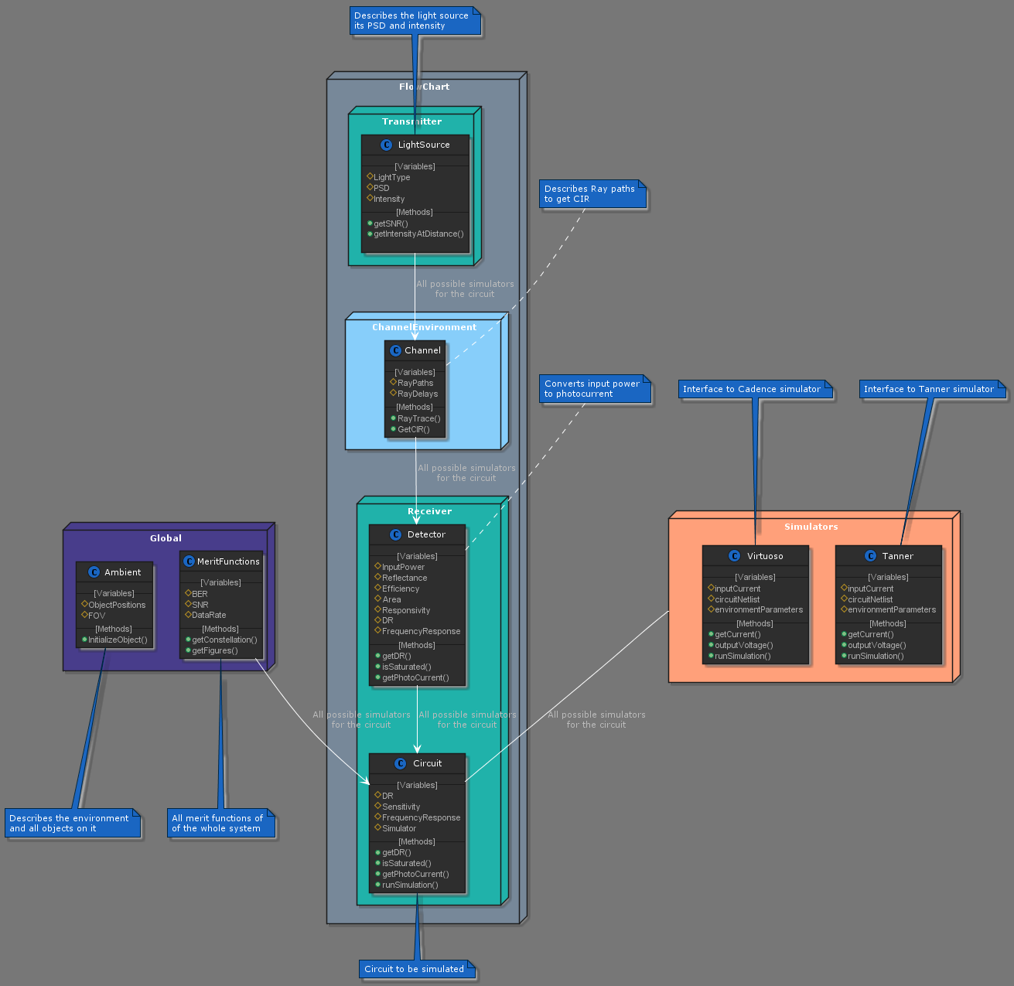
The Simulator
Modular design
Highly integrated
Python vs. Matlab
Python vs. C++
UML

Slide 9
The Simulator

Slide 10
The Simulator

Slide 11
Project
Ambient
Sensor and transmitter positions
FOV
LOS
3D modelling
Transmitter
LED / laser
PSD
Power / Intensity
Flicker / ripple
SNR
Channel Environment
CIR calculation
LOW
Multiple paths
Receiver
Input power / photocurrent
Physical PD
Integrated Circuit
Global
Merit Functions

Slide 12
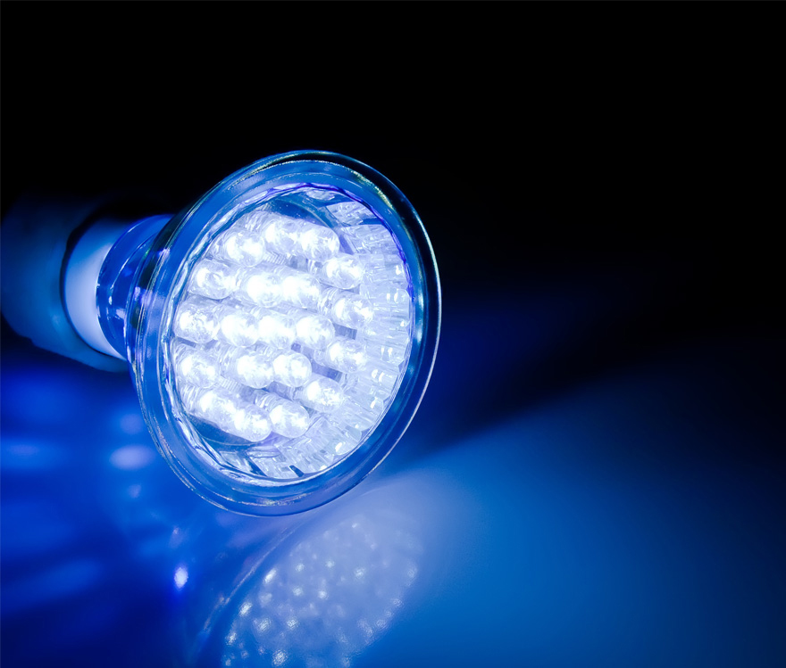
Thank You
Notes:
..
..

