Slide 1
ExtremeSolarTexas
National Renewable Energy Laboratory
Pablo Botin
October 2025

Slide 2
Understanding the Model
- Represented electric grid: Texas power system derived from the ACTIVSg2000 test case, extended with large-scale solar, wind, and hydro additions to study high‑renewable scenarios.
- Implementation: Copperplate power model; modeled as a single-node (infinite transmission capacity) system so energy flows freely across the system (transmission constraints and congestion are ignored).
The system:
Contains detailed static plant capacity, prime‑mover types (PV, WT, hydro, thermal)
Thermal units include detailed operational/economic parameters (is that why thermal processing takes so long?)
Loads and renewables have time‑series attached.
Purpose: This model is the basis for simulations to analyze the effect of a high penetration of renewables in the grid.
- Files: JSON snapshots of different version of the system, HDF5 time series, geo CSVs, and analysis/plots…
Notes:
This is an electric‑power system model of Texas built from the ACTIVSg2000 test case and extended with large-scale solar, wind and hydro insertions to study high‑renewable scenarios. It is implemented as a copperplate (infinite‑capacity) power model: the whole system is treated as a single node with no transmission constraints, so energy can flow freely between any resources and loads. The snapshot (base_sys.json and companion files) contains detailed static plant capacity, prime‑mover types (PV, WT, hydro, thermal), and time‑series availability for loads and renewables; thermal units have richer operational/economic parameters. Intended uses: system‑level capacity mix and adequacy studies, aggregate dispatch and reserve sizing, and sensitivity experiments on high solar penetration. Key assumptions & limitations: ignores network congestion, AC power‑flow limits, and locational reliability differences; results are best interpreted at the system‑wide (not nodal) scale. Output artifacts: serialized JSON snapshots, HDF5 time series, and derived plots (capacity breakdowns, gen vs load comparisons).

Slide 3
Output files that are interesting for analysis.
Sys_base.json; Basic system includes all the components but no time series attached.
DA_sys.json; Deterministic day‑ahead system snapshot with attached load forecasts and hydro/wind/solar DA time series.
may_19_sys_DA.json; Copy of DA_sys with time series reduced to a single day. Useful for analysis of daily pattern.
DA_sys_31_scenarios.json; System snapshot containing 31-member solar trajectory scenarios for stochastic analysis.
DA_sys_84_scenarios.json; System snapshot containing 84-member solar trajectory scenarios for stochastic analysis.
Notes:
This is an electric‑power system model of Texas built from the ACTIVSg2000 test case and extended with large-scale solar, wind and hydro insertions to study high‑renewable scenarios. It is implemented as a copperplate (infinite‑capacity) power model: the whole system is treated as a single node with no transmission constraints, so energy can flow freely between any resources and loads. The snapshot (base_sys.json and companion files) contains detailed static plant capacity, prime‑mover types (PV, WT, hydro, thermal), and time‑series availability for loads and renewables; thermal units have richer operational/economic parameters. Intended uses: system‑level capacity mix and adequacy studies, aggregate dispatch and reserve sizing, and sensitivity experiments on high solar penetration. Key assumptions & limitations: ignores network congestion, AC power‑flow limits, and locational reliability differences; results are best interpreted at the system‑wide (not nodal) scale. Output artifacts: serialized JSON snapshots, HDF5 time series, and derived plots (capacity breakdowns, gen vs load comparisons).

Slide 4
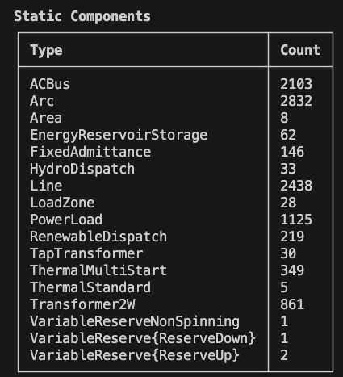
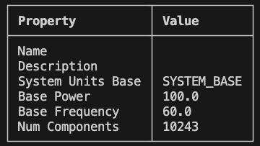
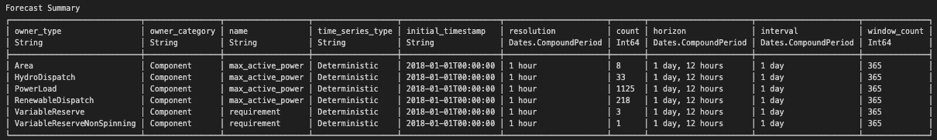
Characterization of the System

Slide 5
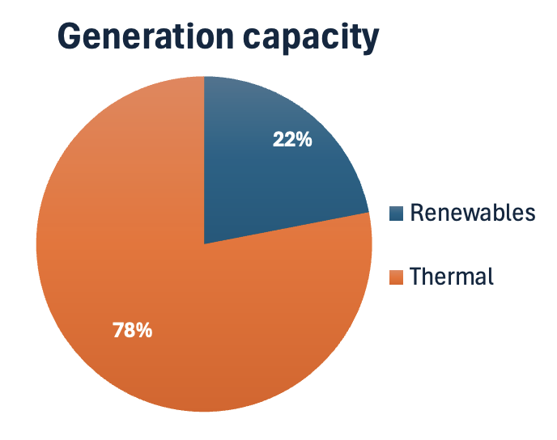
Capacity Statistics
Capacity mix
Renewables | 38903
Thermal | 138346
Renewables mix
Wind | 14755
Hydro | 1581
Solar | 22567
Total Renewables | 38903
Generation | 177250
Load | 782
Delta | -176468

Slide 6
Time Series – Data Files
Aspect | Day-Ahead (DA) | Hour-Ahead (HA) | Real-Time (RT)
Forecast Horizon | 24 hours ahead | 12 intervals (1 hour) | 5-15 minutes
Update Frequency | Once daily (midnight) | Every hour | Every 5 minutes
Resolution | 1 hour | 5 minutes | 5 minutes
Purpose | Unit commitment, market clearing | Short-term dispatch adjustments | Real-time economic dispatch
Uncertainty | Highest | Medium | Lowest
Planning Window | Day-ahead operations | Intra-hour scheduling | Immediate balancing
Data Shape | 3D (365Days, 36h, 99 percentiles) | 2D(105120 5-min, 24 values) | 2D(8760h, 24 values)

Slide 7
Generation Statistics (19 May) – Percentile 1% (conservative/pesimistic)
In order to modify the percentile, modify this line: power_output[:, :, 1] in make_day_ahead.
Calculate the difference and plot the generation profile that would be required from the thermal source.
Renewable (total and each type too) generation and Load profile on a typical day in the same plot.

Slide 8
Generation Statistics (19 May) – Percentile 50% (realistic)
Renewable (total and each type too) generation and Load profile on a typical day in the same plot.
Calculate the difference and plot the generation profile that would be required from the thermal source.

Slide 9
Generation Statistics (19 May) 90% percentile (optimistic)
Renewable (total and each type too) generation and Load profile on a typical day in the same plot.
Calculate the difference and plot the generation profile that would be required from the thermal source.

Slide 10
Generation Statistics (Total)
Renewable generation over the timeseries span. Total and also per generation type (wind/solar/hydro).
Load over the timeseries span.
Required reserves over the timeseries span.

Slide 11
Thank You
pbotin@nrel.gov, ashok email, jeff email

