Slide 1
Superstore Profitability Analysis
Pablo García Maya

Slide 2
Table of Contents
01
Problem Statement
02
Regional Performance
Understanding why strong sales performance is not translating into profitability
Identifying regional disparities in profitability across the business
03
High-Revenue States in Underperforming Regions
04
Customer Segment Analysis
Analyzing whether high-revenue states in low-performing regions are contributing to profitability
Assessing whether profitability varies across customer segments

Slide 3
Table of Contents
05
Category-Level
Profitability
06
Sub-Category Profitability Breakdown
Assessing profitability differences across main product categories
Identifying specific sub-categories driving profitability issues
07
Discount Impact
on Profitability
08
Discount Usage by
Sub-Category
Evaluating how different discount levels affect overall profitability
Analyzing how discount levels are applied across different product
sub-categories

Slide 4
Table of Contents
09
Discount Dependency in Loss-Making States
10
Conclusions & Business Recommendations
Assessing how discount strategies impact sales in the worst-performing states
Key insights and actionable recommendations to improve profitability

Slide 5
Problem Statement

Slide 6
Problem Statement
This analysis examines a retail business that is achieving strong sales performance, but where profitability appears to be underperforming.
Why is the business generating strong sales but low profitability?

Slide 7
Regional Performance

Slide 8
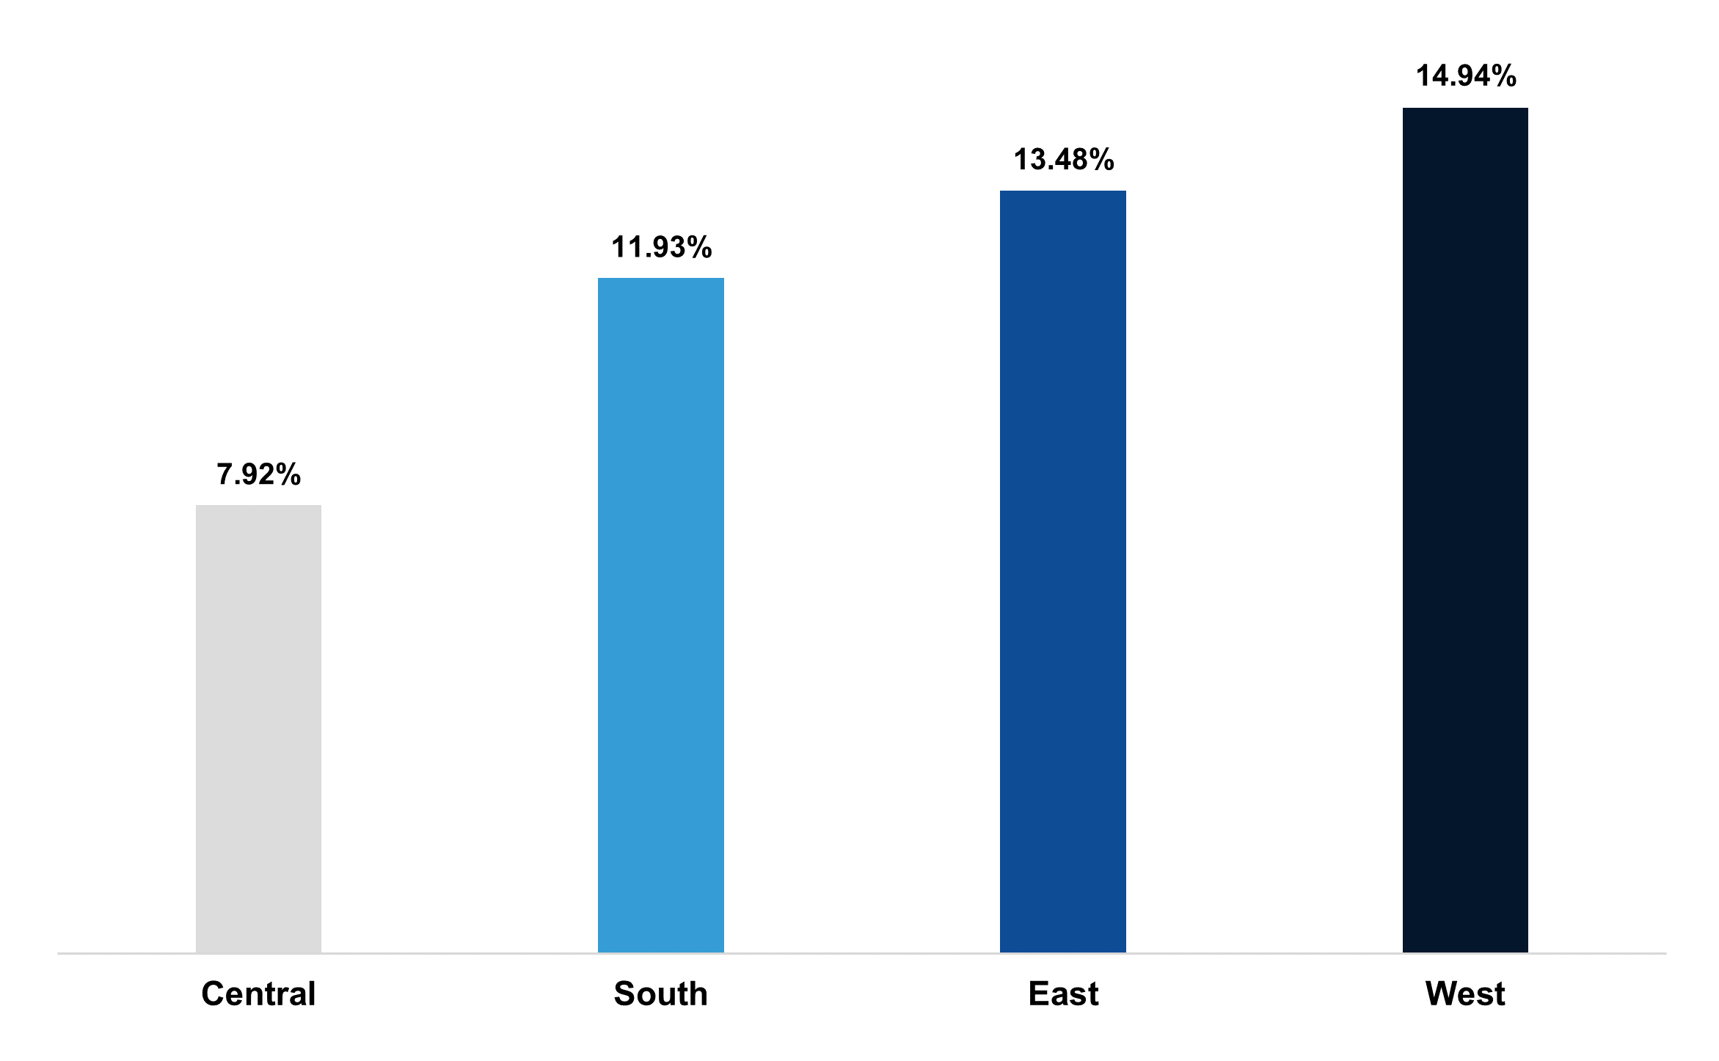
Regional Performance
Central and South regions show significantly lower profitability margin compared to the rest of them
Profit Margin by Region

Slide 9
High-Revenue States in Underperforming Regions

Slide 10
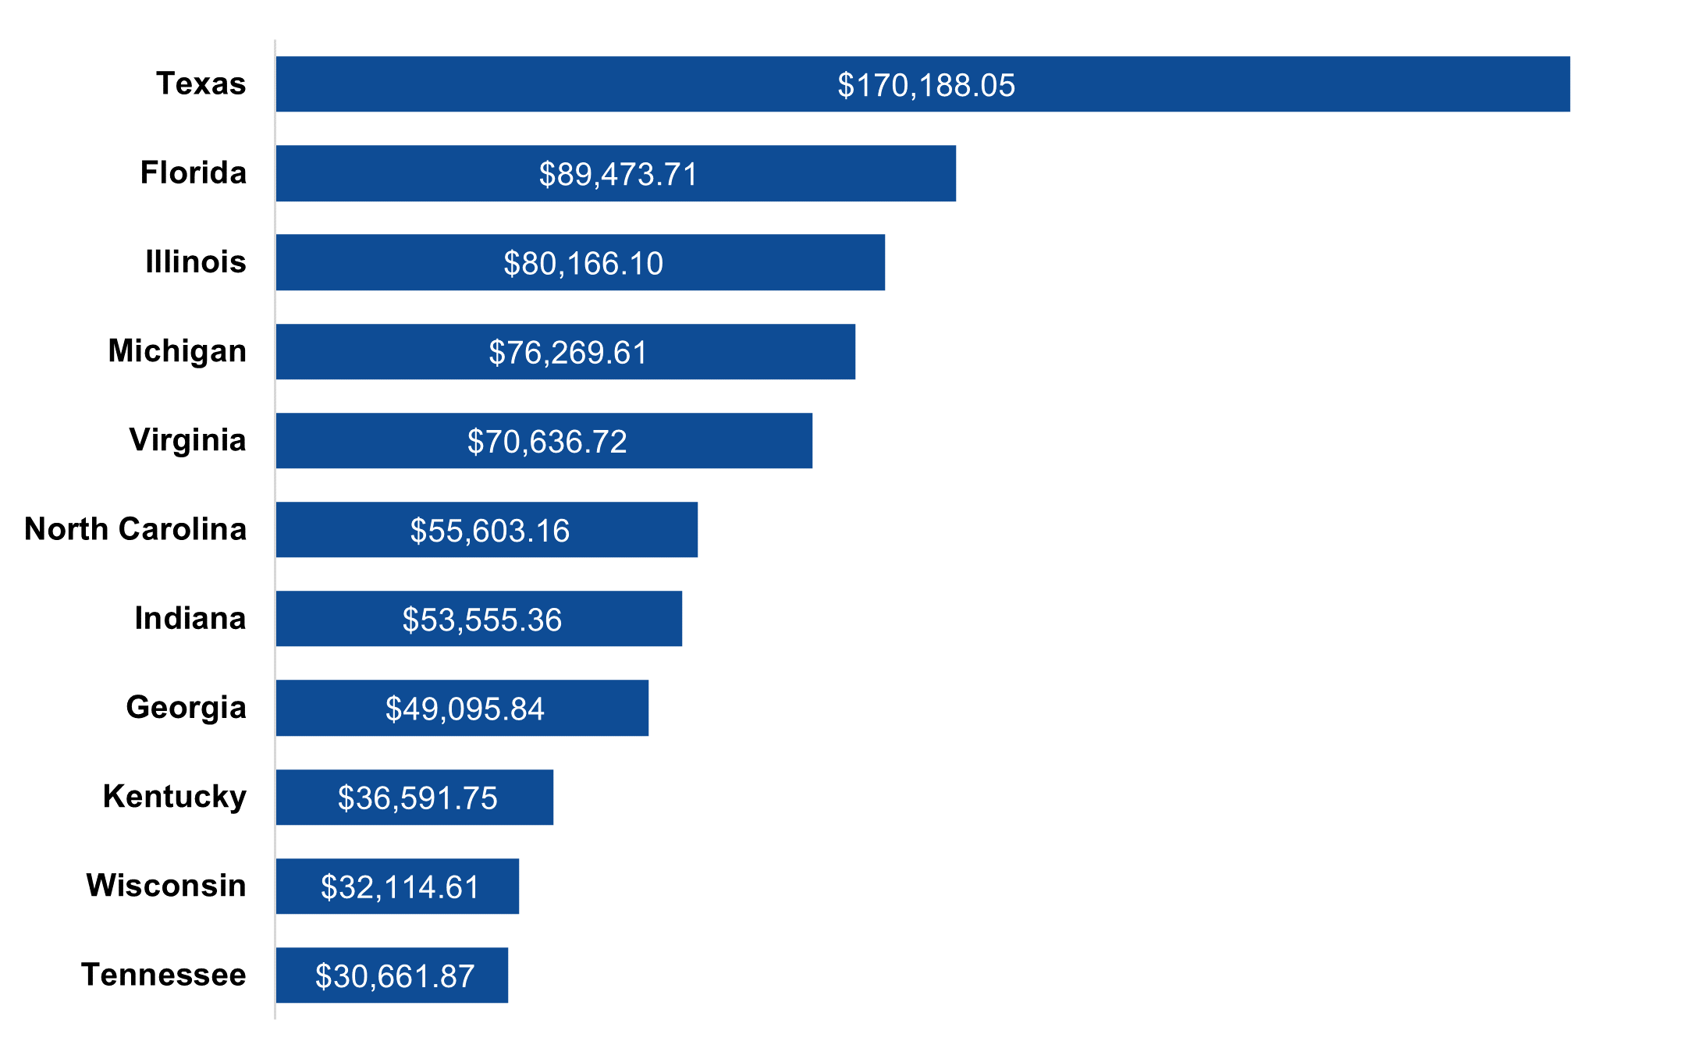
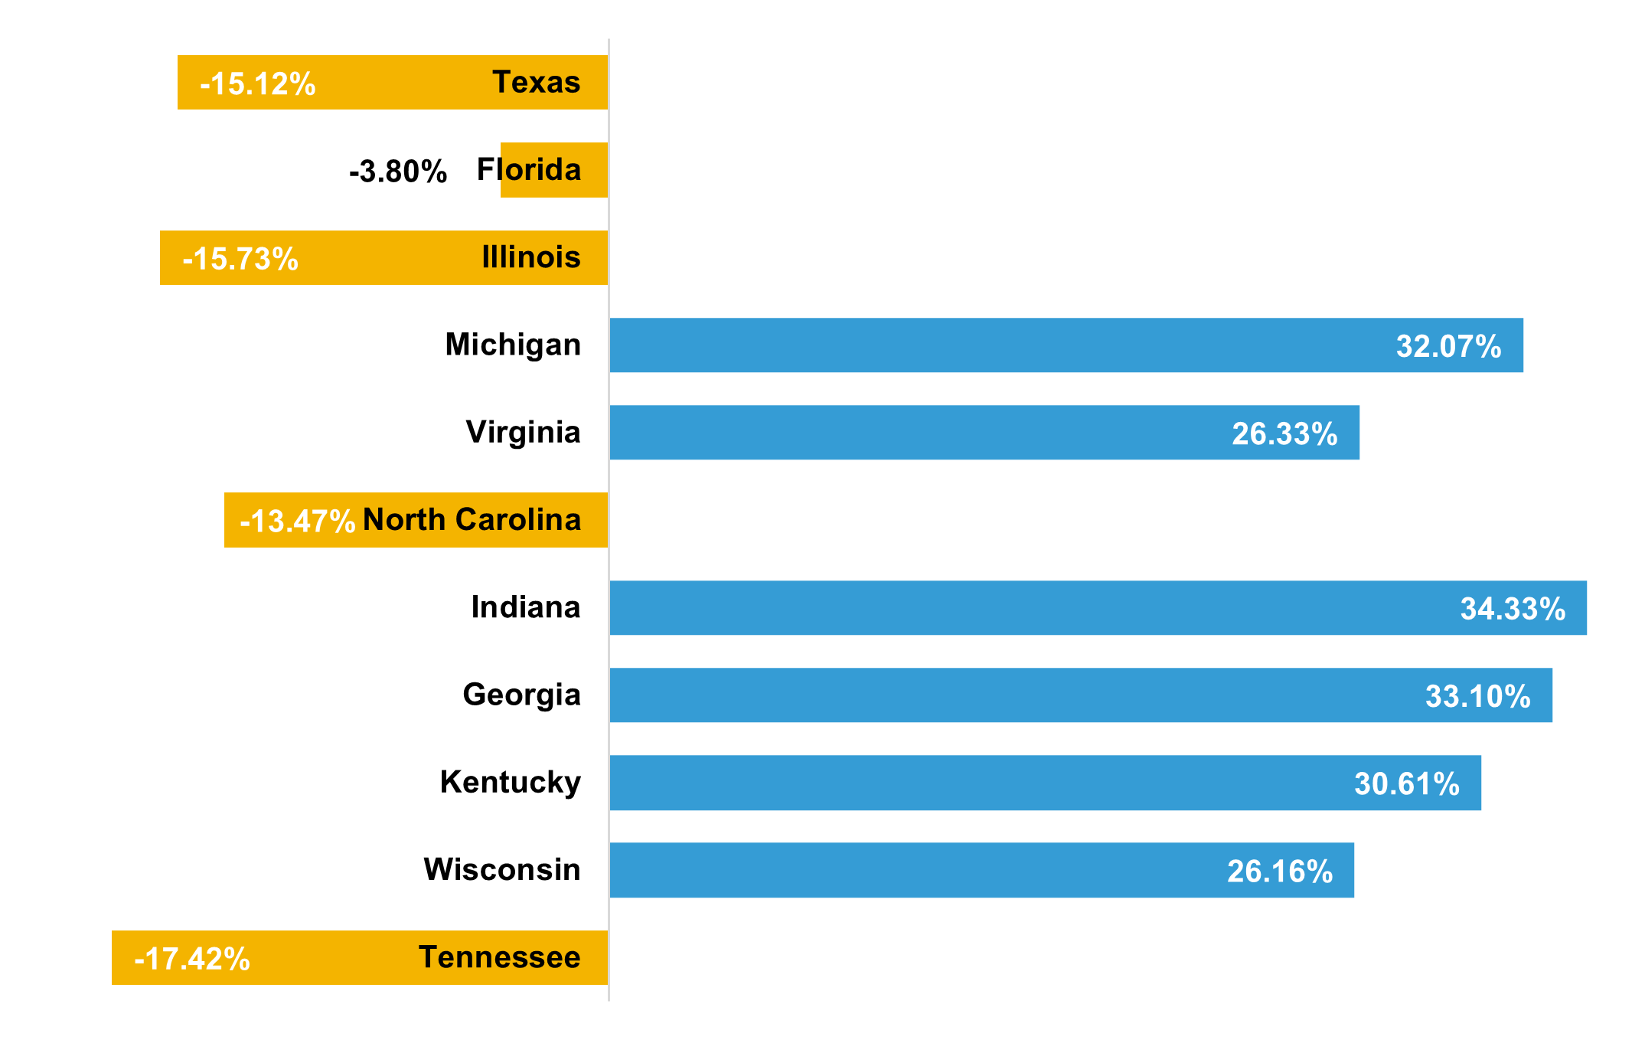
High-Revenue States in Underperforming Regions
Revenue in Central and South is concentrated in a few states, many of which show negative margins
Top Revenue-Generating States (Central & South)
Profit Margin in those High-Revenue States

Slide 11
Customer Segment Analysis

Slide 12
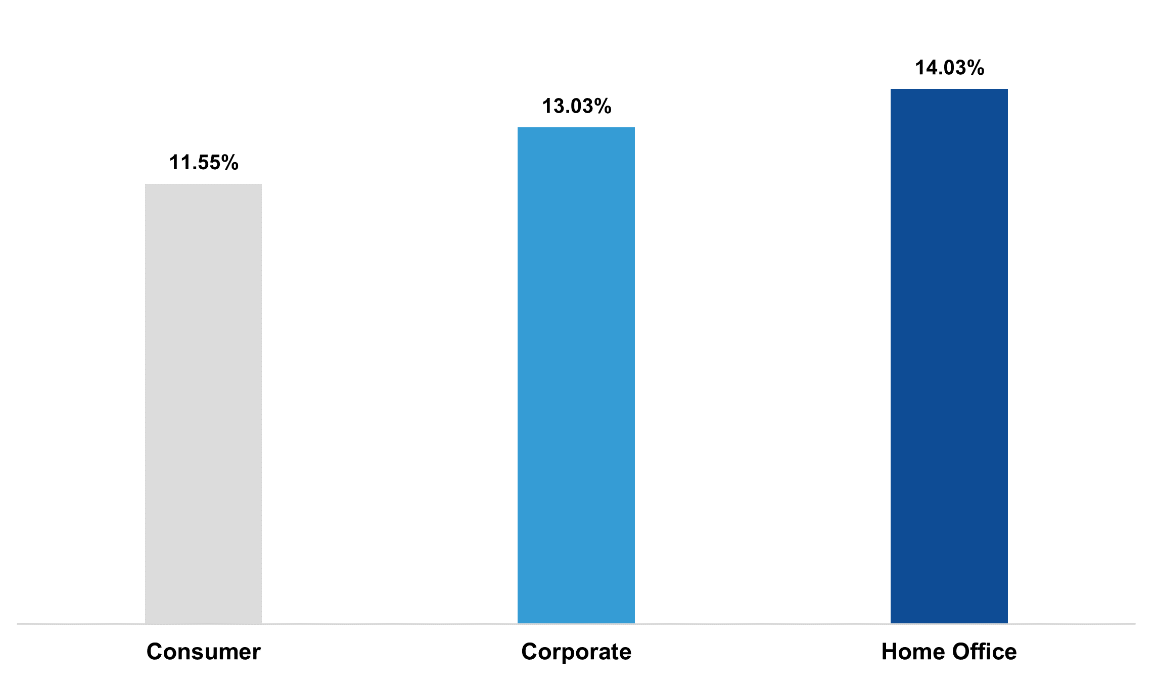
Customer Segment Analysis
Profitability does not vary significantly across customer segments
Profit Margin by Customer Segment

Slide 13
Category-Level Profitability

Slide 14
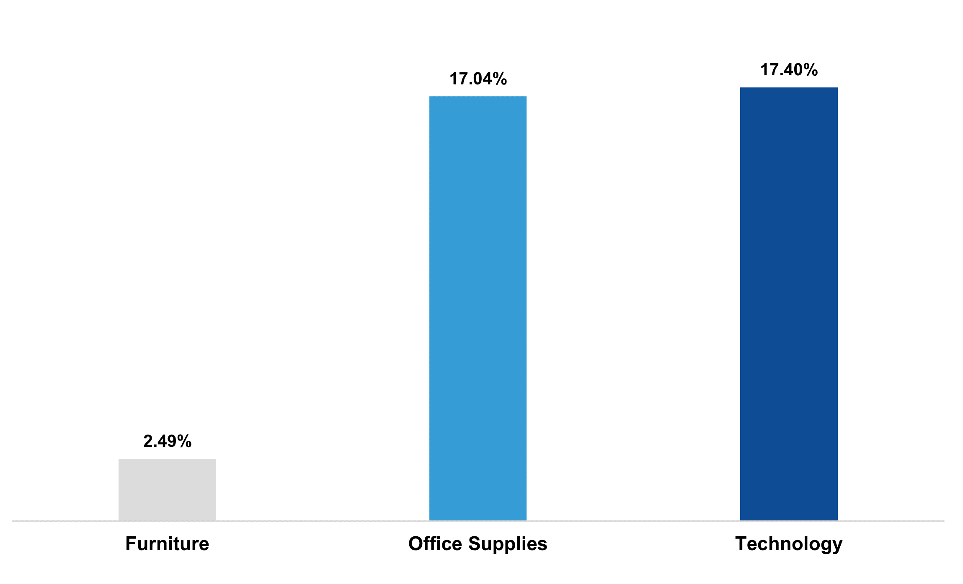
Category-Level Profitability
Furniture shows significantly lower profitability compared to Office Supplies and Technology
Margin per Category

Slide 15
Sub-Category Profitability Breakdown

Slide 16
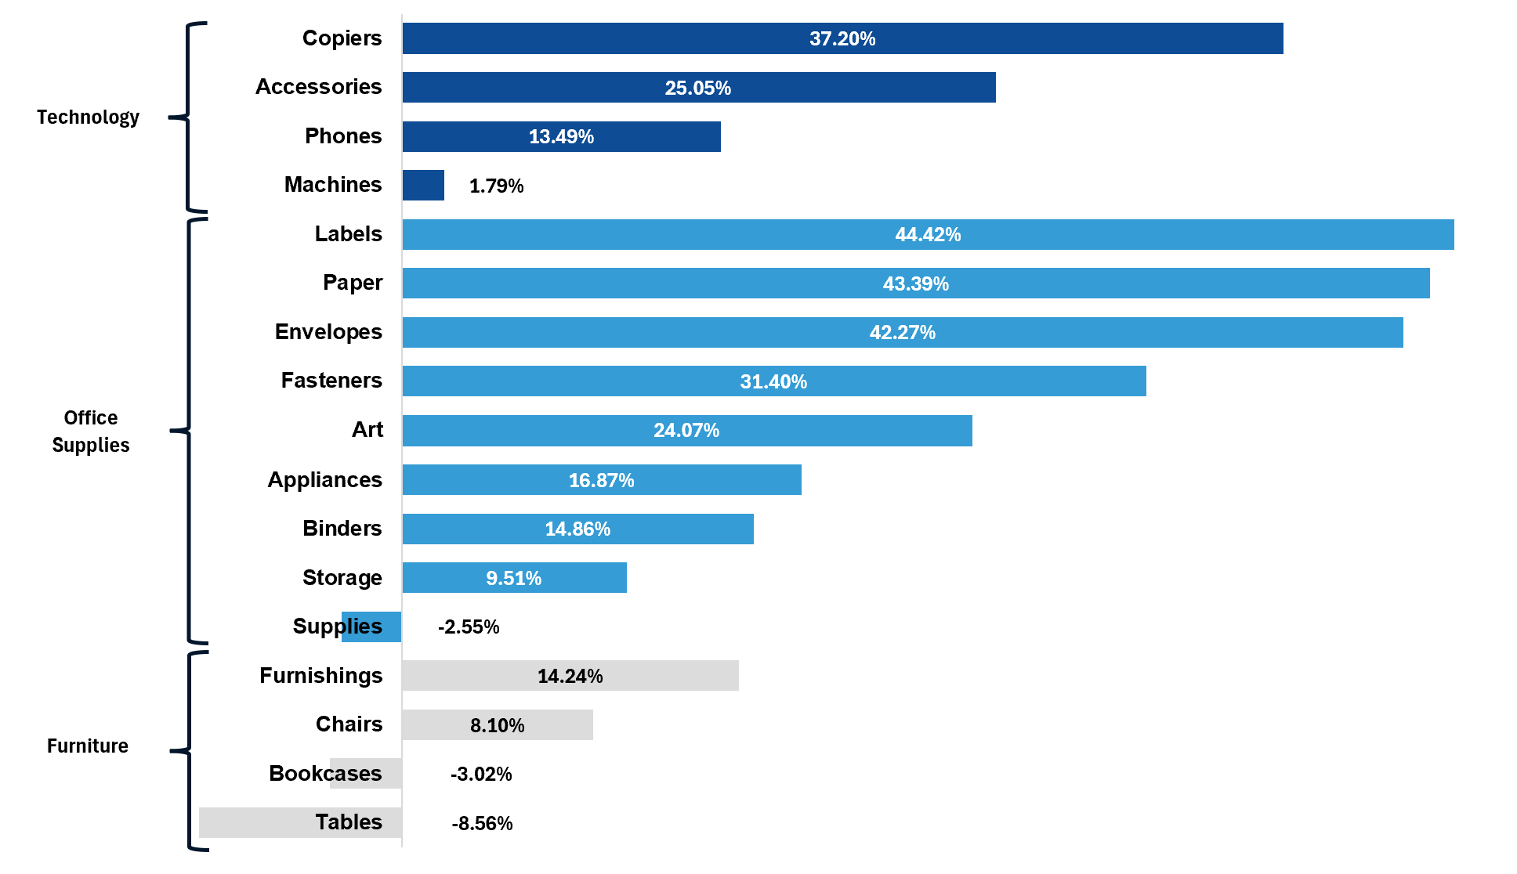
Sub-Category Profitability Breakdown
Losses are concentrated in a few sub-categories, particularly Tables, Bookcases and Supplies
Margin per Sub-Category

Slide 17
Discount Impact on Profitability

Slide 18
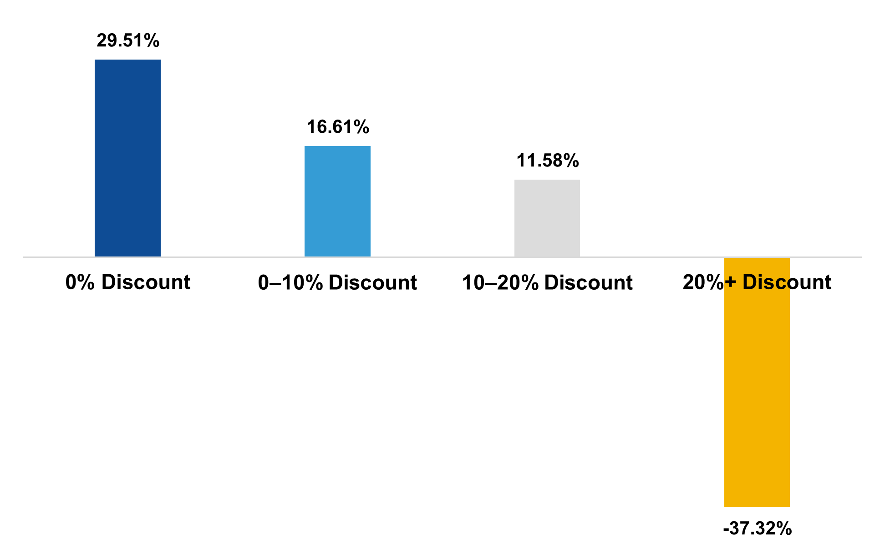
Discount Impact on Profitability
Profitability declines sharply as discount levels increase, becoming negative above 20% discounts
Profit Margin by Discount Level

Slide 19
Discount Usage by Sub-Category

Slide 20
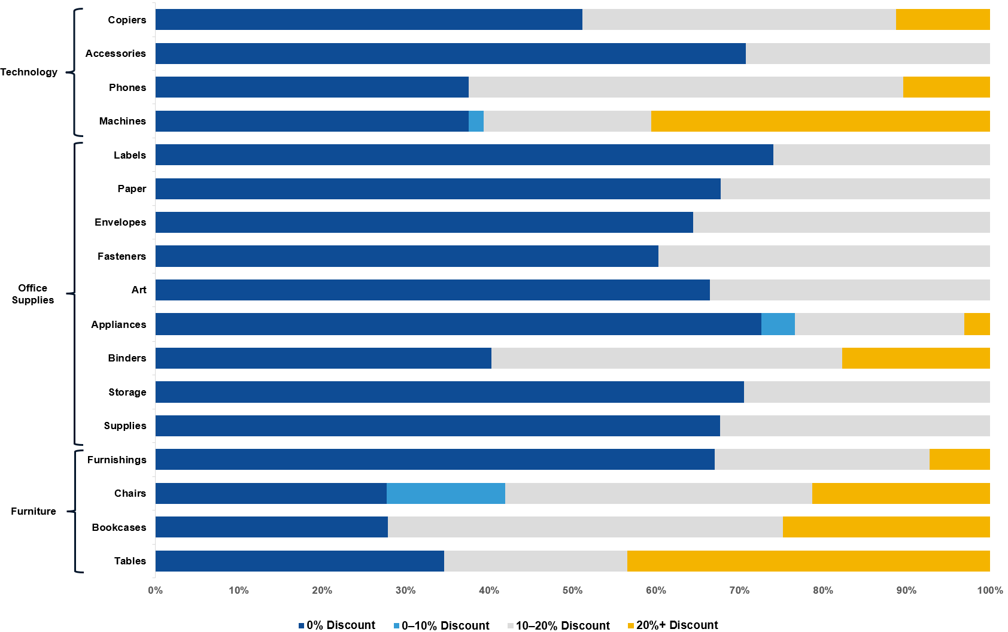
Discount Usage by Sub-Category
High discount levels are widely applied across multiple sub-categories, including those with negative margins
Sales Distribution by Discount Level (by Sub-Category)

Slide 21
Discount Dependency in
Loss-Making States

Slide 22
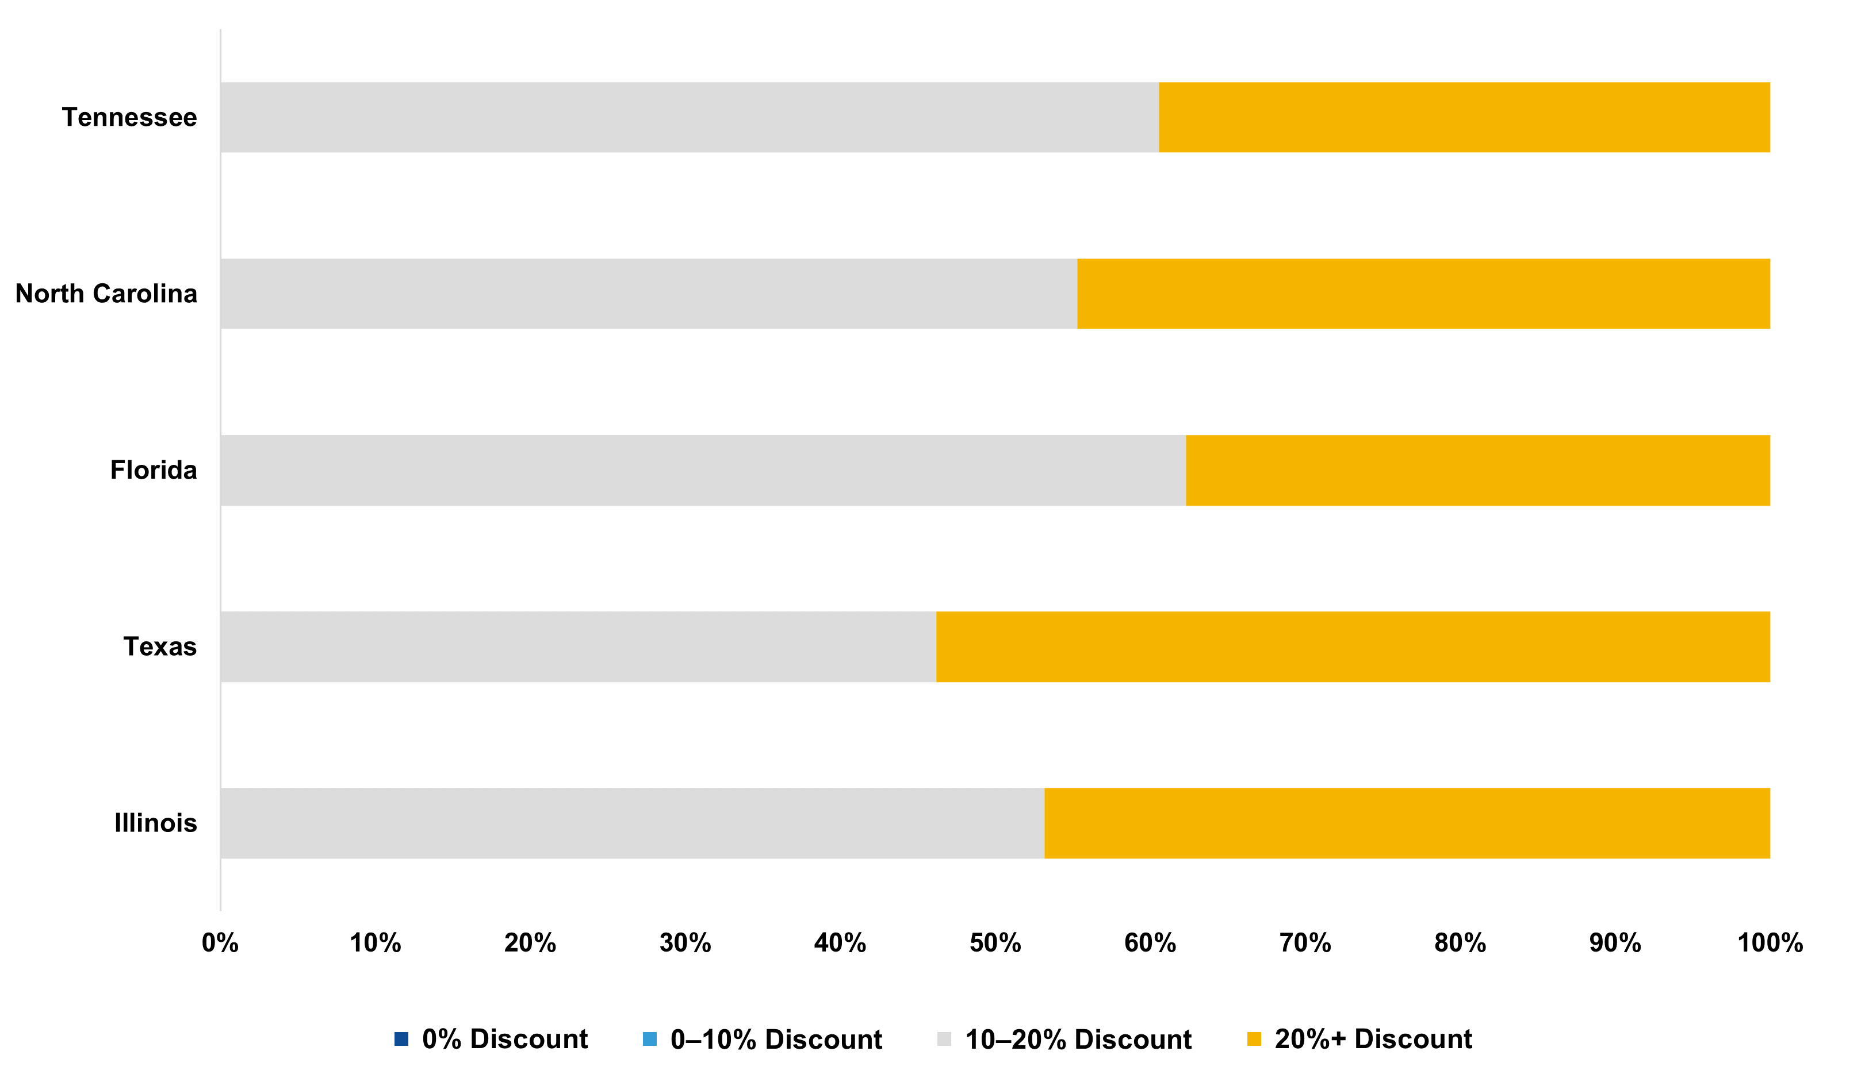
Discount Dependency in Loss-Making States
Sales in loss-making states are entirely dependent on discounts of at least 10–20%, with no full-price or low-discount transactions observed
Sales Distribution by Discount Level (Loss-Making States)

Slide 23
Conclusions & Business Recommendations

Slide 24
Conclusions & Business Recommendations
Key Findings
Business Recommendations
Strong sales performance is not translating into profitability
Implement stricter discount controls, especially above 10–20% thresholds
Central and South regions concentrate the lowest margins
Redesign pricing strategies in loss-making states to reduce dependency on discounts
Loss-making states are fully dependent on discount-driven sales (≥10%)
Focus on promoting high-margin sub-categories without aggressive discounting
High discount levels (20%+) systematically destroy profitability across products
Introduce discount optimization models to balance volume and profitability
Profitability can be significantly improved by reducing dependency on discount-driven sales and implementing more targeted pricing strategies

