Slide 1

FOR END TO END TESTING

Slide 2
Important Concepts
BBD (Behaviour-Driven Development)
Cucumber
Gherkin

Slide 3
BDD
It evolves from TDD.
Helps to map business requirements to software implementation.
Helps define high-level requirements.
Improves readbility of tests.
Can act as eye-opener to catch scenarios not covered in initial requirements.

Slide 4
Cucumber
Tool that supports BDD.
Reads executable specifications written in plain text and validates software against specifications.
Generates reports inidicating success or failure of scenarios written.

Slide 5
Gherkin
Gherkin is a human-readable language to define Cucumber’s test cases.
Syntax follows the Given-When-Then pattern to write Scenarios.
Given defines the initial context of the system.
When describes the interaction of the user.
Then defines the expected outcome of the interaction.
Keeps the text non-technical, can be used as documentation.

Slide 6
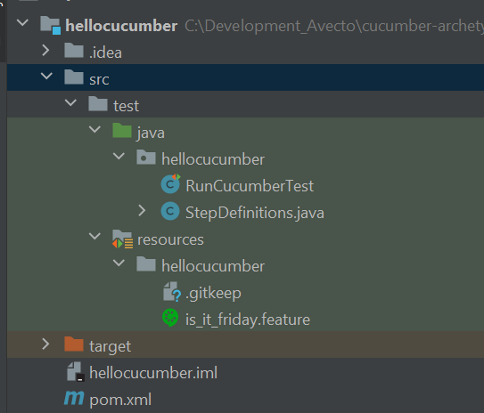
Cucumber Basic Structure

Slide 7
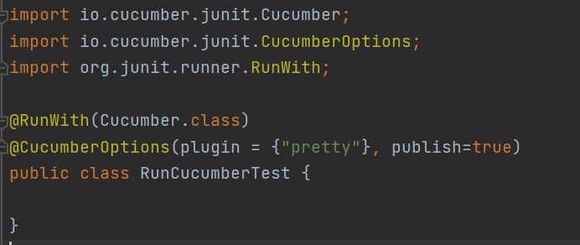
Cucumber Basic Structure
Cucumber runner file
Cucumber.class is a Junit Runner implementation that load the .feature files and looks for Step definition annotations.
Configures the runner.

Slide 8
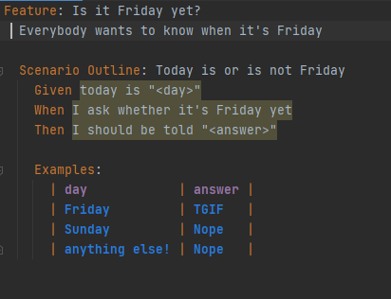
Cucumber Basic Structure
Feature file

Slide 9
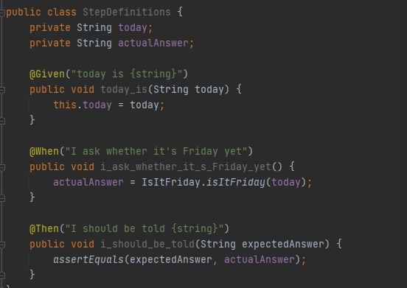
Cucumber Basic Structure
Steps Definition

Slide 10
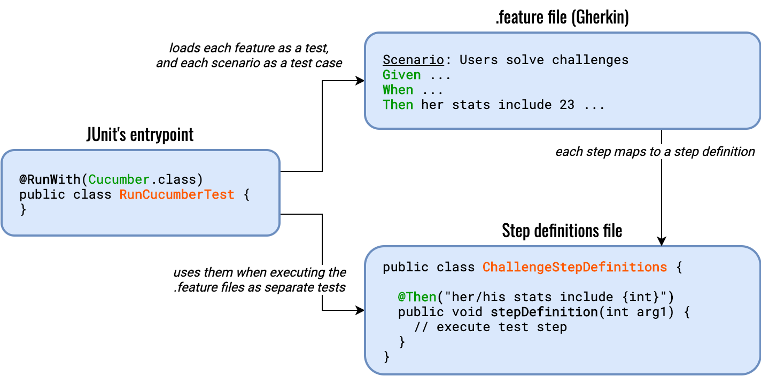

Slide 11
How does it fit in our project?
From the end-to-end testing perspective, we’ll interact with the public REST API -the exposed endpoints (in the future this will be exposed by the Gateway ) to simulate the user’s behavior.
We will test the scenarios cover in the requirements and catch those which wasn’t covered.

