Slide 1
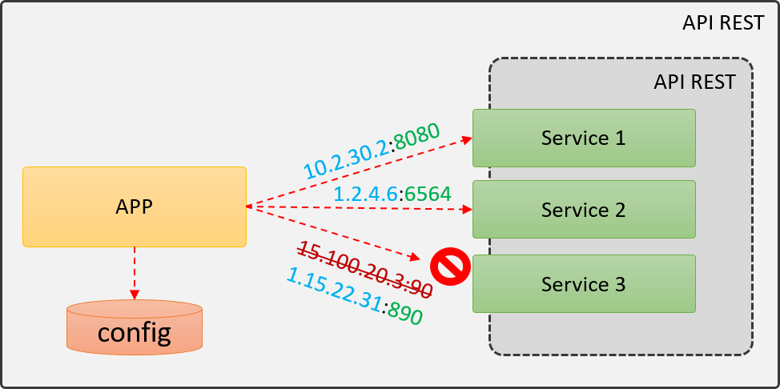
SERVICE DISCOVERY – THE PROBLEM
If the IP change:
- Change the configuration in all applications that uses it.
- How know the availability of the service?

Slide 2
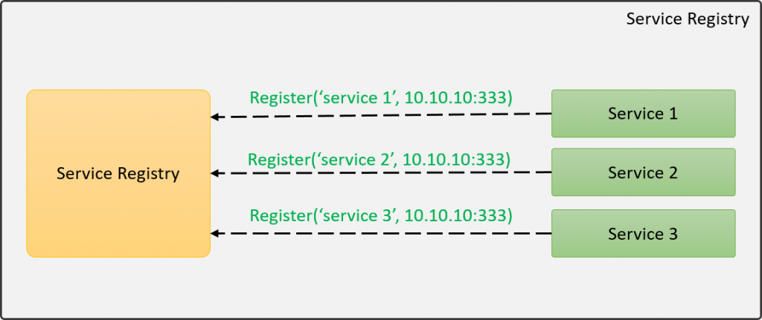
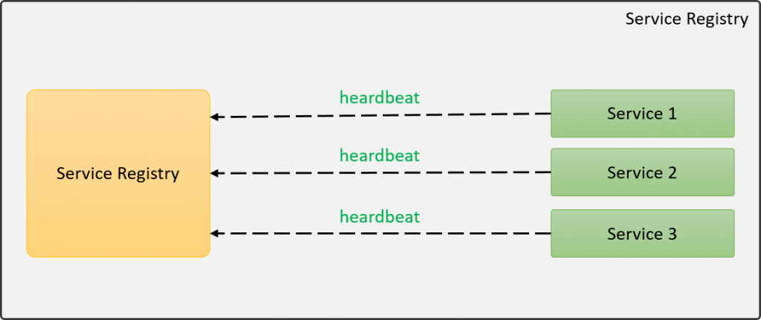
SERVICE DISCOVERY
Service Registry:
Register a service.
Look up for a service.

Slide 3
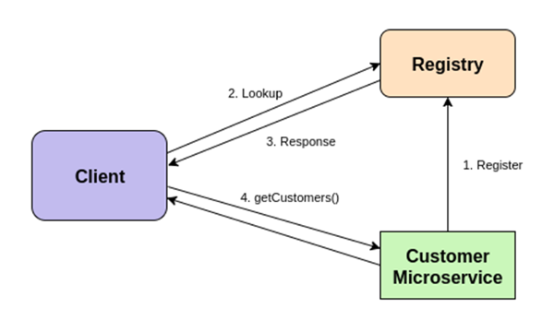
SERVICE DISCOVERY
Zookeper
Consul,
Eureka,
IBM WSRR
WSO2 Registry.

Slide 4
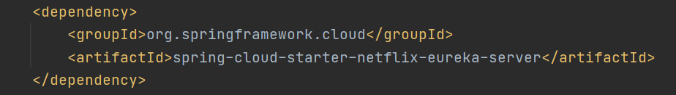
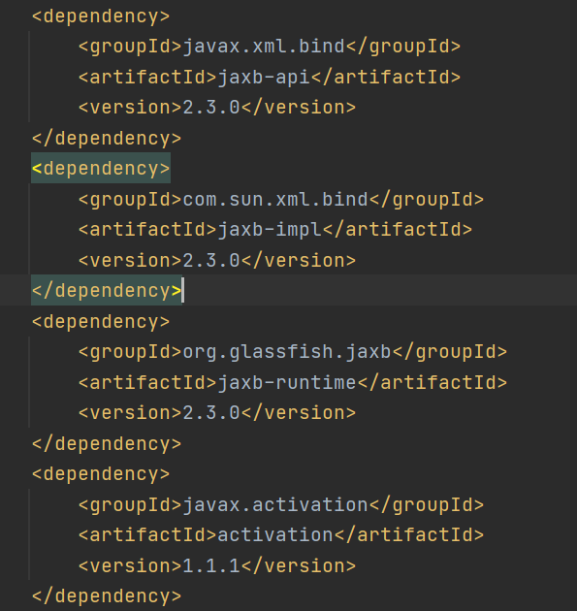
ServiceDiscovery Configuration (Eureka Server)
eureka dependencies
For jdk 11 add jaxb dependencies

Slide 5
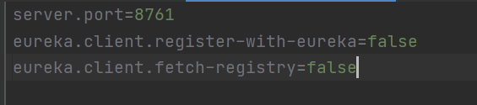
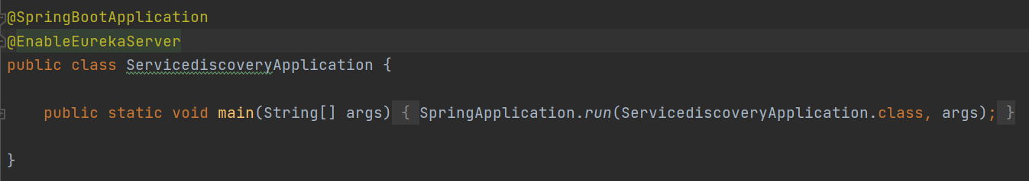
Application properties
Spring boot class

Slide 6
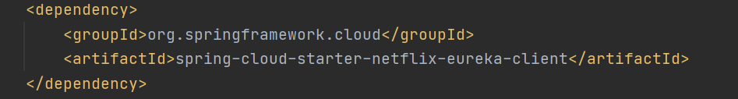

CompanyManagement Configuration
pom dependencies
Properties file

Slide 7
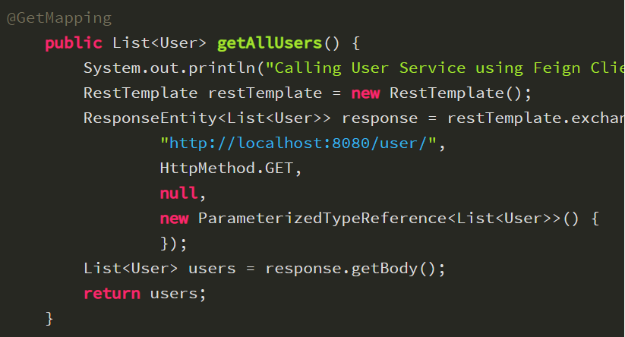
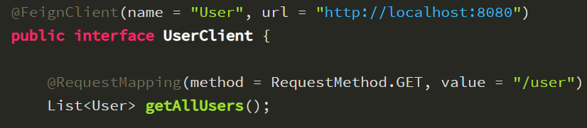
FEIGN
Rest Client.
Declarative.
No unit test needed.
Uses spring boot web annotations.
Load balance support.
Rest template vs Feign

Slide 8
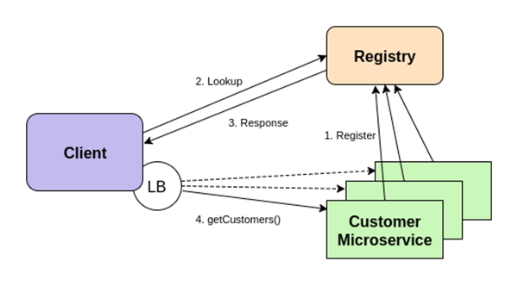
EUREKA - FEIGN
LB = Load Balancer:
Ribbon
Spring Load Balancer
Load Balancer saves in its local files the metadata of the services.

Slide 9
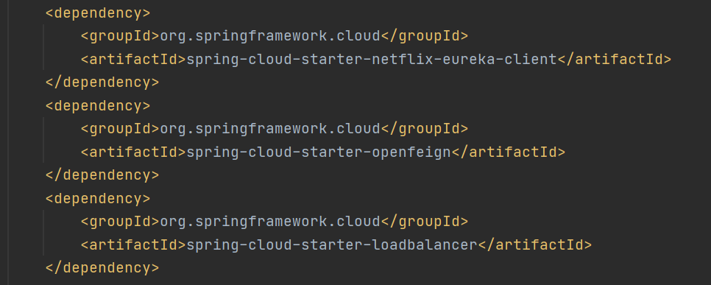
MortgageFeasibilityValidator Configuration
pom dependencies

Slide 10
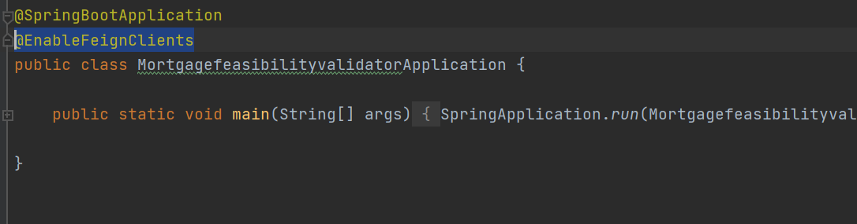
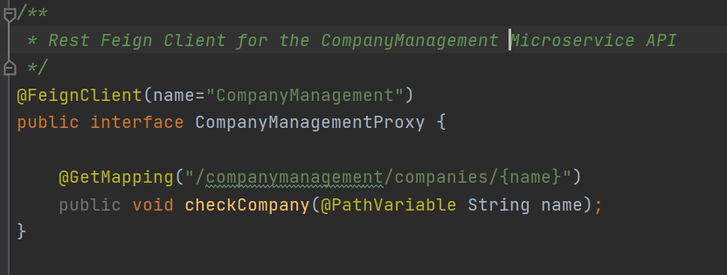
The springboot application class
The CompanyManagement interface

