Slide 1


Java-based database open-source tools for tracking, managing and applying database schema changes

Slide 2
Flyway
Created by Axel Fontaine in early 2010 under the Apache 2.0 license and acquired by Redgate Software around mid-2019.
Really easy to use
Migrations can be written in SQL or Java
Command-line client, Java API(also works on Android), Maven and Gradle plugin
Supported databases include Oracle, SQL Server, DB2, MySQL, H2, Amazon MySQL…

Slide 3
Liquibase
It was started in 2006
Database-independent library for tracking, managing and applying database schema changes
Customizable
Migrations can be written in SQL, XML, JSON, YAML.
Based on changelog, changeset.
Supported databases include Oracle, SQL Server, DB2, MySQL, H2, Amazon MySQL…

Slide 4
Similarities
Both are to some degree open source and provide some part of features for free but also have paid versions that provide more features.
Both can use plain old SQL to write your migration scripts.
Both are strongly "Java oriented" and also have built in support for basic build tools like Maven or Gradle as well as integration with the most common Java frameworks, for example: Spring Boot.
Both can be run as simple shell scripts from command line.
The list of supported databases is more or less similar. There can be some minor differences in supported versions or drivers but in general, there are no easily visible differences between them in this area.
Both are based on the same approach for handling database changes, namely Migration Based Database Delivery.
Both tools try to implement the concept of Evolutionary database presented and explained by Martin Fowler.

Slide 5
Differences
Customization and easy to use
Liquibase is a powerful tool due to his customization environment. Flyway on the contrary is really easy to use but less configurable.
Cross-database usage
If you decide to use Liquibase and write your scripts in one of other supported formats(JSON, XML, YAML) you should easily be able to use the same scripts across different databases.
Diff generation
You can do generate diff with Liquibase but not with Flyway, even with its paid version.
Integration
Flyway has a native Java API. It is designed to help us with more complex migrations like BLOB and CLOB changes or advanced bulk data changes.
Rollbacks
On one hand, they are relatively easy to set up in Liquibase changelog files. In fact, there is even a special field defined in changelog XML structure for rollback code. On the other hand, in Flyway it is only available in the paid version.
Change order management
Flyway order of applied changes depends on migration scripts names. Whole naming convention for Flyway migration scripts, which you must follow if you want it to work as expected. In Liquibase the order of applying changes to our database instance is based on a particular change location in the overall changelog file.

Slide 6

How to implement Flyway
Pom.xml addition
Add resource properties
It will create this structure
<dependency> <groupId>org.flywaydb</groupId> <artifactId>flyway-core</artifactId> </dependency>
spring.flyway.enabled=true spring.flyway.locations=classpath:/db/migration

Slide 7
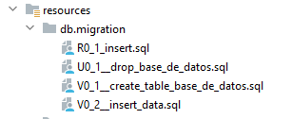
How to implement Flyway
Files should use this standard: <Prefix><Version>__<Description>.sql
Prefix:
Versioned Migration -> V
Repeatable Migration -> R
Undo Migration(Paid versión) –> U
Version:
Version with dots or underscores separate as many parts as you like (Not for repeatable migrations)
Separator:
__ (two underscores) (configurable)
Description:
Underscores or spaces separate the words
Suffix:
.sql (configurable)

Slide 8
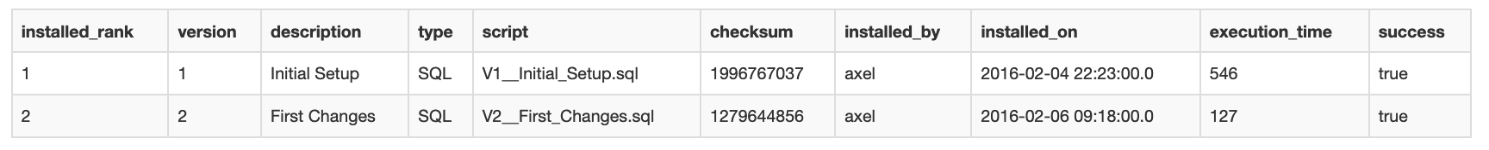
How to implement Flyway
Flyway will create “flyway_schema_history” table to store every single migration done.

Slide 9

How to implement Liquibase
Pom.xml addition
Add resource properties
Create Structure
<dependency> <groupId>org.flywaydb</groupId> <artifactId>flyway-core</artifactId> </dependency>
spring.liquibase.change-log=classpath:/db/changelog/changelog-master.xml logging.level.liquibase = INFO

Slide 10
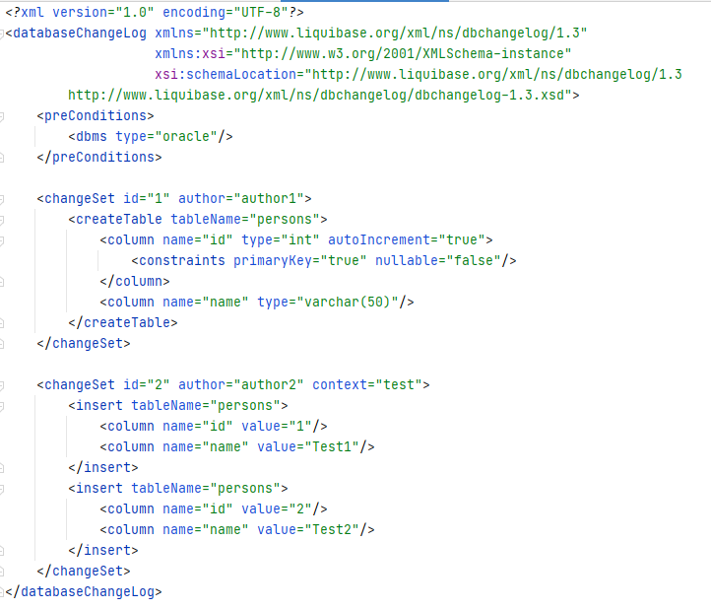
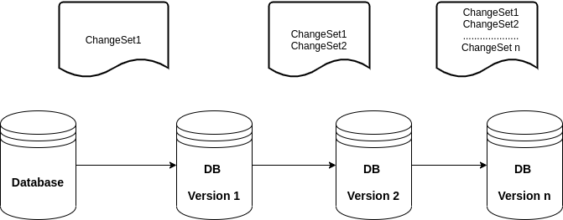
How to implement Liquibase
changelog-master.xml

Slide 11
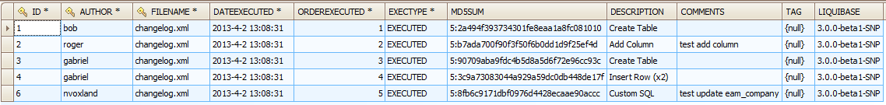
How to implement Liquibase
Liquibase will create “DATABASECHANGELOG ” table to store every single migration done.
Also will create “DATABASECHANGELOGLOCK”

Slide 12
Links of interest
https://docs.liquibase.com/
https://www.red-gate.com/
https://blog.quadiontech.com/database-migrations-with-springboot-maven-and-liquibase-9fe7a7b8b8df
https://javatodev.com/flyway-spring-boot/#Prefix
https://www.youtube.com/watch?v=vK0CXYA0bt4
https://www.youtube.com/watch?v=9ursb7RKJHA

