Slide 1

Monitoring
Spring Boot Actuator to monitoring

Slide 2
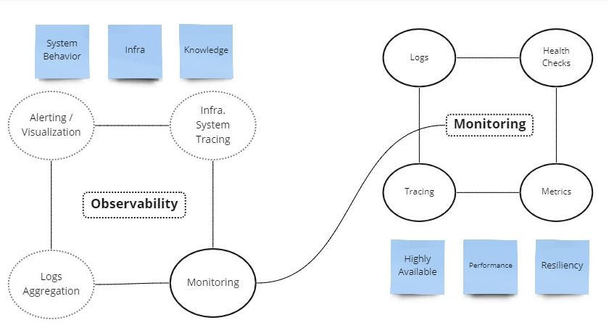
INTODUCTION
Monitoring is an activity performed in an application, Observability is the analysis of system infrastructure behaviour
White box vs Black box
Pull and Push strategy

Slide 3
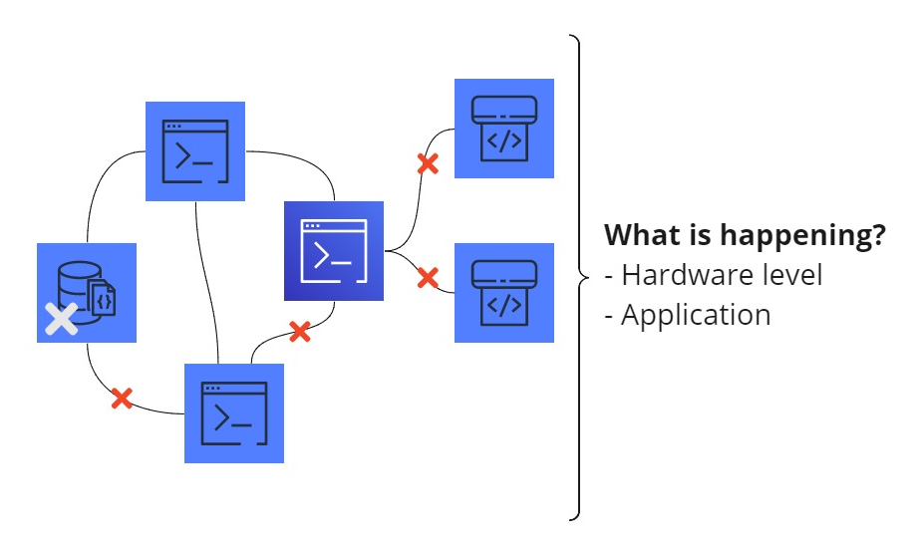
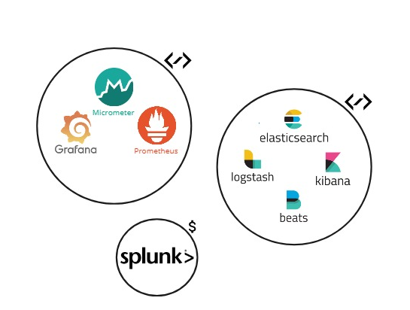
MONITORING
Automated
Monitoring and Alerting
Identify possible anomalies
Single point to inspect

Slide 4
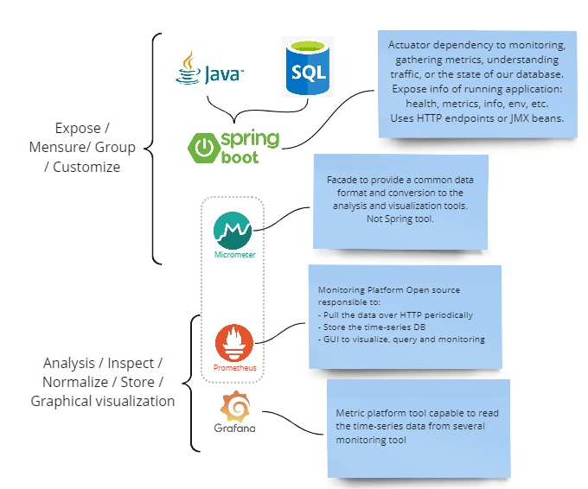
GOAL
For our architecture with Spring:
Monitoring individual microservices
Health Checker
Metrics
Security enable
Custom metrics

Slide 5
HANDS ON
Actuator configuration in SPB
Micrometer configuration
Prometheus configuration
Grafana configuration
Look for the appendix section

Slide 6
Suggestion of monitoring stack
To achieve the level of monitoring:
Health checks
Metrics
Tracing
Logs
This stack is the suggestion:
Spring actuator
Micrometer
Prometheus
Grafana

Slide 7
Appendix I
Next slides is how to setup a local demo:
Spring boot rest service to be monitored.
Micrometer configuration for Prometheus
Prometheus standalone configuration with docker.
Grafana configuration.

Slide 8
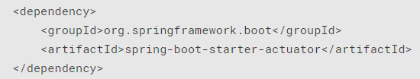
Appendix I
Spring boot actuator:
Dependency
Application configuration (.properties)

Slide 9
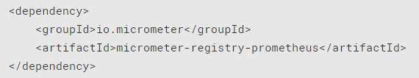

Appendix I
Micrometer configuration for Prometheus:
Dependency
Endpoint exposed for Prometheus

Slide 10
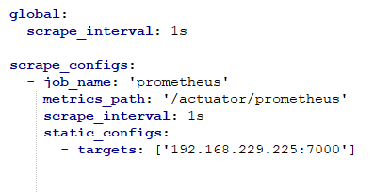
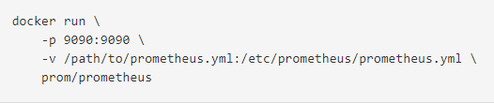
Appendix I
Prometheus standalone configuration with Docker:
Prometheus configuration (prometheus.yml)
Docker run image from Prometheus

Slide 11
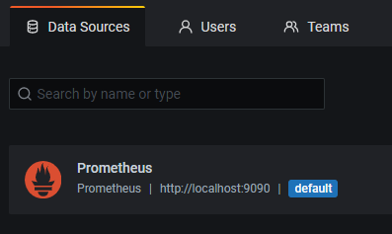
Appendix I
Grafana configuration:
Docker Grafana
docker run -d -p 3000:3000 grafana/grafana
Connected with Prometheus data source
http://localhost:3000/datasources

