Slide 1

Documenting API with Swagger
Paula Caso
Bruno Vitoriano

Slide 2
Introducing Swagger
Free and opensource framework
Define a standard, language-agnostic interface to a REST API
Allow both humans and computers to discover and understand the capabilities of the service
Specification donated to Open API Initiative (OAI) per 1-1-2016
Linux Foundation Collaboration Project

Slide 3
Swagger vs OpenAPI
OpenAPI is the specification
Swagger is the group of tools to implement the specification

Slide 4
Introducing Swagger
Swagger Core
Swagger Editor
{specification}
json, yaml
Swagger Codegen
Swagger UI
Notes:
Swagger Core
Java-related libraries for generating and reading Swagger definitions
Swagger Codegen
Command-line tool for generating both client and server side code from a Swagger definition
Swagger UI
Browser based UI for exploring a Swagger defined API
Swagger Editor
Browser based editor for authoring Swagger definitions in YAML or JSON format

Slide 5
Goal: Generate an OpenAPI specification
Backend
{specification}
Swagger UI
Frontend
Interpretation
Validation
API
api-docs
Database
Notes:
Swagger will generate an OpenAPI specification based in our code → api-docs (json or yml)
To make that json more legible and understandable, we can use Swagger UI, another Swagger tool that generates and user interface based on our api-docs

Slide 6
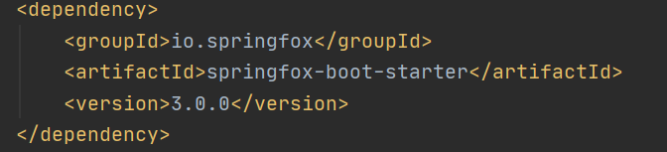
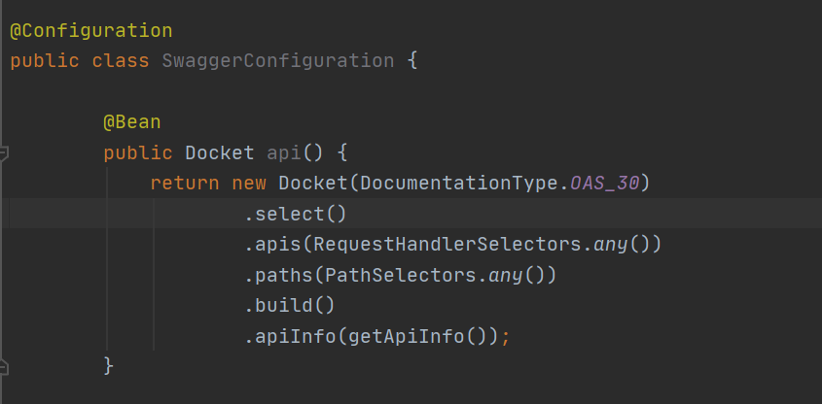
Goal: Generate an OpenAPI specification
Generate api-docs for our API
How? Using springfox dependency
for Java, plus a config file in our
project
This will generate a json document
with the specification in: http://microserviceName:port/v3/api-docs

Slide 7
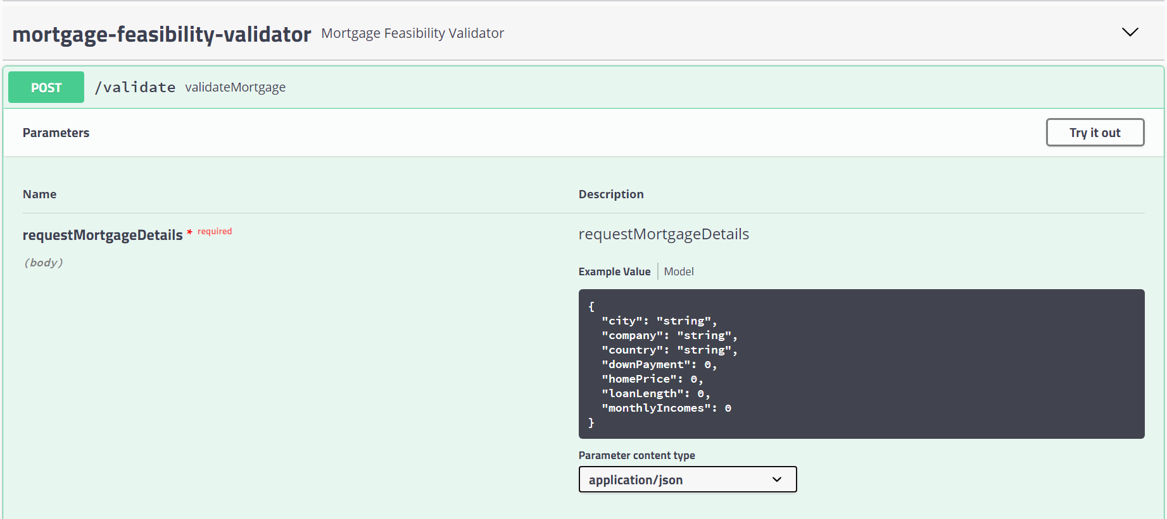
Goal: Making specification understandable
We will use swagger UI to generate a user interface based on our api-docs. We can fint it in: http://microserviceHost:Port/swagger-ui/index.html

Slide 8
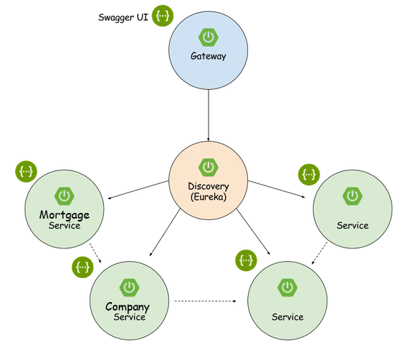
Best Practices: Centralized Swagger
We want to access to all the microservices documentation through the gateway
We will need it also because when deploying with docker, microservices are on a private network and are not accessible from outside the gateway

Slide 9
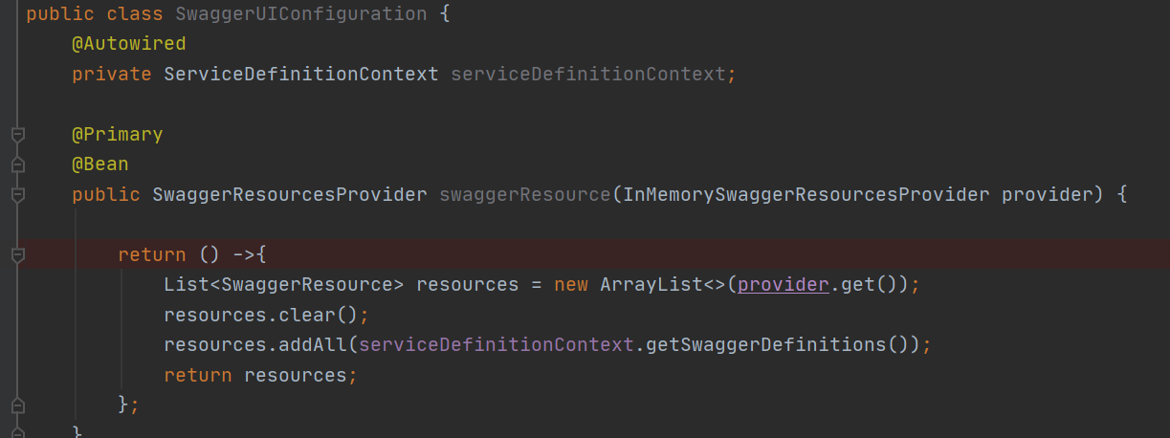
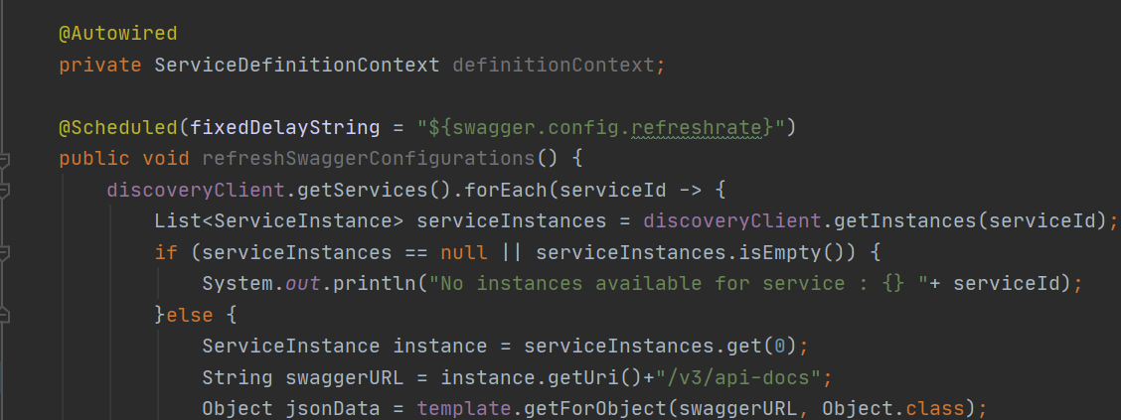
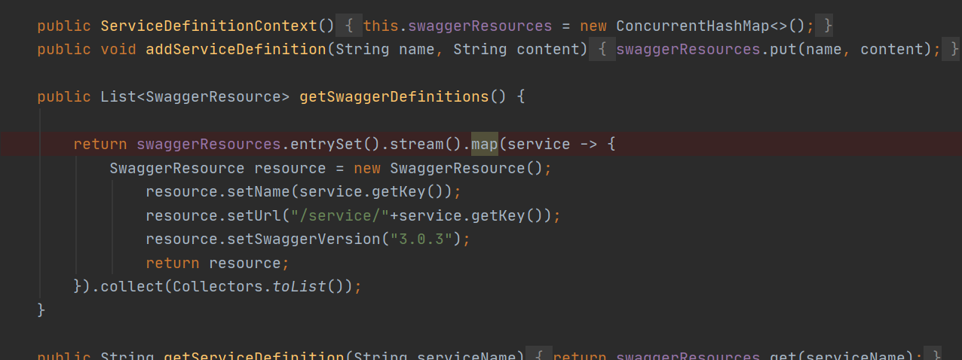
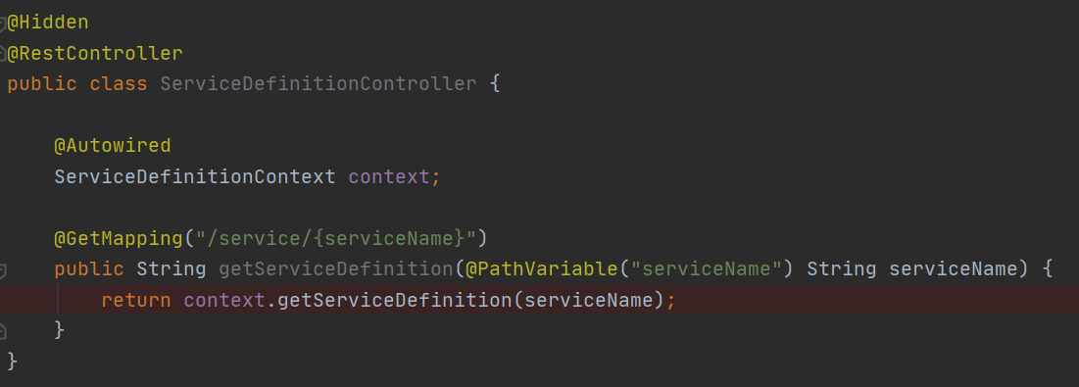
Centralized Swagger: Gateway config
Configuration of swagger UI
Configuration of the microservices swagger definitions
Configuration to add services to swagger definitions based on registered services in discovery client
Swagger endpoints to get api-docs

Slide 10
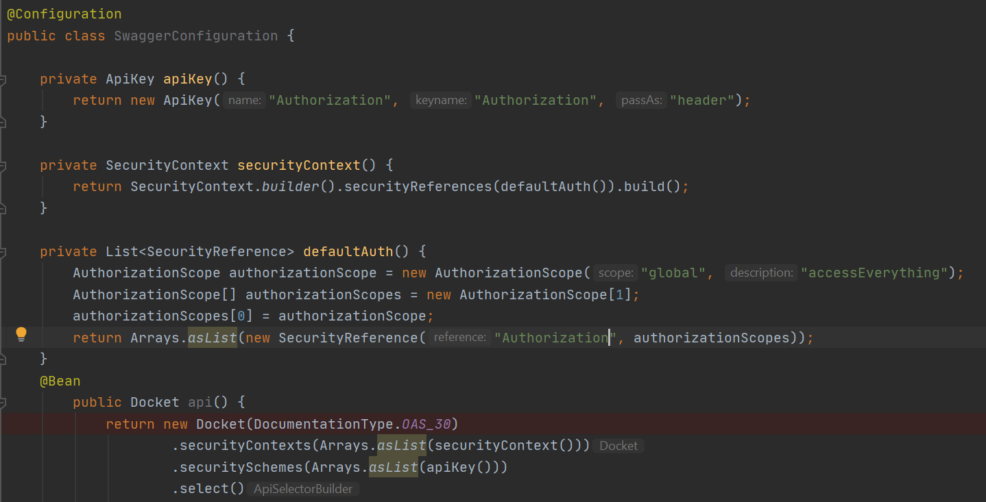
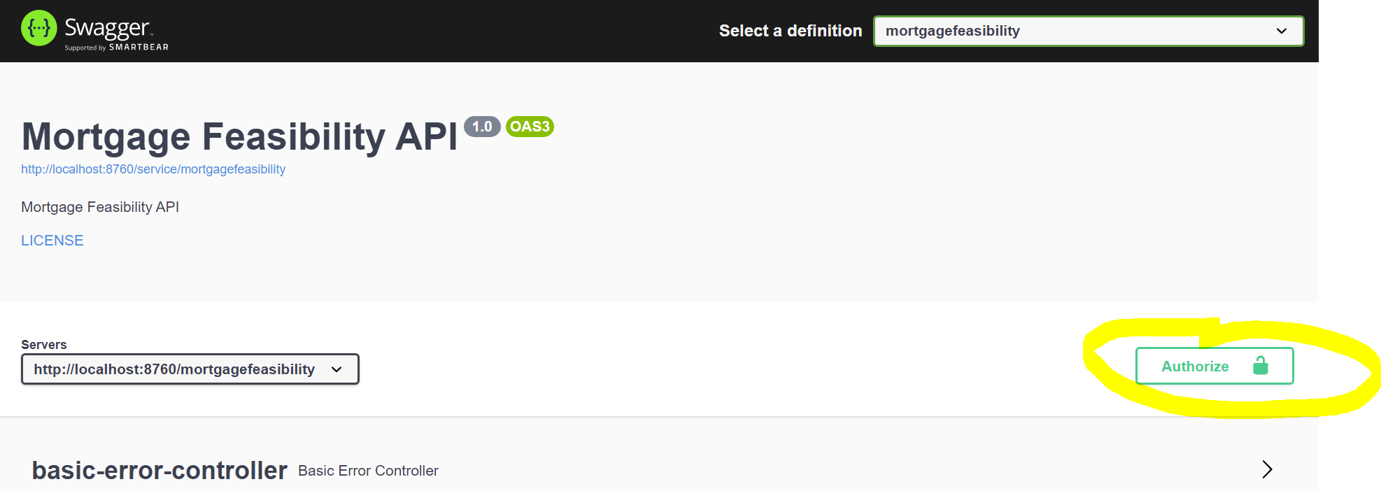
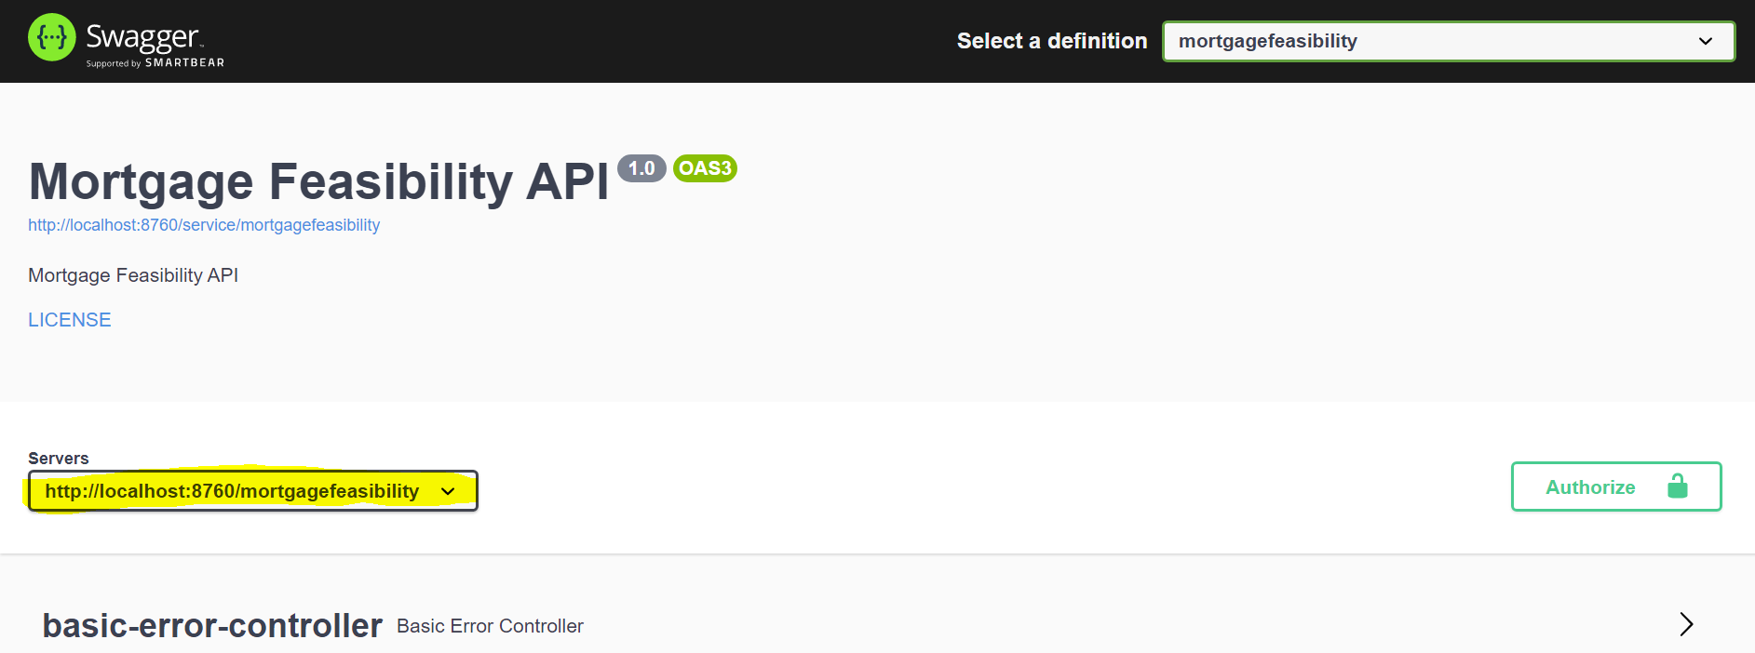
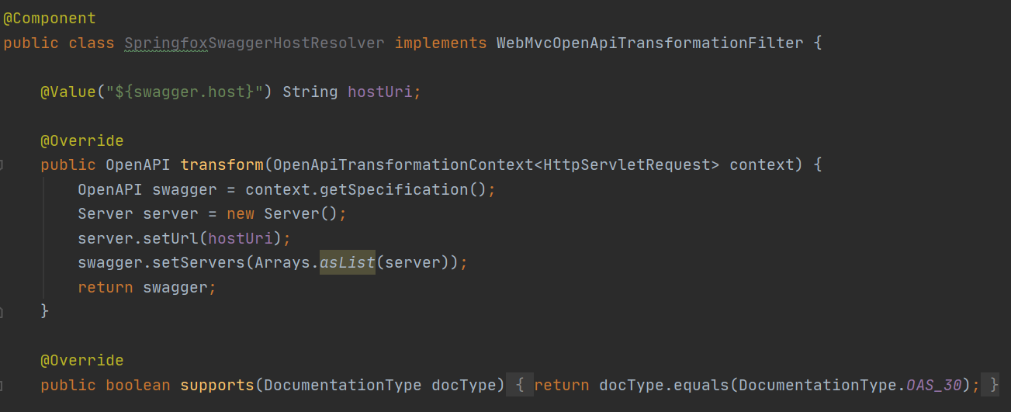
Centralized Swagger: Adding security
We want to add authorization header to requests for each microservice
Requests should be done through api gateway, we need to configure the swagger server in each microservice

Slide 11
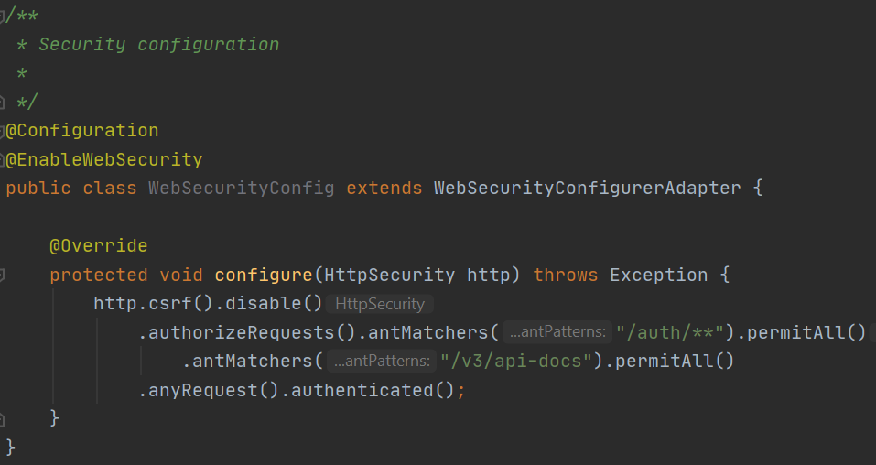
Centralized Swagger: Company Management
We will need to add a special configuration for this microservice since is the one handling security.
We need to disable authorization for the openAPI specification endpoint, so the gateway can obtain the api-docs to generate the swagger UI

Slide 12
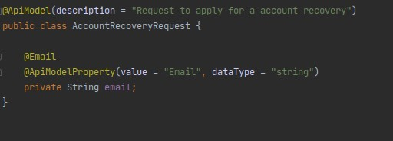
Goal: Customization
Now we are all set up to make some customizations
We can customize our models to accept specific parameters, string formats…
We can also add descriptions to every method and model

Slide 13
Questions?

Slide 14
Resources
Swagger http://swagger.io/

