Slide 1

WireMock
simulator for HTTP-based APIs
It enables you to stay productive when an API you depend on doesn't exist or isn't complete
Simulates a dependency service called STUB

Slide 2
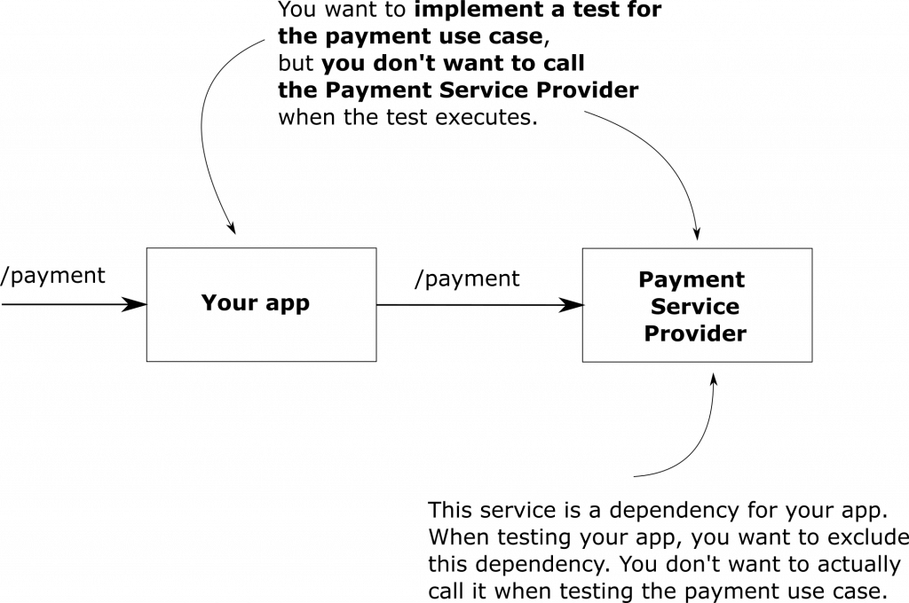
Why use WireMock

Slide 3
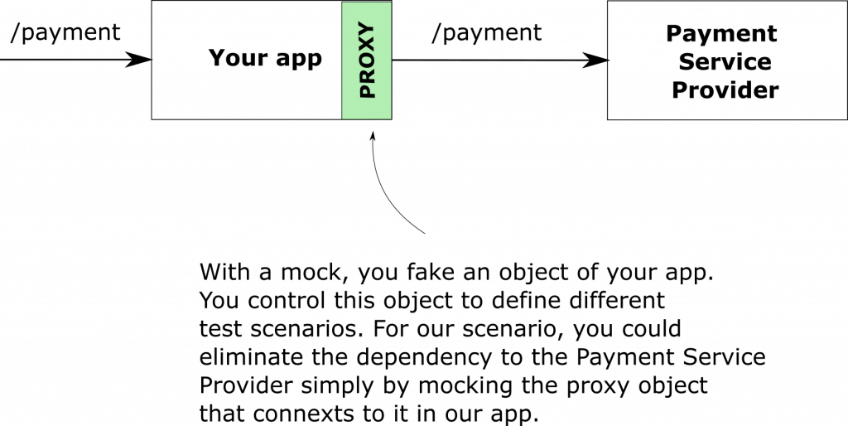
Stub vs Mock

Slide 4
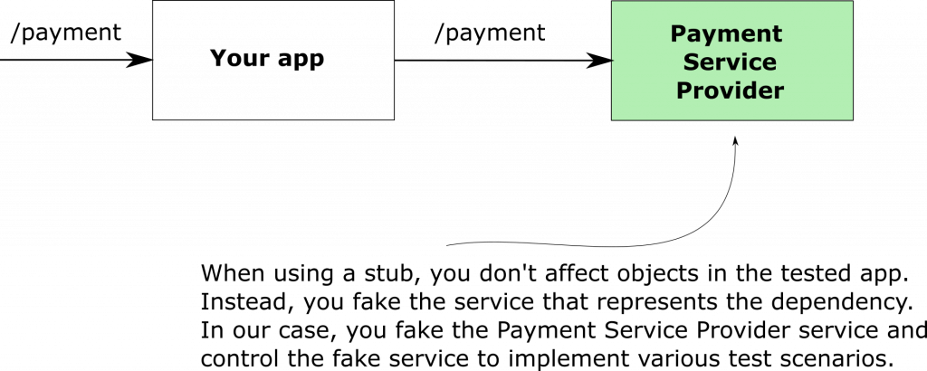
Stub vs Mock

Slide 5
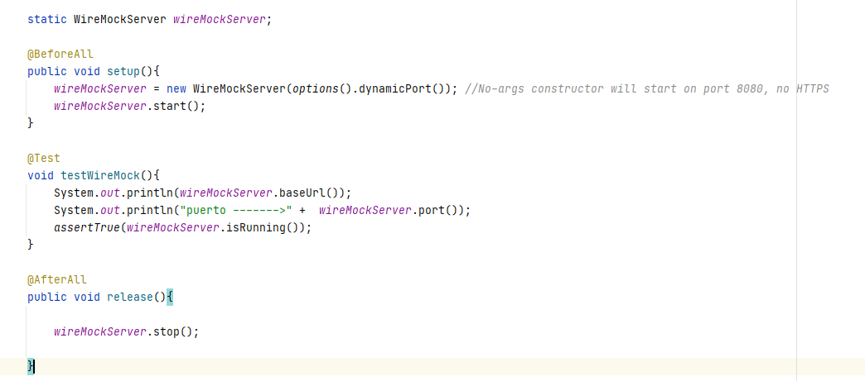
How to
<dependency> <groupId>com.github.tomakehurst</groupId> <artifactId>wiremock</artifactId> <version>2.21.0</version> <scope>test</scope> </dependency>

Slide 6
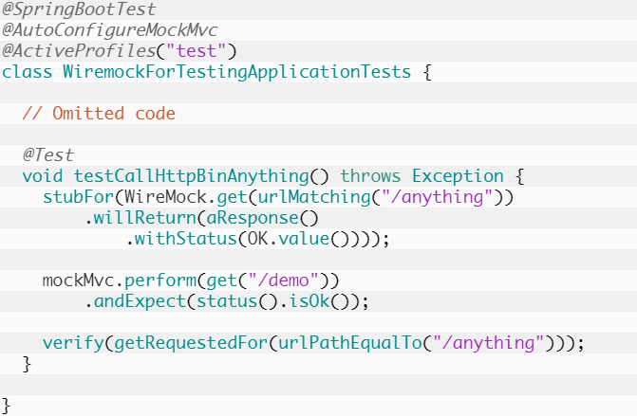
How to

Slide 7
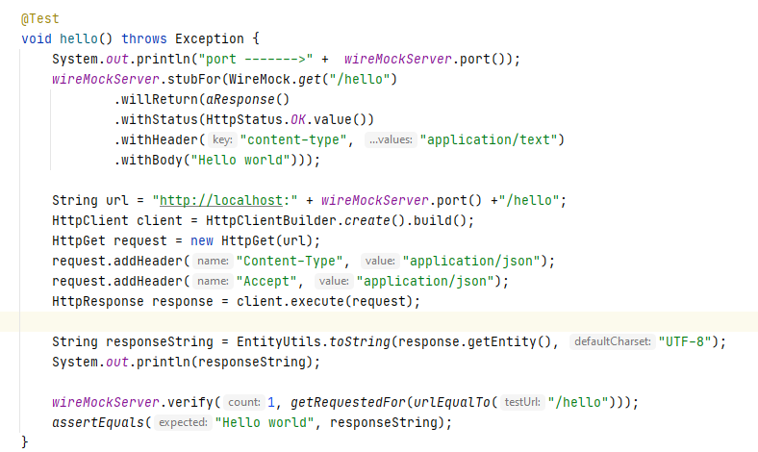
How to

Slide 8
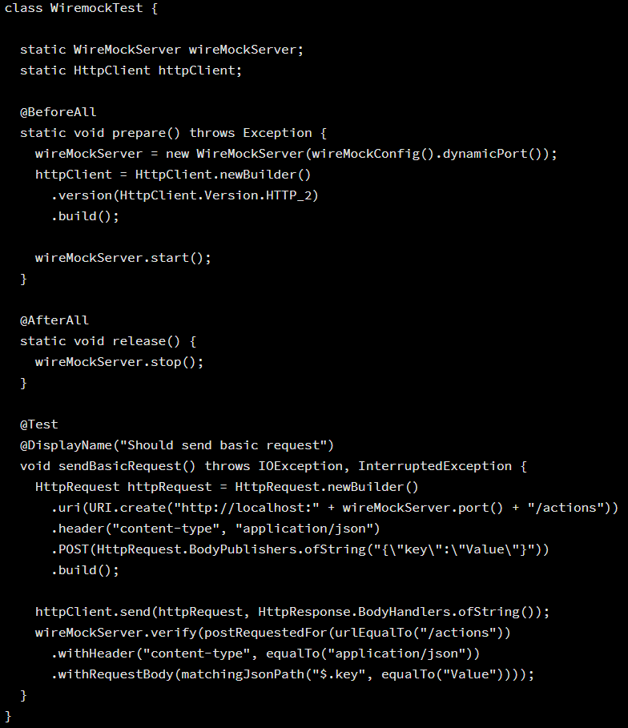
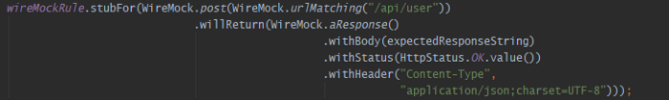
How to

Slide 9
Links
http://wiremock.org/
https://danielme.com/2018/11/26/testing-en-spring-boot-con-junit-45-mockito-mockmvc-rest-assured-bases-de-datos-embebidas/
https://usoar.es/posts/verifying-http-requests-with-wiremock/
https://faun.pub/integration-tests-in-spring-using-wiremock-42e214618aea
https://laurspilca.com/using-wiremock-for-integration-tests-in-spring-apps/

