Slide 1

How successful is the NHS in the different regions at delivering on referral to treatment waiting time targets for cancer?

Slide 2
How successful is the NHS at delivering the targets in general?
Is cancer = cancer?
Are there differences between cancer types for waiting times?
Should there be?

Slide 3
How successful is the NHS at delivering the targets in general?
Targets:
A patient should start treatment in 62 days after initial referral...” (NHS source)
Alternatives:
Different targets for different cancer types? (Types by mortality, effectiveness of treatment)
Different targets for different risk groups? (Recovery rates for different age groups)

Slide 4
How successful is the NHS at delivering the targets in general?
How should we evaluate if the targets are met?
By the percentage of patients waiting longer than the target? (NHS Source)
Alternatives?
By counting the average number of days above the target.

Slide 5
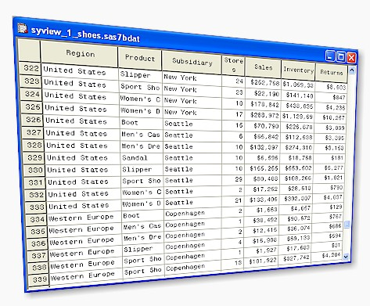
How successful is the NHS in the different regions at delivering on referral to treatment waiting time targets for cancer?
National Statistics:
Percentage over target (62 days): 25%
Average total days over target: 52 days.
By cancer type:
…
…
…
Waiting times dataset
Download
Sources (NHS1, NHS2, ODS)
Repository

Slide 6
The question is shared and readers can interact with it...

Slide 7
How does _____ compare to the UK in
Meeting the NHS cancer referral targets?
Notes:
8/8/17
7
7

Slide 8
How does the South East compare to the UK in
meeting the NHS cancer referral targets?
Notes:
8/8/17
8
8

Slide 9

“A patient should start treatment in 62 days
after initial referral...”
- NHS source
- Discuss
Jane J.
How does the South East compare to the UK in
meeting the NHS cancer referral targets?
Notes:
8/8/17
9
9

Slide 10

How does the South East compare to the UK in
Meeting the NHS cancer referral targets?
How should we evaluate if the targets are met?
- By the percentage of patients
waiting longer than the target?
- By counting the average number of days
above the target.
.. Suggest another measure
Notes:
8/8/17
10
10

Slide 11
How does the South East compare to the UK in
Meeting the NHS cancer referral targets?
How should we evaluate if the targets are met?
- By the percentage of patients
waiting longer than the target?
- By counting the average number of days
above the target.
.. Suggest another measure
Notes:
8/8/17
11
11

Slide 12
How good is the NHS in general at meeting the cancer referral targets?
The NHS is...
☐ always on target
☐ often on target
☐ mostly on target
☐ somewhat target
☑ mostly above target
☐ often above target
☐ always above target
Notes:
8/8/17
12
12

Slide 13
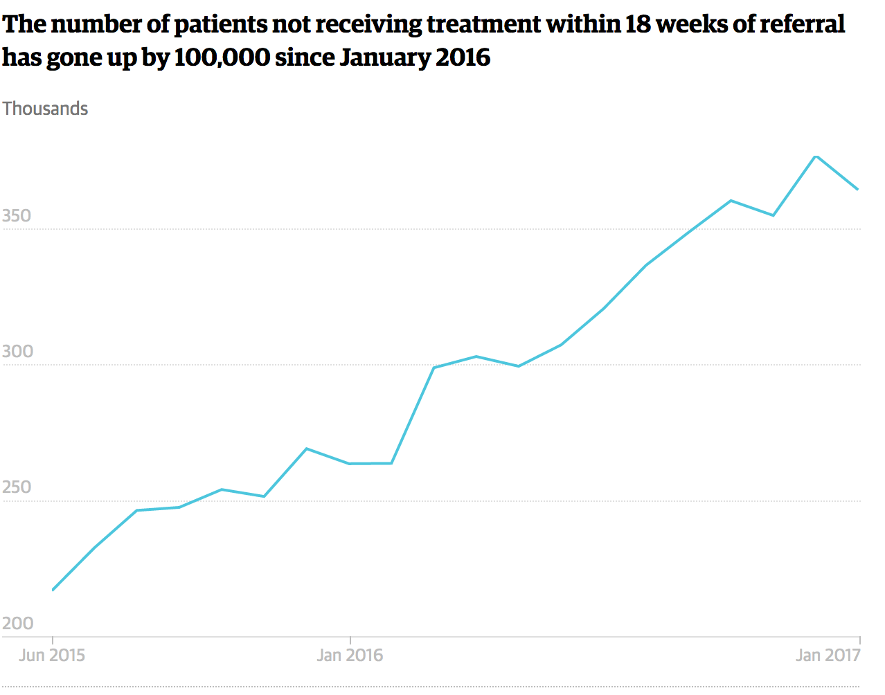
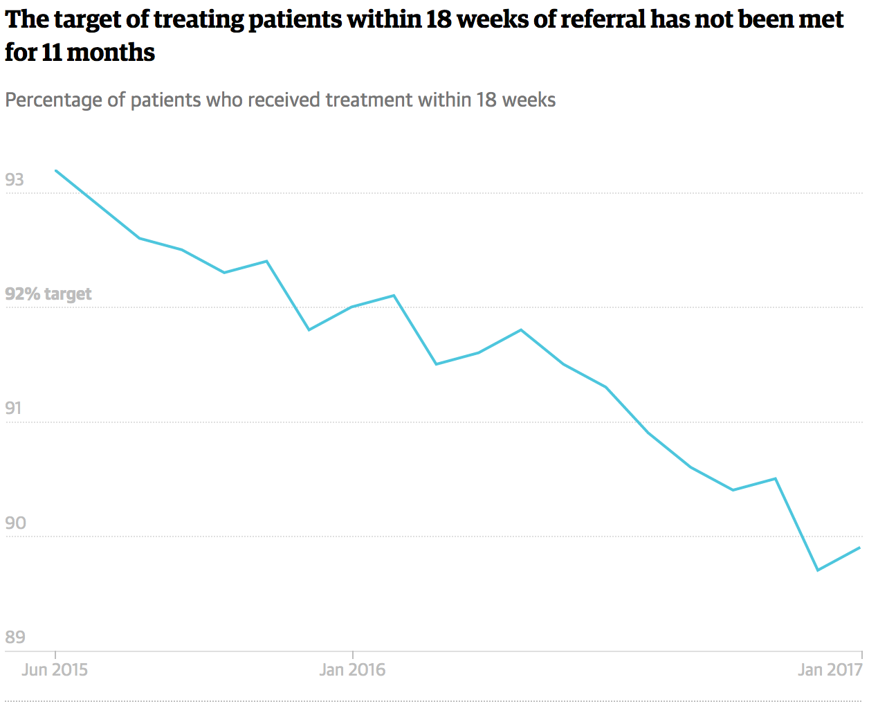
In fact, the NHS hasn’t met the target in the last 11 years…
Trend over last years,
per cancer type etc…
Notes:
8/8/17
13
13

Slide 14
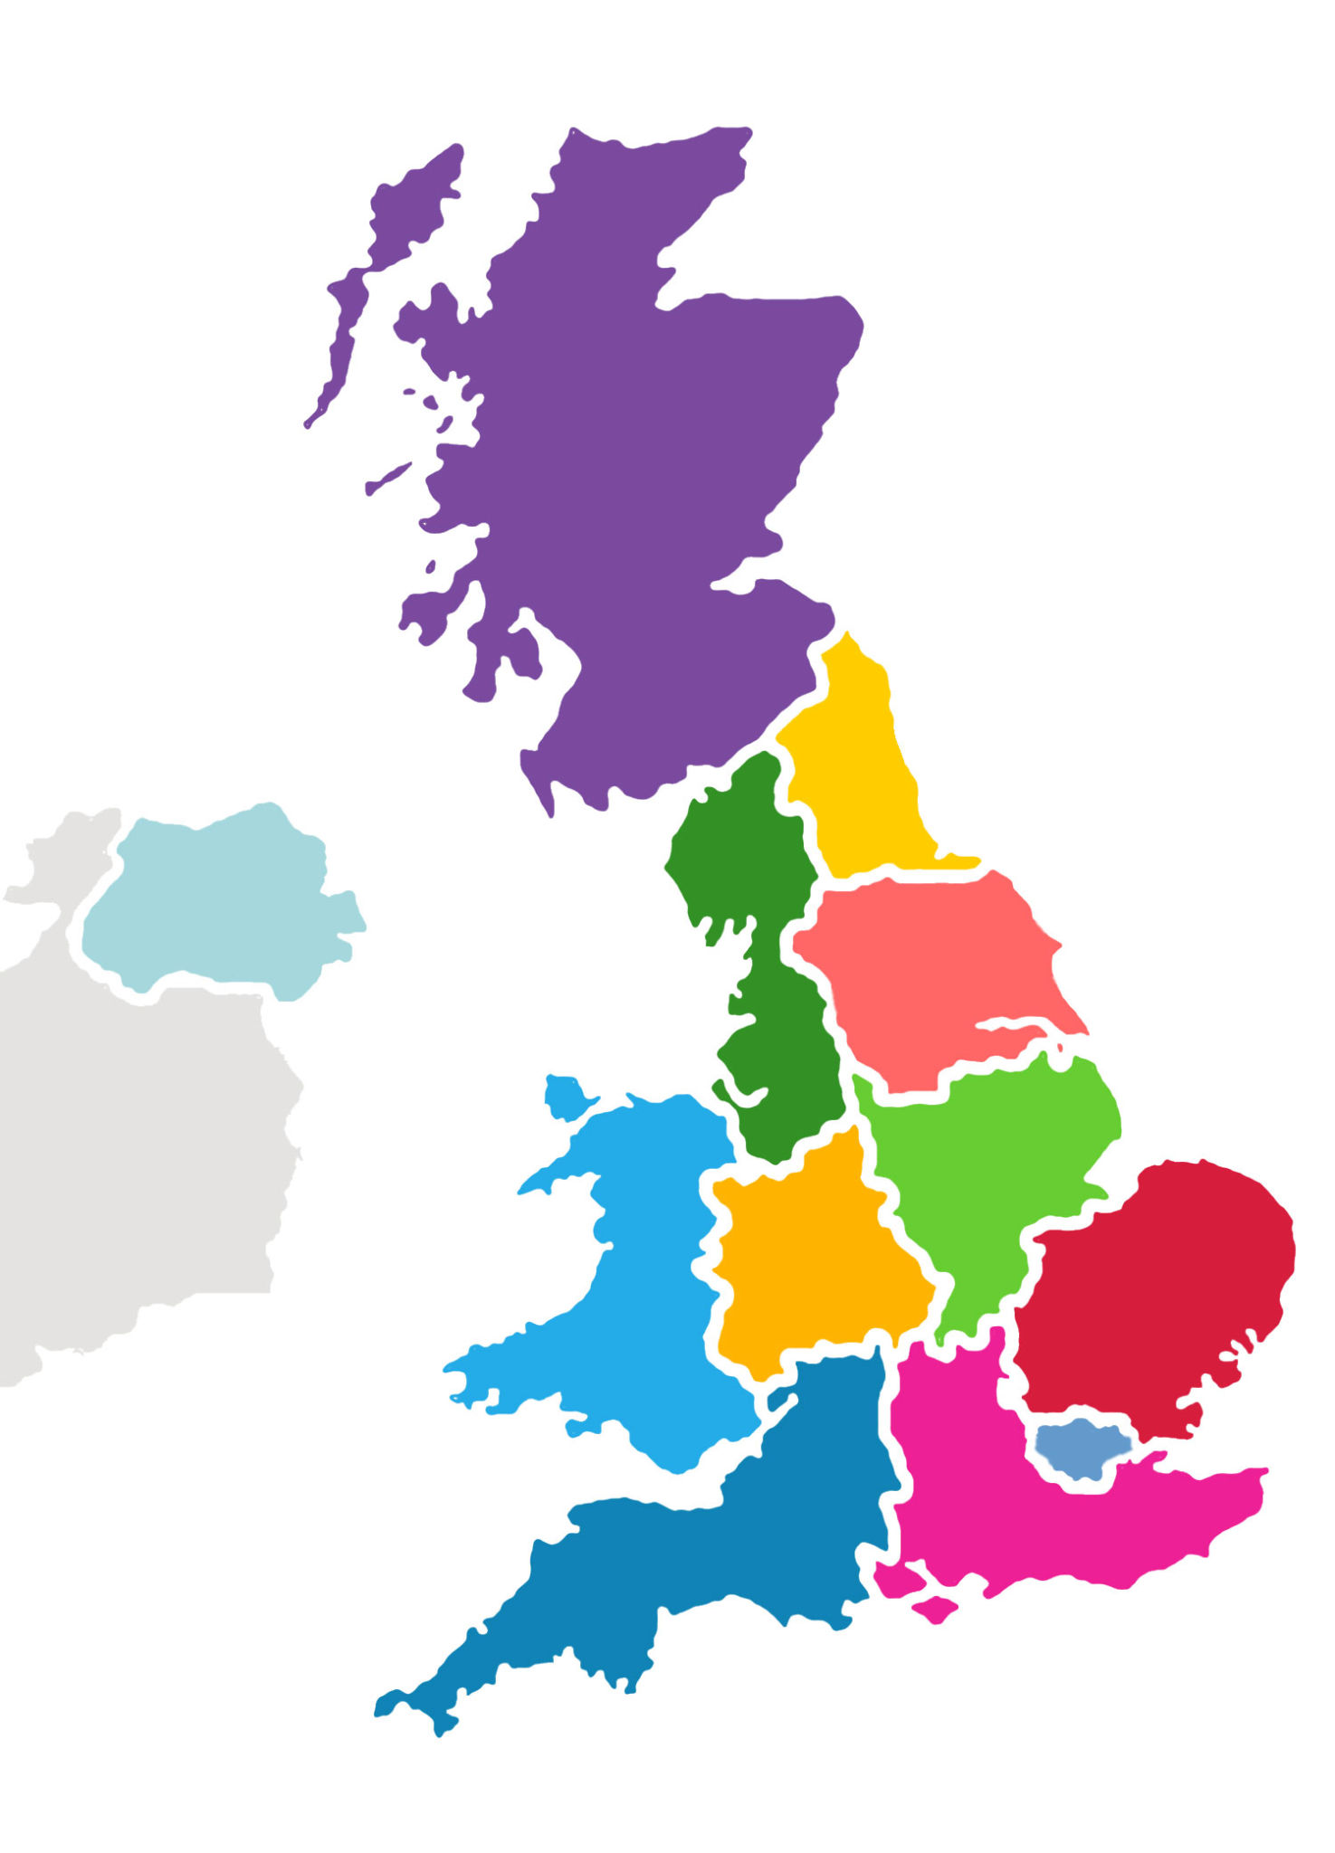

How does waiting times compare for the South East
to London?
Are services in the South East..
☐ much better at delivering the targets
☑ better
☐ similar
☐ worse
☐ much worse
than services in London at delivering the targets?
Notes:
8/8/17
14
14

Slide 15
How does waiting times compare for the South West
to the South East?
Are services in the South West..
☐ much better at delivering the targets
☐ better
☐ similar
☑ worse
☐ much worse
than services in the South East at delivering the targets?
Notes:
8/8/17
15
15

Slide 16
Which factors do you think influence the ability of the NHS to deliver on the waiting time targets?
The number of G
Notes:
8/8/17
16
16

Slide 17
And how much do they contribute relatively?
Distribute the bars according to the factors importance.
The number of GPs
The number of nurses
The number of hospital beds
Notes:
8/8/17
17
17

Slide 18
We've trained a model of waiting times according to your predictors. Here is what the optimal weights look like:
The number of GPs
The number of nurses
The number of hospital beds
Notes:
8/8/17
18
18

Slide 19

According to your predictors this is how the map of waiting time targets would look like...
The South West has
- average number of GPs
- high number of nurses
- average number of hospital beds
According to your model the NHS would be below
average on delivering on the waiting times targets in the South West.
Notes:
8/8/17
19
19

Slide 20
This is the true map of waiting time targets
Waiting times for the South West:
Percentage of patients waiting for treatment after the target: 25%
Your prediction: 50%
Notes:
8/8/17
20
20

Slide 21
Why did you think the number of GPs would have only a weak impact on the ability to deliver on the targets?
Your guess Model weight
Doctors can
Notes:
8/8/17
21
21

Slide 22
Here are some other factors people deemed important:
Financial performance of the hospitals in the region.
How important do you think is this factor?
Notes:
8/8/17
22
22

Slide 23
Why did you think the South West
would perform worse than the South East delivering the NHS targets when in fact they are similar?
Notes:
8/8/17
23
23

Slide 24
Here are some other predictions around the NHS cancer referral targets:
Similar to your prediction
The NHS needs more GPs in rural areas
The NHS cannot achieve the targets for rural areas.
Given that GPs contribute an important factor in achieving
the targets we need...
Other opinions:
The NHS needs more funding
Hospitals need to improve their
administration
Notes:
8/8/17
24
24

Slide 25
Would you like to share your thoughts with the community?
The NHS needs more GPs in rural areas but also better
administration
Predicting NHS targets:
Your model predictions
Other opinions:
The NHS needs more funding
Hospitals need to improve their
administration
Notes:
8/8/17
25
25

Slide 26
Through interaction with the readers the initial question grows into a body of
prior expectations,
regional comparisons and opinions,
alternative storylines…
These could then be combined into one final piece:

Slide 27
How successful is the NHS in the different regions at delivering on referral to treatment waiting time targets for cancer?
What are the targets:
… … …
National statistics NHS
Percentage over target (62 days): 25% … Average total days over target: 52 days.
Regional differences
…
The NHS needs risk-specific targets
…
The NHS did not achieve the targets
in the last 11 years
…

Slide 28
How successful is the NHS in the different regions at delivering on referral to treatment waiting time targets for cancer?
Regional differences
… … …
Reader Expectations
…
The NHS in the South West is
underfunded
…

