Slide 1

Personal Predictive & Local
Three proposals for interactive explanations
Pablo León Villagrá
University of Edinburgh
Notes:
2008 Presidential Candidate Donations: McCain vs. Obama

Slide 2
Outline
Motivation
Interactive Explanations
Three proposals
  Agency
  Implicit models
  Local perspecitve

Slide 3
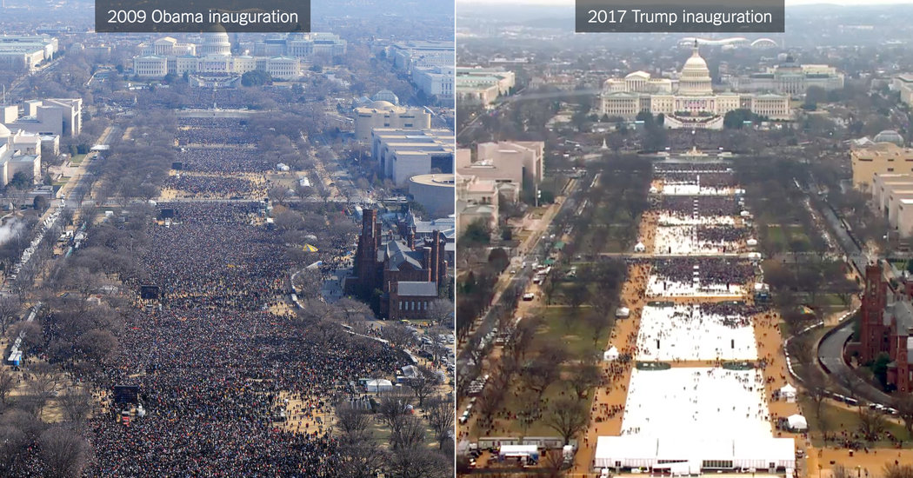
Notes:
Reality: easy issues → tribalism

Slide 4

Notes:
Complex issues → bus slogans

Slide 5
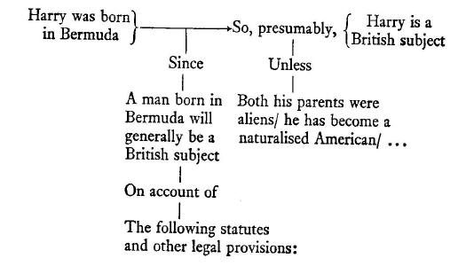
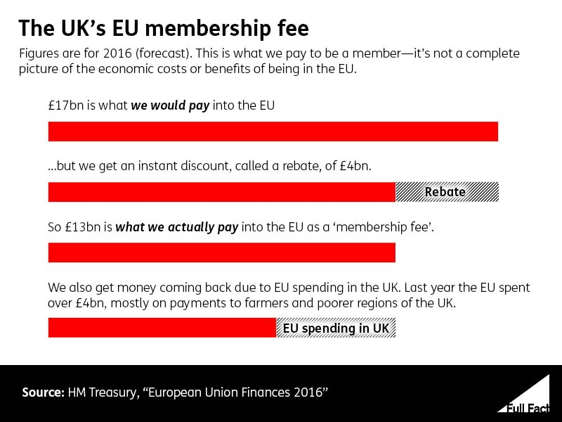
Notes:
Formally how to resolve an argument:
Logic, facts, argument (Toulmin argmument map)
Vs reality: Psychological/emotional/tribal fights
Presenting complex figures: (Pro republica uk membership fee )
However even these fail short ..”argument” on the bus was less about factual statement then about an emotional “look how much money we are waisting”
This requires more system thinking (inflow, outflow, effects etc.) and looks more like

Slide 6
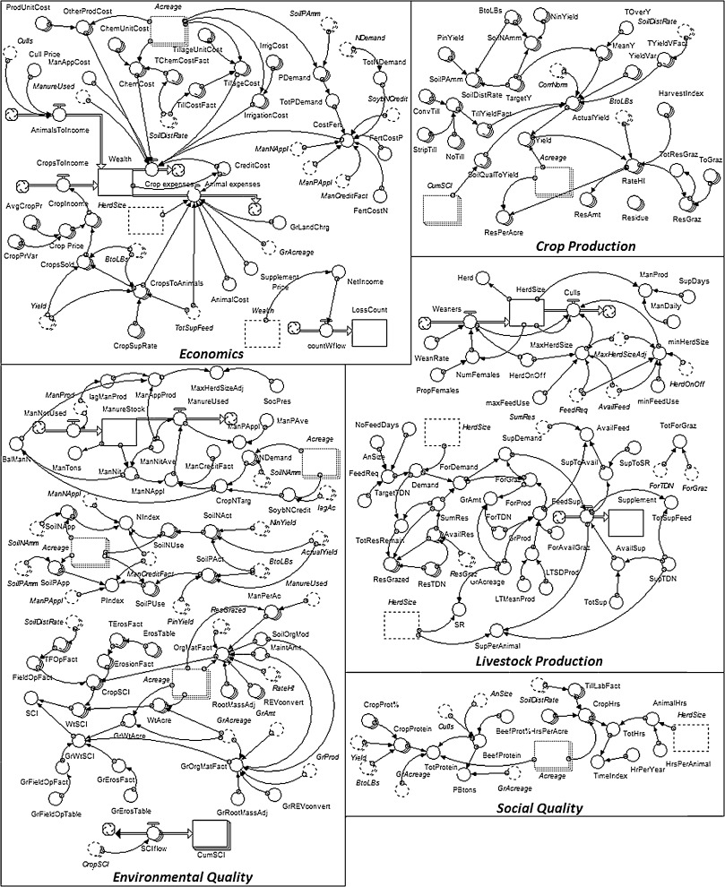
Notes:
If these psychological fallacies (tribalism) and complexities in policy issues exist:
- How do we convey/present those?
- How can citizens be informed such as to be able to make decisions that serve their needs?
- How can we reach out to citizens and change their erroneous beliefs (as the 350 mio bus slogan)?
Exploring agricultural production systems and their fundamental components with system dynamics modelling

Slide 7
Explorable Expanations
Discover ideas for yourself.
Engage with complex data.
Challenge the author's assumptions, and build things the author never even thought of.
Instead of consuming knowledge, actively construct knowledge.
https://projects.propublica.org/graphics/gdp
Notes:
- Great ideas… however difficult to do right, especially for real world issues. I will show one example that exemplifies some of the problems with it (there are however lots of really good ones out there too)

Slide 8
Three proposals

Slide 9
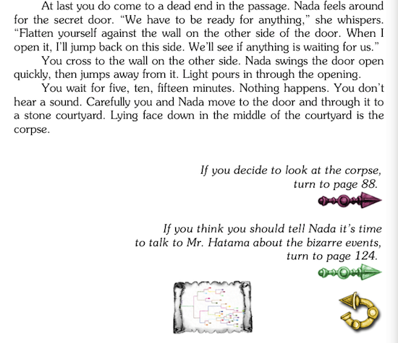
Agency
Notes:
Complex issues involve taking many decisions along the way: what are the variables we look at, how do we measure them, can we simplify these variables?
Instead of consuming the finished product knowledge and “pretending” that all of these decisions were obvious & easy let the reader actively participate in this process
If done right this could leat to readers that are engaged with the issue (it is their convictions and choices at stake).
In addition will lead to a more pluralistic/in-breadth exploration of issues as well as a better/more honest/reproducable articles.
And also teaches us something about our readers!

Slide 10
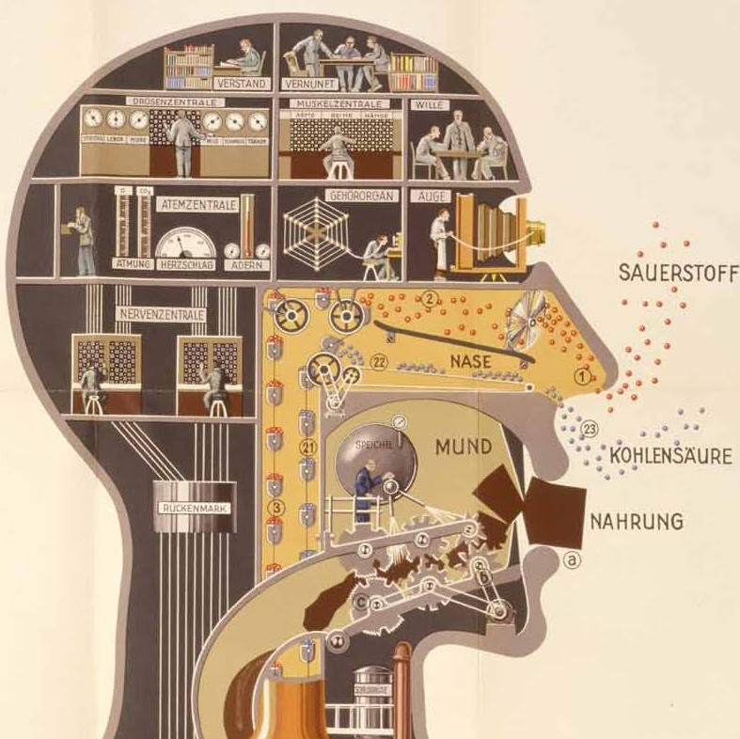
Implicit Models
Notes:
Explaining what a statistical model is is hard: problems of conveying assumptions (in the data), technical terms and statistical issues.
At the core models are about prediction: If I capture the core/characteristic relationships that generate some quantity => I should be able to predict that quantity from the characteristics.
As humans we all have some sort of implicit models (maybe not conscious insight into them) and can use them to do predictions.
The idea is: Instead of presenting the model, convey how some variables are predictive for (say GDP). We can do that by asking readers to predict the quantity given characteristics that they chose as relevant.
In addition to (ideally) teaching something about model characteristics (reliability, validity, simplicity etc) that can teach us something about our readers.

Slide 11
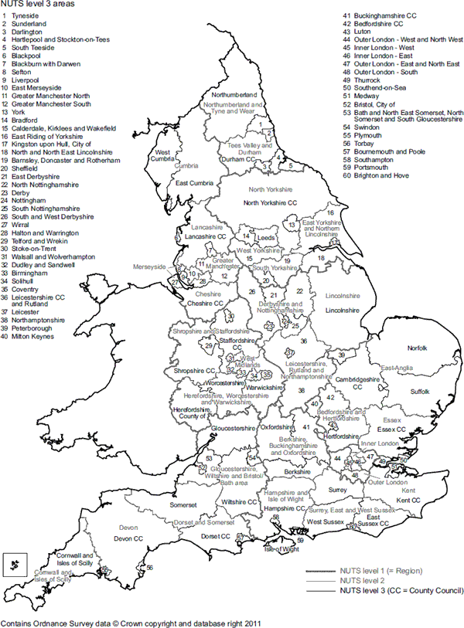
Local perspective
Notes:
How does that affect me and my city/region?
How does the situation in my region/city relate to other regions? How to the national average?

Slide 12
Demo

Slide 13
Next
Finish functionality and presentation.
Record reader interaction (which factors, what kind of predictors) and present it to the reader.
Allow readers to suggest new variables & aggregations.
Editor for writing these sorts of interctions.
I am looking for stories and/or data to present in this style!

