Slide 1

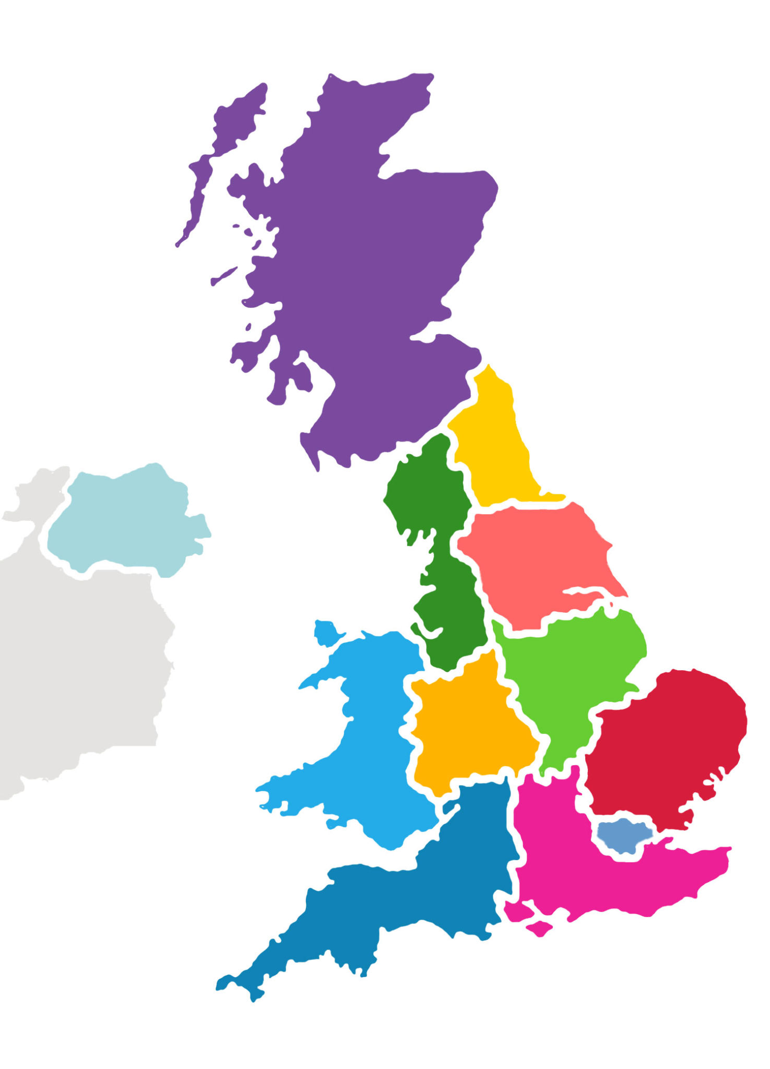


How successful is the NHS at delivering on referral to treatment waiting time targets for cancer?
The NHS needs more GPs in rural areas
The NHS cannot achieve the targets for rural areas.
Given that Gps contribute an important factor in achieving
the targets we need...
Other opinions:
The NHS needs more funding
Hospitals need to improve their
administration

Slide 2
How successful is the NHS at delivering on referral to treatment waiting time targets for cancer?
The NHS needs more GPs in rural areas
The NHS cannot achieve the targets for rural areas.
Given that GPs contribute an important factor in achieving
the targets we need...
Other opinions:
The NHS needs more funding
Hospitals need to improve their
administration

Slide 3
How does _____ compare to the UK in
Meeting the NHS cancer referral targets?
Notes:
8/7/17
3
3

Slide 4
How does the South East compare to the UK in
meeting the NHS cancer referral targets?
Notes:
8/7/17
4
4

Slide 5
“A patient should start treatment in 62 days
after initial referral...”
- NHS source – Jeremy Hunt Interview
- Discuss
Jane J.
How does the South East compare to the UK in
meeting the NHS cancer referral targets?
Notes:
8/7/17
5
5

Slide 6
How does the South East compare to the UK in
Meeting the NHS cancer referral targets?
How should we evaluate if the targets are met?
- By the percentage of patients
waiting longer than the target?
- By counting the average number of days
above the target.
.. Suggest another measure
Notes:
8/7/17
6
6

Slide 7
How does the South East compare to the UK in
Meeting the NHS cancer referral targets?
How should we evaluate if the targets are met?
- By the percentage of patients
waiting longer than the target?
- By counting the average number of days
above the target.
.. Suggest another measure
Notes:
8/7/17
7
7

Slide 8
How good is the NHS in general at meeting the cancer referral targets?
The NHS is...
☐ always on target
☐ often on target
☐ mostly on target
☐ somewhat target
☑ mostly above target
☐ often above target
☐ always above target
Notes:
8/7/17
8
8

Slide 9

How does waiting times compare for the South East
to London?
Are services in the South East..
☐ much better at delivering the targets
☑ better
☐ similar
☐ worse
☐ much worse
than services in London at delivering the targets?
Notes:
8/7/17
9
9

Slide 10
How does waiting times compare for the South West
to the South East?
Are services in the South West..
☐ much better at delivering the targets
☐ better
☐ similar
☑ worse
☐ much worse
than services in the South East at delivering the targets?
Notes:
8/7/17
10
10

Slide 11
Which factors do you think influence the ability of the NHS to deliver on the waiting time targets?
The number of G
Notes:
8/7/17
11
11

Slide 12
And how much do they contribute relatively?
Distribute the bars according to the factors importance.
The number of Gps
The number of nurses
The number of hospital beds
Notes:
8/7/17
12
12

Slide 13
We've trained a model of waiting times according to your predictors. Here is what the optimal weights look like:
The number of Gps
The number of nurses
The number of hospital beds
Notes:
8/7/17
13
13

Slide 14

According to your predictors this is how the map of waiting time targets would look like...
The South West has
- average number of Gps
- high number of nurses
- average number of hospital beds
According to your model the NHS would be below average on delivering on the waiting times targets.
Notes:
8/7/17
14
14

Slide 15
This is the true map of waiting time targets
Waiting times for the South West:
Percentage of patients waiting for treatment after the target: 25%
Your prediction: 50%
Notes:
8/7/17
15
15

Slide 16
Why did you think the number of GPs would have only a weak impact on the ability to deliver on the targets?
Your guess Model weight
Doctors can
Notes:
8/7/17
16
16

Slide 17
Here are some other factors people deemed important:
Financial performance of the hospitals in the region.
How important do you think is this factor?
Notes:
8/7/17
17
17

Slide 18
Why did you thing the South West
would perform worse than the South East delivering the NHS targets when in fact they are similar?
Notes:
8/7/17
18
18

Slide 19
Here are some other predictions and articles around the NHS cancer referral targets:
Similar to your prediction
The NHS needs more Gps in rural areas
The NHS cannot achieve the targets for rural areas.
Given that Gps contribute an important factor in achieving
the targets we need...
Other opinions:
The NHS needs more funding
Hospitals need to improve their
administration
Notes:
8/7/17
19
19

Slide 20
Would you like to share your thoughts with the community?
Similar to your prediction
The NHS needs more Gps in rural areas but also better administration
Predicting NHS targets:
Your model predictions
Other opinions:
The NHS needs more funding
Hospitals need to improve their administration
Notes:
8/7/17
20
20

