Slide 1

Lecture 14:
Object-Oriented Programming
Utrecht Summer School:
Programming with Python 2023
All icons by: https://www.flaticon.com/
Notes:
Hay paro. Considerar grabar la clase

Slide 2
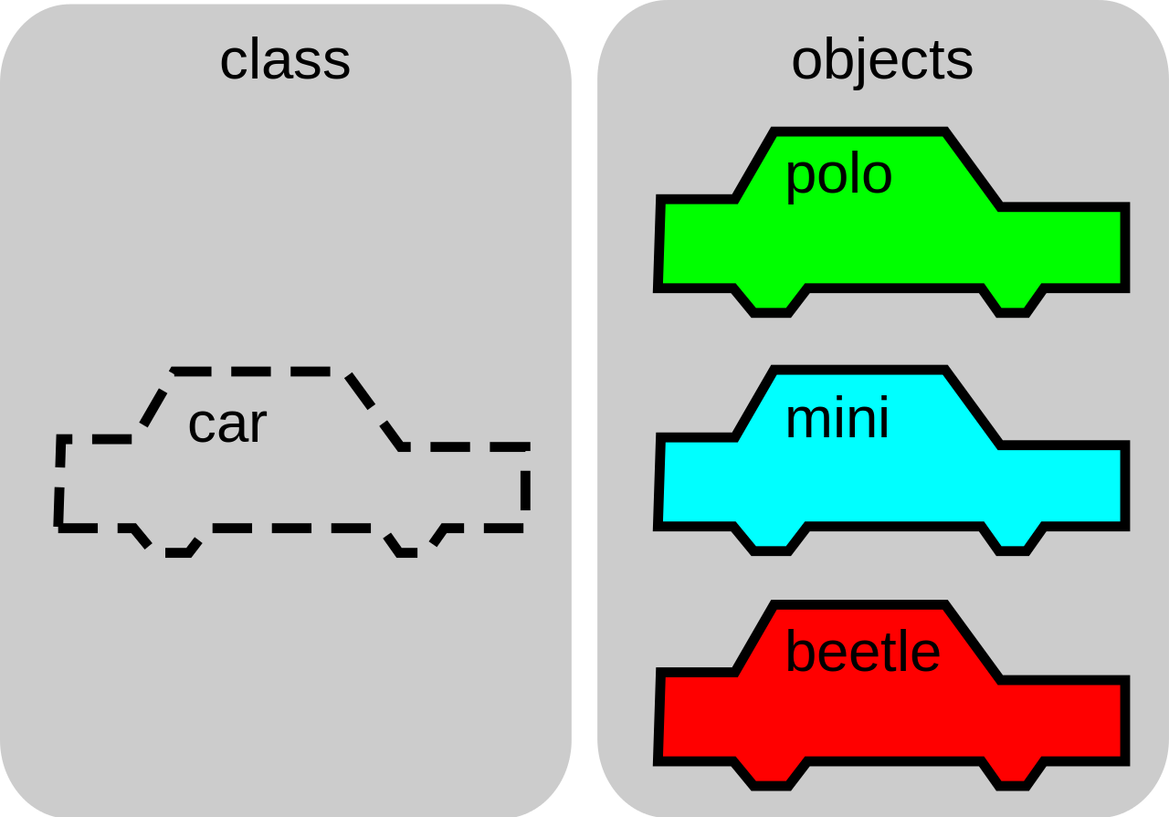

Slide 3


Slide 4
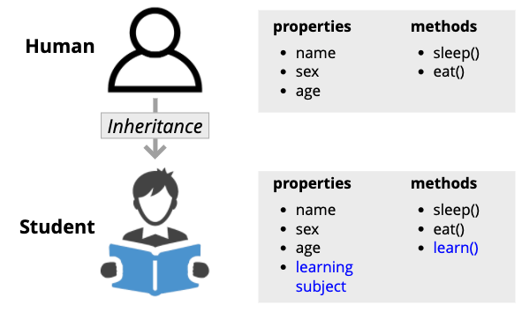

Slide 5


