Slide 1
Actor
fc1
fc2
fc3
fc4
Observations
Actions

Slide 2
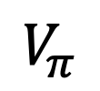
Critic
fcs1
fc2
fc3
Observations
$$V_{π}$$
Actions

Slide 3
Critic
fcs1
fc2
fc3
Actor
Observations
$$V_{π}$$
fc1
fc2
fc3
fc4
Observations
Actions

